Slide 1
Functions , mathematical kind
A relation that gives exactly one unique output for each input
x → → y :this is a function as you always get one answer
x → :Not a function as you get multiple answers
Representation
  f(x) = 2x+1 : this is a function
  g(x) = ± 3x : this is not a function , why?
Follow up reading (optional): pg 11-13 : functions
Rule
a
b
c
Rule

Slide 2
Evaluating functions
Solving
  Substitute variables with numerals
  Evaluate
    Follow PEMDAS/BODMAS
Solve for x = 0,1,2,3
  f(x) = 3x + 1
  g(x) = 2x² + 3
  h(x) = x² + 2x +1

Slide 3
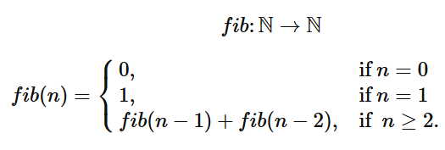
Recursive Functions
Functions calling themselves
Evaluate for ‘n’ = 2 , 4, 5, 6
Follow up reading (optional): nested functions visualized
Fibonacci numbers
Factorial | fact(n) = n * fact(n-1) {given, fact(1) = fact(0) =1}
Lucas numbers (same rule as Fibonacci but with different starting values) | l (n) = l(n-1) + l(n-2) {given , l(0) = 2, l(1) = 1}

Slide 4
Programming, , Test #1
Need to know
  Data types
  Conditionals : If/else
  Loops : for
  Arrays : 2 dimensional
Practice
  Arrays- DS (Hackerrank)
    Do the 4 problems marked “easy”
    Optional :“hard”, “medium” one are for extra challenge

