Slide 1
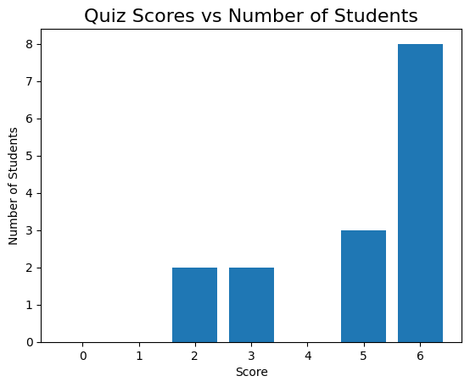
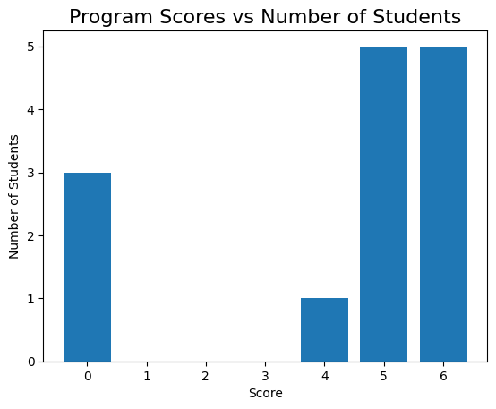
Test 1, observations
Great participation, nearly everyone attempted!
Overall students did better in quiz
  8x full marks in quiz vs 5x full marks in programming
4 students got a zero in programming ( with 1 not attempted)

Slide 2
Test 2 , analysis
The quizzes
  seem to be easier for students to master
  Success cause everyone attempted, next we figure out how to raise scores there
    Suggestions ?
Programming
  It was amazing attempt
  The codes generally worked
  But 4/15 students had zeroes.
  Suggestions ?
Goal :We need raise scores for everyone and move some in attempted stage
  Note
    Compete with yourself , Do better than your last attempt
    Ask for help
      on what you don’t know, to learn it.
      And even on what you know , i.e. to master it

Slide 3
Topics for Test 2
Mathematical expressions
  Representations ( infix, prefix, postfix)
  Evaluation or expression
Discrete Mathematics
  Logical Operators (AND , OR , NOT, SHIFT,…)
  Boolean logic
Programming
  char, string ,arrays
  Loops
  Conditionals
    If/else
    switch/case

Slide 4
Infix expressions
Encounter them in grade maths. e.g.
  (11+14)/(9 - 3) + 2
  3+7 / (4 * 5 - 6)
  - 2 + 8 / 2
Can also be written using variables
  (a + b) / (c – d ) + e
  x + y / (g * h – k)
Evaluated using
  PEMDAS / BODMAS

Slide 5
Expression : anatomy
Expression is made of
  Operators ( + , - , * , /)
  Operands (numbers, variables)
Unary operators : - a
  <operator> <operand>
Binary operators (infix) : a + b
  < operand> <operator> <operand>

Slide 6
Prefix/Postfix expressions
Benefits
  Remove ambiguity( i.e. can forget PEMDAS, BODMAS)
  Computer friendly
  Works with both unary/binary
  Faster evaluation
Expression styles
  Infix : operator in middle of operands
    (5+6)*3
    < operand> <operator> <operand>
  Prefix : operator before operands
    * + 5 6 3
    <operator> <operand> < operand>
  Postfix : operator after operands
    5 6 + 3 *
    <operand> < operand> <operator>

Slide 7
Evaluating expression, but first Stacks and Queues
What is a Stack ?
  This is a sequential structure of items
  That are pushed at one end
  Pulled via the same end
  LIFO : Last in First Out
  Examples
    Stack of plates
    Your turned in paper assignments
What is a Queue?
  Another sequential structure of items
  that are pushed at one end
  Pulled via the opposite end
  FIFO : First In First Out
  Examples
    Queue for buying tickets
    Traffic in one way single lane

Slide 8
Evaluating prefix expression
Infix : (5+6)*3
  * + 5 6 3
  - + 2 * 3 4 / 16 ^ 2 3
Algorithm (harder way)
  Scan from right to left
  Anytime you find an operator
    Evaluate the operation using the previous 2 operands
    Replace the <operator> <operand> < operand> with result in the expression
  Repeat the steps till only 1 operand is left

Slide 9
Evaluating postfix expression
Evaluate
  2 3 1 * + 9 –
  5 3 + 6 2 / * 3 5 * +
Algorithm to evaluate (use stack)
  Push the operands in a stack
  When you encounter a operator
    Pop 2 operands
    Perform the operation on operands
    Push the result in stack
  Repeat from 1 until expression is parsed
  The last item in stack is the answer
    There would be only 1 item left when done correctly
* prefix expr can also be evaluated in this way ( just in reverse)

Slide 10
Evaluate
Prefix
  - * 5 + - 4 2 2 / 6 3
  - * + 3 5 7 + / 4 2 1
  - + 10 * 2 3 + 4 / 5 5
Postfix
  1 2 + 3 4 + * 5 6 - / 7 +
  8 2 / 3 4 + * 5 1 + 2 / -
  9 8 4 2 1 ^ * / - 3 +

Slide 11
Answers
Prefix
  - * 5 + - 4 2 2 / 6 3
    Ans : 18
  - * + 3 5 7 + / 4 2 1
    Ans : 53
  - + 10 * 2 3 + 4 / 5 5
    Ans : 11
Postfix
  1 2 + 3 4 + * 5 6 - / 7 +
    Ans : -14
  8 2 / 3 4 + * 5 1 + 2 / -
    Ans : 25
  9 8 4 2 1 ^ * / - 3 +
    Ans : 11

Slide 12
Practice: Programming
Write a function that takes a string and checks if it is a palindrome
  Returns true if palindrome is found else false
  Hints: string indexing, loops, if , comparing characters
Count the number of vowels, consonants in a sentence.
  Vowels : a,e,i,o,u
  Consonant : everything else other than vowels
  Ignore : spaces (‘ ’,) comma(,) dash(-),semicolon(;),colon( : )
Find the most frequent word in a sentence
  If more than 1 word has same frequency return the lexicographically smaller one.

