Slide 1
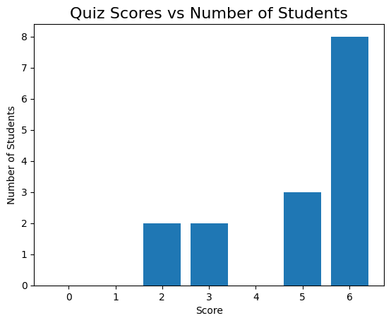
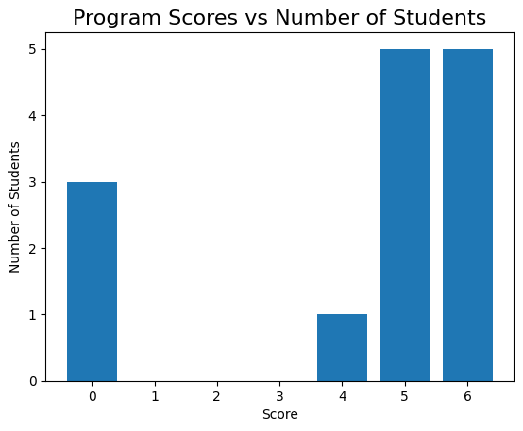
Test 1, observations
Great participation, nearly everyone attempted!
Overall students did better in quiz
  8x full marks in quiz vs 5x full marks in programming
4 students received a zero in programming ( with 1 not attempted)

Slide 2
Test 2 , analysis
The quizzes
  seem to be easier for students to master
  Success cause everyone attempted, next we figure out how to raise scores there
    Suggestions ?
Programming
  It was amazing attempt
  The codes generally worked
  But 4/15 students had zeroes.
  Suggestions ?
Goal :We need raise scores for everyone and move some in attempted stage
  Note
    Compete with yourself , Do better than your last attempt
    Ask for help
      on what you don’t know, to learn it.
      And even on what you know , i.e. to master it

Slide 3
Topics for Test 2
Mathematical expressions
  Representations ( infix, prefix, postfix)
  Evaluation or expression
Discrete Mathematics
  Logical Operators (AND , OR , NOT, SHIFT,…)
  Boolean logic
Programming
  char, string ,arrays
  Loops
  Conditionals
    If/else
    switch/case

Slide 4
Infix expressions
Encounter them in grade maths. e.g.
  (11+14)/(9 - 3) + 2
  3+7 / (4 * 5 - 6)
  - 2 + 8 / 2
Can also be written using variables
  (a + b) / (c – d ) + e
  x + y / (g * h – k)
Evaluated using
  PEMDAS / BODMAS

Slide 5
Expression : anatomy
Expression is made of
  Operators ( + , - , * , /)
  Operands (numbers, variables)
Unary operators : - a
  <operator> <operand>
Binary operators (infix) : a + b
  < operand> <operator> <operand>

Slide 6
Prefix/Postfix expressions
Benefits
  Remove ambiguity( i.e. can forget PEMDAS, BODMAS)
  Computer friendly
  Works with both unary/binary
  Faster evaluation
Expression styles
  Infix : operator in middle of operands
    (5+6)*3
    < operand> <operator> <operand>
  Prefix : operator before operands
    * + 5 6 3
    <operator> <operand> < operand>
  Postfix : operator after operands
    5 6 + 3 *
    <operand> < operand> <operator>

Slide 7
Evaluating expression, but first Stacks and Queues
What is a Stack ?
  This is a sequential structure of items
  That are pushed at one end
  Pulled via the same end
  LIFO : Last in First Out
  Examples
    Stack of plates
    Your turned in paper assignments
What is a Queue?
  Another sequential structure of items
  that are pushed at one end
  Pulled via the opposite end
  FIFO : First In First Out
  Examples
    Queue for buying tickets
    Traffic in one way single lane

Slide 8
Evaluating prefix expression
Infix : (5+6)*3
  * + 5 6 3
  - + 2 * 3 4 / 16 ^ 2 3
Algorithm (harder way)
  Scan from right to left
  Anytime you find an operator
    Evaluate the operation using the previous 2 operands
    Replace the <operator> <operand> < operand> with result in the expression
  Repeat the steps till only 1 operand is left

Slide 9
Evaluating postfix expression
Evaluate
  2 3 1 * + 9 –
  5 3 + 6 2 / * 3 5 * +
Algorithm to evaluate (use stack)
  Push the operands in a stack
  When you encounter a operator
    Pop 2 operands
    Perform the operation on operands
    Push the result in stack
  Repeat from 1 until expression is parsed
  The last item in stack is the answer
    There would be only 1 item left when done correctly
* prefix expr can also be evaluated in this way ( just in reverse)

Slide 10
Evaluate
Prefix
  - * 5 + - 4 2 2 / 6 3
  - * + 3 5 7 + / 4 2 1
  - + 10 * 2 3 + 4 / 5 5
Postfix
  1 2 + 3 4 + * 5 6 - / 7 +
  8 2 / 3 4 + * 5 1 + 2 / -
  9 8 4 2 1 ^ * / - 3 +

Slide 11
Answers
Prefix
  - * 5 + - 4 2 2 / 6 3
    Ans : 18
  - * + 3 5 7 + / 4 2 1
    Ans : 53
  - + 10 * 2 3 + 4 / 5 5
    Ans : 11
Postfix
  1 2 + 3 4 + * 5 6 - / 7 +
    Ans : -14
  8 2 / 3 4 + * 5 1 + 2 / -
    Ans : 25
  9 8 4 2 1 ^ * / - 3 +
    Ans : 11

Slide 12
Practice: Programming
Write a function that takes a string and checks if it is a palindrome
  Returns true if palindrome is found else false
  Hints: string indexing, loops, if , comparing characters
Count the number of vowels, consonants in a sentence.
  Vowels : a,e,i,o,u
  Consonant : everything else other than vowels
  Ignore : spaces (‘ ’,) comma(,) dash(-),semicolon(;),colon( : )
Find the most frequent word in a sentence
  If more than 1 word has same frequency return the lexicographically smaller one.

Slide 13
Review Evaluating Prefix/Postfix
From last week
  Operator
  Operand
  Stack
  Queue
Evaluating Prefix/Postfix
  <3 questions each>

Slide 14
Precedence and associativity
Precedence ( highest priority first)
  ()
  ^
  / *
  - +
Associativity
  Right to left : ^
  Left to right : + , - , * , /
Notes
  () not categorized as associative, they represent grouping mechanism

Slide 15
Precedence and associativity
Example
  10 + 20 / 2 * 3 – 5
    ➔ 10 +((20 / 2) * 3)-5 // added parenthesis for denoting precedence
    ➔ 10 + (10 * 3 ) -5 // interior most precedence first
    ➔10 + 30 - 5
    ➔ 35

Slide 16
Precedence and associativity (lets evaluate)
2 + 3 * 4 ^2
2 ^ 3 ^ 2
100 / 2 * 5 ^ 2 ^ 1

Slide 17
Precedence and associativity (answers)
2 + 3 * 4 ^2
  ➔ 2 + 3 * 16
  ➔ 2 + 48
  ➔ 50
2 ^ 3 ^ 2
  ➔ 2 ^ 9 // ^ is evaluated from right to left , so 3 ^ 2 goes first
  ➔ 512
  Not 64
100 / 2 * 5 ^ 2 ^ 1
  ➔ 100 / 2 * 25 // Again 2 ^ 1 goes first
  ➔ 50 x 25
  ➔1250

Slide 18
Convert to Prefix/Postfix (examples)
B * C
  Prefix : * B C
  Postfix : B C *
A + B * C
  Prefix : +A*BC
  Postfix : ABC*+
(5 + 6) * 3
  Prefix : * + 5 6 3
  Postfix : 5 6 + 3 *

Slide 19
Convert to Postfix
How to convert!
  Convert the highest precedence/priority first
  ( do paranthesize for mental ease)
(a + b) / (c – d ) + e
x + y / (g * h – k)

Slide 20
Convert to Postfix
How to convert!
  Convert the highest priority first
  ( and paranthesize for mental ease)
(a + b) / (c – d ) + e
  Prefix : + / + a b – c d e
  Postfix : a b + c d - / e +
x + y / (g * h – k)
  Prefix : + x / y - * g h k
  Postfix : x y g h * k - / +

Slide 21
Convert to Prefix and Postfix
a + b - c * d + e ^ f
(a + b) * c - (d - e) * (f + g)
((a + b) * (c + d) / (e - f)) + g
a * (b + c) / (d - e)
a - b / (c * d ^ e)
(a + b) * (c + d) - e

Slide 22
Convert to Prefix and Postfix (answers)
Infix | Prefix | Postfix
a + b - c * d + e ^ f | + - + a b * c d ^ e f | a b + c d * - e f ^ +
(a + b) * c - (d - e) * (f + g) | - * + a b c * - d e + f g | a b + c * d e - f g + * -
((a + b) * (c + d) / (e - f)) + g | + / * + a b + c d - e f g | a b + c d + * e f - / g +
a * (b + c) / (d - e) | / * a + b c - d e | a b c + * d e - /
a - b / (c * d ^ e) | - a / b * c ^ d e | a b c d e ^ * / -
(a + b) * (c + d) - e | - * + a b + c d e | a b + c d + * e -

