Slide 1
Intro to VCS, Git, & GitHub
general assembly

Slide 2

AGENDA
What is version control?
What is Git
What is Github
Creating a repo
Cloning a repo
Bringing to local computer
Making changes
Staging
Pushing
data science

Slide 3
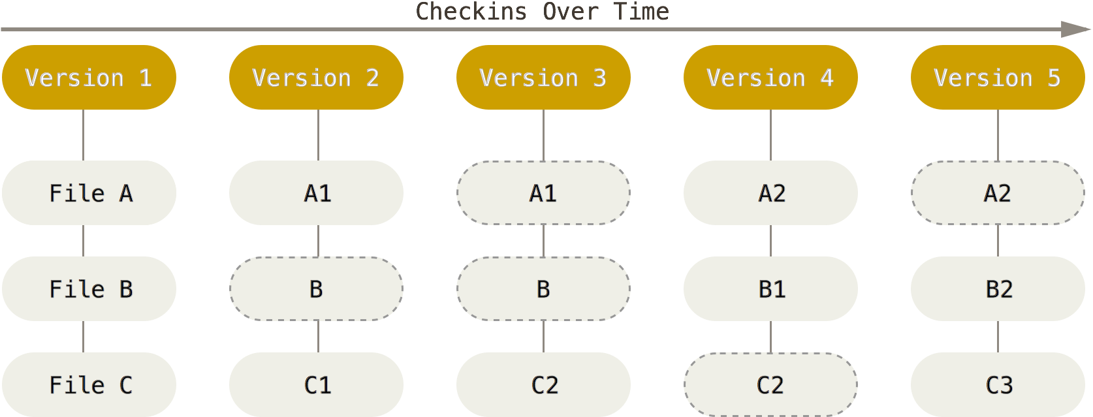
Version Control
A system that records changes to a file or a set of files over time so that you can recall specific versions later
Local Version Control
Centralized Version Control (Subversion, Perforce, CVS, etc)
Distributed Version Control: (Git, Mercurial, etc)
data science

Slide 4
Version Control
A system that records changes to a file or a set of files over time so that you can recall specific versions later
Local Version Control
Centralized Version Control (Subversion, Perforce, CVS, etc)
Distributed Version Control: (Git, Mercurial, etc)
data science

Slide 5
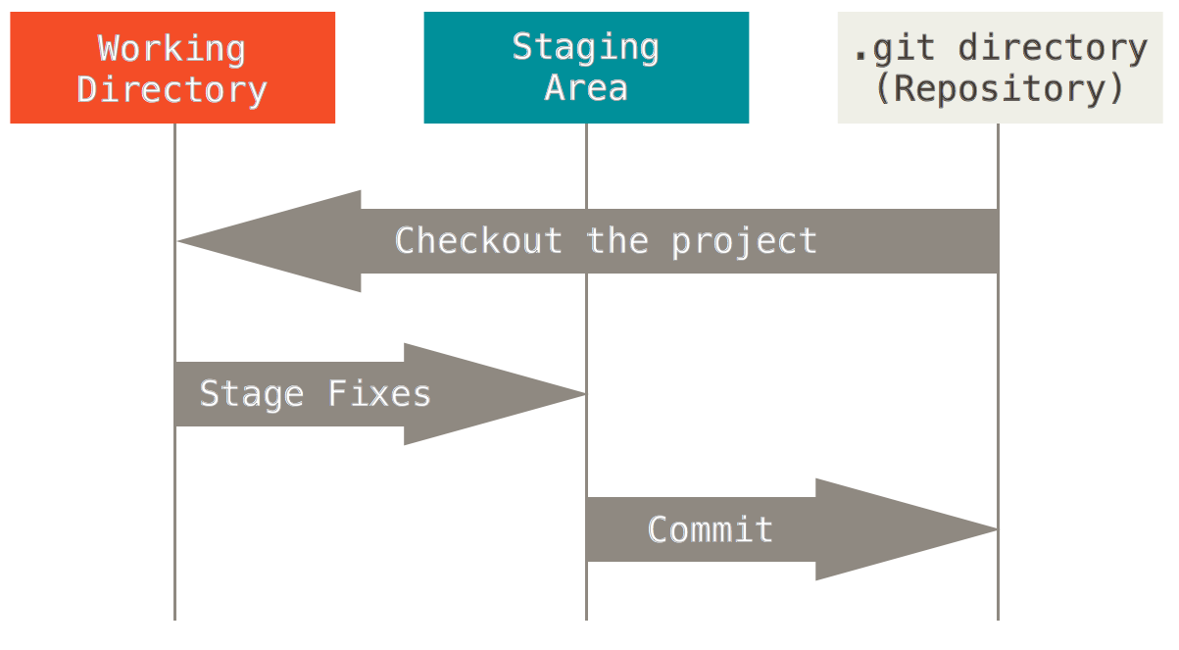
Three File States
Committed: Data stored in local database
Modified: Changed but not committed yet
Staged: Marked in its current version to go into next commit
3 Sections of a Git Project
Working Directory
Staging Area
Git Directory
data science

Slide 6
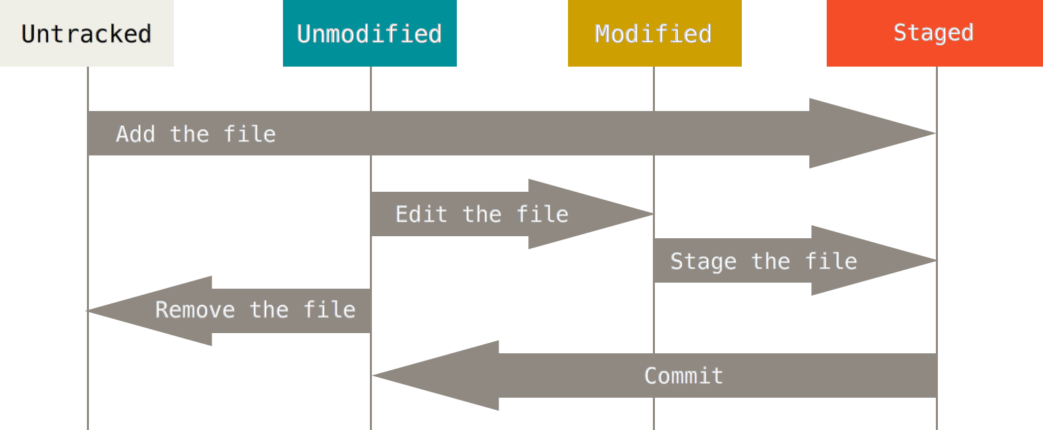
Basic Workflow
data science

Slide 7
Commands
Fork a repo: Make a copy of a repo in your account.
Log into GitHub
Go to repository
Click fork
Pull: Pull your changes into a repo
Create a new repository
Click on + then new repository
Choose name and description
Public
Initial readme
Click create
Copying repo to local computer:
Open git, terminal
Change working directory to where you want to save the repo
git clone [url of repo]
Hit enter
Type password
Repo is copied to a sub directory of working directory
data science

Slide 8
Commands
Status: Status of files (tracked, untracked, modified or not)
git status
Staging: Prepping files for committing.
git add filename
git add .
Commiting: Committing the changes to Git
git commit –m “Comment for the commit”
Log: Log of changes
git log
Push: Push the changes to the GitHub repo
git push origin master
Push master branch to the origin remote
Type password and you’re done
data science

