Slide 1
Domain Modelling with the F# type system
fsharpforfunandprofit.com/ddd

Slide 2
Prologue: how many things are wrong?
type Contact = {
FirstName: string
MiddleInitial: string
LastName: string
EmailAddress: string
IsEmailVerified: bool
}
How many things are wrong with this design?
// true if ownership of // email address is confirmed

Slide 3
The software development process
Process
Input
Output

Slide 4
The software development process
Coding & testing
Process
Input
Output
Most dev talks
Garbage in Garbage out

Slide 5
The software development process
Design
Process
Input
Output
This talk
(reduce) Garbage in (reduced) Garbage out

Slide 6
Prologue: which values are optional?
type Contact = {
FirstName: string
MiddleInitial: string
LastName: string
EmailAddress: string
IsEmailVerified: bool
}
Which values are optional?

Slide 7
Prologue: what are the constraints?
type Contact = {
FirstName: string
MiddleInitial: string
LastName: string
EmailAddress: string
IsEmailVerified: bool
}
Must not be more than 50 chars
What are the constraints?

Slide 8
Prologue: what groups are atomic?
type Contact = {
FirstName: string
MiddleInitial: string
LastName: string
EmailAddress: string
IsEmailVerified: bool
}
Must be updated as a group
Which fields are linked?

Slide 9
Prologue: domain logic?
type Contact = {
FirstName: string
MiddleInitial: string
LastName: string
EmailAddress: string
IsEmailVerified: bool
}
What is the domain logic?
Must be reset if email is changed

Slide 10
Prologue: F# can help
Which values are optional?
type Contact = {
FirstName: string
MiddleInitial: string
LastName: string
EmailAddress: string
IsEmailVerified: bool
}
What are the constraints?
Which fields are linked?
Any domain logic?
F# can help with all these questions!

Slide 11

What is DDD?
"Focus on the domain and domain logic rather than technology" -- Eric Evans

Slide 12
Functional Programming
Domain Modelling
This talk

Slide 13
Understanding functional programming
A non-technical overview

Slide 14

Functional programming is...
I’ve heard that...

Slide 15
Functional programming is...
I’ve heard that...
... good for mathematical and scientific tasks
... good for complicated algorithms
... really good for parallel processing
... but you need a PhD in computer science ☹
All true...
So not true...

Slide 16
Functional programming is good for...
really ^
Boring
Line Of Business
Applications
(BLOBAs)

Slide 17
Must haves for BLOBA development...
Express requirements clearly
Rapid development cycle
High quality deliverables
F# is concise! Easy to communicate.
An interactive environment and many conveniences to make teams highly productive
type system ensures correctness
Fun
"fun" is a keyword in F#

Slide 18
F# for Domain Driven Design
Communicating a domain model

Slide 19
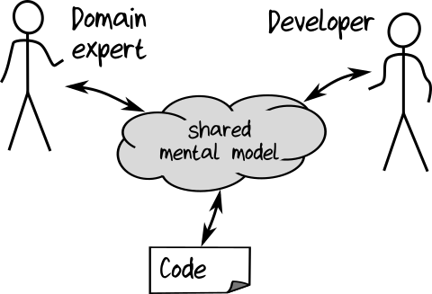
But shared communication can be hard!

Slide 20

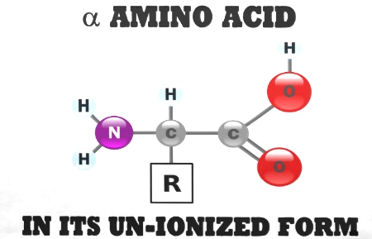
U-N-I-O-N-I-Z-E
U-N-I-O-N-I-Z-E
U-N-I-O-N-I-Z-E

Slide 21
Bounded context
Business
Supermarket
Sales
Marketing
Chemistry
Email System
Warehouse
Finance
unionize
Spam
Product
Customer
un-ionize
Spam
Product
Customer

Slide 22
Chemistry
Sales
Warehouse
Ion Atom Molecule Polymer Compound Bond
Product Promotion Customer Tracking
Product Stock Transfer Depot Tracking
Ubiquitous Language

Slide 23
Bounded context
module CardGame =
type Suit = Club | Diamond | Spade | Heart
type Rank = Two | Three | Four | Five | Six | Seven | Eight
| Nine | Ten | Jack | Queen | King | Ace
type Card = Suit * Rank
type Hand = Card list
type Deck = Card list
type Player = {Name:string; Hand:Hand}
type Game = {Deck:Deck; Players: Player list}
type Deal = Deck –› (Deck * Card)
type PickupCard = (Hand * Card) –› Hand
Ubiquitous language

Slide 24
'|' means a choice -- pick one from the list
module CardGame =
type Suit = Club | Diamond | Spade | Heart
type Rank = Two | Three | Four | Five | Six | Seven | Eight
| Nine | Ten | Jack | Queen | King | Ace
type Card = Suit * Rank
type Hand = Card list
type Deck = Card list
type Player = {Name:string; Hand:Hand}
type Game = {Deck:Deck; Players: Player list}
type Deal = Deck –› (Deck * Card)
type PickupCard = (Hand * Card) –› Hand
'*' means a pair. Choose one from each type
list type is built in
X -> Y means a function - input of type X - output of type Y

Slide 25
Do you think this is a reasonable amount of code to write for this domain?
module CardGame =
type Suit = Club | Diamond | Spade | Heart
type Rank = Two | Three | Four | Five | Six | Seven | Eight
| Nine | Ten | Jack | Queen | King | Ace
type Card = Suit * Rank
type Hand = Card list
type Deck = Card list
type Player = {Name:string; Hand:Hand}
type Game = {Deck:Deck; Players: Player list}
type Deal = Deck –› (Deck * Card)
type PickupCard = (Hand * Card) –› Hand
Do you think a non programmer could understand this?

Slide 26
module CardGame =
type Suit = Club | Diamond | Spade | Heart
type Rank = Two | Three | Four | Five | Six | Seven | Eight
| Nine | Ten | Jack | Queen | King | Ace
type Card = Suit * Rank
type Hand = Card list
type Deck = Card list
type Player = {Name:string; Hand:Hand}
type Game = {Deck:Deck; Players: Player list}
type Deal = Deck –› (Deck * Card)
type PickupCard = (Hand * Card) –› Hand
"persistence ignorance"
"The design is the code, and the code is the design."
This is not pseudocode – this is executable code!

Slide 27
Domain model == F# code == documentation

Slide 28
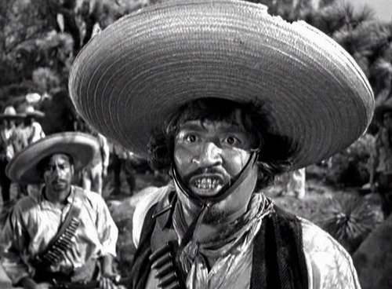
We don’t need no Stinking UML DIAGRAMs

Slide 29
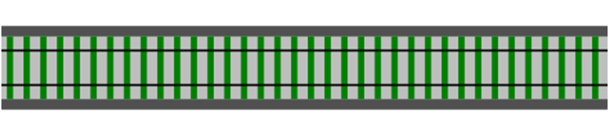

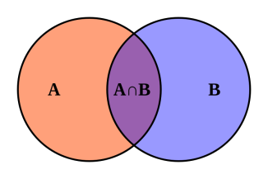
Functional programming in 3 easy steps
Functions
Function
Composition
Types

Slide 30
What are mathematical functions?

Slide 31
Domain (int)
Codomain (int)
…
-1
0
1
2
3
…
…
0
1
2
3
4
…
Function add1(x) input x maps to x+1

Slide 32
A function doesn’t “do” anything
Domain (int)
Codomain (int)
…
-1
0
1
2
3
…
int add1(int input)
{
switch (input)
{
case 0: return 1;
case 1: return 2;
case 2: return 3;
case 3: return 4;
etc ad infinitum
}
}
…
0
1
2
3
4
…
Function add1(x) input x maps to x+1
Input and output values already exist
A function is not a calculation, just a mapping
Input and output values are unchanged (immutable)

Slide 33
Domain (int)
Codomain (int)
…
-1
0
1
2
3
…
int add1(int input)
{
switch (input)
{
case 0: return 1;
case 1: return 2;
case 2: return 3;
case 3: return 4;
etc ad infinitum
}
}
…
0
1
2
3
4
…
Function add1(x) input x maps to x+1
A (mathematical) function always gives the same output value for a given input value
A (mathematical) function has no side effects

Slide 34
What are functions in F#?
Function

Slide 35


The Tunnel of Transformation
Function apple -> banana
A function is a thing which transforms inputs to outputs

Slide 36
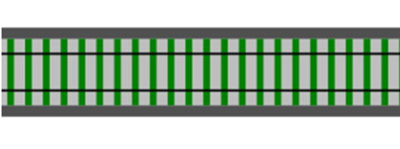

A function is a standalone thing, not attached to a class
It can be used for inputs and outputs of other functions
input
A function can be an output
output
A function can be an input
A function can be a parameter
input
output
from a simple foundation => build complex systems

Slide 37
What is composition?

Slide 38

Function 1 apple -> banana
Function 2 banana -> cherry

Slide 39
Function 1 apple -> banana
Function 2 banana -> cherry
>>
Composition

Slide 40
New function
New Function apple -> cherry
Can't tell it was built from smaller functions!
Where did the banana go?

Slide 41

An application is glued together from smaller functions

Slide 42
Low-level operation
string
ToUpper
string

Slide 43
Low-level operation
Low-level operation
Low-level operation
>>
>>
Composition
Service
Address
AddressValidator
Validation Result
Btw, a “Service” is just like a microservice but without the "micro" in front

Slide 44
Service
Service
Service
>>
>>
Composition
Use-case
ChangeProfile Request
UpdateProfileData
ChangeProfile Result

Slide 45
Use-case
Use-case
Use-case
>>
>>
Composition
Web application
Http Request
Http Response
“Composition is fractal”

Slide 46
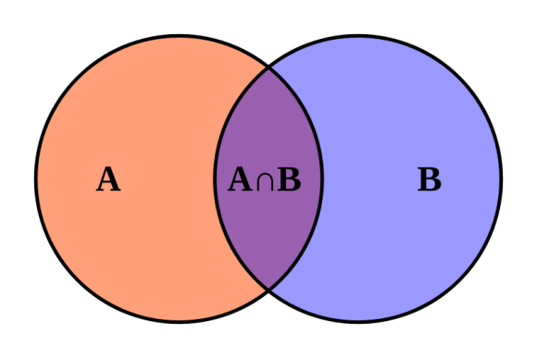
What are types?

Slide 47
What is a type?
Set of valid inputs
Set of valid outputs
Function
A type is a just a name for a set of things

Slide 48
1
2
3
4
5
6
Set of valid inputs
Set of valid outputs
Function
This is type "integer"
A type is a just a name for a set of things

Slide 49
Set of valid inputs
"abc"
"but"
"cobol"
"double"
"end"
"float"
Set of valid outputs
Function
This is type "string"
A type is a just a name for a set of things

Slide 50
Donna Roy
Javier Mendoza
Nathan Logan
Shawna Ingram
Abel Ortiz
Lena Robbins
Gordon Wood
Set of valid inputs
Set of valid outputs
Function
This is type "Person"
A type is a just a name for a set of things

Slide 51
Set of valid inputs
Set of valid outputs
Function
This is type "Fruit"
A type is a just a name for a set of things

Slide 52
Set of valid inputs
Set of valid outputs
Function
This is a type containing functions
A type is a just a name for a set of things

Slide 53
Types can be composed

Slide 54
composable means => like Lego

Slide 55
New types are built from smaller types in two ways

Slide 56
New types are built from smaller types in two ways
"AND"
type FruitSalad =
2 each of and and
Example: pairs, tuples, records

Slide 57
New types are built from smaller types in two ways
"OR"
type Snack = or or
Not available in C# or Java
Example coming up!

Slide 58
Real world example of type composition

Slide 59
type ChequeNumber = int
type CardNumber = string
Primitive types

Slide 60
type ChequeNumber = int
type CardNumber = string
type CardType = Visa | Mastercard
type CreditCardInfo = CardType * CardNumber
ORtype
AND type

Slide 61
type ChequeNumber = int
type CardNumber = string
type CardType = Visa | Mastercard
type CreditCardInfo = CardType * CardNumber
type PaymentMethod =
| Cash
| Cheque of ChequeNumber
| Card of CreditCardInfo
ORtype

Slide 62
type ChequeNumber = int
type CardNumber = string
type CardType = Visa | Mastercard
type CreditCardInfo = CardType * CardNumber
type PaymentMethod =
| Cash
| Cheque of ChequeNumber
| Card of CreditCardInfo
type PaymentAmount = decimal
type Currency = EUR | USD
Another primitive type
Another ORtype

Slide 63
type ChequeNumber = int
type CardNumber = string
type CardType = Visa | Mastercard
type CreditCardInfo = CardType * CardNumber
type PaymentMethod =
| Cash
| Cheque of ChequeNumber
| Card of CreditCardInfo
type PaymentAmount = decimal
type Currency = EUR | USD
type Payment = { Amount : PaymentAmount Currency: Currency Method: PaymentMethod }
AND type
Final type built from many smaller types

Slide 64
Functions
Function
Composition
Types
Congratulations! You now understand functional programming.

Slide 65
Functions
Function
Composition
Types
We'll be focusing on this bit today

Slide 66
"Values" not "variables"

Slide 67
thing1
thing2
thing3
thing4
Set of valid inputs
Set of valid outputs
Function
A value

Slide 68
Set of valid inputs
Set of valid outputs
Function
A value

Slide 69
Values (F#)
Simple Value let x = 1
Function Value let add1 x = x + 1
A value

Slide 70
Function 1 apple -> banana
What is the type?
Example of a value?

Slide 71
Values vs. Objects
A “value” is just a member of a type
Values have no behaviour
Values are immutable
Changes done by external functions
A “object” is an encapsulation of a data structure …
… with its associated behavior
Objects are expected to have state (that is, be mutable)
All operations that change the internal state must be provided by the object itself (via "dot" notation).

Slide 72
Benefits of immutable values for domain modelling
Immutability also helps parallelism, etc. But that is not relevant here.

Slide 73
Value object definition in C#
class PersonalName
{
public PersonalName(string firstName, string lastName)
{
this.FirstName = firstName;
this.LastName = lastName;
}
public string FirstName { get; private set; }
public string LastName { get; private set; }
}
use "private set" for immutability

Slide 74
Value object definition in C#
Classes are reference types
class PersonalName
{
public PersonalName(string firstName, string lastName)
{
this.FirstName = firstName;
this.LastName = lastName;
}
public string FirstName { get; private set; }
public string LastName { get; private set; }
}

Slide 75
Value object definition in C# (extra code for equality)
class PersonalName
{
// all the code from above, plus...
public override int GetHashCode()
{
return this.FirstName.GetHashCode() + this.LastName.GetHashCode();
}
public override bool Equals(object other)
{
return Equals(other as PersonalName);
}
public bool Equals(PersonalName other)
{
if ((object) other == null)
{
return false;
}
return FirstName == other.FirstName && LastName == other.LastName;
}

Slide 76
Value object definition in F#
type PersonalName = {FirstName:string; LastName:string}

Slide 77
Value object definition in F# (extra code for equality)
This page intentionally left blank
the best code is no code at all

Slide 78
F# values and DDD
F# values are excellent for Value Objects
F# values are immutable by default
F# values define equality and comparison
F# values are excellent for Entities too
Immutable entities are good!

Slide 79
Advantages of immutability
type Person = { ... ... ... }
immutable
The only way to create an object
let tryCreatePerson name = // validate on construction // if input is valid return something // if input is not valid return error
✓
✗
All changes must go through this checkpoint
Great for enforcing invariants in one place

Slide 80
WHY USE TYPES FOR DOMAIN MODELLING?

Slide 81
Types are executable documentation

Slide 82
type CardType = Visa | Mastercard
type CardNumber = CardNumber of string
type ChequeNumber = ChequeNumber of int
type PaymentMethod =
| Cash
| Cheque of ChequeNumber
| Card of CardType * CardNumber
Can you guess what payment methods are accepted?

Slide 83
module CardGame =
type Suit = Club | Diamond | Spade | Heart
type Rank = Two | Three | Four | Five | Six | Seven | Eight
| Nine | Ten | Jack | Queen | King | Ace
type Card = Suit * Rank
type Hand = Card list
type Deck = Card list
type ShuffledDeck = ShuffledDeck of Deck
type Player = {Name:string; Hand:Hand}
type Game = {Deck:Deck; Players: Player list}
X -> Y means a function - input of type X - output of type Y
type ToShuffle = Deck –› ShuffledDeck
type ToDeal = ShuffledDeck –› (ShuffledDeck * Card)

Slide 84
module CardGame =
type Suit = Club | Diamond | Spade | Heart
type Rank = Two | Three | Four | Five | Six | Seven | Eight
| Nine | Ten | Jack | Queen | King | Ace
type Card = Suit * Rank
type Hand = Card list
type Deck = Card list
type ShuffledDeck = ShuffledDeck of Deck
type Player = {Name:string; Hand:Hand}
type Game = {Deck:Deck; Players: Player list}
Question : can you deal with an unshuffled deck?
type ToShuffle = Deck –› ShuffledDeck
type ToDeal = ShuffledDeck –› (ShuffledDeck * Card)

Slide 85
module CardGame =
type Suit = Club | Diamond | Spade | Heart
type Rank = Two | Three | Four | Five | Six | Seven | Eight
| Nine | Ten | Jack | Queen | King | Ace
type Card = Suit * Rank
type Hand = Card list
type Deck = Card list
type ShuffledDeck = ShuffledDeck of Deck
type Player = {Name:string; Hand:Hand}
type Game = {Deck:Deck; Players: Player list}
Types can be nouns
Types can be verbs
type ToShuffle = Deck –› ShuffledDeck
type ToDeal = ShuffledDeck –› (ShuffledDeck * Card)

Slide 86
Bounded context
module CardGame =
type Suit = Club | Diamond | Spade | Heart
type Rank = Two | Three | Four | Five | Six | Seven | Eight
| Nine | Ten | Jack | Queen | King | Ace
type Card = Suit * Rank
type Hand = Card list
type Deck = Card list
type ShuffledDeck = ShuffledDeck of Deck
type Player = {Name:string; Hand:Hand}
type Game = {Deck:Deck; Players: Player list}
Ubiquitous language
type ToShuffle = Deck –› ShuffledDeck
type ToDeal = ShuffledDeck –› (ShuffledDeck * Card)

Slide 87
module CardGame =
type Suit = Club | Diamond | Spade | Heart
type Rank = Two | Three | Four | Five | Six | Seven | Eight
| Nine | Ten | Jack | Queen | King | Ace
type Card = Suit * Rank
type Hand = Card list
type Deck = Card list
type ShuffledDeck = ShuffledDeck of Deck
type Player = {Name:string; Hand:Hand}
type Game = {Deck:Deck; Players: Player list}
Do you think this is a reasonable amount of code to write for this domain?
Do you think a non programmer could understand this?
type ToShuffle = Deck –› ShuffledDeck
type ToDeal = ShuffledDeck –› (ShuffledDeck * Card)

Slide 88
module CardGame =
type Suit = Club | Diamond | Spade | Heart
type Rank = Two | Three | Four | Five | Six | Seven | Eight
| Nine | Ten | Jack | Queen | King | Ace
type Card = Suit * Rank
type Hand = Card list
type Deck = Card list
type ShuffledDeck = ShuffledDeck of Deck
type Player = {Name:string; Hand:Hand}
type Game = {Deck:Deck; Players: Player list}
"The design is the code, and the code is the design."
This is not pseudocode – this is executable code!
type ToShuffle = Deck –› ShuffledDeck
type ToDeal = ShuffledDeck –› (ShuffledDeck * Card)

Slide 89
Types encourage accurate domain modelling

Slide 90
Business rule: “First and last name must not be more than 50 chars”
type Contact = {
FirstName: string
MiddleInitial: string
LastName: string
EmailAddress: string
IsEmailVerified: bool
}
Must not be more than 50 chars

Slide 91
Business rule: “First and last name must not be more than 50 chars”
type Contact = {
FirstName: String50
MiddleInitial: String1
LastName: String50
EmailAddress: string
IsEmailVerified: bool
}
Define a type that has the required constraint

Slide 92
Business rule: “Email field must be a valid email address”
type Contact = {
FirstName: String50
MiddleInitial: String1
LastName: String50
EmailAddress: string
IsEmailVerified: bool
}
Must contain an "@" sign

Slide 93
Business rule: “Email field must be a valid email address”
type Contact = {
FirstName: String50
MiddleInitial: String1
LastName: String50
EmailAddress: EmailAddress
IsEmailVerified: bool
}
Define a type that has the required constraint

Slide 94
Business rule: “Middle initial is optional”
type Contact = {
FirstName: String50
MiddleInitial: String1
LastName: String50
EmailAddress: EmailAddress
IsEmailVerified: bool
}
Required?

Slide 95
Business rule: “Middle initial is optional”
type Contact = {
FirstName: String50
MiddleInitial: String1 option
LastName: String50
EmailAddress: EmailAddress
IsEmailVerified: bool
}
Optional can be applied to any type

Slide 96
Business rule: “Verified emails are different from unverified emails”
type Contact = {
FirstName: String50
MiddleInitial: String1 option
LastName: String50
EmailAddress: EmailAddress
IsEmailVerified: bool
}
What is the business logic?

Slide 97
Business rule: “Verified emails are different from unverified emails”
type EmailAddress = ...
type VerifiedEmail =
VerifiedEmail of EmailAddress
type EmailContactInfo =
| Unverified of EmailAddress
| Verified of VerifiedEmail
Represent with ORtype

Slide 98
Business rule: “Verified emails are different from unverified emails”
type EmailAddress = ...
type VerifiedEmail =
VerifiedEmail of EmailAddress
type EmailContactInfo =
| Unverified of EmailAddress
| Verified of VerifiedEmail
type Contact = {
FirstName: String50
MiddleInitial: String1 option
LastName: String50
EmailAddress: EmailContactInfo
}
And boolean has gone!
Better modelling

Slide 99
Types can encode business rules
"compile time unit tests"

Slide 100
Business rule: “A contact must have an email or a postal address”
type Contact = { Name: Name Email: EmailContactInfo Address: PostalContactInfo
}
Not right. This implies both are required.

Slide 101
Business rule: “A contact must have an email or a postal address”
type Contact = { Name: Name Email: EmailContactInfo option Address: PostalContactInfo option
}
Not right either. Both could be missing.
"Make illegal states unrepresentable!" – Yaron Minsky

Slide 102
“A contact must have an email or a postal address”
implies:
email address only, or
postal address only, or
both email address and postal address
only three possibilities

Slide 103
“A contact must have an email or a postal address”
type ContactInfo =
| EmailOnly of EmailContactInfo
| AddrOnly of PostalContactInfo
| EmailAndAddr of EmailContactInfo * PostalContactInfo
requirements are now encoded in the type!
only three possibilities
type Contact = { Name: Name ContactInfo : ContactInfo }

Slide 104
What we’ve seen so far...
Executable documentation
Ubiquitous language
Design and code are synchronized
Code is understandable by domain expert
Accurate domain modelling
Constraints are explicit
Encode business rules
Illegal states can be made unrepresentable
More at fsharpforfunandprofit.com/ddd

Slide 105
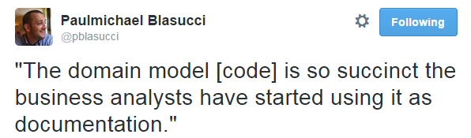
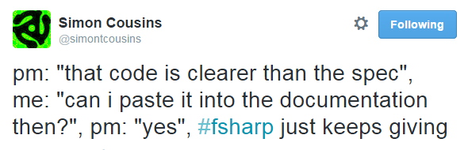
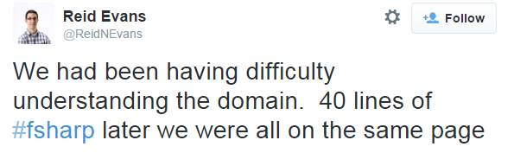

Slide 106
End of part 1

Slide 107
What do you want to do next?
I live code a domain suggested by audience
I keep going and explain types more deeply
You work on exercises

Slide 108
Part 1I

Slide 109
Understanding the F# type system
An introduction to “algebraic” types
An introduction to “algebraic” types
"composable types"

Slide 110
Composable types
composable means => like Lego

Slide 111
Creating new types
New types are constructed by combining other types using two basic operations:
type typeW = typeX "times" typeY
type typeZ = typeX "plus" typeY

Slide 112
Creating new types
1 2 3 4
2 3 4
5
AddOne
(a function)
AddOne int –› int

Slide 113
Representing pairs
(1,2)
(2,3)
(3,4)
(4,5)
3
5
7
9
AddPair ? –› int
Type: ?
Type: Integer
How can we represent this type?

Slide 114
Representing pairs
(1,2)
(2,3)
(3,4)
(4,5)
1
2
3
4
2
3
4
5
=
×
One from this pile...
And one from this pile...

Slide 115
Representing pairs
(true, false)
(true, true)
(false, false)
(false, true)
true false
true false
=
×
One from this pile...
And one from this pile...

Slide 116
Representing pairs
pair of ints
written int * int
pair of bools
written bool * bool

Slide 117
Using tuples for data
Alice, Jan 12th
Bob, Feb 2nd
Carol, Mar 3rd
Set of people
Set of dates
=
×
How to represent this?

Slide 118
Using tuples for data
Alice, Jan 12th
Bob, Feb 2nd
Carol, Mar 3rd
Set of people
Set of dates
=
×
type Birthday = Person * Date

Slide 119
Representing a choice
Temp F
true
false
IsFever ? –› bool
or
Temp C
Type: ?
How can we represent this type?

Slide 120
Representing a choice
One from this pile...
98˚ F 99˚ F 100˚ F 101˚ F
Temp F
=
+
or
Temp C
37.0˚ C 37.5˚ C
38.0˚ C 38.5˚ C
Or one from this pile...

Slide 121
Representing a choice
98˚ F 99˚ F 100˚ F 101˚ F
Tag these with “F”
Temp F
=
type Temp =
| F of int
| C of float
+
or
Temp C
37.0˚ C 37.5˚ C
38.0˚ C 38.5˚ C
Tag these with “C”

Slide 122
Using choices for data
type PaymentMethod =
| Cash
| Cheque of int
| Card of CardType * CardNumber
No extra data needed
Cheque no.
2 pieces of extra data

Slide 123
Working with a choice type
type PaymentMethod =
| Cash
| Cheque of int
| Card of CardType * CardNumber
let printPayment method =
match method with
| Cash –› printfn “Paid in cash"
| Cheque checkNo –› printfn “Paid by cheque: %i" checkNo
| Card (cardType,cardNo) –› printfn “Paid with %A %A" cardType cardNo
Match and assign in one step!

Slide 124
Using choices vs. inheritance
“closed” set of options
type PaymentMethod =
| Cash
| Cheque of int
| Card of CardType * CardNumber
extra data is obvious
OO version:
What goes in here? What is the common behaviour?
interface IPaymentMethod {..}
class Cash : IPaymentMethod {..}
class Cheque : IPaymentMethod {..}
class Card : IPaymentMethod {..}
Data and code is scattered around many locations
“open” set of options –unpleasant surprises?
class Evil : IPaymentMethod {..}

Slide 125
Summary: What are types for in FP?
An annotation to a value for type checking
type AddOne: int –› int
Domain modelling tool
type Deal = Deck –› (Deck * Card)
both at once!
"a good static type system is like having compile-time unit tests"

Slide 126

TYPE ALL THE THINGS

Slide 127
Designing with types
What can we do with this type system?

Slide 128
Optional values

Slide 129
Required vs. Optional
type PersonalName =
{
FirstName: string;
MiddleInitial: string;
LastName: string;
}
required
optional
required
How can we represent optional values?

Slide 130
Null is not the same as “optional”
“a” “b” “c”
“a” “b” “c” null
1 2
3
Length string –› int
Type: String

Slide 131

Spock, set phasers to null!
That is illogical, Captain

Slide 132
Null is not the same as “optional”
“a” “b” “c” null
1 2
3
Length string –› int
is null really a string?
Type: String

Slide 133

“null is the Saruman of static typing”

Slide 134
Null is not allowed
“a” “b” “c” null
1 2
3
Length string –› int
X
null is not allowed as a value!
Type: String

Slide 135
A better way for optional values
Tag these with “SomeString”
“a” “b” “c”
“a” “b” “c”
=
type OptionalString =
| SomeString of string
| Nothing
+
or
missing
Tag with “Nothing”

Slide 136
Defining optional types
type OptionalString =
| SomeString of string
| Nothing
type OptionalInt =
| SomeInt of int
| Nothing
Duplicate code?
type OptionalBool =
| SomeBool of bool
| Nothing

Slide 137
The built-in “Option” type
type Option<'T> =
| Some of 'T
| None
generic type
type PersonalName =
{
FirstName: string
MiddleInitial: string
LastName: string
}
type PersonalName =
{
FirstName: string
MiddleInitial: Option<string>
LastName: string
}
type PersonalName =
{
FirstName: string
MiddleInitial: string option
LastName: string
}
nice and readable!

Slide 138
Single choice types

Slide 139
Single choice types
type Something = | ChoiceA of A
One choice only? Why?
type Email = | Email of string
type CustomerId = | CustomerId of int

Slide 140
Wrapping primitive types
Is an EmailAddress just a string?
Is a CustomerId just a int?
Use single choice types to keep them distinct
type EmailAddress = EmailAddress of string
type PhoneNumber = PhoneNumber of string
Distinct types
type CustomerId = CustomerId of int
type OrderId = OrderId of int
Also distinct types

Slide 141
Creating the EmailAddress type
let createEmailAddress (s:string) =
if Regex.IsMatch(s,@"^\S+@\S+\.\S+$")
then (EmailAddress s)
else ?
let createEmailAddress (s:string) =
if Regex.IsMatch(s,@"^\S+@\S+\.\S+$")
then Some (EmailAddress s)
else None
createEmailAddress: string –› EmailAddress
createEmailAddress: string –› EmailAddress option

Slide 142
Constrained strings
type String50 = String50 of string
let createString50 (s:string) =
if s.Length <= 50
then Some (String50 s)
else None
createString50 : string –› String50 option

Slide 143
Constrained numbers
What’s wrong with this picture?
Qty:
–
999999
+
Add To Cart
How could this happen?

Slide 144
Constrained numbers
How many people ever do this?
New type just for this domain
type OrderLineQty = OrderLineQty of int
let createOrderLineQty qty =
if qty >0 && qty <= 99
then Some (OrderLineQty qty)
else None
createOrderLineQty: int –› OrderLineQty option

Slide 145
The challenge, revisited

Slide 146
The challenge, revisited
type Contact = {
FirstName: string
MiddleInitial: string
LastName: string
EmailAddress: string
IsEmailVerified: bool
}

Slide 147
The challenge, revisited
type Contact = {
FirstName: string
MiddleInitial: string option
LastName: string
EmailAddress: string
IsEmailVerified: bool
}

Slide 148
The challenge, revisited
type Contact = {
FirstName: String50
MiddleInitial: String1 option
LastName: String50
EmailAddress: EmailAddress
IsEmailVerified: bool
}

Slide 149
The challenge, revisited
type PersonalName = {
FirstName: String50
MiddleInitial: String1 option
LastName: String50 }
type Contact = {
Name: PersonalName
Email: EmailContactInfo }
type EmailContactInfo = {
EmailAddress: EmailAddress
IsEmailVerified: bool }

Slide 150
Encoding domain logic
type EmailContactInfo = {
EmailAddress: EmailAddress
IsEmailVerified: bool }
anyone can set this to true
Rule 1: If the email is changed, the verified flag must be reset to false.
Rule 2: The verified flag can only be set by a special verification service

Slide 151
Encoding domain logic
"there is no problem that can’t be solved by wrapping it in another type"
type VerifiedEmail = VerifiedEmail of EmailAddress
type VerificationService = (EmailAddress * VerificationHash) –› VerifiedEmail option
type EmailContactInfo =
| Unverified of EmailAddress
| Verified of VerifiedEmail

Slide 152
The challenge, completed

Slide 153
The challenge, completed
type EmailAddress = ...
type VerifiedEmail =
VerifiedEmail of EmailAddress
type EmailContactInfo =
| Unverified of EmailAddress
| Verified of VerifiedEmail
type PersonalName = {
FirstName: String50
MiddleInitial: String1 option
LastName: String50 }
type Contact = {
Name: PersonalName
Email: EmailContactInfo }

Slide 154
The challenge, completed
type EmailAddress = ...
type VerifiedEmail =
VerifiedEmail of EmailAddress
type EmailContactInfo =
| Unverified of EmailAddress
| Verified of VerifiedEmail
type PersonalName = {
FirstName: String50
MiddleInitial: String1 option
LastName: String50 }
type Contact = {
Name: PersonalName
Email: EmailContactInfo }
Which values are optional?
Which fields are linked?
What are the constraints?
Domain logic clear?

Slide 155
The challenge, completed
type EmailAddress = ...
type VerifiedEmail =
VerifiedEmail of EmailAddress
type EmailContactInfo =
| Unverified of EmailAddress
| Verified of VerifiedEmail
type PersonalName = {
FirstName: String50
MiddleInitial: String1 option
LastName: String50 }
type Contact = {
Name: PersonalName
Email: EmailContactInfo }
Which values are optional?

Slide 156
The challenge, completed
type EmailAddress = ...
type VerifiedEmail =
VerifiedEmail of EmailAddress
type EmailContactInfo =
| Unverified of EmailAddress
| Verified of VerifiedEmail
type PersonalName = {
FirstName: String50
MiddleInitial: String1 option
LastName: String50 }
type Contact = {
Name: PersonalName
Email: EmailContactInfo }
What are the constraints?

Slide 157
The challenge, completed
type EmailAddress = ...
type VerifiedEmail =
VerifiedEmail of EmailAddress
type EmailContactInfo =
| Unverified of EmailAddress
| Verified of VerifiedEmail
type PersonalName = {
FirstName: String50
MiddleInitial: String1 option
LastName: String50 }
type Contact = {
Name: PersonalName
Email: EmailContactInfo }
Which fields are linked?

Slide 158
The challenge, completed
type EmailAddress = ...
type VerifiedEmail =
VerifiedEmail of EmailAddress
type EmailContactInfo =
| Unverified of EmailAddress
| Verified of VerifiedEmail
type PersonalName = {
FirstName: String50
MiddleInitial: String1 option
LastName: String50 }
type Contact = {
Name: PersonalName
Email: EmailContactInfo }
Domain logic clear?

Slide 159
The challenge, completed
type EmailAddress = ...
type VerifiedEmail =
VerifiedEmail of EmailAddress
type EmailContactInfo =
| Unverified of EmailAddress
| Verified of VerifiedEmail
type PersonalName = {
FirstName: String50
MiddleInitial: String1 option
LastName: String50 }
type Contact = {
Name: PersonalName
Email: EmailContactInfo }
The ubiquitous language is evolving along with the design
(all this is compilable code, BTW)

Slide 160
Making illegal states unrepresentable

Slide 161
Making illegal states unrepresentable
type Contact = { Name: Name Email: EmailContactInfo Address: PostalContactInfo
}
Added some time later

Slide 162
Making illegal states unrepresentable
New rule: “A contact must have an email or a postal address”
type Contact = { Name: Name Email: EmailContactInfo Address: PostalContactInfo
}
Doesn't meet new requirements

Slide 163
Making illegal states unrepresentable
New rule: “A contact must have an email or a postal address”
type Contact = { Name: Name Email: EmailContactInfo option Address: PostalContactInfo option
}
Doesn't meet new requirements either
Could both be missing?
"Make illegal states unrepresentable!" – Yaron Minsky

Slide 164
Making illegal states unrepresentable
“A contact must have an email or a postal address”
implies:
email address only, or
postal address only, or
both email address and postal address
only three possibilities

Slide 165
Making illegal states unrepresentable
“A contact must have an email or a postal address”
type ContactInfo =
| EmailOnly of EmailContactInfo
| AddrOnly of PostalContactInfo
| EmailAndAddr of EmailContactInfo * PostalContactInfo
type Contact = { Name: Name ContactInfo : ContactInfo }
requirements are now encoded in the type!
only three possibilities

Slide 166
Making illegal states unrepresentable
“A contact must have an email or a postal address”
BEFORE: Email and address separate
AFTER: Email and address merged into one type
type Contact = { Name: Name Email: EmailContactInfo Address: PostalContactInfo
}
type Contact = { Name: Name ContactInfo : ContactInfo }
type ContactInfo =
| EmailOnly of EmailContactInfo
| AddrOnly of PostalContactInfo
| EmailAndAddr of EmailContactInfo * PostalContactInfo

Slide 167

Static types are almost as awesome as this

Slide 168
Making illegal states unrepresentable
Is this really what the business wants?
“A contact must have an email or a postal address”
“A contact must have at least one way of being contacted”
type ContactInfo =
| Email of EmailContactInfo
| Addr of PostalContactInfo
Way of being contacted
At least one way of being contacted is required
type Contact = { Name: Name PrimaryContactInfo: ContactInfo SecondaryContactInfo: ContactInfo option }

Slide 169
States and Transitions
Modelling a common scenario

Slide 170
States and transitions
States and transitions
Transition from A to B
State A
State B
State C
Transition from B to C
Transition from B to A

Slide 171
States and transitions
States and transitions for email address
Unverified EmailAddress
Verified EmailAddress
Verified
Rule: "You can't send a verification message to a verified email"
Rule: "You can't send a password reset message to a unverified email "

Slide 172
States and transitions
States and transitions for shipments
Put on truck
Undelivered
Out for delivery
Delivered
Signed for
Address not found
Rule: "You can't put a package on a truck if it is already out for delivery"
Rule: "You can't sign for a package that is already delivered"

Slide 173
States and transitions
States and transitions for chess game
White to play
White plays and wins
Black plays
Game Over
White plays
Black to play
Black plays and wins
Rule: “White and Black take turns playing. White can’t play if it is Black’s turn and vice versa"
Rule: “No one can play when the game is over"

Slide 174
States and transitions
States and transitions for shopping cart
Add Item
Add Item
Empty Cart
Active Cart
Paid Cart
Pay
Remove Item
Remove Item
Rule: "You can't remove an item from an empty cart"
Rule: "You can't change a paid cart"
Rule: "You can't pay for a cart twice"

Slide 175
States and transitions
States and transitions for shopping cart
Add Item
Add Item
Empty Cart
Active Cart
Paid Cart
Pay
no data needed
Remove Item
Remove Item
type ActiveCartData = { UnpaidItems: Item list }
type PaidCartData = { PaidItems: Item list; Payment: Payment }
What data do we need to store?

Slide 176
Shopping cart example
Add Item
Add Item
Empty Cart
Active Cart
Paid Cart
Shopping Cart API
Pay
Remove Item
Remove Item
initCart : Item –› ShoppingCart
addToActive: (ActiveCartData * Item) –› ShoppingCart
removeFromActive: (ActiveCartData * Item) –› ShoppingCart
pay: (ActiveCartData * Payment) –› ShoppingCart
might be empty or active – can’t tell

Slide 177
Shopping cart example
Server code to add an item
let initCart item = { UnpaidItems=[item] }
create a new ActiveCart with list of one item
let addToActive (cart:ActiveCart) item = { cart with UnpaidItems = item :: cart.existingItems }
Prepends item to list

Slide 178
Shopping cart example
Client code to add an item using the API
let addItem cart item =
match cart with
| EmptyCart –›
initCart item
| ActiveCart activeData –›
addToActive(activeData,item)
| PaidCart paidData –›
???
Cannot accidentally alter a paid cart!

Slide 179
Shopping cart example
Client code to remove an item using the API
let removeItem cart item =
match cart with
| EmptyCart –›
???
| ActiveCart activeData –› removeFromActive(activeData,item)
| PaidCart paidData –›
???
Compiler will not let you remove from an empty cart!

Slide 180
Why design with state transitions?
Each state can have different allowable data.
All states are explicitly documented.
All transitions are explicitly documented.
It is a design tool that forces you to think about every possibility that could occur.
Put on truck
Undelivered
Out for delivery
Delivered
Signed for
Address not found

Slide 181
Summary: What types are good for
Types as executable documentation
Ubiquitous language
Design and code are synchronized
Code is understandable by domain expert
Types for accurate domain modelling
Constraints are explicit
Types can encode business rules
Illegal states can be made unrepresentable

Slide 182
Review
What we covered in this talk:
Ubiquitous language
Self-documenting designs
Algebraic types
products and sums
Designing with types
Options instead of null
Single case unions
Choices rather than inheritance
Making illegal states unrepresentable
States and transitions

Slide 183
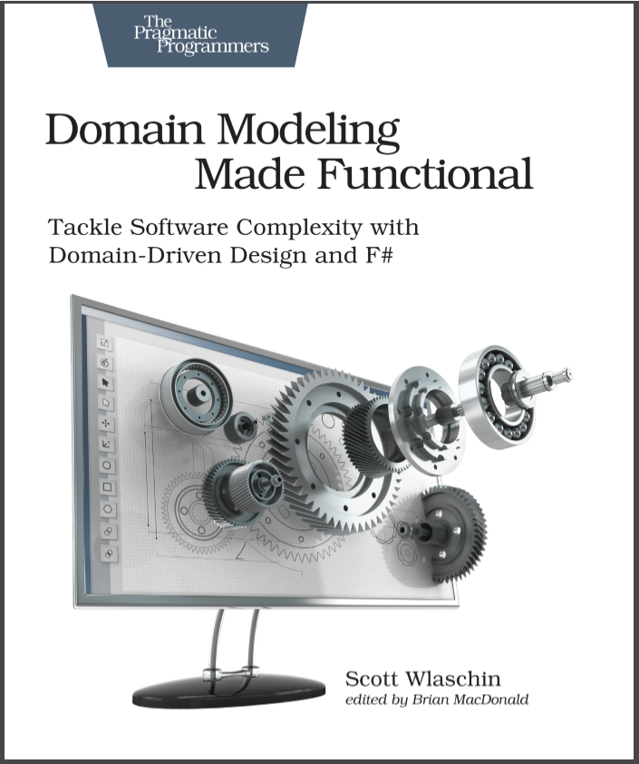

Domain Modeling Made Functional
fsharpforfunandprofit.com/ddd
Slides and video here
More F# at fsharp.org
I have a book coming soon!

