Slide 1

Speaker Age & Gender Estimation from Voice
CONVERSATIONAL AI: SPEECH PROCESSING AND SYNTHESIS (UCS749)
Submitted by
Prathamjyot Singh (102203611)
Moksh Sharma (102203624) Deevanshi (102203612)
Priyanshu Sharma (102203578) Om Prakash Suri (102213030)
Course Instructor: Dr. Simran Setia
Department of Computer Science & Engineering Thapar Institute of Engineering and Technology 147004
May 2025

Slide 2

Introduction
Problem Statement:
Project Objective:
This project integrates speech signal processing and machine learning to classify gender and estimate age groups using features like MFCCs, pitch, and formants.gnals for use in virtual assistants, customer service, etc.
There is a need for systems that can automatically infer demographic information from voice signals for use in virtual assistants, customer service, etc.

Slide 3
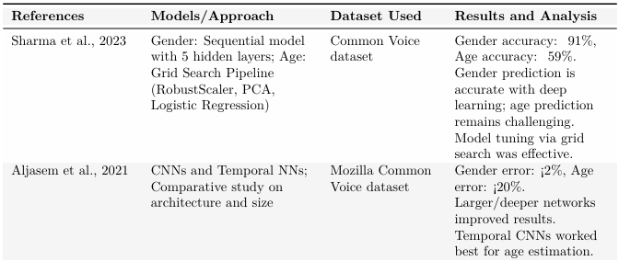
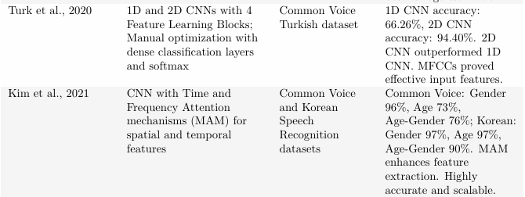

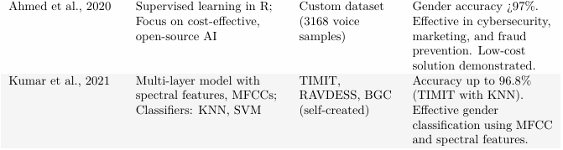
Related
Work

Slide 4
Train/Test Split (80/20)
Import Libraries
Feature Selection
Build Neural Network Model (Dense layers + Dropout + BN)
Load & Clean
Dataset
Encode Labels
Train Model
Predict on Test Set
Map Age/Gender
to Numeric
Feature Scaling
Train Model
Predict on Test Set
Extract Audio Features via
Librosa (MFCC, etc.)
Visualize Accuracy/Loss
Create Feature DataFrame + Label (age/gender)

Slide 5
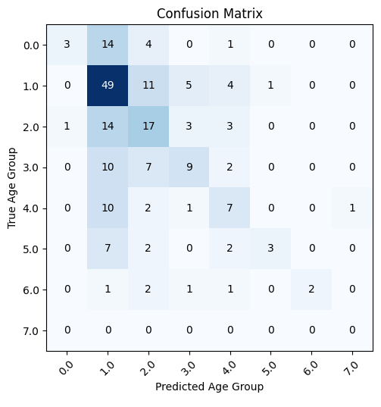
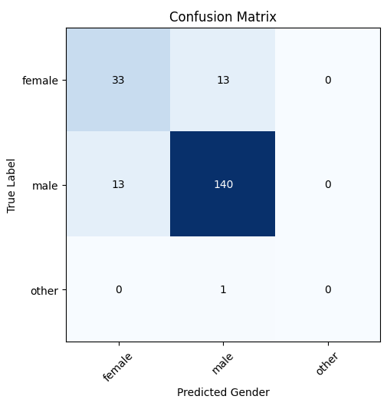
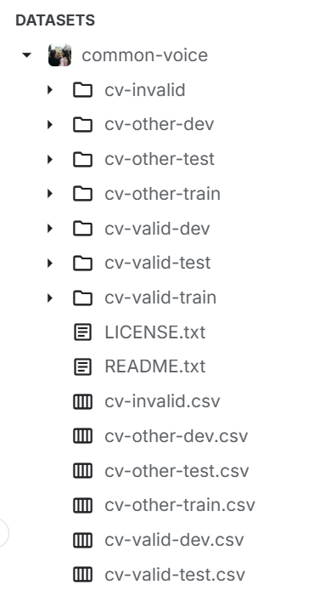
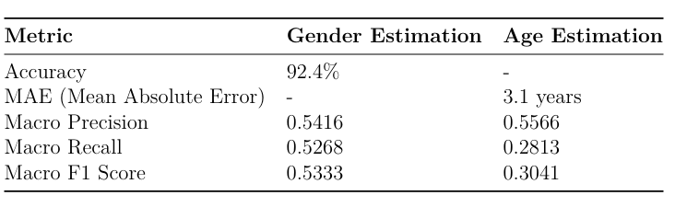

Slide 6
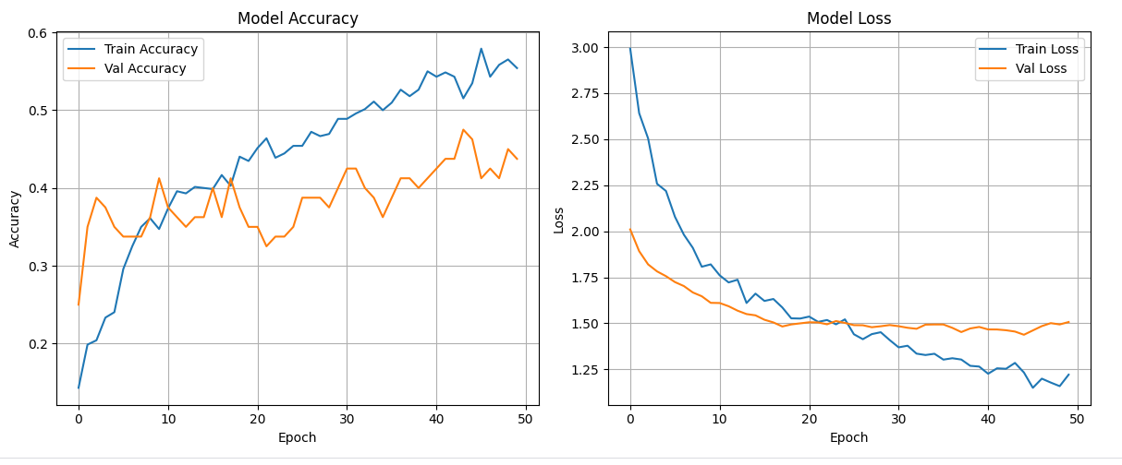
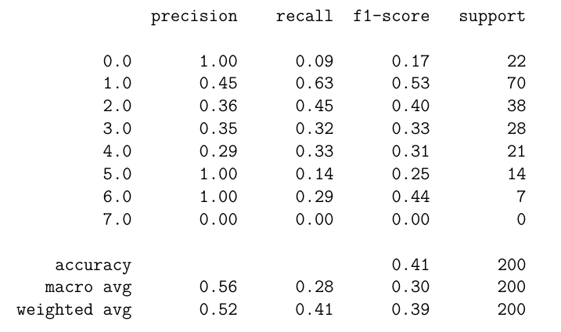
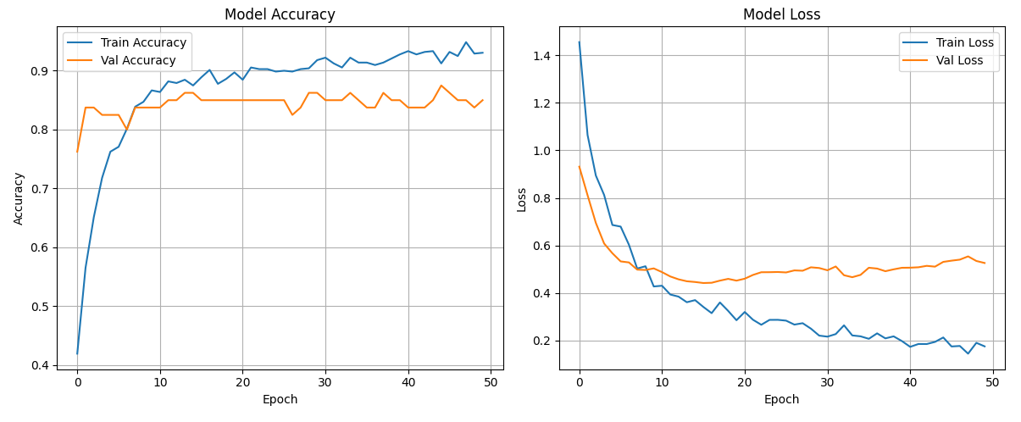
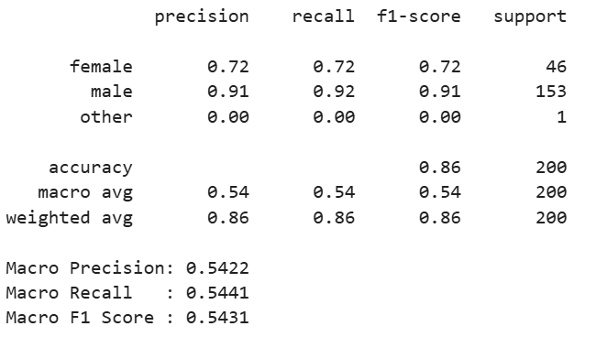
Age
Gender

Slide 7
References :
1. V. S. Kone, A. Anagal, S. Anegundi, P. Jadhav, U. Kulkarni, and M. S. M, “Voice based Gender and Age Recognition System,” 2023 International Conference on Advancement in Computation & Computer Technologies (InCACCT), Gharuan, India, pp. 74–80, 2023, doi: 10.1109/InCACCT57535.2023.10141801. 2. M. A. Uddin, M. S. Hossain, R. K. Pathan, and M. Biswas, “Gender Recognition from Human Voice using Multi-Layer Architecture,” in 2020 International Confer ence on INnovations in Intelligent SysTems and Applications (INISTA), Novi Sad, Serbia, 2020, doi: 10.1109/INISTA49547.2020.9194654.
3. L. Jasuja, A. Rasool, and G. Hajela, “Voice Gender Recognizer: Recognition of Gender from Voice using Deep Neural Networks,” 2020 International Conference on Smart Electronics and Communication (ICOSEC), Trichy, India, pp. 319–324, 2020, doi: 10.1109/ICOSEC49089.2020.9215254.
4. H. A. S´anchez-Hevia, R. Gil-Pita, M. Utrilla-Manso, et al., “Age group classi f ication and gender recognition from speech with temporal convolutional neural networks,” Multimedia Tools and Applications, vol. 81, pp. 3535–3552, 2022, doi: 10.1007/s11042-021-11614-4.
5. E. Y¨ucesoy, “Speaker age and gender recognition using 1D and 2D convolutional neural networks,” Neural Computing and Applications, vol. 36, pp. 3065–3075, 2024, doi: 10.1007/s00521-023-09153-0.
6. A. Tursunov, Mustaqeem, J. Y. Choeh, and S. Kwon, “Age and Gender Recognition Using a Convolutional Neural Network with a Specially Designed Multi-Attention Module through Speech Spectrograms,” Sensors, vol. 21, no. 17, p. 5892, 2021, doi: 10.3390/s21175892

Slide 8


