Slide 1
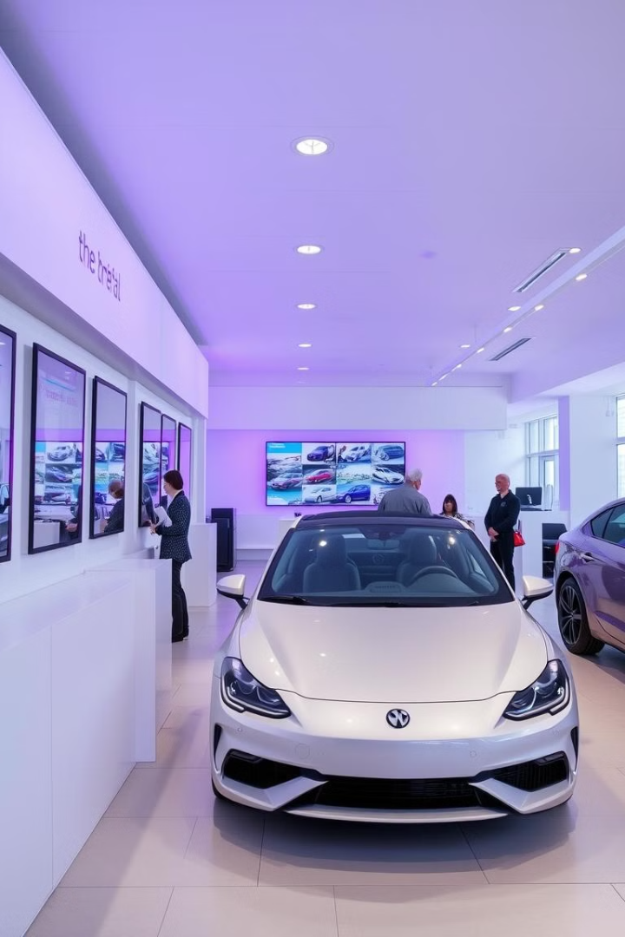

Revolutionizing Car Rentals: A Seamless System
Welcome! This presentation outlines a car rental system. It highlights key features and future scope. Discover the system's innovative workflow. It will transform the rental experience.

Slide 2
Dual Interface: Owner and Customer
Owner Interface
Customer Interface
Manage vehicles and track metrics. Set pricing and availability easily. Monitor performance.
Seamless booking experience for users. Find your car quickly. Easy payments.

Slide 3

Diverse Access Methods
Different methods are used to make the interface easy to use for both customer and owner.
Contains Common utilities, helps to gain upto-date data.

Slide 4





Streamlined Workflow
Search
Customers easily search available cars. Quick filtering by type or dates.
Book
Secure booking system, making rentals easy. Manage your booking.
Bill Generation
Bill generates according to the car he/she rents.
Return
Hassle-free return process and checkout. Easy to get going.

Slide 5
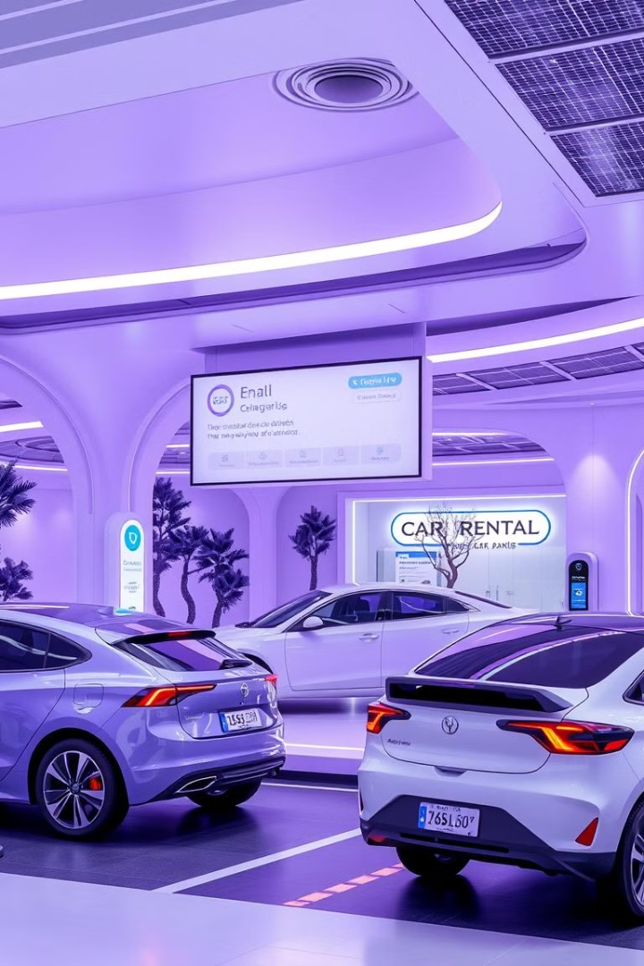
Future Horizons and Scope
1
AI Integration
2
Electric Vehicles
Smart predictive maintenance analytics. Reduce downtime.
Expansion of the electric vehicle fleet. Environmentally friendly options.
3
Loyalty Program
Reward frequent renters with exclusive offers. Incentivize regular business.

