Slide 1


Travel Planner
Prepared by: Moksh Kothari

Slide 2


Introduction
Travelling Management System build with modern technology can make travel planning and bookings less stressful.
This system have all the facilities that one need to arrange for a safe and joyous journey.
This system should allow users to book or have information about any transportation, hotels and restaurants.
It has all the facilities one would need for travelling. It is easy to use and understand by users.
One can access this software through app or its website.

Slide 3
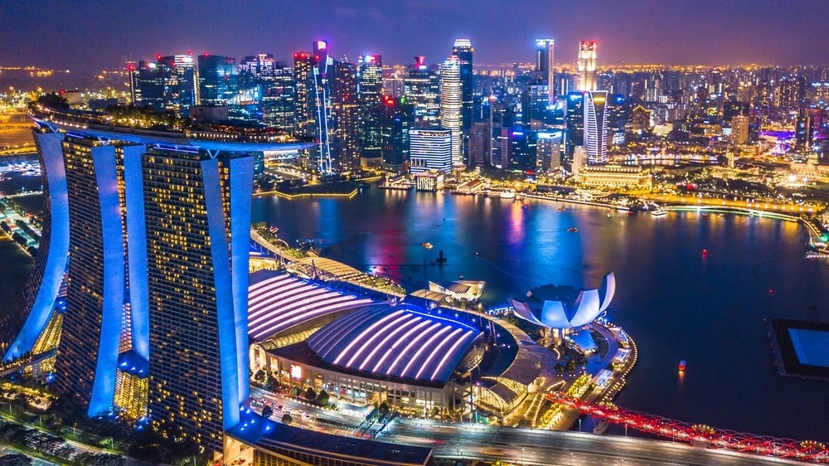

Purpose
Increases Efficiency
Instant Access at Any Time
Ensures Smooth Data Flow
Helps Reduce Errors Significantly
Helps Reduce Cost
Enhanced Communication
Data Security and Privacy
Provides Employees with a Self-Booking Option

Slide 4


Functionalities
Sign Up Page: Allows User to enter their credentials.
Login/Registration Page: This page allows user to gain access to an system, by entering their credentials.
Dashboard is the main entry point for the user to interact with the system after login.
Add Personal Details and Update Personal Details are related to managing user information.
Book Package and Book Hotel are related to making travel bookings.
View Destinations allows users to explore travel destinations
Make Payment is related to handling payment transactions for bookings.

Slide 5


Data Flow Diagram
Login
Sign up
Dashboard
Personal details
Book Tour
Payment
Exit

Slide 6


id
name
number
username
security
Extra details
gender
answer
account
Customer
country
username
address
name
password
email
phone
persons
number
days
Books Package
Gives Hotel Details
username
ac
Books Hotel
Book Hotel
username
phone
id
Book Package
package
name
Hotels
Cost_per_day
food
cost
price
persons
Ac_charge
name
E-R Diagram
phone
number
id
Food_charge

Slide 7


Sign up
Login
Forgot Password
Dashboard
Add Personal Details
Update Personal Details
View Personal Details
View Destination
View Package
Use Case Diagram
View Hotel
Book Tour

Slide 8


Data Structure using java | Java-II | Database Management System
Array | GUI based on Swing class | Use of DDL
Singly linked list | Connection with database using jdbc | Use of DML
- | Inheritance | ResultSet
- | Encapsulation | JDBC
- | Multi-threading | SQL queries
- | Image Handling | Trigger for deletion of data.
- | Action handling | -
- | Object oriented programming | -
- | Common Package for class | -

Slide 9
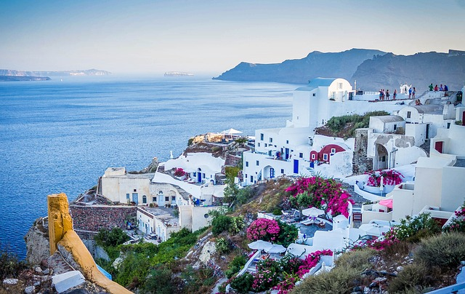

Merits
Efficiency and Time-Saving:
Automation
Centralization
2. Cost Control:
Budget Management
Negotiated Rates
3. Improved Experience:
Convenience
Support
4. Risk Management:
Travel alerts
Emergency assistance

Slide 10


Demerits
Lack of Direct Client Relationship
Brand Dilution and Loss of Customer Ownership
Commission Fees
Changing Consumer Preferences
Regulatory challenges

Slide 11


Future Scopes
Advanced algorithms will tailor travel recommendations and itineraries based on user preferences, past behavior, and predictive analytics.
Internet of Things devices will offer real-time updates on travel conditions, airport wait times, and hotel room availability.
Push notifications for flight changes, gate updates, and itinerary modifications.
Virtual tours can offer immersive previews of destinations and accommodations before booking.
Dynamic adjustment of travel plans based on real-time data and user preferences.
Use of biometric data (e.g., facial recognition, fingerprints) for secure access and verification.

Slide 12


