Slide 1
Programming Languages
Made by Maya,Moksh,
,(Anchal)^2,komal,Alka,
Khoosbu,Simran
,Ravi and Pradeep

Slide 2
Programming language
A programming language is a formal language, which comprises a set of instructions that produce various kinds of output. Programming languages are used in computer programming to implement algorithms.
Thousands of different programming languages have been created, and more are being created every year. Many programming languages are written in an imperative form (i.e., as a sequence of operations to perform) while other languages use the declarative form

Slide 3
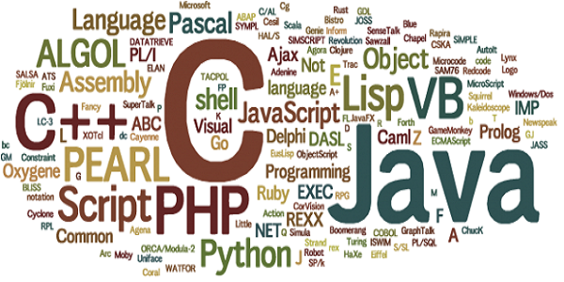

Slide 4
History of Programming
First programming languages(ancient time)
Establishing fundamental paradigms
Consolidation, modules, performance(1980s)
The Internet age(1990s)
Current trends

Slide 5
First programming languages
In the 1940s, the first recognizably modern electrically powered computers were created and early proposal for a high-level programming language was Plankalkül, developed by Konrad Zuse between 1943 and 1945
1951 – Regional Assembly Language
1952 – Autocode
1954 – IPL (forerunner to LISP)
1955 – FLOW-MATIC (led to COBOL)
1957 – FORTRAN (first compiler)
1957 – COMTRAN (precursor to COBOL)
1958 – LISP
1958 – ALGOL 58
1959 – FACT (forerunner to COBOL)
1959 – COBOL
1959 – RPG
1962 – APL
1962 – Simula
1962 – SNOBOL
1963 – CPL (forerunner to C)
1964 – Speakeasy
1964 – BASIC
1964 – PL/I
1966 – JOSS
1966 - MUMPS
1967 – BCPL (forerunner to C)

Slide 6
Establishing fundamental paradigms
The period from the late 1960s to the late 1970s brought a major flowering of programming languages.
1967 – BCPL (forerunner to B)
1968 – Logo
1969 – B (forerunner to C)
1970 – Pascal
1970 – Forth
1972 – C
1972 – Smalltalk
1972 – Prolog
1973 – ML
1975 – Scheme
1978 – SQL (a query language, later extended)

Slide 7
Programming in C++
By Moksh Choudhary

Slide 8
Consolidation, modules, performance(1980s)
The 1980s were years of relative consolidation in imperative languages. Rather than inventing new paradigms, all of these movements elaborated upon the ideas invented in the previous decade
1980 – C++ (as C with classes, renamed in 1983)
1983 – Ada
1984 – Common Lisp
1984 – MATLAB
1984 – dBase III, dBase III Plus (Clipper and FoxPro as FoxBASE, later developing into Visual FoxPro)
1986 – Objective-C
1986 – LabVIEW (Visual Programming Language)

Slide 9
The Internet age(1990s)
The rapid growth of the Internet in the mid-1990s was the next major historic event in programming languages.
1990 – Haskell
1991 – Python
1991 – Visual Basic
1993 – R
1995 – Ruby
1995 – Java
1995 – JavaScript
1995 – PHP

Slide 10
Current trends
Programming language evolution continues, in both industry and research. Some of the recent trends have included:
Constructs to support concurrent and distributed programming.
XML for graphical interface (XUL, XAML)
Massively parallel languages for coding 2000 processor GPU graphics processing units and supercomputer arrays including OpenCL
Etc.
Some notable languages developed during this period include
2001 – C#
2003 – Scala
2005 – F#
2009 – Go
2011 – Kotlin
2014 – Swift
2014 – Hack

Slide 11
Why C++
C++ was designed with a bias toward system programming and embedded, resource-constrained software and large systems, with performance, efficiency and flexibility of use as its design highlights.
C++ is also use for desktop applications, servers (e.g. e-commerce, Web search or SQL servers), and performance-critical applications (e.g. telephone switches or space probes).
C++ is standardized by the ISO
First initially standardized in 1998 as ISO/IEC 14882:1998 C++98
Now we are on ISO/IEC 14882:2017 ->C++17
C++20 is the next planned standard, keeping with the current trend of a new version every three years

Slide 12
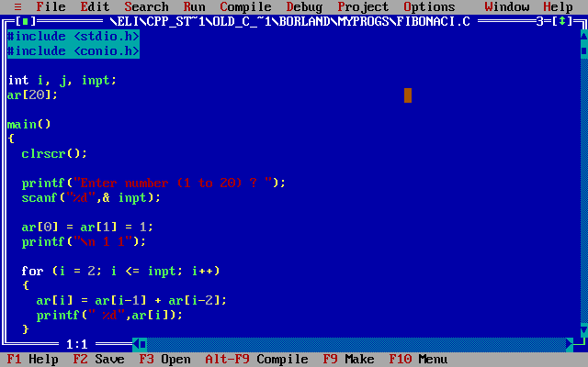
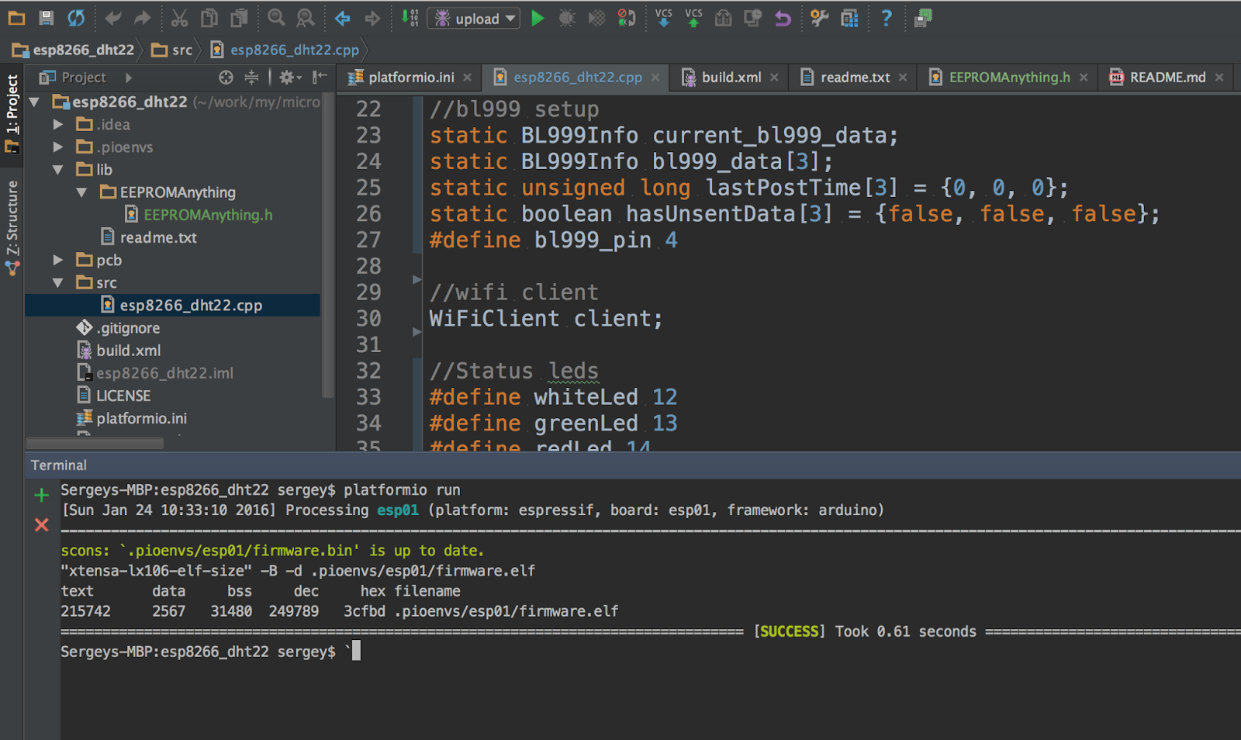

Slide 13
Use C++
Operating Systems
Most of the operating systems are written in C and C++ language. These include Windows 95, 98, 2000, XP, Vista, Windows 7, Windows 8, Apple Mac OS X, Symbian OS and Be-OS, Google Chrome OS, RIM BlackBerry OS 4.x, Apple iPhone iPod Touch and iPad OS ,All Linux Distros ,etc.

Slide 14
Web Browsers
Microsoft Internet Explorer
Google Chrome (based on chromium web browser)
Mozilla Firefox
Safari
Netscape Navigator
Opera and Opera Mini

Slide 15
Compilers and Virtual Machines for programming languages
It is amazing to notice that various compilers and run-time environments for other programming languages are written in C++. This means without C++, it would not be possible to execute .Net and Java applications.
Microsoft Visual C++ Compiler
Microsoft Visual Basic Compiler
Microsoft Visual C# Compiler
Microsoft .Net CLR
Java Virtual Machine (JVM)
Python Virtual Machine (PVM)

Slide 16
Office Products
Microsoft Office (Word, Excel, Access, PowerPoint, Outlook, Front Page)
Apache OpenOffice
Corel Office/Word-perfect Office
LiberOffice

Slide 17
Web Sites
Facebook - Several high-performance and high-reliability components are developed in C++.
YouTube
Amazon
PayPal

Slide 18
Graphical Layers
Microsoft Windows UI
Apple MacOS UI (Aqua)
KDE

Slide 19
Games
Majority of computer games and game engines are developed in C++. It is difficult to provide list of all games here but some of them are Doom III engine, Counter Strike, Sierra On-line: Birthright, Hellfire, Football Pro, Bull rider I & II, Trophy Bear, Kings Quest, Antara, Hoyle Card games suite, SWAT, Blizzard: StarCraft, StarCraft: Brood War, Diablo I, Diablo II: Lord of Destruction, Warcraft III, World of Warcraft, Starfleet Command, Invictus, PBS's Heritage: Civilization and the Jews, Master of Orion III, CS-XII, MapleStory etc.

Slide 20
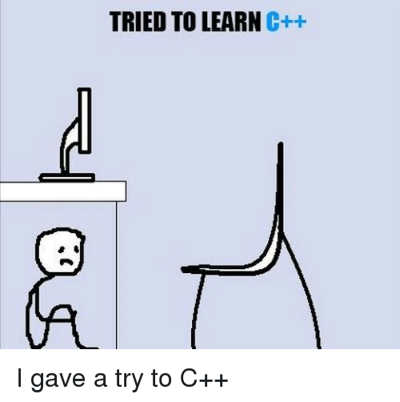
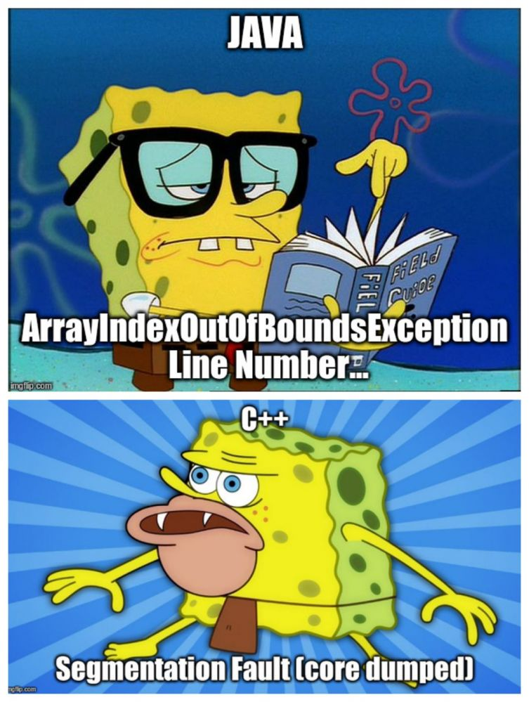


Slide 21


Slide 22
New In C++17
Boost C++ Libraries
Atomic
QT
wxwidgets
auto
Lambda
Etc.

Slide 23


