Slide 1
Topic : AI-Enhanced Career Guidance System for Personalized Career Pathways
PIP4004 Capstone Project
Review-0
Batch Number: 78
Under the Supervision of,
Dr. Vairavel Chenniyappan
Assistant Professor
School of Computer Science and Engineering
Presidency University
Roll Number | Student Name
20211CSE0464 | Dhanya MU
20211CSE0232 | Sneha A
20211CSE0210 | Vennapusa Moksha Sravani
20211CSE0409 | Pragathi MS
Name of the Program: CSE
Name of the HoD: Dr.Asif Mohammed H.B
Name of the Program Project Coordinator: Mr. Amarnath J.L & Dr. Jayanthi. K.
Name of the School Project Coordinators: Dr. Sampath A K / Dr. Abdul Khadar A / Mr. Md Ziaur Rahman

Slide 2
Content
Problem Statement
Github Link
Analysis of Problem Statement
Literature Review
Objectives
Methodology
Timeline of the Project
References

Slide 3
Problem Statement Number: PSCS_479
Organization: Ministry of Skill Development and Entrepreneurship (MSDE)
Category (Hardware / Software / Both) : Software
Problem Description : Individuals struggle to find personalized career guidance that aligns with their unique skills, interests, aspirations, and experiences, while traditional career counseling methods lack dynamic personalization and fail to account for individual profiles and future career trends .

Slide 4
Github Link
The Github link provided should have public access permission.
Github Link
https://github.com/Moksha122/AI-Enhanced-Career-Guidance-System

Slide 5
The challenge is to develop an AI-powered career guidance system
Assesses aptitude, strengths, and abilities.
Incorporates aspirations and interests to align career recommendations with long-term goals and passions.
Maps current skills and experiences to relevant career paths and identifies gaps.
Uses predictive analytics to suggest future career progression opportunities based on industry trends.

Slide 6
Analysis of Problem Statement
Technology Stack Components:
Frontend:
React.js / Angular.js – Responsive UI
Tailwind CSS / Material-UI – Modern designs
Framer Motion – Dynamic animations
Backend:
Python (Django/Flask) / Node.js (Express.js) – APIs & logic and for building a scalable backend.
FastAPI – Real-time AI processing and user interactions
Machine Learning & AI:
Scikit-learn / TensorFlow / PyTorch – ML models
NLP: SpaCy (resume parsing), Hugging Face (recommendations)
Recommendation Systems: Collaborative & Content-based filtering
Data Storage:
PostgreSQL / MySQL – For structured relational data like user profiles and career databases.
MongoDB – Semi-structured data like skill metadata and trends.
Redis – Caching real-time recommendations & session data

Slide 7
Analysis of Problem Statement (contd...)
Data Collection & Integration:
APIs – LinkedIn, Indeed, Coursera for job and course data
Web Scraping – tools like BeautifulSoup or Scrapy to fetch industry insights and trends.
Real-Time Pipelines – Kafka (job trends), Airflow (workflows)
Cloud Infrastructure:
AWS / GCP / Azure – Hosting & scaling
Kubernetes – Container orchestration
Docker – Containerized applications
Security:
OAuth2.0 – Secure authentication
SSL/TLS – Data encryption in transit
Encryption Libraries – Protect stored data
Analytics & Reporting:
Google Analytics / Mixpanel – User interaction tracking
Power BI / Tableau – Data visualization

Slide 8
Analysis of Problem Statement (contd...)
Software Requirements
Operating System: Windows/Linux
Backend Development: Node.js, Python (Django/Flask)
Frontend Development: React.js, Angular, or mobile frameworks
Database: MySQL, PostgreSQL, MongoDB
AI/ML Libraries: TensorFlow, PyTorch, scikit-learn
Cloud: AWS, Azure, Google Cloud
External API Integrations: Job portals, learning platforms
Security: Encryption, compliance with GDPR
Scalability & Performance: Cloud-based, high availability

Slide 9
Literature Review
Previous Research:
Manual career guidance was limited by human expertise, lacking personalization and adaptability.
AI systems now automate career recommendations by analyzing user profiles and market trends.
Algorithms in Use:
Collaborative Filtering: Recommends careers based on similar users
Content-Based Filtering: Matches careers with user skills
Natural Language Processing (NLP):
Resume Parsing: Extracts key skills to match with career paths.
Job Matching: Aligns job descriptions with user profiles
Challenges & Future Scope:
Bias in Data: AI models may inherit biases from training data.
Real-Time Updates: Need for constant updates based on job market trends.

Slide 10
Objectives
Create personalized career recommendations based on user profiles and job trends.
Use machine learning to suggest the best career paths based on skills and interests.
Use NLP to match resumes with job descriptions for better suggestions.
Provide real-time guidance through AI chatbots that suggest career steps.
Update recommendations with the latest job market trends.
Make the system fair and transparent, avoiding biases in career suggestions.

Slide 11
Methodology
Step 1: Collect user data (skills, interests, experience, job market trends).
Step 2: Apply machine learning algorithms (collaborative filtering, content-based filtering) to generate career recommendations.
Step 3: Use Natural Language Processing (NLP) to analyze resumes and job descriptions for better alignment.
Step 4: Integrate real-time job market trends to ensure recommendations stay current.
Step 5: Test and refine recommendations by considering factors like job stability, salary expectations, and growth opportunities.
Step 6: Provide personalized feedback through AI-powered chatbots and adjust suggestions based on user preferences and feedback.

Slide 12
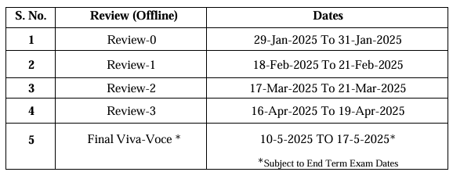
Timeline of the Project (Gantt Chart)
Phase 1: Research and Planning
Phase 2: Backend & AI Development
Phase 3: Frontend & System Integration
Phase 4: Testing, Deployment & Finalization

Slide 13
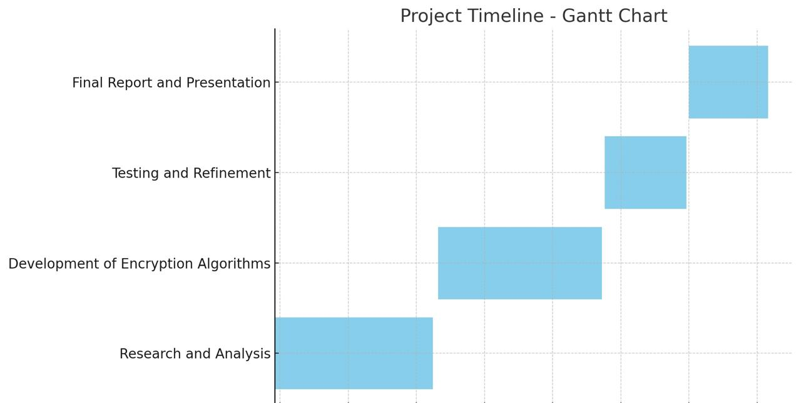
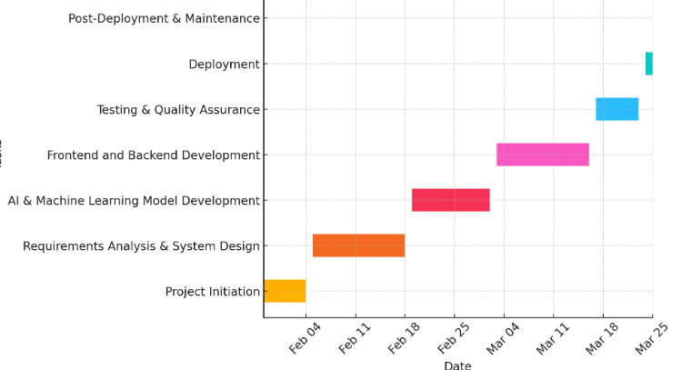
Timeline(cont…)
16-Apr-2025 to 19-Apr-2025
Testing, Deployment & Finalization
17-Mar-2025 to 21-Mar-2025
Frontend & System Integration
18-Feb-2025 to 21-Feb-2025
Backend & AI Development
29-Jan-2025 to 31-Jan-2025
Research and Planning

Slide 14
References (IEEE Paper format)
https://ieeexplore.ieee.org/stamp/stamp.jsp?arnumber=10477957
https://ieeexplore.ieee.org/document/10560126
https://ieeexplore.ieee.org/document/10564423
https://ieeexplore.ieee.org/document/10426016
https://ieeexplore.ieee.org/document/10560126
https://ieeexplore.ieee.org/iel7/6287639/10380310/10477957.pdf
https://ieeexplore.ieee.org/iel8/6287639/10380310/10721454.pdf
https://ieeexplore.ieee.org/iel7/6287639/10380310/10477957.pdf
https://ieeexplore.ieee.org/iel7/4509581/10298835/10299548.pdf
https://ieeexplore.ieee.org/iel7/6287639/10380310/10477957.pdf

Slide 15


