Slide 1
PROJECT TITLE : Mobile App for Direct Market Access to Farmers
PIP104 University Project-II Review-3
Batch Number: 68
Roll Number | Student Name
20211CSE0464 | Dhanya M U
20211CSE0232 | Sneha A
20211CSE0210 | Vennapusa Moksha Sravani
20211CSE0409 | Pragathi M S
Under the Supervision of,
Dr. Pajany M
Assistant Professor
School of Computer Science & Engineering Presidency University

Slide 2
Abstract
Project Overview
Title: Farm-to-Consumer Agriculture Platform
Objective: Bridge the gap between farmers and consumers through a direct online marketplace.
Key Features
Direct Purchase: Consumers can buy agricultural products directly from verified farmers.
Profile Management: Separate user and farmer profiles for personalized experience.
Real-time Inventory: Farmers can update product availability instantly.
Admin Role:
Verifies and onboards genuine farmers
Uploads and manages schemes beneficial to farmers
Online Payments: Integrated payment gateway with UPI support for smooth transactions.
Future Enhancements
Vehicle Renting: Farmers can rent transportation vehicles for produce delivery.
Land Renting: Landowners can lease land to farmers via the platform.
Fertilizer Management: Track, purchase, and manage fertilizers efficiently.

Slide 3
Objective
Direct Connection: Build an application that connects consumers directly with farmers.
Seamless Transactions: Integrate a secure and easy-to-use payment gateway (e.g., UPI).
Profile Management: Allow both consumers and farmers to create and manage their profiles.
Inventory System: Enable real-time inventory management for farmers to update product availability.
Verified Farmers: Display only verified farmers to ensure trust and product authenticity.
Product Listings: Provide farmers with tools to list, edit, and manage their agricultural products.
Scheme Updates: Inform farmers about relevant government schemes and benefits through the platform.
Administrator Role:
Onboard and verify genuine farmers
Manage scheme-related content for farmer support
Ensure trust and transparency across the platform

Slide 4
Problem Statement
Lack of Transparency: Traditional marketplaces do not offer clear information about product quality and pricing.
Inefficient Payments: Farmers face delays and challenges in receiving payments through conventional systems.
Limited Market Access: Farmers are often disconnected from end consumers and rely on middlemen.
Consumer Constraints: Consumers have limited access to fresh and affordable produce directly from farmers.
Middlemen Dependency: Involvement of intermediaries often reduces profits for farmers and increases prices for consumers.
Information Gap: Farmers lack a unified platform to stay updated about government schemes and support.
Solution Aim: This project bridges these gaps by offering a transparent, efficient, and direct farm-to-consumer platform.

Slide 5
Introduction
Agriculture’s Importance: Agriculture remains the backbone of many economies and rural livelihoods.
Current Challenges: Farmers face limited market access, low profitability, and inefficient sales processes.
Project Focus: "Uplifting the Farmer through a Connected Ecosystem" aims to bridge these gaps.
Direct Marketplace: Enables farmers to sell products directly to consumers, eliminating middlemen.
User-Friendly Platform: Features include:
UPI-based secure payments
Real-time inventory management
Profile handling for both farmers and consumers
Government Scheme Access: Farmers are informed and connected to relevant schemes via the platform.
Promoting Transparency: Ensures clear pricing, trusted sellers, and real-time product updates.

Slide 6
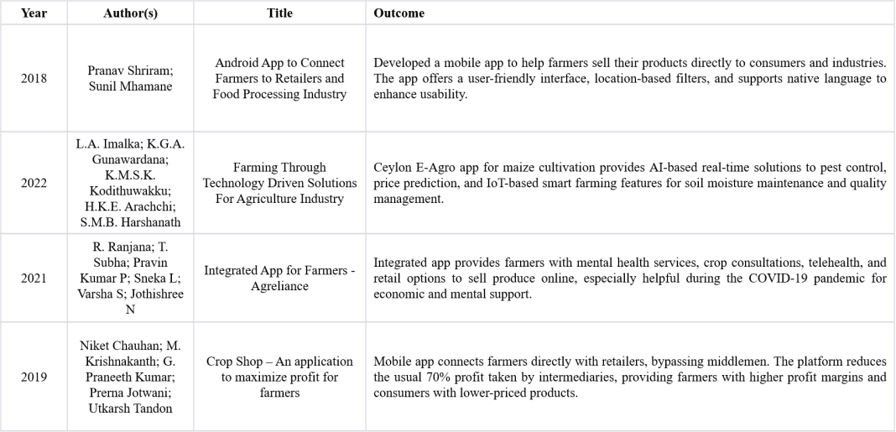
Literature Review

Slide 7
Proposed Method
Unified Platform Integration
Single platform for farmers, users, and administrators.
User Features
Browse and purchase products seamlessly.
UPI-based payment gateway for secure transactions.
Access to detailed product descriptions, reviews, and ratings. Real-time order tracking for enhanced transparency.
Farmer Features
Manage inventory and update product listings.
Receive payments directly into accounts.
Access data-driven insights on market demand and pricing trends.
Administrator Role
Onboard trusted farmers and upload helpful schemes.
Verify product authenticity to ensure quality standards.
Manage the platform's ecosystem and resolve disputes.
Community Support Feature
Encourages engagement and feedback between farmers and consumers, fostering collaboration.

Slide 8
Hardware and Software Requirements
SOFTWARE REQUIREMENS
Operating System - Windows 10
JDK - Java(kotlin)
SDK - Android
IDE - Android studio
Database - my SQL
HARDWARE REQUIREMENTS
Processor - I3/Intel Processor
RAM - 8 GB
Hard Disk - 1TB

Slide 9
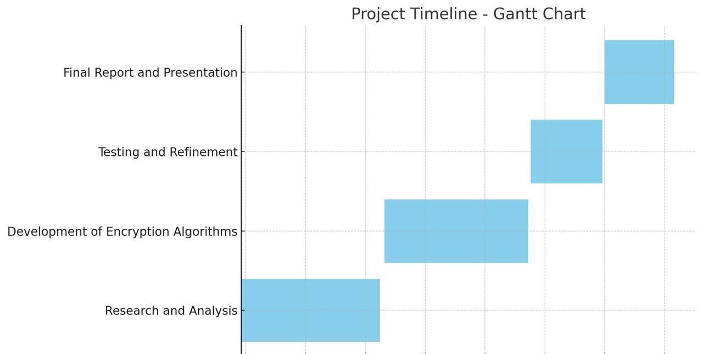
Timeline of Project
16-Apr-2025 to 19-Apr-2025
17-Mar-2025 to 21-Mar-2025
18-Feb-2025 to 21-Feb-2025
29-Jan-2025 to 31-Jan-2025

Slide 10
Conclusion
Comprehensive Solution: Addresses key challenges faced by farmers in accessing markets and managing transactions.
Direct Connectivity: Bridges the gap between farmers and consumers, eliminating the need for intermediaries.
Enhanced Transparency: Promotes trust through clear product information and pricing.
Efficient Payments: Integrates secure and fast payment systems, ensuring timely transactions for farmers.
Trustworthy Ecosystem: Admin verification and scheme uploads help maintain platform integrity.
Sustainable Agriculture: Encourages long-term, eco-friendly practices for improved farmer livelihoods.
Mutual Benefits: Ensures value for both farmers (increased income, access) and consumers (fresh produce, fair prices).

Slide 11
References
Pranav Shriram; Sunil Mhamane | Android App to Connect Farmers to Retailers and Food Processing Industry | 15-16 November 2018
L.A. Imalka; K.G.A. Gunawardana; K.M.S.K. Kodithuwakku; H.K.E. Arachchi; S.M.B. Harshanath | Farming Through Technology Driven Solutions For Agriculture Industry Ceylon E-Agro mobile application-find technology based solutions for agricultural problems | 16-18 September 2022
R. Ranjana; T. Subha; Pravin Kumar P; Sneka L; Varsha S; Jothishree N | Integrated App for Farmers - Agreliance | 16-17 December 2021

Slide 12
Niket Chauhan; M. Krishnakanth; G. Praneeth Kumar; Prerna Jotwani; Utkarsh Tandon | Crop Shop – An application to maximize profit for farmers | 30-31 March 2019
Aina Marie Joseph; Nurfauza Jali; Amelia Jati Robert Jupit; Suriati Khartini Jali | eMarket for
Local Farmers | 23-25 November 2021

Slide 13
Thank You

