Slide 1
VIVA DEMONSTRATION
AXI4: five channels, a master and a memory
Input D flip-flops, master, slave, output D flip-flops: a write and a read, and 76 checks pass in simulation.
AW
W
B
AR
R
[Your name] · [Course and institution] · [Date]
Notes:
Open with the one-sentence summary: we built an AXI4 master and an AXI4 memory in Verilog. The testbench loads an address and four words into input D flip-flops. The master takes them from there, writes them to the slave over the five AXI channels, then reads them back into output D flip-flops. The master and the slave are connected directly. Everything shown comes from the simulation in the project folder, so every number can be reproduced live. The five amber pills are the five AXI channels; we come back to each one.

Slide 2
What we built
Five files, each with one job.
Input DFFs
Master
Slave
Output DFFs
Top
axi4_in_dff.v
axi4_master.v
axi4_slave.v
axi4_out_dff.v
axi4_top.v
Five registers: an address and four words. The testbench loads them.
Takes the data from the input DFFs. Writes it, then reads it back.
A 4 KiB memory. Answers bursts of up to 256 beats.
Four registers that hold the words read back.
Wires it all together. Master and slave connect directly.
Full AXI4 rather than AXI4-Lite: bursts, transaction IDs, WLAST and RLAST.
AXI4: input D flip-flops, a master, a slave and output D flip-flops, in Verilog
2
Notes:
Five small files, and the top level that wires them. The input D flip-flops hold the address and four words the testbench loads. The master is the active side: it takes them from there and starts the AXI transfers when start goes high. The slave is a 4 KiB memory that answers the five channels. The output D flip-flops catch the words that come back. The top level only wires them together; the master and slave are connected directly.

Slide 3
Five independent channels
WRITE
AW write address
W write data
Master
axi4_master
Slave
axi4_slave
B write response
READ
AR read address
R read data
AXI4: input D flip-flops, a master, a slave and output D flip-flops, in Verilog
3
Notes:
AXI separates a transaction into five independent one-way channels, so a read can proceed while a write waits. A write uses AW for the address, W for the data beats, and B for one response at the end. A read uses AR for the address and R for the data coming back. Notice B and R point the other way.

Slide 4
The VALID and READY handshake
Transfer
One transfer, cycle by cycle
0
1
2
3
4
5
The sender raises VALID when its data is real. The receiver raises READY when it can take it. The transfer happens in the cycle where both are high.
CLK
VALID
Two rules
Once VALID is up, the data and VALID stay put until the handshake completes.
A sender may not wait for READY before raising VALID.
READY
Amber dot: cycle 3 is the only cycle where VALID and READY are both high, so that is where the transfer happens.
AXI4: input D flip-flops, a master, a slave and output D flip-flops, in Verilog
4
Notes:
Every channel uses the same handshake. The sender raises VALID when its data is real. The receiver raises READY when it can take it. The transfer happens in the one clock cycle where both are high. Two rules keep it safe. First, once VALID is up the data must not change until the handshake completes. Second, a sender may not wait for READY before raising VALID, or two sides could wait on each other forever. Our testbench checks both rules on every run.

Slide 5
What a burst is made of
LEN
LAST
WSTRB
ID
beats minus 1
marks the final beat
which bytes to write
tag copied to the response
What the master sends: four words starting at address 0x10, with AxLEN = 3
beat 0
beat 1
beat 2
beat 3
0x10
0x14
0x18
0x1C
0xA5A5_0001
0x5A5A_0002
0xDEAD_BEEF
0x0BAD_F00D
WLAST = 0
WLAST = 0
WLAST = 0
WLAST = 1 on this beat
The address goes up by 4 for each beat, because each word is 4 bytes.
AXI4: input D flip-flops, a master, a slave and output D flip-flops, in Verilog
5
Notes:
A burst is one address followed by many beats. AxLEN says how many beats minus one, so 3 means four beats. WLAST and RLAST mark the final beat so the receiver knows where it ends. WSTRB says which of the four bytes of a word to write; 1111 is the whole word. The ID is a small tag put on the request and copied onto its response. In our design the address simply counts up by 4 for each beat. The example is exactly what the master does: four words starting at address 0x10.

Slide 6
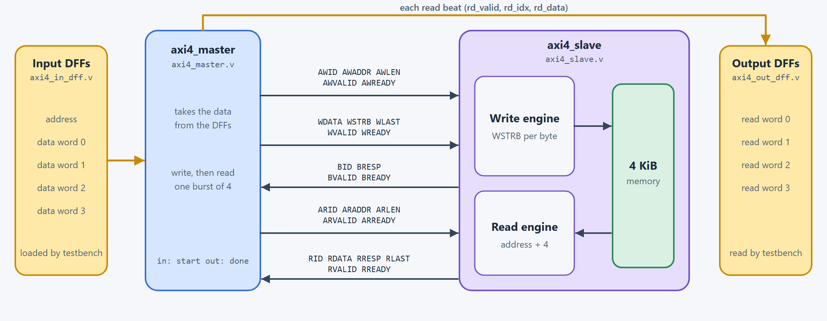
System architecture
Yellow boxes are the D flip-flops. The master and the slave are connected directly.
AXI4: input D flip-flops, a master, a slave and output D flip-flops, in Verilog
6
Notes:
Walk left to right. The yellow box on the left is the input D flip-flops, loaded by the testbench. The master takes its data from them and starts the transfers when start goes high. The five channels, with the real signal names above each wire, go straight across to the slave: there is no interconnect and nothing in between. On the right the slave has a write engine, a read engine and a 4 KiB memory. Each read beat is stored in the output D flip-flops, the yellow box on the far right. B and R run the other way.

Slide 7
The master, step by step
S_IDLE
S_AW
S_W
S_B
S_AR
S_R
S_DONE
Waits for start.
Sends the write address.
Sends the four words from the input DFFs. WLAST on the fourth.
Waits for the one write response.
Sends the read address.
Hands each beat to the output DFFs. Ends on RLAST.
done = 1 until start drops.
Data from the input DFFs
Start and done
The address and four words are not in the master. The testbench loads them into the input DFFs and the master reads them from there.
Nothing happens until start goes high. done goes high when the read has finished; drop start to run it again.
AXI4: input D flip-flops, a master, a slave and output D flip-flops, in Verilog
7
Notes:
The master is one small state machine. It sits in S_IDLE until start goes high. S_AW sends the write address. S_W sends the four words, one per beat, taken from the input flip-flops, and raises WLAST on the fourth. S_B waits for the one response. S_AR sends the read address. S_R takes four beats and hands each one to the output flip-flops. S_DONE raises done and waits for start to drop, so the sequence can run again. The master itself holds no data.

Slide 8
The D flip-flops at both ends
Input DFFs
Master
Output DFFs
load, load_sel, load_data
start, done
rd_valid, rd_idx, rd_data
Five registers: an address and four words. One value is stored per clock edge where load = 1.
Reads the values straight from the input DFFs, writes them, reads them back.
Four registers. Each read beat is stored in its own register as it arrives.
How pass is made
Direct connection
pass = done and the four output registers equal the four input registers.
Nothing sits between the master and the slave, so a beat moves every clock the receiver is ready.
AXI4: input D flip-flops, a master, a slave and output D flip-flops, in Verilog
8
Notes:
These are the D flip-flops you asked for, one bank at each end. The input bank is five 32-bit registers: an address and four words. The testbench writes one register per clock edge using load, load_sel and load_data. The master reads their outputs directly and does not change them. The output bank is four registers. Each read beat is stored in the register for its position, using rd_valid and rd_idx. pass is done AND all four output registers equal the four input registers. Reset clears both banks.

Slide 9
The slave
Write engine
Read engine
Responses
IDLE, DATA, RESP
IDLE, DATA
BRESP and RRESP are always 00, OKAY. There is no request checking. An address beyond the 4 KiB wraps inside the memory.
Takes the address. Then takes beats until WLAST, writing each word and adding 4 to the address. WSTRB picks the bytes. Then sends one response.
Takes the address. Sends ARLEN + 1 beats, adding 4 each time, and marks the last with RLAST.
AXI4: input D flip-flops, a master, a slave and output D flip-flops, in Verilog
9
Notes:
The slave has two state machines because reads and writes use different channels. The write engine takes the address, then raises WREADY and writes each word into memory, using WSTRB to pick bytes. When WLAST arrives it sends one response. The read engine takes the address, then sends the first word, and fetches each next word as the previous one is taken. Every response is OKAY: this slave does no request checking, so an address beyond the 4 KiB simply wraps inside the memory.

Slide 10
One sequence, end to end
The master writes four words, then reads them back.
1 Write address
2 Write data
3 Response
4 Read
5 Done
AW taken at cycle 1. The slave is ready, so no wait.
Four beats taken at cycles 2, 3, 4, 5. WLAST on the fourth.
B taken at cycle 6, right after the last beat.
AR taken at cycle 7, then four beats at cycles 8 to 11. RLAST on the fourth.
done = 1 at cycle 12, pass = 1. 13 cycles from start.
The next two slides show the write and the read as waveforms.
AXI4: input D flip-flops, a master, a slave and output D flip-flops, in Verilog
10
Notes:
The whole sequence, with the real cycle numbers from the simulation. Cycle 0 is the first cycle with start high. The write address is taken at cycle 1: the slave was already ready, so there is no wait. The four data beats are taken at cycles 2, 3, 4 and 5, one every clock, and WLAST is on the fourth. The response is taken at cycle 6. The read address is taken at cycle 7, the four beats arrive at cycles 8 to 11, and done goes high at cycle 12. That is 13 clock cycles from start.

Slide 11
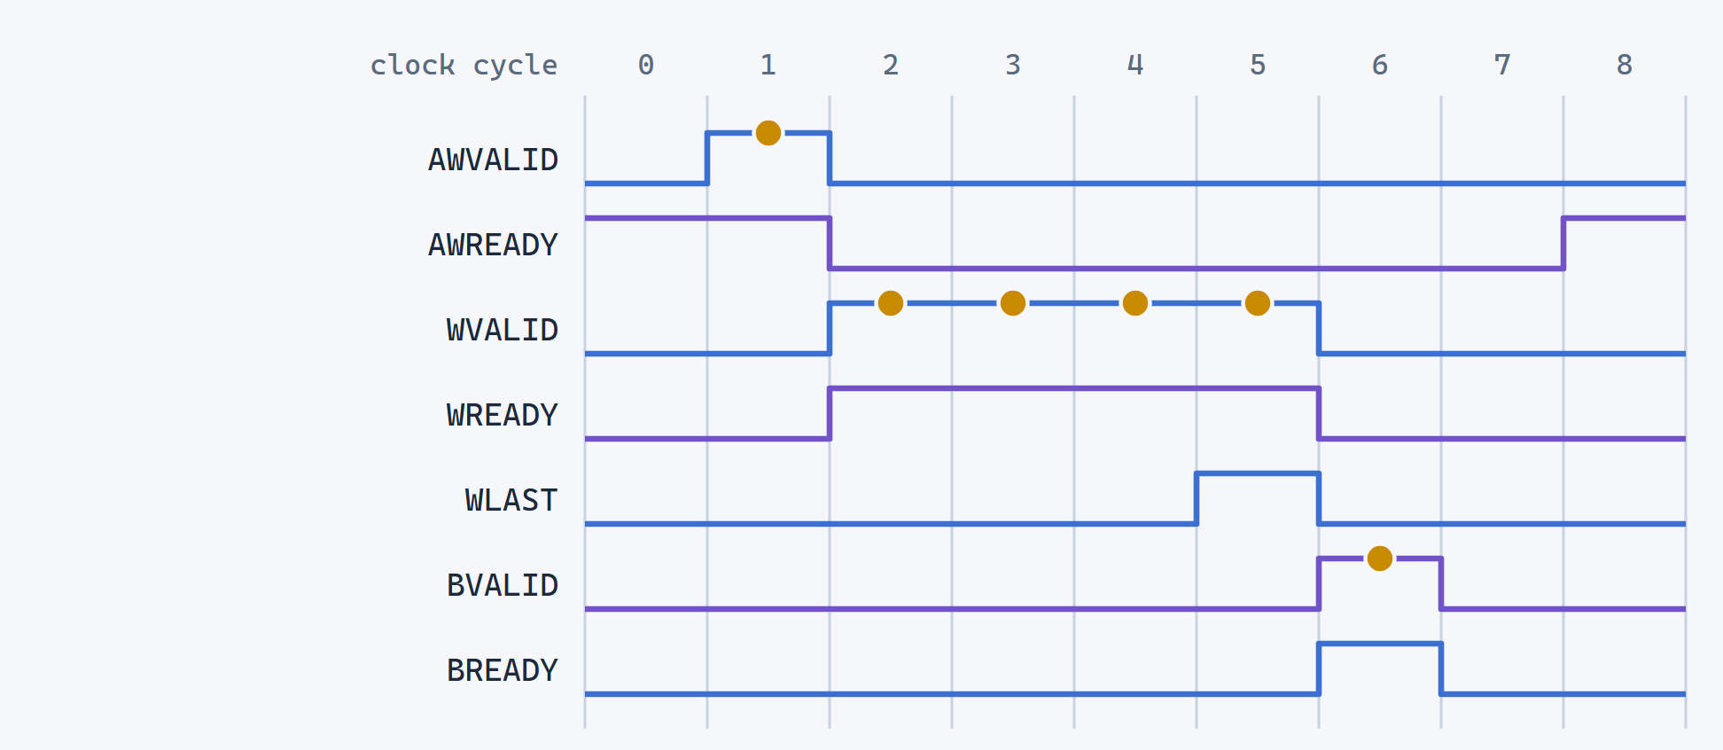
Write: four words, recorded from the simulation
Amber dots
are handshakes.
Address
taken at 1: the slave was already ready.
Data beats
taken at 2, 3, 4, 5: one every clock.
Response
taken at 6, right after WLAST.
AXI4: input D flip-flops, a master, a slave and output D flip-flops, in Verilog
11
Notes:
This waveform was recorded from our simulation. Amber dots are handshakes. The master raises AWVALID at cycle 1 and AWREADY is already high, so the address is taken at once. The four data beats are taken at cycles 2, 3, 4 and 5: WREADY stays high, so one beat moves every clock. WLAST is high on the fourth. BVALID comes at cycle 6 and BREADY is already high, so the response is taken immediately.

Slide 12
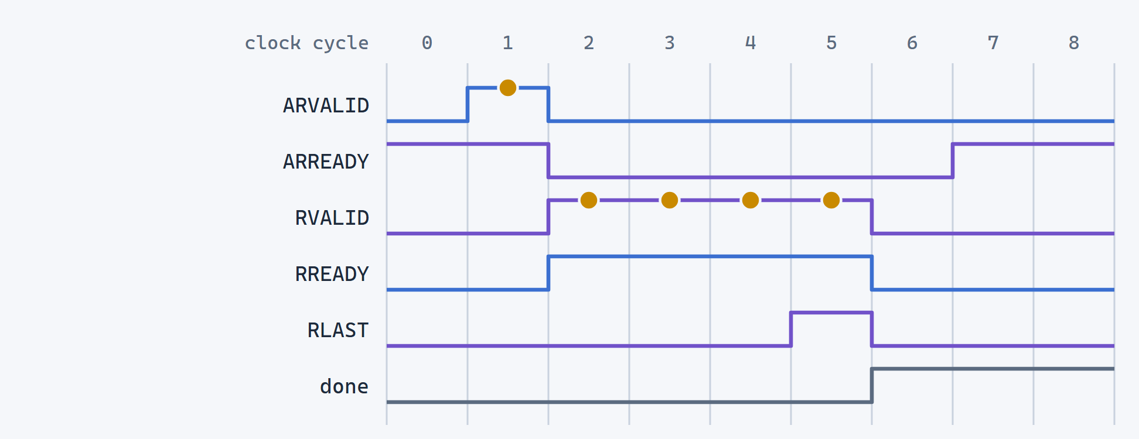
Read: the same four words, from the simulation
Address
taken at 1: the slave was already ready.
Data beats
taken at 2, 3, 4, 5: one every clock.
RLAST
rides on the fourth beat, at cycle 5.
done
goes high at 6. The sequence took 13 cycles.
AXI4: input D flip-flops, a master, a slave and output D flip-flops, in Verilog
12
Notes:
Same four words read back. The read address is taken at cycle 1 of this window, which is cycle 7 of the whole run. The four beats come back at cycles 2, 3, 4 and 5 of the window, one every clock, with RLAST on the fourth. Then done goes high at cycle 6. Each beat is stored in the output D flip-flops as it arrives, and pass says they equal what was written.

Slide 13
How it was verified
Slave on its own
Whole system
tb_axi4_slave.v
tb_axi4_top.v
The testbench plays the master. 33 checks: single and multi-beat bursts, data first or address first, held-off responses, byte strobes, ID echo, 256 beats, reset mid-burst.
Input DFFs, master, slave, output DFFs. 43 checks: idle until start, words in memory and in the output DFFs, pass, OKAY responses, VALID holds, a second run with other values, reset mid-sequence.
Total: 33 + 43 = 76 checks, 0 failing. Run it: .\run_tests.ps1
AXI4: input D flip-flops, a master, a slave and output D flip-flops, in Verilog
13
Notes:
We test two things. First the slave on its own: the testbench plays the master and drives each channel by hand, so it can force awkward cases such as data before address, held-off responses, byte strobes, the longest burst of 256 beats, and a reset in the middle of a burst. Second the whole system: the testbench loads the input flip-flops, raises start, and checks that the master finishes, that pass is set, that the output flip-flops and the slave's memory hold the four words, that every response is OKAY with the right ID, and that VALID and the payload hold steady until READY. It also runs a second set of values at another address, and resets mid-sequence.

Slide 14
Limits, stated plainly
Fixed burst shape
Load, then start
The master always writes and reads four words, with all four bytes enabled.
The input DFFs must not change while a sequence runs. The master reads them live.
Counting-up bursts only
Always OKAY
No FIXED or WRAP bursts and no narrow beats. The address adds 4 per beat.
No error responses. An address beyond the 4 KiB wraps inside the memory.
One burst at a time
No attribute signals
One write or one read in progress. IDs are echoed, never used to reorder.
AxLOCK, AxCACHE, AxPROT and AxQOS are not included.
AXI4: input D flip-flops, a master, a slave and output D flip-flops, in Verilog
14
Notes:
Say these before you are asked. The burst shape is fixed: the master always writes and reads four words with all bytes enabled. The input flip-flops must not change while a sequence runs, because the master reads them live. Only counting-up bursts, so no FIXED or WRAP and no narrow beats. Every response is OKAY and an out-of-range address wraps. One burst at a time. And the lock, cache, protection and QoS signals are not included.

Slide 15
Live demo
What to point at
cd E:\FPGA_Project
.\run_tests.ps1
.\run_tests.ps1 -Suite top -Wave
Two suites, each ending TEST PASSED
Check counts: 33 and 43
"the whole sequence took 13 clock cycles"
If the live run fails
Slides 11 and 12 are recorded from this same simulation. Logs and waveforms are written to the build folder.
AXI4: input D flip-flops, a master, a slave and output D flip-flops, in Verilog
15
Notes:
Live demo, about two minutes. Open PowerShell in E:\FPGA_Project and run .\run_tests.ps1. It compiles and runs two suites. Point at the two TEST PASSED lines and the check counts, 33 and 43, and the line that says the whole sequence took 13 clock cycles. Then run the top suite with -Wave to open the waveform in GTKWave and show the same shape as the recorded slides: the handshakes, with WREADY high so a beat moves every clock. If the live run fails for any reason, slides 11 and 12 are recorded from this exact simulation.

Slide 16
Questions we expect
Why five channels?
Is there an interconnect?
Address, data and response move independently, so a slow response never blocks the next address.
No. One master and one slave are wired directly. An interconnect is for more of either.
Where does the data come from?
Where does the read data go?
From the input D flip-flops, loaded by the testbench. The master reads them and writes to the slave.
Into the output D flip-flops, one register per beat. pass compares them with the input.
How do we know it worked?
How does the slave know the end?
pass compares read-back with what was written. The testbench also checks the slave's memory.
On writes, from WLAST. On reads, by counting ARLEN + 1 beats.
AXI4: input D flip-flops, a master, a slave and output D flip-flops, in Verilog
16
Notes:
Likely questions with short answers. Why five channels: address, data and response move independently. Is there an interconnect: no, one master and one slave are wired directly. Where does the data come from: the input D flip-flops, loaded by the testbench. Where does the read data go: the output D flip-flops, one register per beat. How do we know it worked: the master's pass compares them, and the testbench checks the slave's memory. How does the slave know the burst ended: WLAST on writes, a beat count on reads.

