Slide 1


Safety-Enhanced UAV Path Planning Using Spherical Vector-Based Particle Swarm Optimization

Slide 2
Safety-Enhanced UAV Path Planning Using SPSO
Application domain
Real-World Motivation
Autonomous UAV navigation
Urban and complex environments
UAVs are widely used in logistics, surveillance, and rescue
Safe navigation is critical in environments with obstacles and terrain variations
Why Uncertainty Exists
Imperfect terrain and obstacle information
Environmental disturbances affecting UAV motion
Safety margins must account for unknown risks
01/07/19
| 2

Slide 3
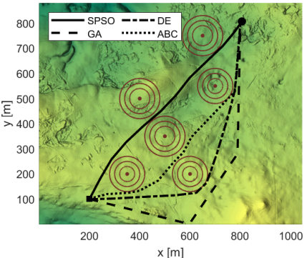
Path Planning Performance Comparison in Complex Terrain

Slide 4
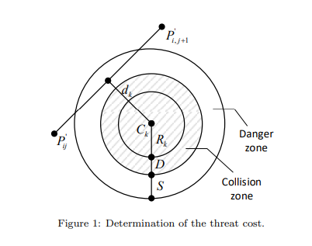
Project Objective and Scope.
Objective
Scope
To compute a safe, feasible, and optimal UAV flight path
Optimization considers:
Path length
Obstacle avoidance
Smoothness of motion
Altitude and turning constraints
Offline path planning
Static obstacles and terrain
UAV motion constraints explicitly considered
01/07/19
| 3

Slide 5
Project System Overview
End-to-End Pipeline
Input environment data (terrain, threats)
Encode UAV path using waypoints
Evaluate path cost using multiple criteria
Optimize path using SPSO
Output optimal UAV trajectory
Key insight
Path planning is treated as a decision-making problem.

Slide 6
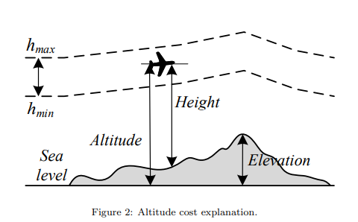
Sources of Uncertainty in the Project
Environmental Uncertainty
Modeling Uncertainty
Simplified UAV dynamics
Deterministic safety margins
Terrain elevation approximation
Obstacle influence regions
Measurement Uncertainty
GPS position error
Altitude estimation error
01/07/19
| 2

Slide 7
Key Random Variables and Their Roles
Key Random Variables
dₖ: Distance from UAV path to obstacle k
θ, ϕ: Turning and climbing angles
C(P): Combined measure of distance, safety, and smoothness
Xᵢ: Candidate UAV path in the swarm.
F(Xᵢ): Evaluated cost of a candidate path
Role in the System
These variables determine safety, feasibility, and efficiency of a path

Slide 8
Probabilistic Models and Assumptions
Modeling Approach
Key Assumptions
Obstacles are static
Safety distances absorb uncertainty
Paths violating constraints are rejected
Deterministic optimization used as a proxy for probabilistic safety
Safety margins act as implicit uncertainty buffers
01/07/19
| 3

Slide 9
Probabilistic Reasoning and Inference Logic
Reasoning Flow
Generate multiple candidate paths
Evaluate each path under safety and motion constraints
Assign higher cost to risky paths
Prefer paths with lower expected risk
Interpretation
The algorithm implicitly reasons under uncertainty by penalizing unsafe outcomes

Slide 10
Operationalizing the Reasoning
How It Is Implemented
Population-based search (PSO)
Multiple iterations and particles
Statistical evaluation using:
Mean cost
Standard deviation
Repeated runs
Decision Rule
Path with minimum average cost is selected

Slide 11
Current Limitations and Conceptual Gaps
Known Limitations
No explicit probability distributions
Static environment assumption
Wind and dynamic obstacles ignored
Conceptual Gaps
Uncertainty is indirectly handled
No Bayesian or stochastic modeling

Slide 12
Planned Refinements and Role Coordination
Future Extensions
Incorporating dynamic environments
Probabilistic obstacle modeling
Multi-objective optimization
Team Coordination
Model refinement
Validation and evaluation

Slide 13
Summary of Group-Level Understanding
Key Takeaways
UAV path planning is a safety-critical decision problem
SPSO provides a feasible and robust optimization framework
Deterministic constraints serve as risk-control mechanisms
Final Insight
Deterministic optimization can effectively approximate uncertainty-aware decision-making in UAV navigation.

