Slide 1

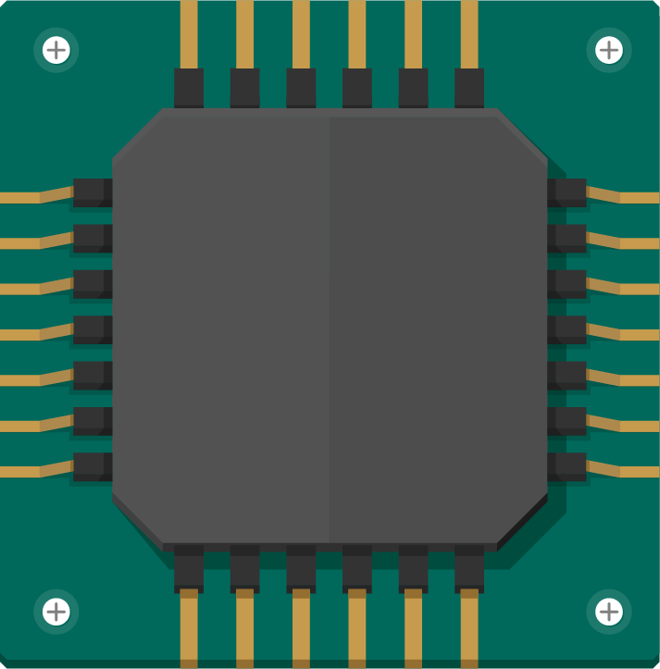
GPU Accelerated Multidirectional Sobel Edge Detection using CUDA
Presented By: Moksha Kothari, 210905017

Slide 2
Introduction
Edge detection is used to identify the margins in an image
Edges are detected by a sharp change in intensity
Several algorithms have been developed, such as: Roberts Cross Edge Detector, Prewitt Edge Detector, Sobel Edge Detector, etc
Sobel algorithm is simple and elegant
Traditionally, it uses two 3x3 kernels to detect gradient values in the horizontal and vertical directions
This may not be sufficient to detect diagonal edges
Introducing the multidirectional Sobel algorithm addresses these limitations

Slide 3
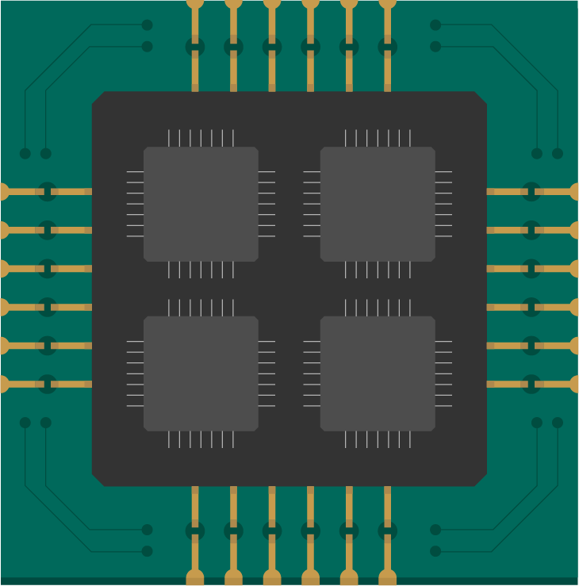
Literature Review

Slide 4
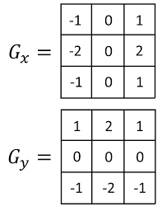
A Descriptive Algorithm for Sobel Image Edge Detection
Edge detection algorithms can be classified into:
Gradient method: Detects edges by looking for maximum first derivative of image
Laplacian method: Searches for zero crossing in second derivative of image
Sobel algorithm is an example of the gradient method
It involves applying masks to the input image to calculate gradient values, combining the gradients and applying a threshold to obtain output
It cannot detect diagonal edges effectively
It is also sensitive to noise
Notes:
(Research paper 1)

Slide 5
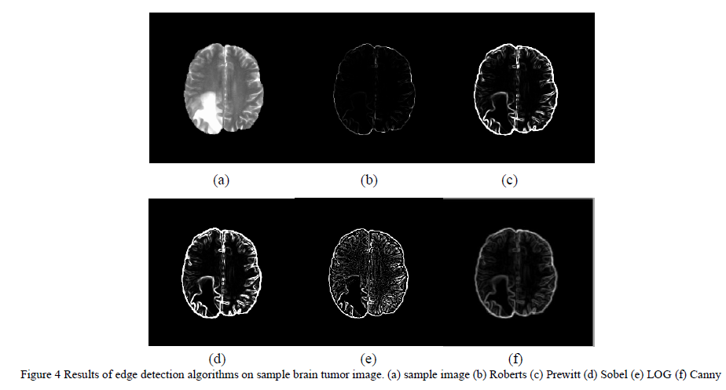
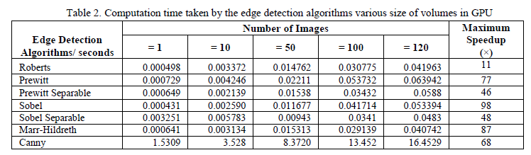
Parallel Processing Edge Detection Methods for MR Imagery Volumes using CUDA Enabled GPU Machine
Sobel algorithm outperforms other algorithms when executed parallelly on GPUs
The parallel implementation is 98 times faster than the sequential implementation
Notes:
(Research paper 2)

Slide 6
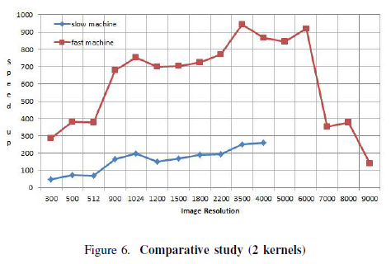
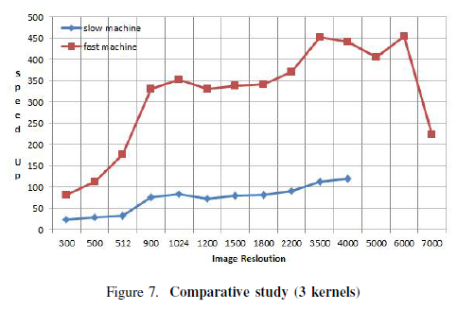
Parallel Edge Detection By Sobel Algorithm Using CUDA C
The program can be split into three major parts
Fetching the red, green and blue components of the image
Conversion of the RGB image to grayscale
Applying Sobel’s mask and calculating gradient
Using three kernels, one for each task, leads to less speedup compared to using two kernels to parallelize (b) and (c)
Speedup also increases only up to a certain image resolution
Communication time between CPU and GPU increases
Notes:
(Research paper 3)

Slide 7
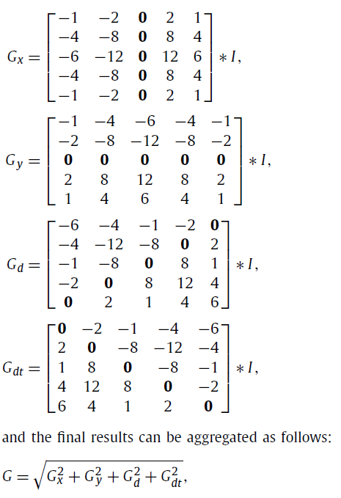
Multi-directional Sobel operator kernel on GPUs
To overcome the limitations of the traditional Sobel algorithm, a four directional Sobel operator has been developed
It uses four 5x5 kernels to calculate the gradient at 0º, 45º, 90º and 135º
It detects diagonal edges more effectively
The larger kernels and added directions make it less sensitive to noise
Notes:
(Research paper 4)

Slide 8
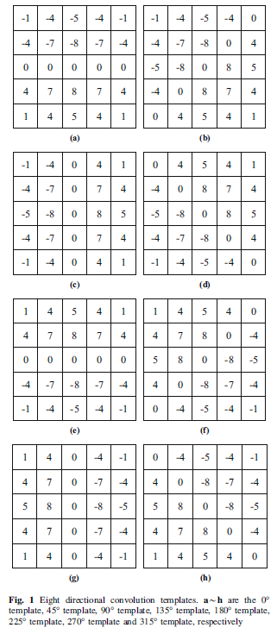
Sobel operator enhancement based on eight-directional convolution and entropy
This idea can be extended further to include 180º, 225º, 270º and 315º as well
However, this uses eight 5x5 kernels, making it very computationally intensive
It also involves calculation of entropy of the image
Entropy is the average amount of information held by a pixel
Notes:
(Research Paper 5)

Slide 9
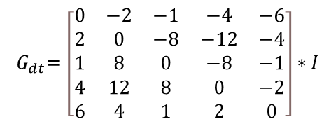
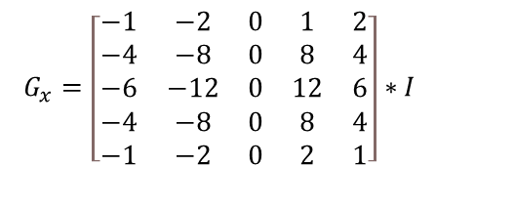
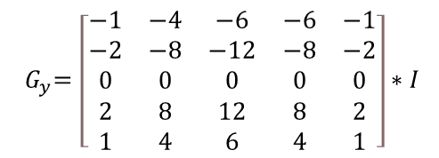
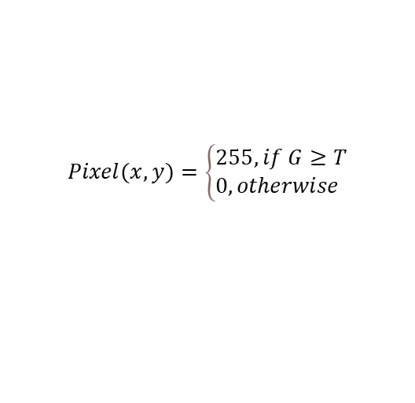

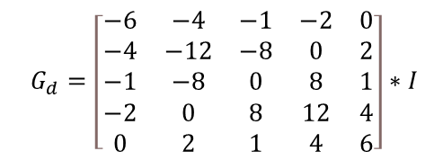
Methodology
$$G_{x}=\left[\begin{matrix}−1 & −2 & 0 & 1 & 2 \\ −4 & −8 & 0 & 8 & 4 \\ −6 & −12 & 0 & 12 & 6 \\ −4 & −8 & 0 & 8 & 4 \\ −1 & −2 & 0 & 2 & 1\end{matrix}\right]∗I$$
$${ G}_{y}=\left[\begin{matrix}−1 & −4 & −6 & −6 & −1 \\ −2 & −8 & −12 & −8 & −2 \\ 0 & 0 & 0 & 0 & 0 \\ 2 & 8 & 12 & 8 & 2 \\ 1 & 4 & 6 & 4 & 1\end{matrix}\right]∗I$$
$$G_{d}=\left[\begin{matrix}−6 & −4 & −1 & −2 & 0 \\ −4 & −12 & −8 & 0 & 2 \\ −1 & −8 & 0 & 8 & 1 \\ −2 & 0 & 8 & 12 & 4 \\ 0 & 2 & 1 & 4 & 6\end{matrix}\right]∗I$$
$${ G}_{dt}=\left[\begin{matrix}0 & −2 & −1 & −4 & −6 \\ 2 & 0 & −8 & −12 & −4 \\ 1 & 8 & 0 & −8 & −1 \\ 4 & 12 & 8 & 0 & −2 \\ 6 & 4 & 1 & 2 & 0\end{matrix}\right]∗I$$
$$G=\sqrt{{G_{x}}^{2}+ {G_{y}}^{2}+ {G_{d}}^{2}+ {G_{dt}}^{2}}$$
$$Pixel(x,y)=\left\{\begin{aligned}&255, if G≥T \\ &0, otherwise\end{aligned}\right.$$
Notes:
Multidirectional version
Perform convolution, combine to obtain gradient, apply threshold

Slide 10
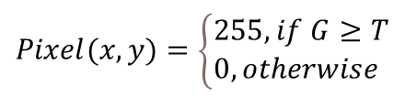
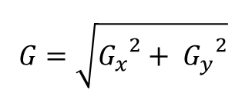
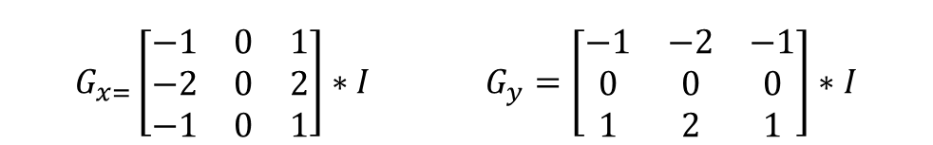
Methodology
$G_{x=}\left[\begin{matrix}−1 & 0 & 1 \\ −2 & 0 & 2 \\ −1 & 0 & 1\end{matrix}\right]∗I$ $G_{y}=\left[\begin{matrix}−1 & −2 & −1 \\ 0 & 0 & 0 \\ 1 & 2 & 1\end{matrix}\right]∗I$
$G=\sqrt{{G_{x}}^{2}+ {G_{y}}^{2}}$
$$Pixel(x,y)=\left\{\begin{aligned}&255, if G≥T \\ &0, otherwise\end{aligned}\right.$$
Notes:
Two dimensional version

Slide 11
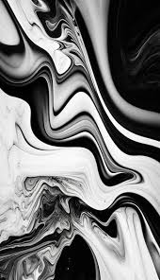
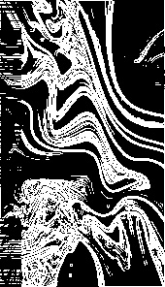
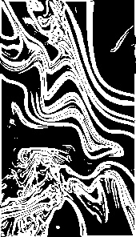
Results
Notes:
First column: Actual image, Second column: two directional algorithm results, Third column: multidirectional algorithm results
Differences: diagonal edges, clarity, noise

Slide 12
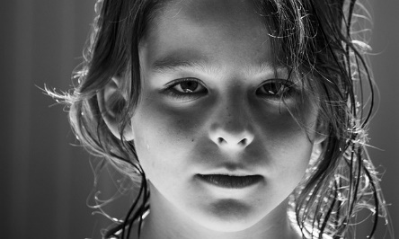
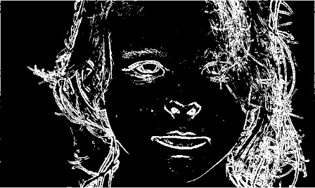
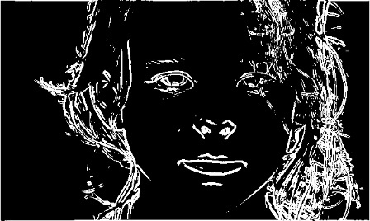
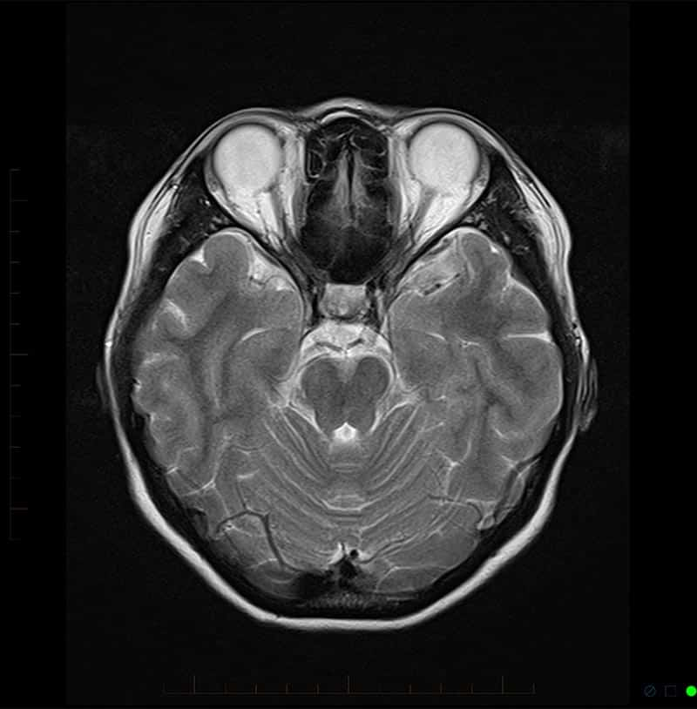
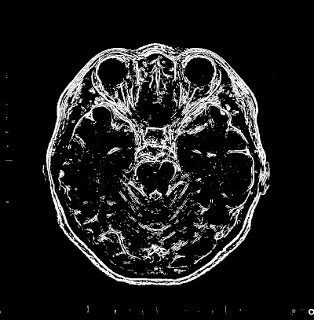
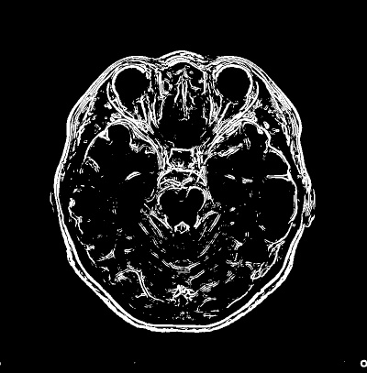
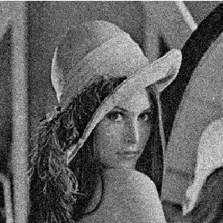
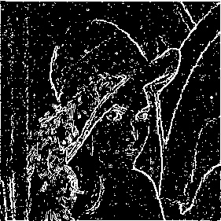
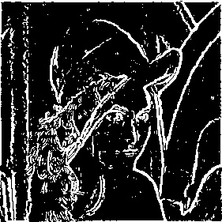
Notes:
-Large difference in threshold values of two implementations due to larger kernels with larger numbers in the mask, results of convolution squared and added up

Slide 13
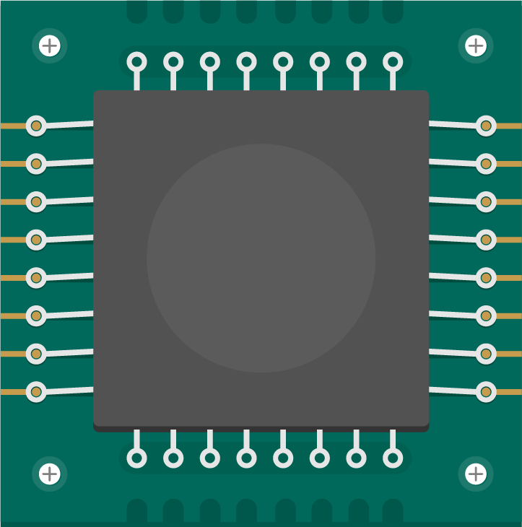
Conclusion & Future Enhancements
The multidirectional algorithm is less sensitive to noise
Detects diagonal edges more precisely
Larger kernels
Computationally slower
It is useful in scenarios where accuracy more important
Machine learning techniques can be integrated for optimal threshold values
Deep learning based denoising models would enhance adaptability

Slide 14
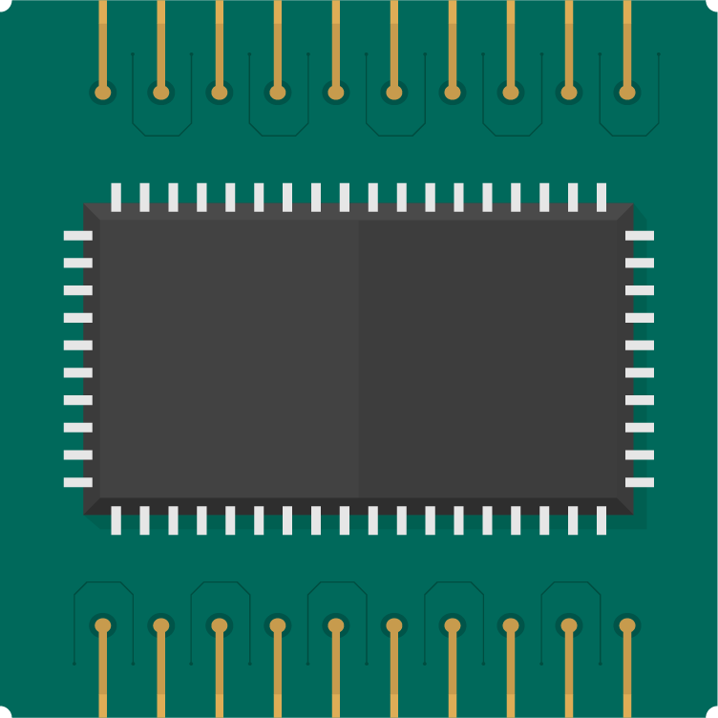
Thanks!

