Slide 1
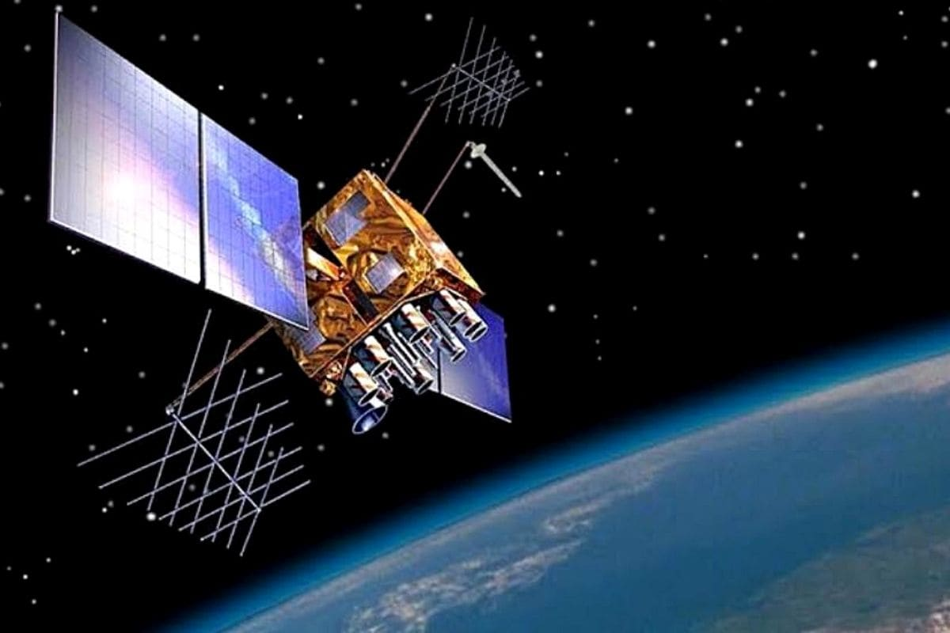
“IRNS”
INDIAN
RAILWAYS
REIGONAL
NAVIGATION
SATELLITE
SYSTEM
BY
MOKSHATA JADHAV

Slide 2

Indian Regional Navigation Satellite System (IRNSS) : NAVIC
IRNSS is an independent regional navigation satellite system being developed by India.
It is designed to provide accurate position information service to users in India.
It is a satellite navigation system, like GPS, that provides positioning and timing services with very high accuracy in real-time.
Indian Railways has joined hands with the Indian Space Research organization(ISRO) to ensure real-time tracking and maintain punctuality of trains.

Slide 3
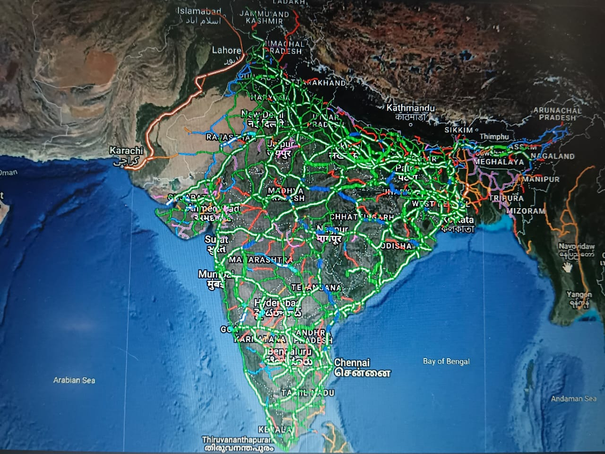
View of Indian railways route from satellite
The Centre for Railway Information System (CRIS), the information technology arm of the Ministry of Railways has collaborated with ISRO to implement Real-time Train Information System (RTIS) project in trains.
Indian Railways has installed a GPS aided geo-augmented navigation system based devices on locomotives to acquire train movement data.

Slide 4
Conclusion
Railways are able to track time data of train arrival and run-through from the station.
This technology will especially come handy at the time of major rail accidents.
The satellite will help to point out the exact location of the trains.

Slide 5


