Slide 1
Ict Ganpat university
BANKING MANAGEMENT SYSTEM.

Slide 2
HEY GUYS, WELL THIS IS MOKSHAYAGYNA OF ICT GANPAT UNIVERSITY OF SEMESTER 01 BRANCH CS ENROLLMENT NUMBER: CS 16 AND TODAY I AM HERE TO SHOW YOU MY PRESENTATION AND PROJECT WORK ON A VERY COMMON BUT IMPORTANT TOPIC OF BANKING MANAGEMENT SYSTEM.

Slide 3
IN THIS PROJECT :
The Bank Management System (BMS) is a web-based application used for paying financial institutions for the services they provide to the Bureau of the Fiscal Service. BMS also provides analytical tools to review, and approve compensation, budgets, and outflows.
Bank management governs various concerns associated with bank in order to maximize profits. The concerns broadly include liquidity management, asset management, liability management and capital management.
The origin of bank or banking activities can be traced to the Roman empire during the Babylonian period. It was being practiced on a very small scale as compared to modern day banking and frame work was not systematic.

Slide 4
CONCEPTS USED IN THIS PROJECT:
I MADE THIS PROJECT BY USING THE CONCEPTS OF C LANGUAGE INCLUDING:
POINTERS,
ARRAY,
LOOP,
FUNCTIONS,
STRUCTURE & UNION,
FILE HANDLING WITH ANIMATION

Slide 5
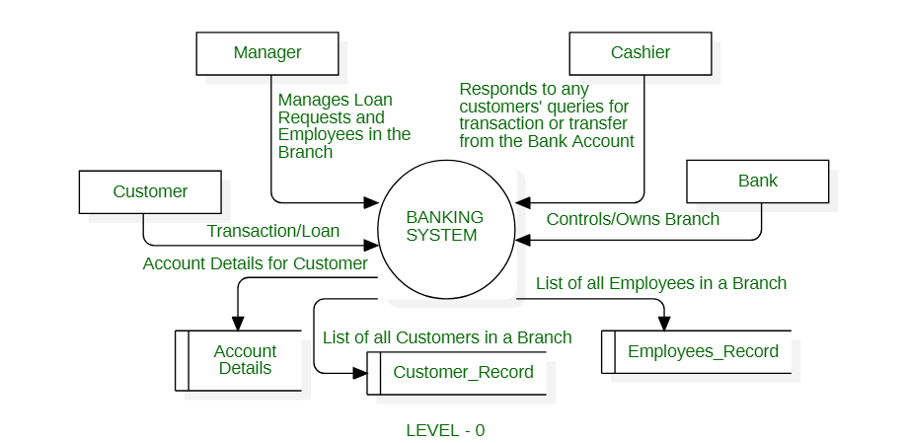
FLOWCHART OF BANKING MANAGEMENT SYSTEM

Slide 6
BANKING MANAGEMENT SYSTEM
“In banking or finance, trust is the only thing you have to sell.”
― Patrick Dixon
“Banking is necessary, Banks are Not.”
― Bill Gates
“Banking is a branch of the information business.”
― Walter Wriston
“Business and life are like a bank account you can’t take out more than you put in.”

Slide 7
BANKING MANAGEMENT SYSTEM
INQUIRY FOR ADMISSION
CREATE NEW ACCOUNT
UPDATE INFORMATION
FOR TRANSACTIONS
CHECK THE DETAILS FOR EXISTING ACCOUNT
REMOVE EXISTING ACCOUNT
VIEW CUSTOMER’S LIST
EXIT

Slide 8
THANK YOU

