Slide 1
Introduction to AI
• AI refers to systems that mimic human intelligence
• Involves machines performing tasks requiring human-like thinking
• Combines computer science with large datasets
• Uses algorithms to recognize patterns and make decisions

Slide 2
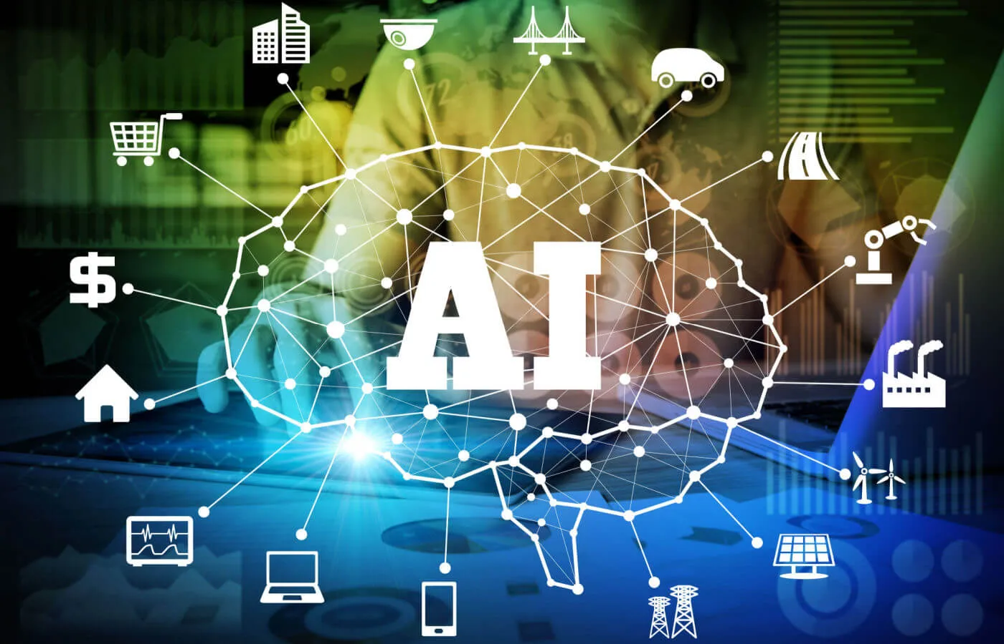
Understanding Artificial Intelligence
• Computer science field focused on replicating human cognitive abilities
• Utilizes machine learning, deep learning, and natural language understanding
• Enables machines to interpret data and make autonomous decisions
• Widely integrated across finance, healthcare, and transportation sectors

Slide 3
AI Challenges and Considerations
• Requires maintaining ethical standards in implementation
• Raises concerns about data privacy protection
• Demands focus on fairness in AI systems
• Necessitates accountability in development and deployment

Slide 4
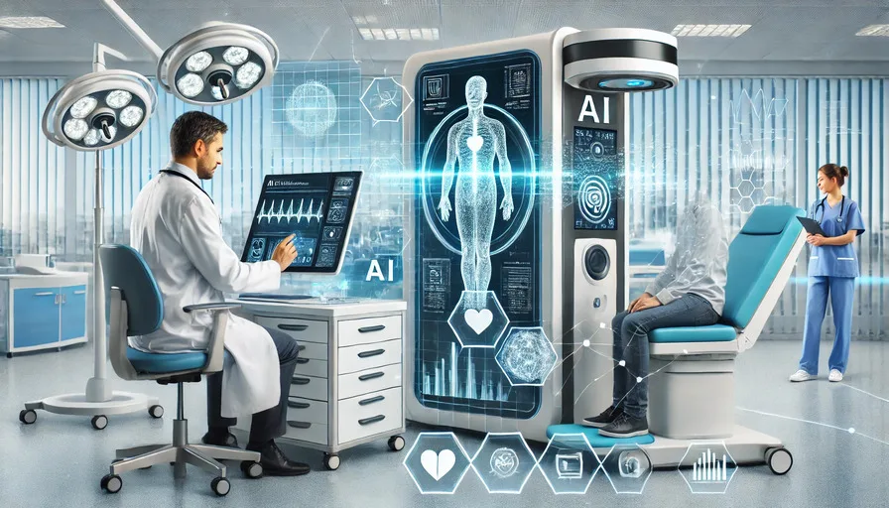
AI in Healthcare: Overview and Applications
• Advanced algorithms analyze medical data to detect patterns and anomalies
• Enables early diagnosis of cancer and cardiovascular conditions
• Supports healthcare professionals with decision-making insights
• Facilitates personalized medicine through tailored treatment plans

Slide 5
AI Medical Technologies
• Neural networks enhance medical imaging interpretation
• Robotic surgery improves procedural accuracy and safety
• Predictive analytics anticipate patient needs
• Efficient resource allocation in emergency care and chronic disease management

Slide 6
Implementation Challenges
• Data privacy concerns require careful consideration
• Need for comprehensive regulatory frameworks
• Requires human oversight for responsible AI interpretation
• Integration challenges with existing healthcare systems

Slide 7
AI's Impact on Education
• Enables personalized learning through adaptive platforms
• Provides real-time feedback via intelligent tutoring systems
• Automates grading and administrative tasks
• Identifies at-risk students through data analysis
• Enhances accessibility with translation and speech recognition tools

Slide 8
Benefits of AI in Educational Support
• Adapts to individual learning styles and paces
• Supports students outside classroom hours
• Increases teacher focus on student engagement
• Promotes inclusive learning for diverse populations
• Creates opportunities for lifelong learning

Slide 9
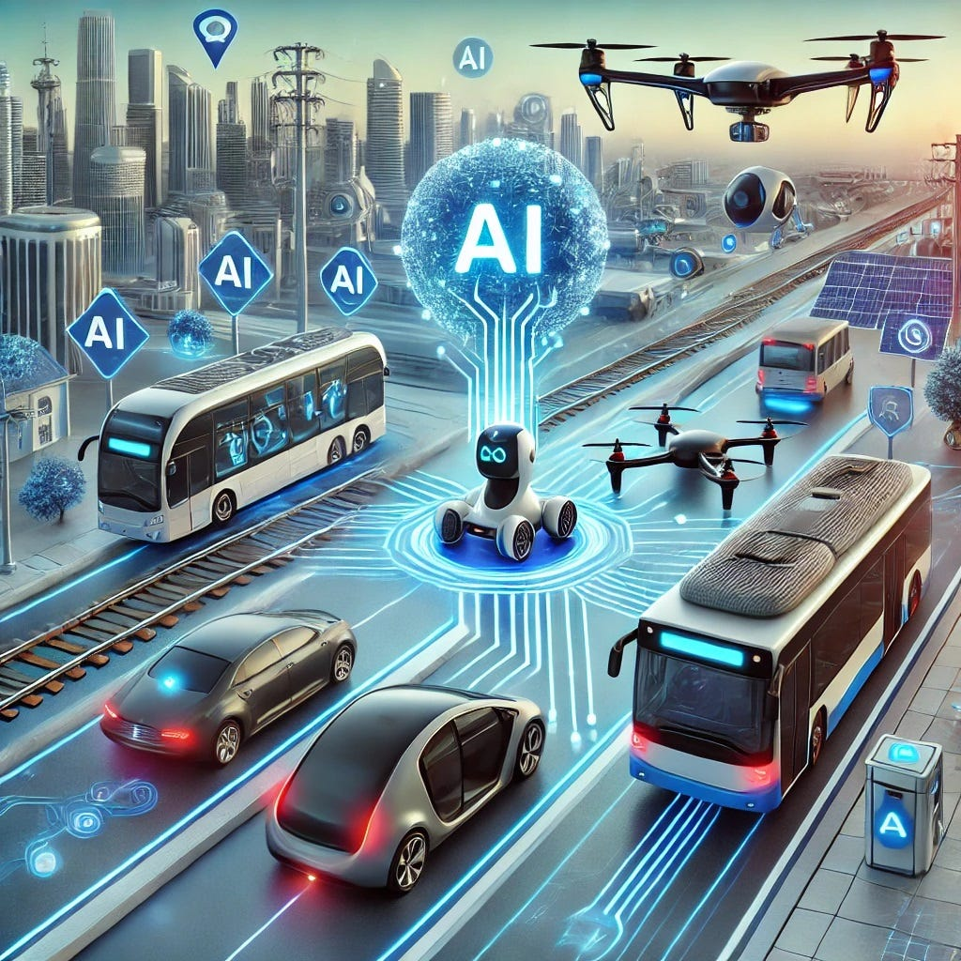
AI in Transportation: Overview
• Enables enhanced safety, efficiency, and sustainability in mobility
• Analyzes real-time data from traffic patterns and weather conditions
• Powers autonomous vehicles to minimize human error
• Optimizes routes and reduces traffic congestion

Slide 10
AI Applications in Transit & Logistics
• Assists in public transit scheduling and demand forecasting
• Enables responsive route planning for commuter needs
• Streamlines deliveries through predictive analytics
• Reduces operational costs in supply chain management

Slide 11
Smart City Integration & Challenges
• Supports growing urban population mobility needs
• Prioritizes environmental sustainability
• Reduces carbon emissions
• Faces regulatory hurdles and cybersecurity concerns
• Requires building public trust for widespread adoption

Slide 12
AI Applications in Finance
• Automates repetitive financial tasks and calculations
• Enables real-time fraud detection and risk assessment
• Provides personalized investment recommendations
• Enhances customer service through chatbots and virtual assistants
• Improves accuracy in market predictions and trading decisions

Slide 13
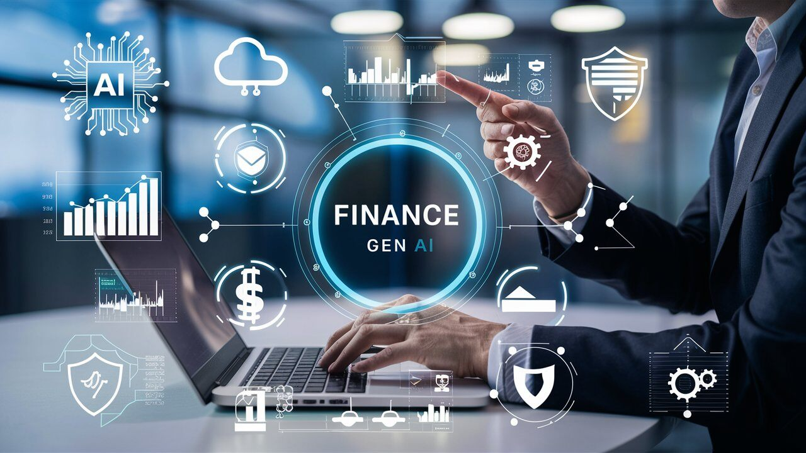
AI in Finance: Core Applications
• Advanced analytics and automation improve financial decision-making
• Machine learning processes real-time data for market predictions
• Enhanced fraud detection through pattern recognition
• Personalized banking via intelligent chatbots and recommendation systems

Slide 14
AI Financial Innovation Benefits
• Algorithmic trading executes rapid market transactions
• Reduced operational costs across financial institutions
• Improved efficiency in financial operations
• Enhanced market competitiveness

Slide 15
AI Implementation Challenges
• Ethical concerns require careful consideration
• Data privacy issues need robust protection
• Algorithmic bias must be monitored and addressed
• Responsible integration essential for equitable benefits

