Slide 1
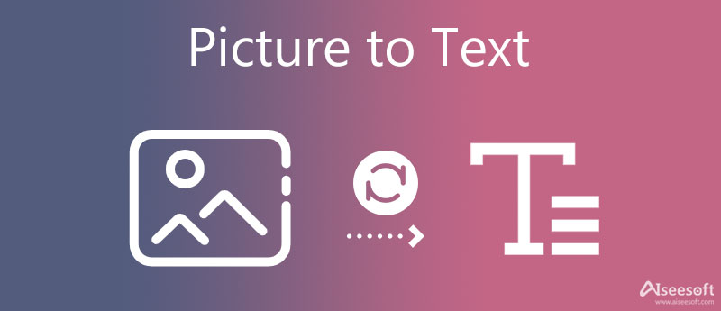
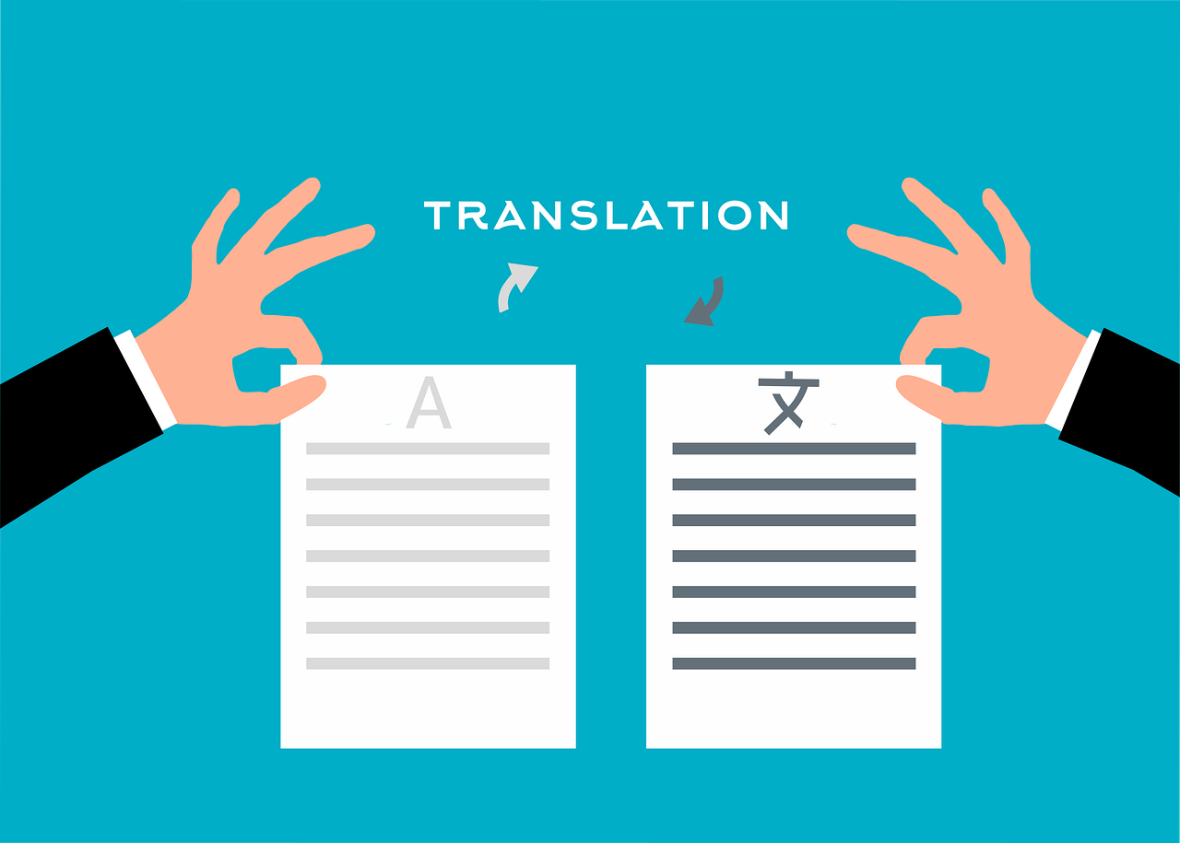
Image To Text With Language Translation
Mokshika Pandey

Slide 2
ABSTRACT
This project explores the development of an innovative system that combines Optical Character Recognition (OCR) with language translation to facilitate the automatic conversion of text from images into multiple languages. Leveraging advanced machine learning algorithms and neural network architectures, this system aims to accurately recognize and translate textual content captured in various image formats, enhancing accessibility and usability across diverse applications. By integrating cutting-edge OCR technologies and sophisticated translation APIs, the system provides a robust solution for real-time text extraction and translation, addressing the needs of global communication and information dissemination. This initiative not only improves the efficiency of processing visual data but also bridges language barriers, making it especially valuable in multilingual contexts such as international travel, global business, and digital content management. The proposed system is designed to be scalable and adaptable, offering potential for expansion and refinement to meet evolving technological and user requirements.

Slide 3
INTRODUCTION
In the digital age, the ability to extract and comprehend text from images is crucial for various applications, ranging from document digitization to accessibility features in mobile applications. Optical Character Recognition (OCR) technology has significantly advanced in this domain, allowing for the extraction of text from images with high accuracy. However, as globalization increases, the need for these texts to be understandable across different linguistic groups becomes apparent. Language translation technologies step in to bridge this gap, converting the extracted text into multiple languages.

Slide 4
Continued..
The convergence of these technologies allows us to not only access textual content from images but also make it accessible to a non-native audience by translating it into their languages. This project will explore the technical implementation of combining these technologies and demonstrate their application through a practical example. We aim to show the effectiveness of this integration in creating a versatile tool that can support global communication and information dissemination in our increasingly interconnected world.
This project introduces a system that integrates OCR and language translation, specifically using EasyOCR for text extraction and Translate Python Library for converting the recognized text into various languages. EasyOCR is a robust tool that supports multiple languages and can handle images under different conditions. The “Translate” python library is used for ML tasks, allowing us to translate texts from one language to another. It provides a simple interface for translating text and supports multiple languages.

Slide 5
Methodology
The methodology for integrating Optical Character Recognition (OCR) with language translation comprises several systematic steps:
1. Image Acquisition:
The process begins with acquiring images containing text. These images can be sourced from documents, signage, user interfaces, or real-world scenarios.
2. Text Detection and Extraction:
Using EasyOCR, the images undergo processing to detect and extract text. EasyOCR, which leverages deep learning models, is adept at recognizing text across diverse fonts and backgrounds. It outputs the text along with its coordinates within the image.

Slide 6
Continued..
3. Text Translation:
The extracted text is then translated into the desired language using the Translate Python library. This library interfaces with multiple translation engines and provides a straightforward API for converting text from one language to another, supporting a broad range of languages.
4. Post-processing:
After translation, the text may require post-processing to correct any grammatical or contextual errors. This step refines the output, ensuring that the translated text is both accurate and contextually appropriate.

Slide 7
Continued..
5. Integration and Output:
The final step involves integrating the translated text back into the original context or presenting it in a format that is useful for the end-user, such as a translated document, a subtitled image, or a database entry for further analysis.
This methodology leverages the strengths of both OCR and automated translation to provide a seamless translation of text directly from images, enhancing accessibility and comprehension across language barriers.

Slide 8
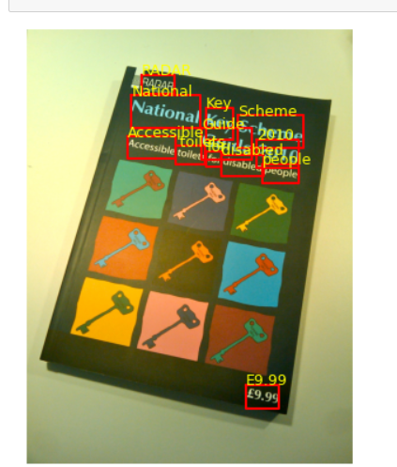
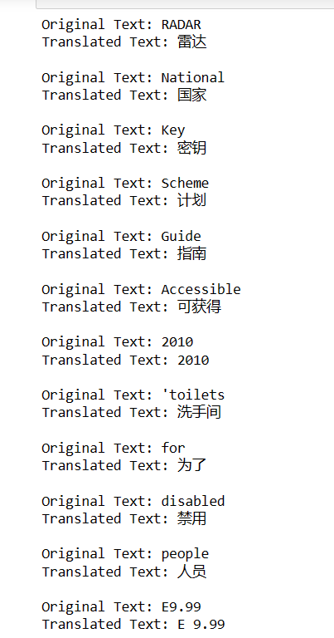
Results

Slide 9
Conclusion
In conclusion, the integration of image-to-text conversion with language translation technologies presents a powerful tool for enhancing accessibility and communication across language barriers. By employing optical character recognition (OCR) technologies, such as EasyOCR, to extract text from images, and then using language translation libraries like the Python `translate` library, we can automate the translation of textual content from images into multiple languages. This technology has broad applications, from aiding cross-lingual communications to enhancing the accessibility of information across different regions. As these tools continue to improve in accuracy and functionality, their potential to foster international collaboration and understanding expands, marking a significant step forward in global digital communication.

