Slide 1
AI ASSIGNMENT-3
CS22B046 TANGUTURI MOKSHITH REDDY
CS22B059 SASAANK JANAPATI

Slide 2

1. Agent-1: 4-ply Minimax
Agent-2: 1-ply Minimax
Game Result: 1-0
Checkmate!
Reason for Agent-1 (4-ply Minimax) Winning
Deeper foresight – Sees 4 moves ahead vs. 1.
Better tactics – Detects traps and threats early.
Stronger defense – Avoids blunders Agent-2 can't see.
Checkmate planning – Can force mate; Agent-2 can't anticipate it.
Result: Agent-1 plays strategically and tactically better, leading to a checkmate win.

Slide 3
2. Agent-1: 1-ply Alphabeta
Agent-2: 4-ply Alphabeta
Game Result: 1/2-1/2
Fivefold repetition!
Reason for Draw (1-ply AlphaBeta vs 4-ply AlphaBeta)
Agent-2 (4-ply) was stronger but likely couldn’t find a forced win within 4 plies.
Agent-1 (1-ply) played safe or repetitive moves it considered best short-term.
The repeated safe responses caused both agents to repeat positions.
AlphaBeta’s pruning may have missed subtle win paths or preferred repetition to risk.
Result: Despite Agent-2 being deeper, both agents repeated the same board state five times → Draw by fivefold repetition.

Slide 4
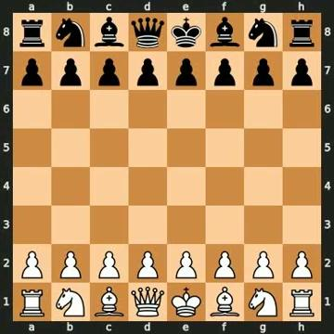
3. Agent-1: 4-ply Minimax
Agent-2: 4-ply Alphabeta
Game Result: 1/2-1/2
Fivefold repetition!
Reason for Draw (4-ply Minimax vs 4-ply AlphaBeta)
Both agents search 4 plies deep, so they’re equally strong tactically.
Neither agent found a clear path to victory within their search horizon.
The agents likely repeated balanced or "safe" positions to avoid risks.
Without deeper strategic planning, the game loops into repetition.
Result: Equal strength + no decisive tactics = draw by fivefold repetition.

Slide 5
Chess Evaluation Function (Material + Positional)
This evaluation function scores a given chess position based on:
Material Balance:
Assigns standard midgame values to each piece (e.g., pawn = 100, queen = 900).
Calculates the material difference between White and Black.
Piece-Square Tables:
Adds positional bonuses/penalties based on where each piece is located.
Encourages strategic placement (e.g., central knights, advanced pawns).
Uses mirrored tables for Black to evaluate from White’s perspective.
Game Termination Checks:
Returns large values for checkmate (win/loss) and 0 for draws/stalemate.
The final score is positive if the current player (to move) is better, and negative if worse. This allows it to be used directly in minimax or alpha-beta search.

Slide 6
Initial Evaluation Function (Material Only)
In the early stages, we used a basic evaluation function that scored positions purely based on material balance:
Assigned simple values to each piece (e.g., pawn = 1, queen = 9).
Counted the difference between White and Black's pieces.
Returned high values for checkmate, and 0 for draws.
This provided a fast, straightforward way to compare positions but lacked positional understanding (like center control or piece activity).

