Slide 1
AI ASSIGNMENT-3
CS22B046 TANGUTURI MOKSHITH REDDY
CS22B059 SASAANK JANAPATI

Slide 2

1. Agent-1: 4-ply Minimax
Agent-2: 1-ply Minimax
Game Result: 1-0
Checkmate!

Slide 3
2. Agent-1: 1-ply Alphabeta
Agent-2: 4-ply Alphabeta
Game Result: 1/2-1/2
Fivefold repetition!

Slide 4
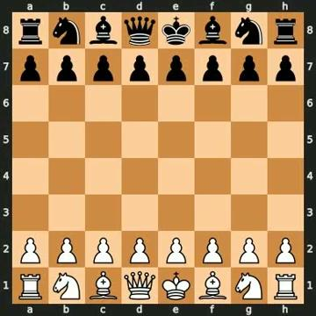
3. Agent-1: 4-ply Minimax
Agent-2: 4-ply Alphabeta
Game Result: 1/2-1/2
Fivefold repetition!

Slide 5
Chess Evaluation Function (Material + Positional)
This evaluation function scores a given chess position based on:
Material Balance:
Assigns standard midgame values to each piece (e.g., pawn = 100, queen = 900).
Calculates the material difference between White and Black.
Piece-Square Tables:
Adds positional bonuses/penalties based on where each piece is located.
Encourages strategic placement (e.g., central knights, advanced pawns).
Uses mirrored tables for Black to evaluate from White’s perspective.
Game Termination Checks:
Returns large values for checkmate (win/loss) and 0 for draws/stalemate.
The final score is positive if the current player (to move) is better, and negative if worse. This allows it to be used directly in minimax or alpha-beta search.

Slide 6
Initial Evaluation Function (Material Only)
In the early stages, we used a basic evaluation function that scored positions purely based on material balance:
Assigned simple values to each piece (e.g., pawn = 1, queen = 9).
Counted the difference between White and Black's pieces.
Returned high values for checkmate, and 0 for draws.
This provided a fast, straightforward way to compare positions but lacked positional understanding (like center control or piece activity).

