Slide 1
AI ASSIGNMENT-2
CS22B046 TANGUTURI MOKSHITH REDDY
CS22B059 SASAANK JANAPATI

Slide 2
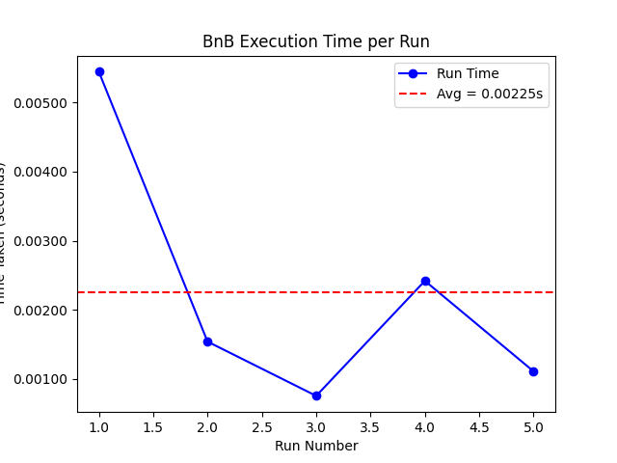
1. Depth First Branch and Bound (DFBnB) - Informed Search
Heuristic function - Manhattan Distance
Environment - Frozen Lake
Dimension of the Lake = 16x16; #Runs = 5;
Heuristic-based Branch and Bound (Informed BnB) improves performance over regular BnB by pruning large parts of the search space using heuristics like Manhattan distance. However, despite being faster and more efficient than uninformed BnB, it still takes more time than IDA* due to its exhaustive nature.
Frame count of the GIF for 16x16 exceeded the limit,so showing for 8x8 (all moves)

Slide 3
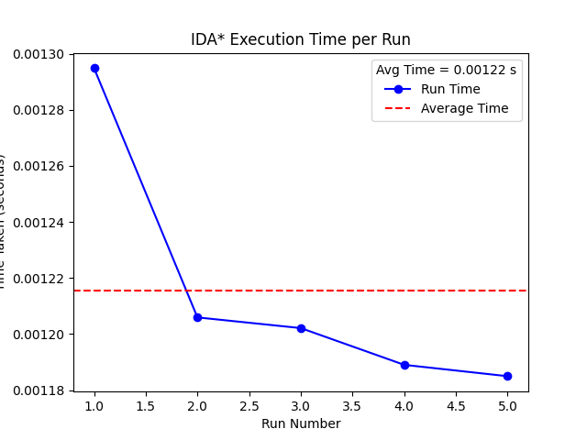
2. Iterative Deepening A* (IDA*) - Informed Search
Heuristic function - Manhattan Distance
Environment - Frozen Lake
Dimension of the Lake = 16x16; #Runs = 5;
Using Manhattan distance heuristic in IDA* drastically reduces execution time by effectively guiding the search towards the goal while preserving optimality. It enhances performance by minimizing node expansions, making it suitable for grid-based pathfinding problems.

Slide 4
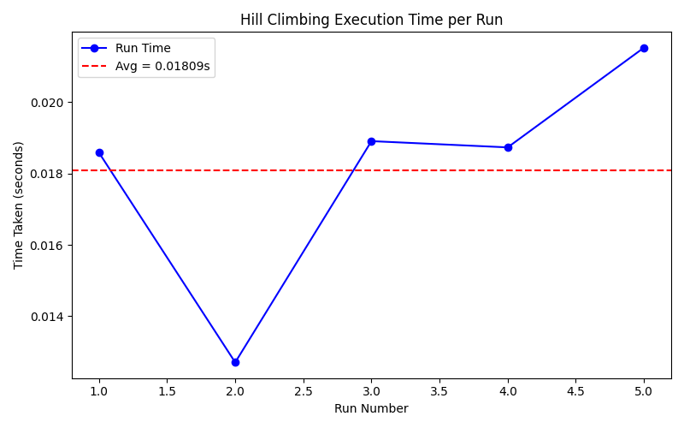
3. Hill Climbing - Steepest Ascent (Local Search)
Heuristic function - Total Euclidean Tour Distance
Environment - VRP-TSP Simulation (gym_vrp)
Dimension of the Graph: 10 nodes, #Runs = 5;
Neighborhood function: All possible 2-swap permutations;
Termination: Time-based (default = 5 seconds per run) or on hitting a local minima

Slide 5
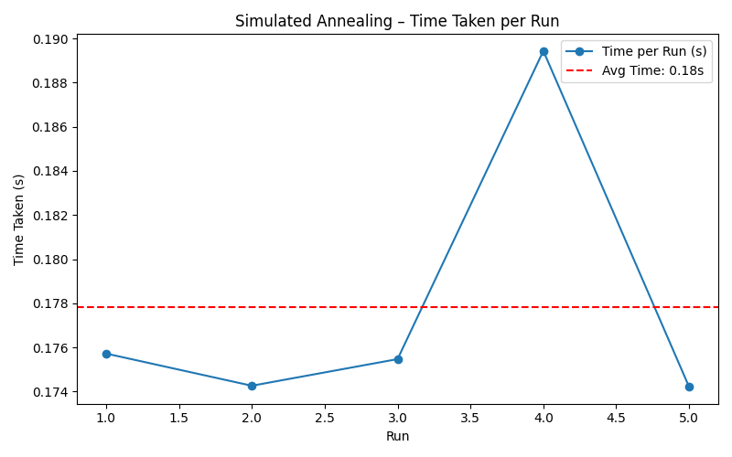
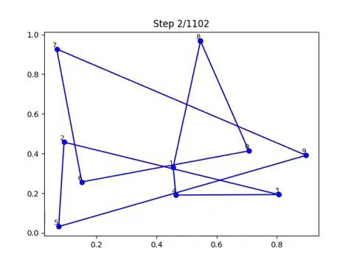
4. Simulated Annealing - Informed Metaheuristic Search
Heuristic function - Total Euclidean Tour Distance
Environment - VRP-TSP Simulation (gym_vrp)
Dimension of the Graph: 10 nodes, #Runs = 5;
Neighborhood function: All possible 2-swap permutations
Termination: Time-based (default = 5 seconds per run) or on hitting a local minima

Slide 6
Observations
Hill Climbing with Total Euclidean Distance heuristic quickly converges to a local minimum due to its greedy nature, often missing the global optimum. Performance is fast but solution quality heavily depends on the starting state.
Simulated Annealing overcomes local minima by probabilistically accepting worse solutions early on. It provides better-quality solutions than Hill Climbing but at the cost of higher execution time due to its controlled exploration-exploitation trade-off.

