Slide 1
AGROMART
Web-Based Agriculture Marketplace — MCA Project by Mokshith P J

Slide 2
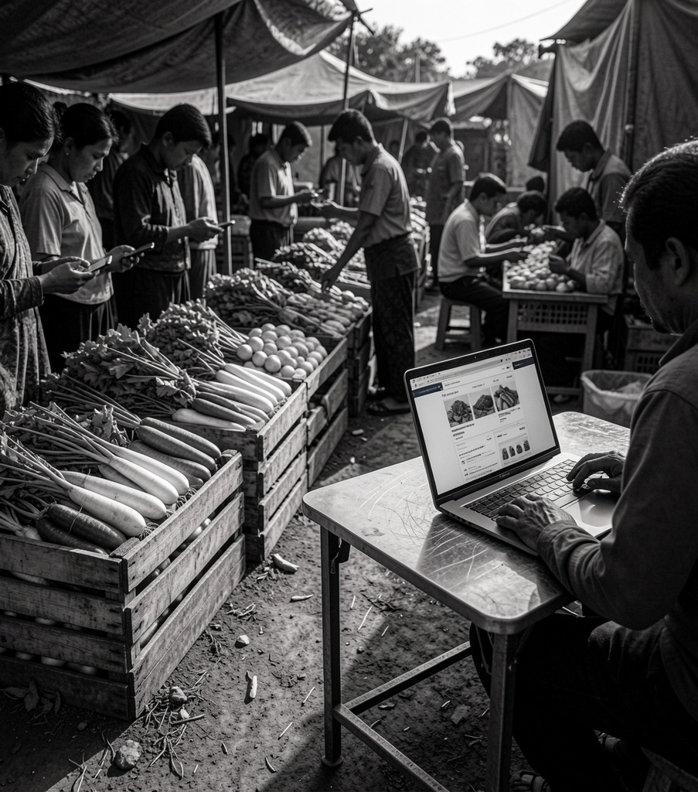
Introduction
Agromart is a web platform connecting farmers, consumers, and vendors in a unified marketplace. It eliminates intermediaries by enabling direct crop sales, bidding, and online purchases while supporting order and payment management.
The system aims to improve farmer income, increase market transparency, and simplify agricultural transactions through accessible web technology.

Slide 3

01
Project Overview

Slide 4
Purpose
Provide a secure, centralized platform where farmers can sell directly and consumers can bid or purchase produce.
Enable fair pricing, reduce dependence on middlemen, and streamline order/payment management to enhance market access for rural producers.

Slide 5
Key Features
Support for crop uploads, product listing, bidding, and online payments.
Role-based modules: Admin management, Farmer dashboards, and Consumer/Vendor interfaces. Includes order tracking, notifications, and basic analytics for transaction oversight.

Slide 6
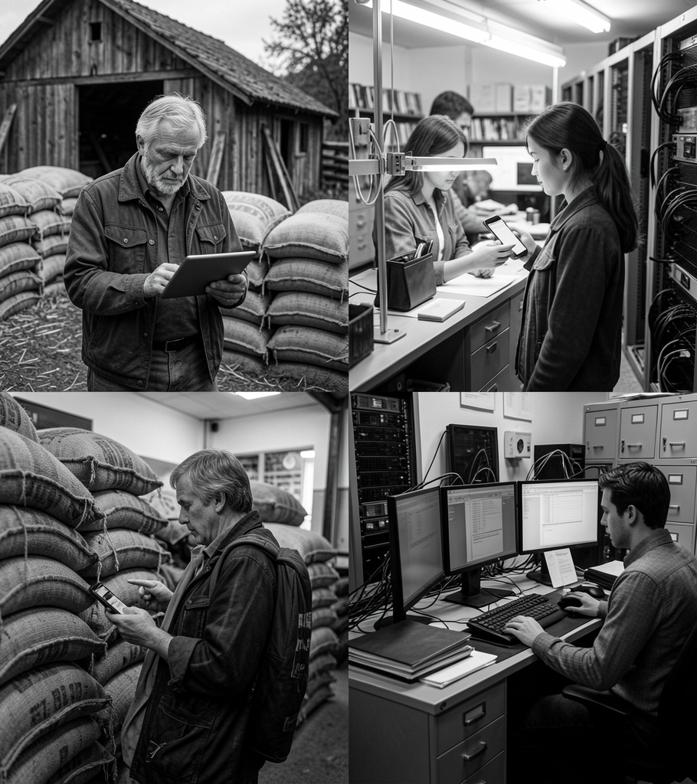
Stakeholders
Primary users include farmers, consumers/vendors, and system administrators responsible for platform governance.
Secondary stakeholders: payment providers, logistics partners, and the hosting/IT team supporting maintenance and scalability.

Slide 7

02
System Design

Slide 8
Architecture
Three-tier design: Presentation Layer (HTML/CSS/JS), Business Logic (PHP), and Data Access (MySQL).
This structure ensures modularity, easier maintenance, and clear separation of concerns for scalable deployment.

Slide 9

Database
Relational MySQL schema with core tables: Farmers, Consumers, Crops, Orders, and Payments.
Normalized relations maintain data integrity and support bidding, order tracking, and transactional consistency.

Slide 10
Modules
Role-based modules: Admin (user/product/order management), Farmer (crop upload, bids, payments), Consumer/Vendor (browse, bid, order).
Shared services include authentication, notifications, reporting, and payment integration for end-to-end operations.

Slide 11
Conclusions
Agromart delivers a professional, centralized marketplace that reduces intermediaries and enables direct farmer-consumer transactions.
The modular architecture and clear data model support future enhancements like mobile apps and cloud deployment to scale access and performance.

Slide 12
Thank you
Do you have any questions?
youremail@freepik.com
+00 000 000 000
yourwebsite.com
Please keep this slide for attribution

