Slide 1
Agromart
A web marketplace connecting farmers and consumers

Slide 2
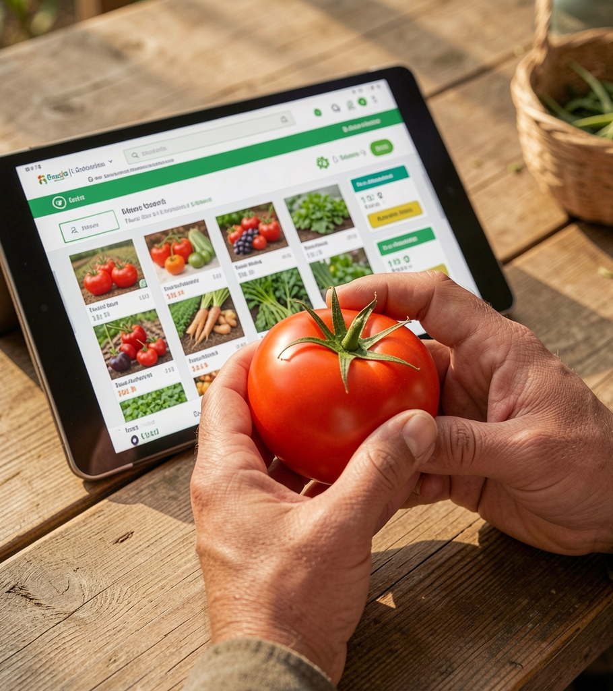
Introduction
Agromart is a web-based platform that connects farmers and consumers/vendors to eliminate intermediaries and improve market access.
The system supports listings, bidding, order management, and online payments for transparent agricultural trade.

Slide 3
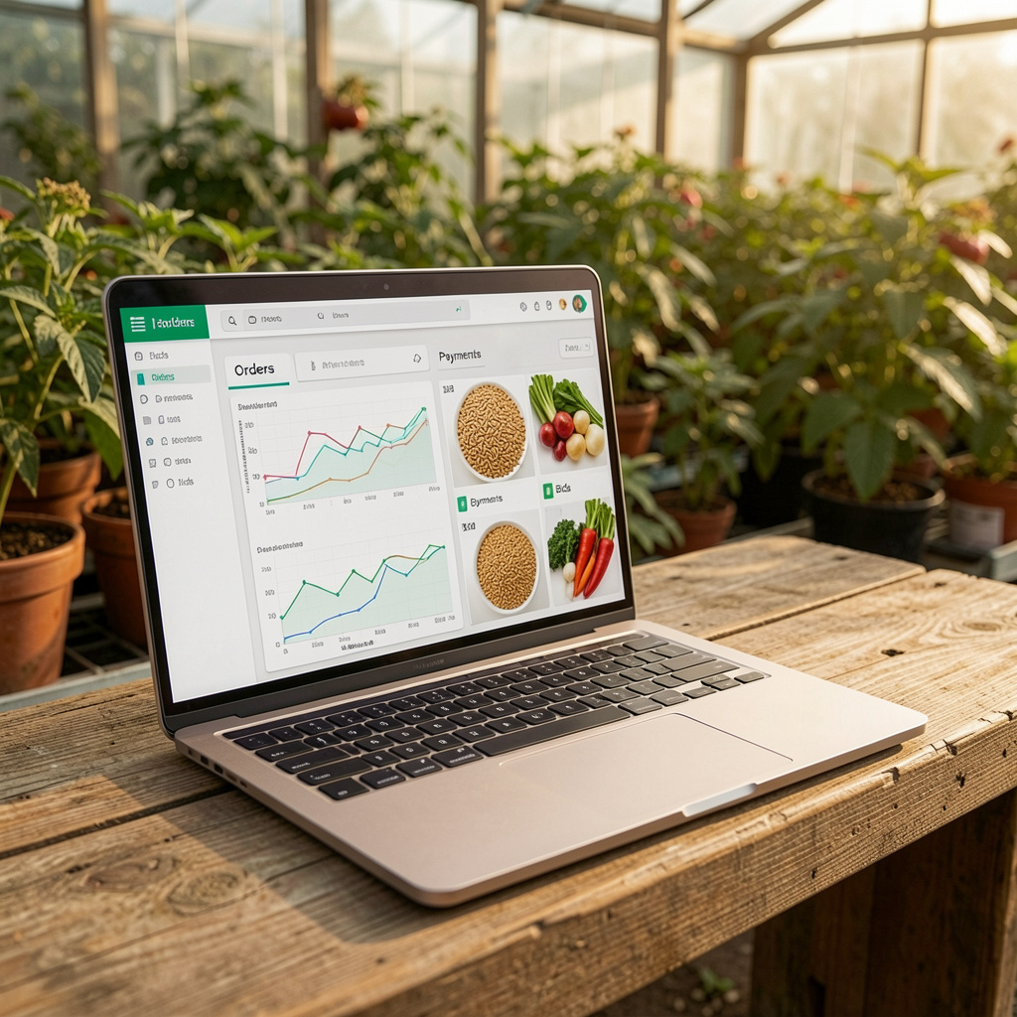
01
Project Overview

Slide 4
Purpose & Scope
Provide a centralized marketplace to enable direct transactions between farmers and buyers, reducing middlemen and improving price fairness.
Scope includes web portal, user roles, bidding, payments, and basic admin controls.

Slide 5
Stakeholders
Admin: platform management, user and order oversight.
Farmer: crop listing, bid management, receive payments.
Consumer/Vendor: browse, bid, purchase, and review orders.

Slide 6

Key Features
Support for crop uploading, online bidding, and product/catalog management.
Integrated order processing, payment gateway support, notifications, and role-based dashboards.

Slide 7

02
Problem & Goals

Slide 8
Pain Points
Farmers face unfair pricing, middlemen dependency, and limited market access.
Consumers struggle to find quality produce and transparent pricing.

Slide 9
Project Objectives
Enable direct farmer-to-buyer transactions, simplify listings and bidding, and provide reliable order/payment workflows.
Facilitate scalability and future mobile/cloud expansion while ensuring security and data integrity.

Slide 10
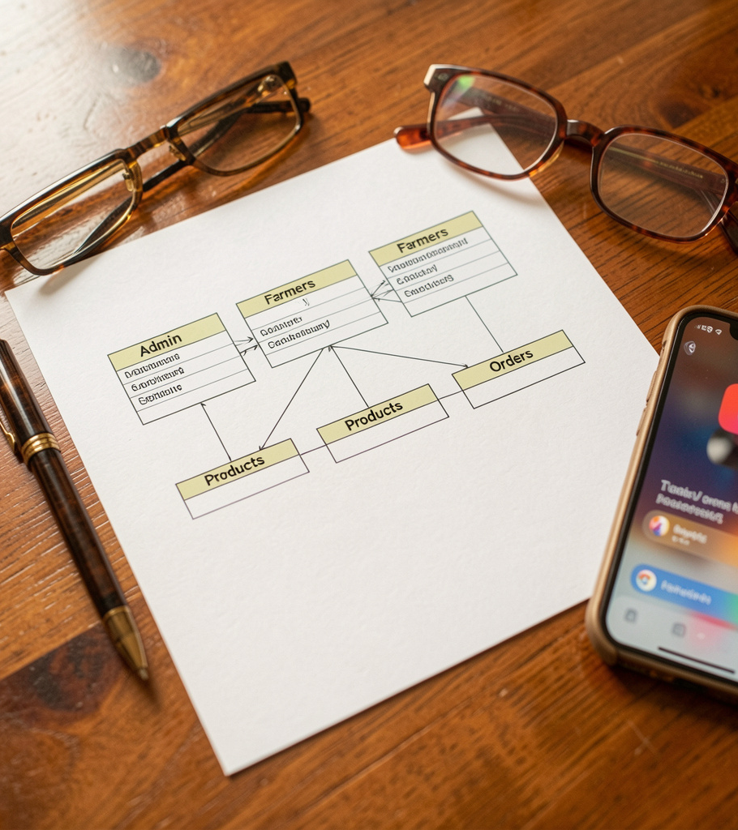
Success Metrics
Track adoption: number of registered farmers and active buyers.
Monitor transactions: daily listings, bids placed, and completed orders.
Measure satisfaction via ratings and reduced intermediary usage to evaluate impact on farmer income.

Slide 11
System Design

Slide 12
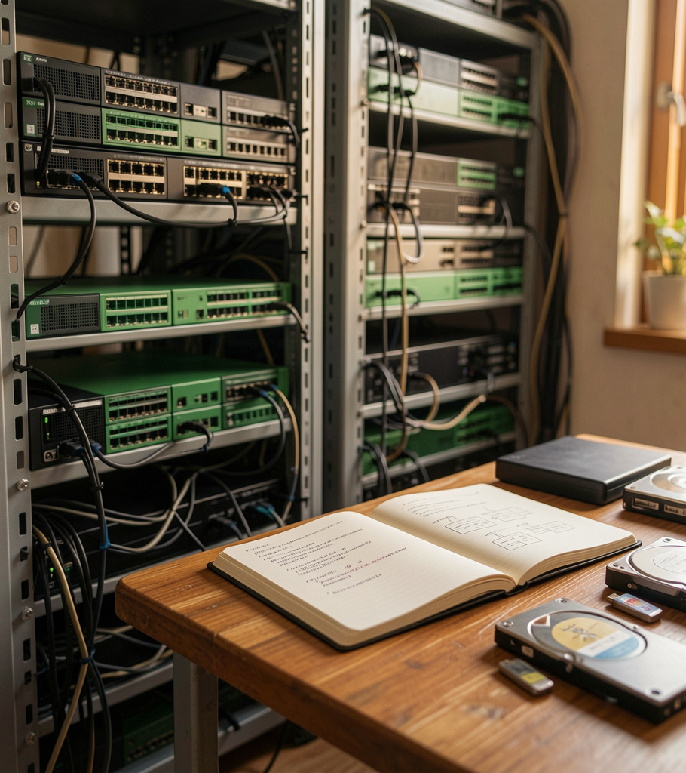
Architecture Layers
Three-tier model: Presentation (HTML/CSS/JS), Business Logic (PHP), Data Access (MySQL).
This separation supports maintainability, scalability, and clear responsibility boundaries.

Slide 13
Modules & Workflows
Core modules: Admin, Farmer, Consumer, Orders, Payments, Notifications.
Typical workflow: registration → listing → bidding/ordering → payment → fulfillment and notifications.

Slide 14
Technology Stack
Front-end: HTML, CSS, JavaScript. Back-end: PHP on Apache (WAMP).
Database: MySQL. Development tools: VS Code / Sublime Text.

Slide 15
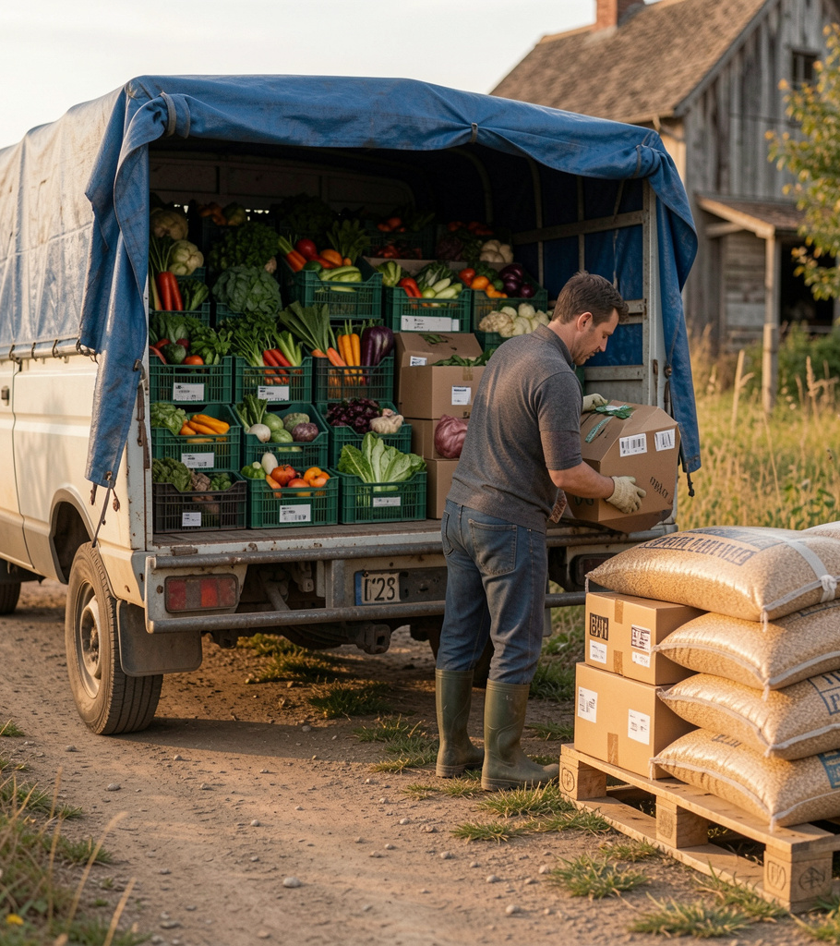
03
Data & Delivery

Slide 16

Database Schema
Core tables: Admin, Farmers, Consumers, Products, Crops, Orders, Payments, Notifications, Feedbacks.
Relationships enforce referential integrity and support bidding and order traceability.

Slide 17
Testing & QA
Test plan: unit, integration, system, and backup/recovery tests.
Key verifications: authentication, database interactions, payment flows, and user workflows.

Slide 18
Deployment & Future Enhancements
Deploy on cloud-enabled Apache/MySQL or containerized platforms for scalability.
Planned enhancements: Android/iOS apps, cloud deployment, advanced analytics, and enhanced storage.

Slide 19
Conclusions
Agromart provides a scalable, secure platform enabling direct farmer-to-buyer transactions, reducing intermediaries and improving market transparency.
The solution combines modular design, robust data relationships, and clear KPIs to support future mobile and cloud expansion.

Slide 20
Thanks!
Do you have any questions?
Presented By
Mokshith P J
(Roll No: 08P232036900049)

