Slide 1

हाम्रो Book पसल
Made By:
Rinchhen Moktan
Umang shrestha
Yogesh Kumar kanth
supervisor:
MR.Nabin Shrestha Sir

Slide 2
CONTENTS
Introduction
Problem Statements
Objectives
System Requirement
System Block Diagram
ER Diagram
Results
References

Slide 3
Introduction
हाम्रो Book पसल is an e-commerce site made with use of readily available programming languages like React JS and scripting language PHP.
It is an open to use e-commerce site mainly targeted to the people who loves to read and buy a lot of books.
It is an e-commerce site that provides different features and will be easy to use for the users.

Slide 4
Problem Statements

Slide 5
Objectives
Main objectives of our project are:
To develop a visually appealing and user-friendly e-commerce website for the book buyers.

Slide 6
System Requirement
Software Requirement
For the program to be run, the set of following software must be prepared with the following specification:
Microsoft-Disk Operating system, Windows 8, Windows 10, Windows 11 etc.
Microsoft VS Code
Node JS
Browsers
Laravel
XAMPP Control Panel
Hardware Requirement
For this program to be run, the computer hardware must be prepared with the following specifications:
4 GB RAM (minimum)
Intel i3, Ryzen 3 or higher series processor
Storage 1GB (minimum)

Slide 7
System Block Diagram
Fig: System Block Diagram

Slide 8
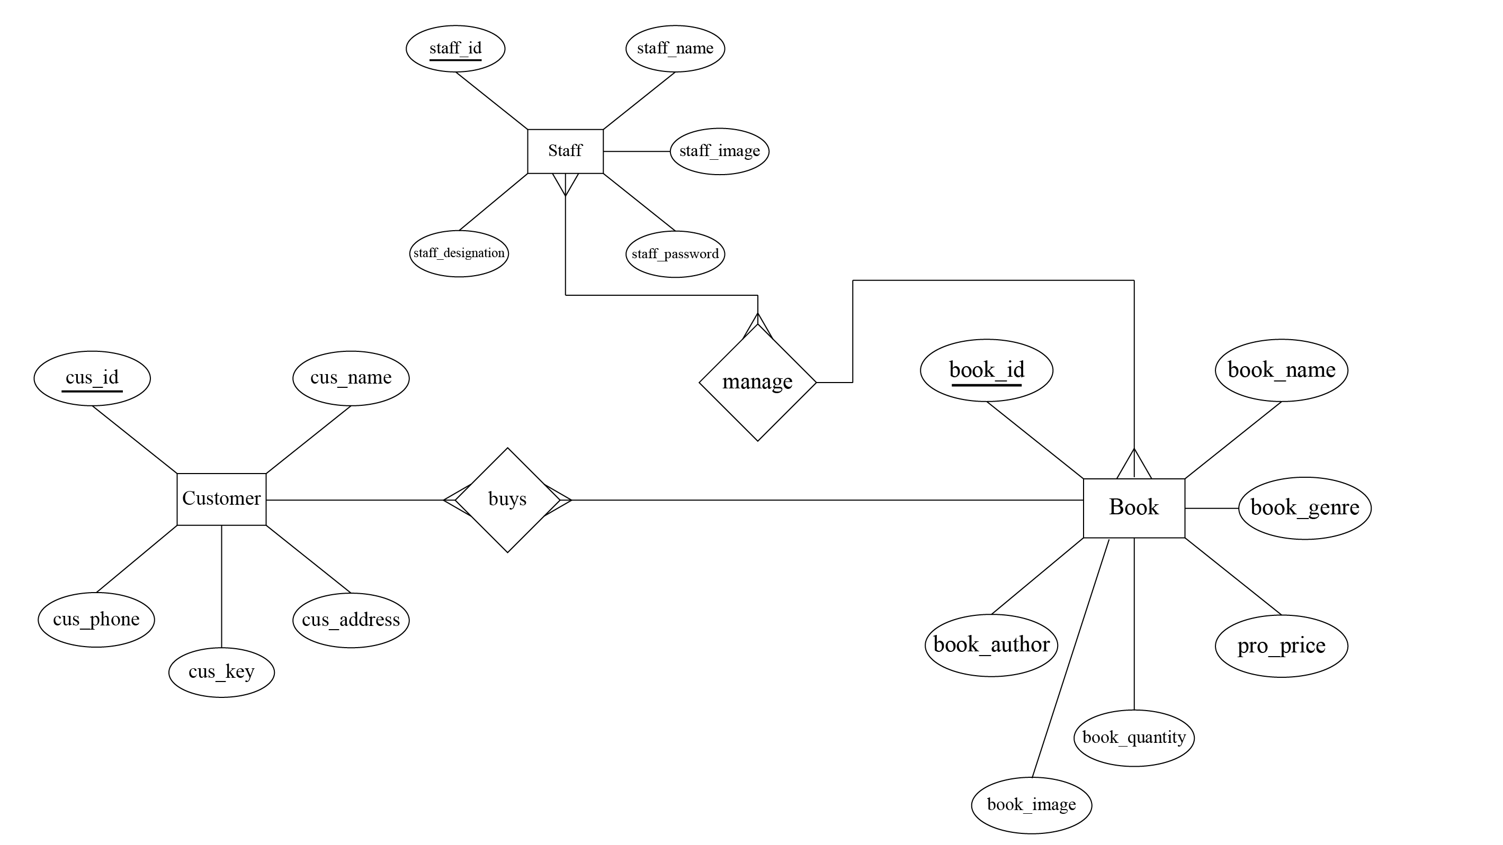
ER Diagram
Fig: ER Diagram

Slide 9
Results
HOME PAGE
Fig: Home Page

Slide 10
Conclusion
All the data and information recorded in our e-commerce site is saved in database with use of MySQL.

Slide 11
References

Slide 12
Thank You

