Slide 1

Курс «Компиляторные технологии»
Лекция 1
Введение в LLVM
Курносов Михаил Георгиевич
www.mkurnosov.net
Сибирский государственный университет телекоммуникаций и информатики
Осенний семестр

Slide 2

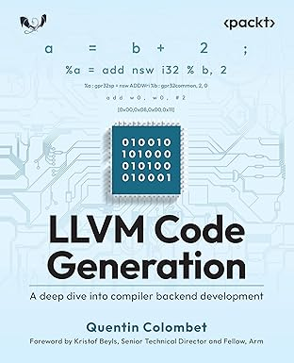
Структура курса
Лекции — 9
Практики — 17
Экзамен
Kai Nacke, Amy Kwan. Learn LLVM 17: A beginner's guide to learning LLVM compiler tools and core libraries with C++, 2024
Quentin Colombet. LLVM Code Generation: A deep dive into compiler backend development, 2025

Slide 3
LLVM (Low Level Virtual Machine)
The LLVM project, 2000, University of Illinois at Urbana-Champaign, Prof. Vikram Adve and Chris Lattner (M.Sc. student!).
Clang, 2006
Core components (sub-projects): Core, Clang, LLDB, libc++, compiler-rt, LLD, BOLT, MLIR, OpenMP, polly, klee
Chris Lattner: LLVM, Clang, Swift, MLIR, Mojo // https://en.wikipedia.org/wiki/Chris_Lattner
https://llvm.org
https://github.com/llvm/
https://en.wikipedia.org/wiki/LLVM

Slide 4
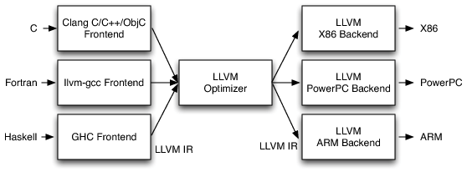
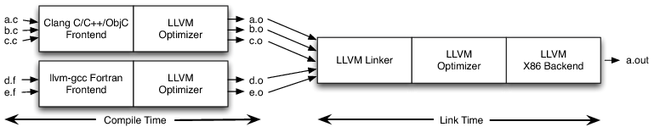
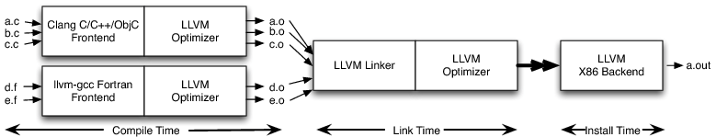
LLVM
LLVM's Implementation of the Three-Phase Design
Link-Time Optimization
Install-Time Optimization
Chris Lattner. The Architecture of Open Source Applications (Volume 1): LLVM // https://aosabook.org/en/v1/llvm.html

Slide 5
LLVM Tools
# C++ to LLVM IR
$ clang++ ./prog.cpp -oprog.ll -S -emit-llvm
# IR level code optimization
$ opt ...
# LLVM IR to target arch asm
$ llc ./prog.ll -o prog.s
# Asm to ELF
$ clang++ ./prog.s -o prog

Slide 6
References
LLVM Tutorials (Kaleidoscope, JIT, Backend) // https://llvm.org/docs/GettingStartedTutorials.html
Getting Started with the LLVM System (clone and build Clang/LLVM) // https://llvm.org/docs/GettingStarted.html
https://llvm.org/docs/ProgrammersManual.html
LLVM Doc // https://llvm.org/docs/
LLVM IR // https://llvm.org/docs/Reference.html#llvm-ir
Clang: https://clang.llvm.org/docs/UsersManual.html
Kai Nacke, Amy Kwan. Learn LLVM 17: A beginner’s guide to learning LLVM compiler tools and core libraries with C++. - Packt Publishing; 2nd ed, 2024
https://ru.wikipedia.org/wiki/Посетитель_(шаблон_проектирования)

Slide 7
Expression compiler
//
// Expression: with a, b: a * (4 + b)
// Expressions grammar (extended Backus-Naur form -- EBNF):
// calc : ("with" ident ("," ident)* ":")? expr ;
// expr : term (( "+" | "-" ) term)* ;
// term : factor (( "*" | "/") factor)* ;
// factor : ident | number | "(" expr ")" ;
// ident : ([a-zAZ])+ ;
// number : ([0-9])+ ;
//
$ calc ‘with a,b: 23 + (a - b)’
Input a: 2
Input b: 3
Result: 22

Slide 8
Демонстрация и разбор кода

