Slide 1
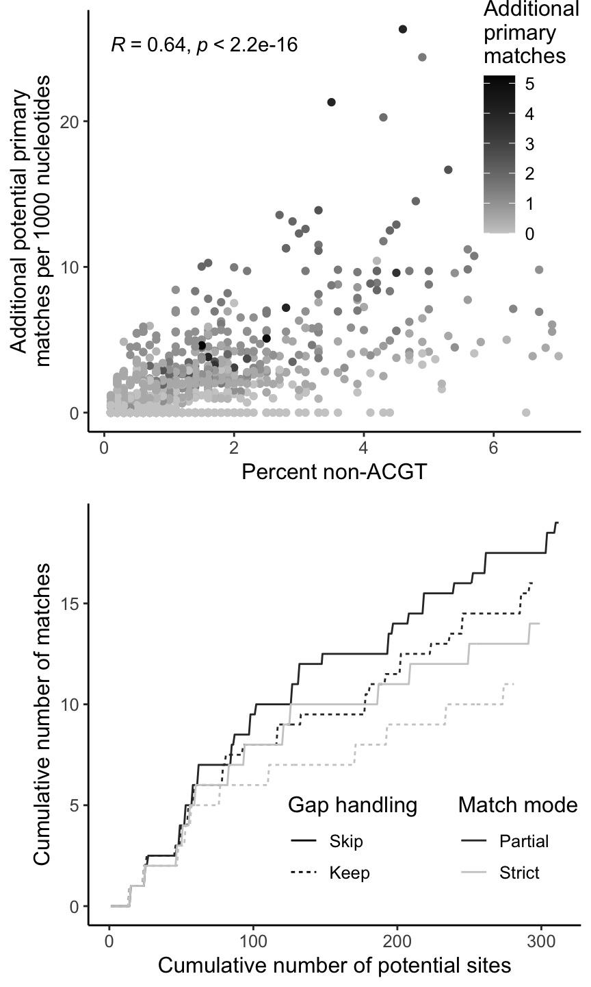
A
C
Upstream context
Mutation site
Downstream context
G
Reference
Primary
A
RD
Query
G
Reference
Control
A
YN|RC
Query
B
 |  | Potential primary match |  |  | Primary match score
ID | Seq | 2.0 | strict | partial | 2.0 | strict | partial
ref | GATC
q1 | AGTC | 1 | 1 | 1 | 1 | 1 | 1
q2 | TGTC | 1 | 1 | 1 | 0 | 0 | 0
q3 | AGCC | 0 | 0 | 0 | 0 | 0 | 0
q4 | -GTC | 1 | 0 | 0 | 0 | 0 | 0
q5 | A-GT | 0 | 1 | 1 | 0 | 1 | 1
q6 | RGTC | 1 | 0 | 1 | 0 | 0 | 0.5
q7 | AGRC | 0 | 1 | 1 | 0 | 1 | 1
q8 | ANTC | 0 | 0 | 0.5 | 0 | 0 | 0.5
q9 | RNTC | 0 | 0 | 0.5 | 0 | 0 | 0.25
D
Notes:
Figure 1: Hypermut 3 overview. (A) Example mutation site and context (for APOBEC3G and APOBEC3F). The control pattern is the complement of the primary pattern and inferred by the program. (B) Example reference and query sequences, and whether they are considered a potential primary match and an actual primary match for 3 Hypermut versions: 2.0, 3.0 strict, and 3.0 partial. These numbers assume that gaps are skipped (for Hypermut 3) and that the context is enforced on the query sequence. In the sequence, the underlined nucleotide is the mutation site, correct mutations or contexts are bolded, and matches for Hypermut 3 partial mode are colored in red. (C) Correlation between percent non-ACGT characters in the query sequence and the number of additional potential primary matches identified when using partial matching compared to strict matching. The color indicates the number of additional primary matches observed. (D) For an example sequence, the cumulative number of potential sites vs. the cumulative number of actual matches identified for each combination of partial vs. strict matching (color) and keeping vs. skipping gaps in the alignment (line type).

