Slide 1
Computer Architecture (x86-64)
Devin A. Matthews
UT Austin
MolSSI Software Summer School 2017

Slide 2
Computing isn’t like your Gran^H^H^H^H Advisor Remembers it…
Computers have gotten faster (more GHz), but they’ve also changed and developed on a fundamental level
Example: a Cray-YMP (1988) could deliver near-peak speed when streaming from memory
A multi-core Broadwell Xeon can only deliver about 1% of peak performance from memory
New features make old optimization strategies obsolete:
Out-of-order execution
Superscalar execution
Vectorization (aka SIMD, not to be confused with vector machines!)
Multiple levels of cache
Multi-core
Many-core
Multi-socket
Distributed computing
And so on…
Compilers (and languages) have gotten better too, but they aren’t magic. To get the best performance, you have to be aware of what the computer is actually doing.

Slide 3
Why is fast code important?
Writing fast code takes time and effort, but when done right it saves a lot more time than you put in.
Computer time costs $$ and grant-writing time. Why not use it effectively?
Fast code allows new and bigger simulations. Sometimes this leads to being able to do fundamentally new science.
Execution time savings are multiplied by number of users and number of times run. So write code that can be reused and shared. Corollary: don’t write it if someone else already has.

Slide 4
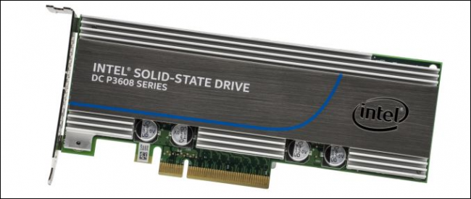
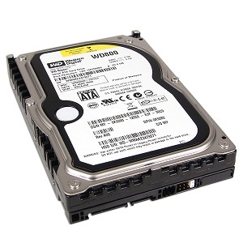
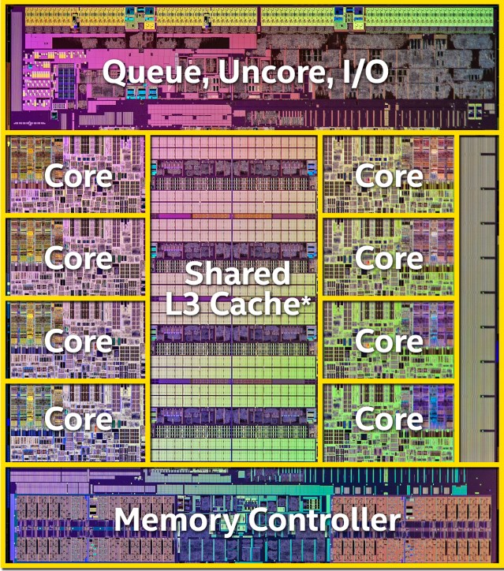
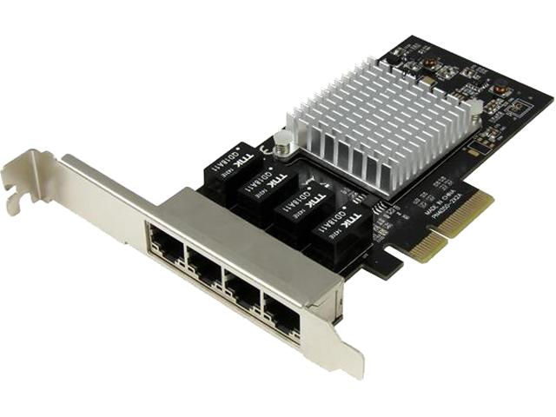
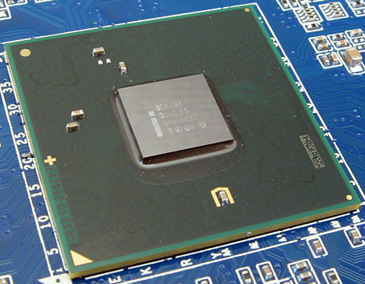
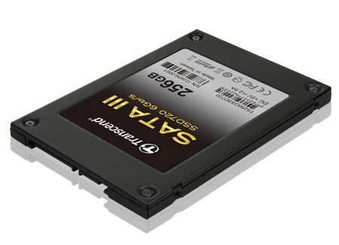
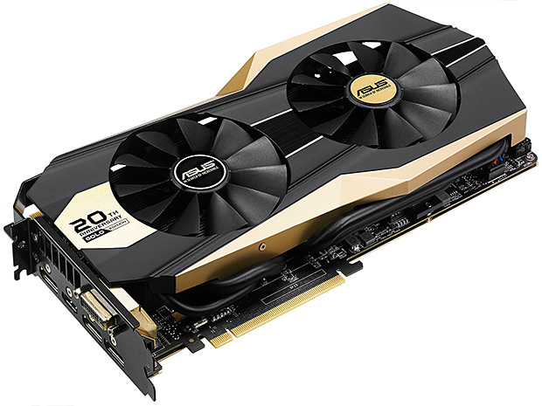
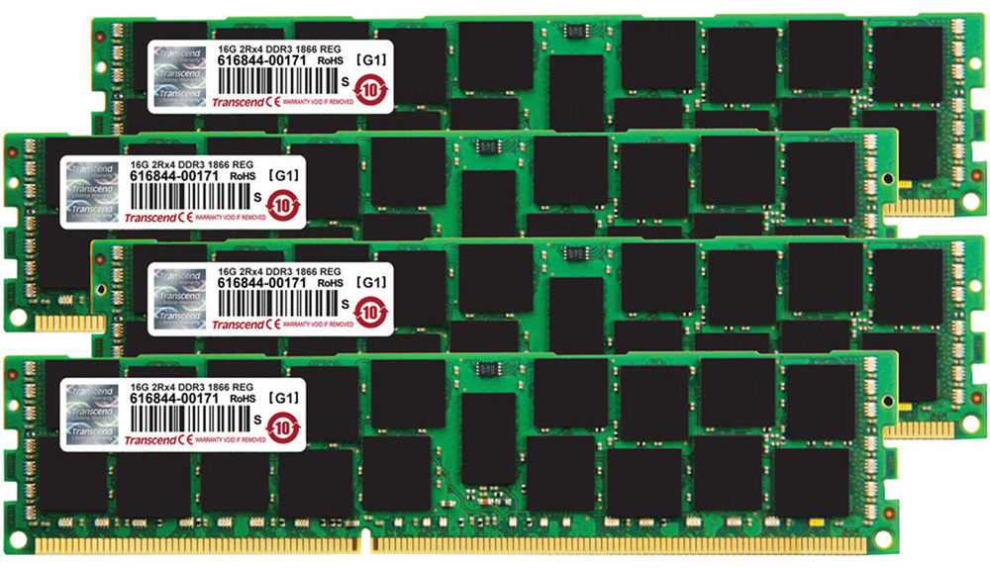
So what’s in a modern computer?
PCI-e
SATA
USB
etc.

Slide 5
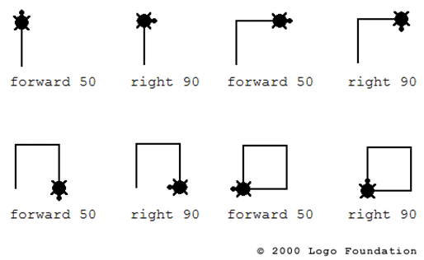
A simple model:
Data
Instructions
Data

Slide 6

Instructions vs. data
Harvard Architecture:
Von Neumann Architecture:
Instructions and Data
Instructions
Data
Most Modern Architectures:
Instructions and Data
Unified cache
Instruction cache
Data cache

Slide 7
Instruction examples
Math
Logic
Memory
Flow control
ADD SUB MUL DIV SHL/SHR/SAR
VADDPD VFMA231SD VSQRTSD VRCP28PS
TEST CMP SETxx CMOVxx AND/OR/XOR/…
MOV LEA PREFETCH VMOVUPS VBROADCASTSS
CALL/RET JMP Jxx REP/REPxx
(xx = AE, NZ, GE, etc.)

Slide 8
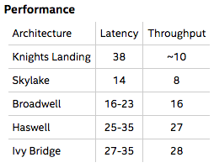
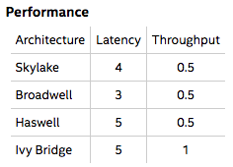
Instruction latency and throughput
Latency is how long it will take in cycles for the results of the instruction to be ready. Lower is better.
(Reciprocal) Throughput is how many cycles on average do you have to wait between two instructions of the same type. This can be lower than the latency because of pipelining and superscalar execution. This is also called CPI (the inverse of IPC). Lower is better.
VDIVPD
VMULPD

Slide 9
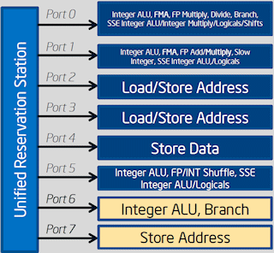
Superscalar execution
Modern processor break instructions down in smaller pieces called µops.
The rate at which instructions can be completed is limited by 1) instruction fetch and decode, and 2) availability of execution ports for the resulting µops.
Instruction Fetcher
~16B/cycle
Instruction Decoder
~5-6 µops/cycle
Scheduler and Queue
(~50-100 entries)

Slide 10
Out-of-order execution
If the processor needs to wait for data to arrive, it can execute other instructions in the mean time. This is only possible when the instructions do not have a data dependency, i.e. the output of one is an input of another.
Instruction Fetcher
~16B/cycle
Store Buffer
Instruction Decoder
Reorder Buffer (~200 entries)
~5-6 µops/cycle
Scheduler and Queue
(~50-100 entries)
Load Buffer

Slide 11
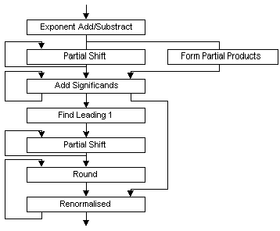
Pipelining
In addition to executing multiple instructions at a time in different execution units, the same execution unit can execute multiple instructions through pipelining. This is especially important for +, -, and * operations of floating point data (but not /!).
Note that pipelining also exists in the interaction of instruction fetching, decoding, and µop scheduling: these all run at the same time on different instructions.
Time
ADD
1
ADD
2
ADD
3
ADD
4

Slide 12
Branches
Most kinds of flow control get converted into branch instructions (or jumps). The processor has to decide which branch is more likely so that it can continue to prefetch instructions and execute out-of-order (this is called speculative execution). If the processor guesses wrong, you pay a branch misprediction penalty (~15-20 cycles), plus a possible pipeline flush.
Processors have gotten pretty good at predicting branches, including pattern recognition for nested loops, but reducing the number of branches can still help a lot.

Slide 13
Single Instruction Multiple Data (SIMD)
Basically all processors for the past 10 years can operate on vectors of floating point and (more recently) integer numbers:
MMX, 3dNow!: legacy SIMD extensions (90’s)
SSE2-SSE4.2: 2x double or 4x float (+integers) (2000’s)
AVX: 4x double or 8x float (2010’s)
AVX2: same as AVX but adds integer support and FMA
AVX512: 8x double or 16x float (2016)
Currently on KNL, just released for Xeon.
vaddpd ymm2, ymm1, ymm0
vbroadcastss ymm0, [rax]
vfmadd213pd ymm0, ymm1, [rcx]
ymm0
memory
at [rax]
ymm1
ymm1
memory at [rcx]
⊕ ⊕ ⊕ ⊕
⊗ ⊗ ⊗ ⊗
⊕ ⊕ ⊕ ⊕
ymm0
ymm2
ymm0

Slide 14
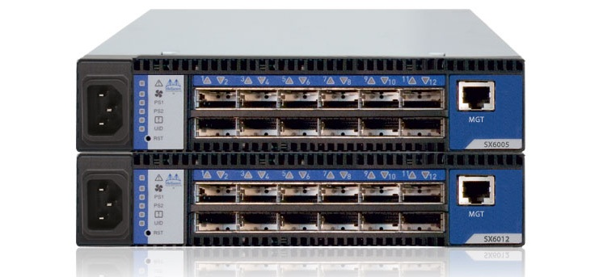
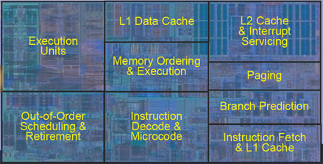
The memory hierarchy
Memory Level | Size | Latency | Bandwidth | Technologies
Registers | ~5K, 624B visible | n/a | n/a | SRAM/DFF
L1 cache | 32K | ~5 cycles | 64B read 32B write per cycle | SRAM
L2 cache | 256K-1M | ~15 cycles | 64B per cycle | SRAM
L3 cache | ~1M-50M | ~20-30 cycles | 32B per cycle | SRAM
Memory | GBs | ~100 cycles | ~100GB/s = <10B/cycle/core | DRAM
Network (remote DMA) | PBs | 1000s of cycles | 1-10GB/s | Ethernet, Infiniband, Custom
Disk (SSD) | TBs | ~100,000 cycles | ~1GB/s | Flash memory, PCIe or SATA
Shared L3 Cache
Interconnect

Slide 15
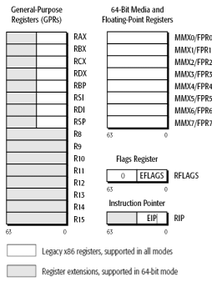
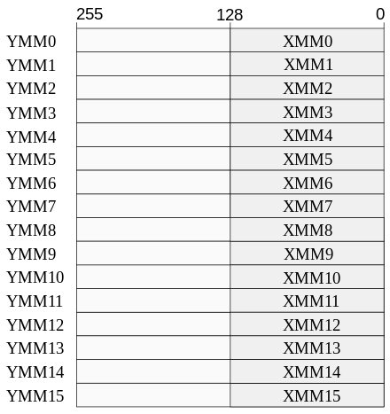
Registers
x86-64 processors have 16 64-bit integer registers and 16 128-bit vector registers (xmm0-15). The x87 FPU is not used in modern code.
AVX extends the vector registers to 256 bits (ymm0-15).
AVX512 increases this to 32 512-bit vector registers (zmm0-31, not shown).
Most inputs and outputs of instructions must be registers. Some instructions allow one memory operand.
The “name” of each register is not important to the compiler. Register renaming allows the processor to use different physical registers for instructions that use the same register name.
Since the number of physical registers (the register file) is much larger than the number of names (~10x), this avoids many false data dependencies.

Slide 16
Cache
The level 1, 2, and 3 caches are all accessed in units of (generally) 64B, called a cache line.
If the entire cache line is not used, bandwidth can be wasted.
When the caches become full, cache lines are evicted based on some policy such as least-recently used (LRU).
If a piece of data is used again, it can be accessed using non-temporal loads and stores, to keep from evicting other data.
Cache lines be proactively moved to one of the caches by a prefetch instruction. The processor also does hardware prefetching based on observed usage patterns.
A given entry in the cache can only store cache lines from certain memory locations. This is referred to as cache associativity. One ramification of this is that repeated accesses to data at intervals of large powers of 2 in bytes (2^{n} ≥ 4KB) reduces the effective cache size drastically.

Slide 17
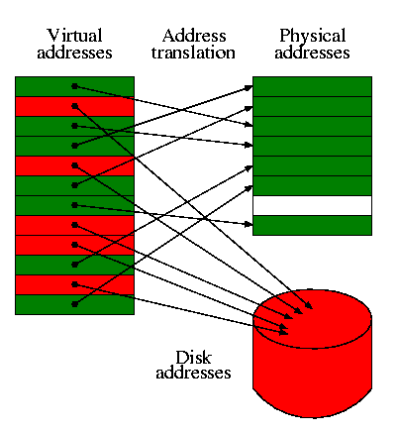
Virtual memory
The memory of a program is divided into pages, generally of size 4KB.
The pages are mapped by the hardware and operating system onto the physical memory.
Since the location of data doesn’t match the underlying hardware, this is called virtual memory.
The mapping from virtual to physical memory is cached in the TLB, but only for a limited number of pages.
Accessing a page that does not have its mapping cached causes a TLB miss. This generally costs O(100) cycles.
If the page has not been assigned a physical address (e.g. if it hasn’t been accessed before), then a page fault occurs, costing an additional O(1000) cycles.
Additionally, virtual memory pages may be memory mapped to files on disk, where the OS transparently handles I/O and caching.

Slide 18
Single-core summary
The processor core can do lots of things at once:
Execute out-of-order.
Execute multiple instructions (superscalar).
Pipeline sequences of instructions.
Predict branches and speculatively execute.
Calculate multiple results simultaneously with SIMD.
The bottleneck is getting data from memory (or beyond)
(Almost) all data has to be brought into registers before being used.
Caches hold a small amount of data closer to the processor.
Cache lines and cache associativity make some access patterns more efficient.
Virtual memory paging can cause additional delays if too many pages are accessed.

Slide 19
Multi-core
Modern processor contain multiple processor cores.
Individual cores may also allow multiple threads to run at the same time, sharing some resources such as the execution units. This is called Simultaneous Multi-Threading (SMT, aka Hyper-Threading).
This can hide additional latency and increase responsiveness.
It is not usually very helpful in HPC. In fact, using all hyper-threads can hurt performance in some cases.

Slide 20
Shared vs. private resources
Some resources in the processor are private to a core (such as the execution units and L1 and L2 caches), and some are shared (the L3 cache, memory, everything else).
(Note that for hyper-threads, only a very few resources are private, such as the register file.)
Which resources are the most heavily used affects how well an algorithm scales with the number of cores:

Slide 21
Data sharing and cache coherence
When processors have the same data in their private caches, what happens when they both write to?
Modern systems use a cache coherence protocol to synchronize writes to cached data so that all processors see writes to some value in the same order (this is called sequential consistency). **Note that only writes to the same value are consistent.
Core 1
Core 1
Core 1
read
delayed
write
L1
L1
L1
coherency
traffic
X
X
Interconnect
Memory

Slide 22
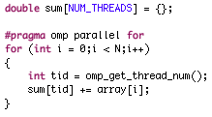
False sharing
False sharing occurs when two or more cores both read and write to different data in the same cache line.
The cores will repeatedly invalidate the others’ cache lines, causing significant overhead.
Thread-private data should be kept on it’s own cache line.
Q: What’s wrong with this code?

Slide 23
False sharing
False sharing occurs when two or more cores both read and write to different data in the same cache line.
The cores will repeatedly invalidate the others’ cache lines, causing significant overhead.
Thread-private data should be kept on it’s own cache line.
Q: What’s wrong with this code?
A: False sharing in sum
…
sum
0
1
2
3
4
5
writes to same
cache line
Core 1
Core 2
Core 3

Slide 24
Multi-socket and NUMA
Multiple processor chips can be connected together in a multi-socket or Multi-Processor (MP) arrangement.
Each processor generally “owns” its own set of physical memory.
Data from other processors is shared through an interconnect such as QPI or HyperTransport.
Since some data takes longer to access than others, this is called a Non-Uniform Memory Architecture (NUMA).
Where the data gets stored is usually determined by the first-touch principle.
Processor 1
Processor 2
not as fast
Processor 3
Processor 4
fast

Slide 25
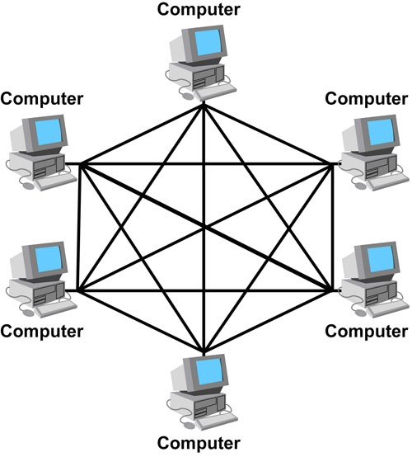

Distributed computing
For even more parallelism, individual machine (nodes) can be connected together with a network.
The most common way to parallelize across nodes is with all of them running the program (single-program multiple data, SPMD), but they can also run other programs such as client-server (multiple-program multiple data, MPMD).
=

Slide 26
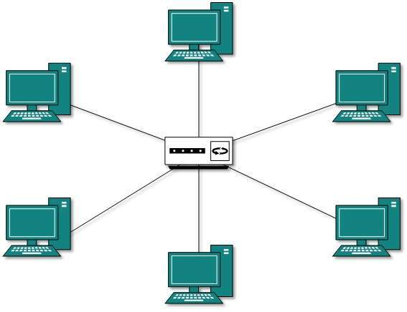
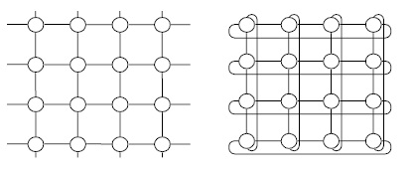
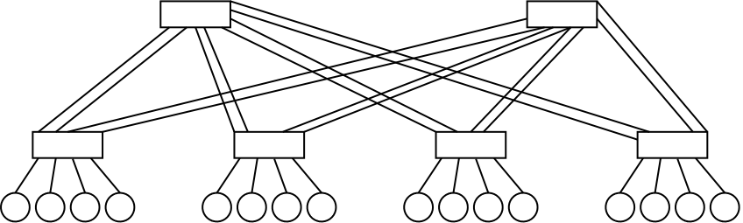
Network topologies
Fully connected
Star
Mesh
Torus
Fat tree

Slide 27
Distributed programming models
Message Passing
Partitioned Global
Address Space (PGAS)
Node 1
Node 2
Node 3
Node 4
Message
or RDMA
Node 1
Node 2
Point-to-point (P2P)
Virtual Memory
Synchron-ization
(e.g. barrier)
Node 3
No communication
Node 4
Collectives
(e.g. bcast)

Slide 28
Types of scaling
Strong scaling measures how much faster multiple processors can do the same work. The quantity usually measures is speedup (T_{p=1}/T_{p=n}).
Weak scaling measures how efficient the computation is when the amount of work increases with the number of processors.

Slide 29
Multi-core and distributed summary
HPC can exploit multiple levels of parallelism outside the processor core:
Multiple cores, including multiple threads per core (hyper-threading).
Multiple processors (multi-socket).
Multiple nodes (distributed computing).
High-performance programs have to be careful about how they access data:
Cache coherency.
False sharing.
NUMA.
Local vs. remote memory.

Slide 30
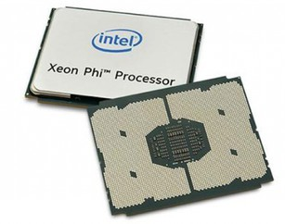
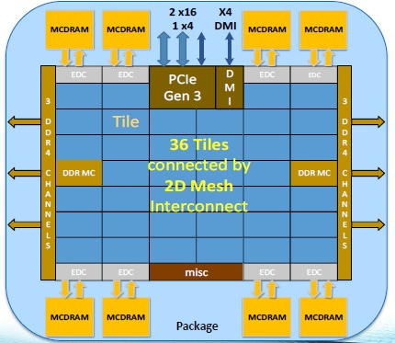
Other architectures: Xeon Phi
Xeon Phi (past: Knight’s Corner, present: Knight’s Landing, future: Knight’s Mill) is a many-core architecture with 64-72 cores per processor.
Knight’s Landing is an x86-64 processor, but:
The cores are fairly slow for non-floating point operations.
There is no shared L3 cache.
There are two types of main memory: high-bandwith memory (16GB at ~400GB/s) and regular DDR (up to 384 GB at ~80GB/s). The HBM can be configured as either cache or as a separate NUMA domain.

Slide 31
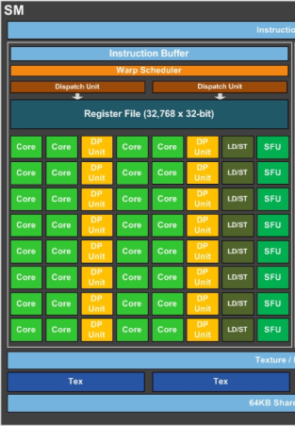
Other architectures: GPU
GPU
SM
SM
CPU:
Fast, smart cores
Large caches
Low memory bandwidth (except KNL)
Each core executes vector instructions
Best scheduled one thread per core
GPU:
Slow, dumb cores
Small caches
High memory bandwidth (100s of GB/s)
Threads act in teams (warps) to execute on multiple cores.
Many more threads then cores to hide latency (1000s of threads)
SM
SM

Slide 32
Questions?

