Slide 1
COMPUTER VISION CONTEST
Cansu Zeynep Kars
Ece Büşra Civelek
Yağmur Dalgıç
Mehmet Efe Zindancı
Yaren Kıy
Mehmet Tarık Atıcı

Slide 2
Project Overview
Our project is a JavaFX-based Computer Vision GUI that allows users to process and analyze images using various filters and transformations.
Our project provides a user-friendly interface for applying image processing filters.
We used optimized methods to ensure the operations align with the methods we have learned during lectures using Matlab.

Slide 3
Design Considerations
We used SceneBuilder to create and manage the GUI efficiently. This tool allowed us to visually design the layout without writing extensive FXML code manually.
Properties and styles of components were customized directly within the tool using its built-in style configuration options.
Controllers were linked directly within Scene Builder making it easier to bind UI actions to backend logic.

Slide 4
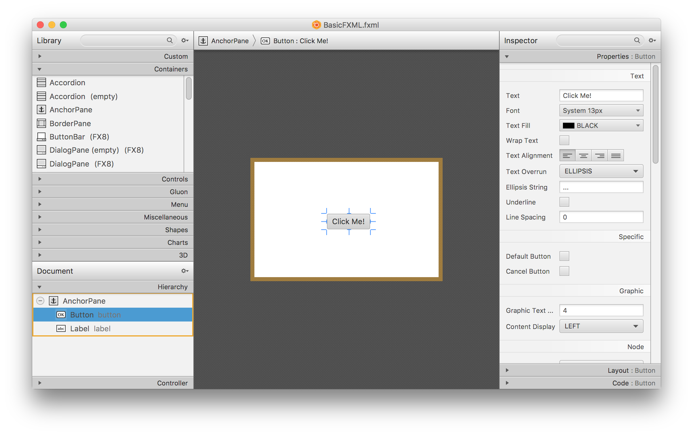
SceneBuilder

Slide 5
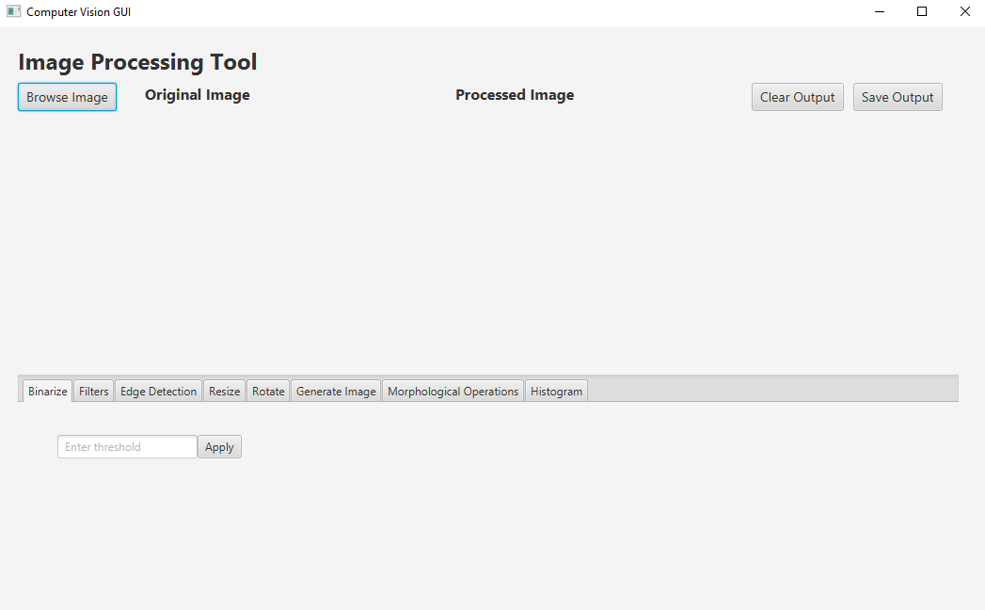

Slide 6
Target User
Our target user group includes students and researchers in the field of computer vision who are looking for a simple and user-friendly tool to apply and analyze basic image processing techniques.
The application is also suitable for beginners in image processing, as it provides a graphical interface that eliminates the need for extensive coding knowledge.
By focusing on educational purposes, our tool aims to bridge the gap between theoretical knowledge and practical implementation.

Slide 7
Implementation Details
The project leverages JavaFX for GUI design and OpenCV for implementing core image processing algorithms.
Image manipulation is performed in the backend using OpenCV, while JavaFX handles the visualization and user interactions.

Slide 8
Functionalities
Uploading and displaying images.
Applying real-time image transformations, such as:
Binarization
Edge Detection
Resize and Rotate
Morphological Operations (dilation, erosion)
Histogram Equalization
Saving the processed images to local storage
Comparing the original and processed images side-by-side for better visualization

Slide 9




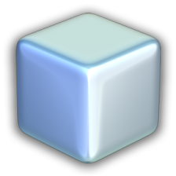
Libraries and Tools
JavaFX: Used for GUI design and layout.
OpenCV: Core library for image processing.
Github: Used for collaboration, development and team coordination.
Intellij and Netbeans(8.2): Used for development, debugging and testing.
Scene Builder: Used for GUI design.

Slide 10
Filtering:
Imgproc.GaussianBlur(): Gaussian blur.
Imgproc.medianBlur(): Median filter.
Imgproc.blur(): Average filter.
Morphological Operations:
Imgproc.dilate(): Dilation.
Imgproc.erode(): Erosion.
Histogram Operations:
Imgproc.calcHist(): Histogram calculation.
Imgproc.equalizeHist(): Histogram equalization.
Core.normalize(): Histogram normalization.
OpenCV functions in our project
Basic Image Processing Functions:
Imgproc.cvtColor(): Color space conversions (e.g., BGR to GRAY).
Imgproc.threshold(): Creating binary images.
Imgproc.resize(): Resizing images.
Imgproc.warpAffine(): Affine transformations like rotation.
Edge Detection:
Imgproc.Canny(): Canny edge detector.
Imgproc.Sobel(): Sobel edge detector.
Imgproc.Laplacian(): Laplacian edge detector.
Imgproc.filter2D(): Custom filters (e.g., Prewitt, Roberts).

