Slide 1
Threads, Executors, and Runnables

Slide 2
Threads
A thread is a thread of execution in a program.
The JVM allows multiple threads to run concurrently.
Programs start with a single thread which calls the main method
Every thread has a priority 1 (low) to 10 (high).
Higher priority threads get preference over lower.
Thread may be marked as Daemon, meaning the thread will not prevent JVM from exiting program.

Slide 3
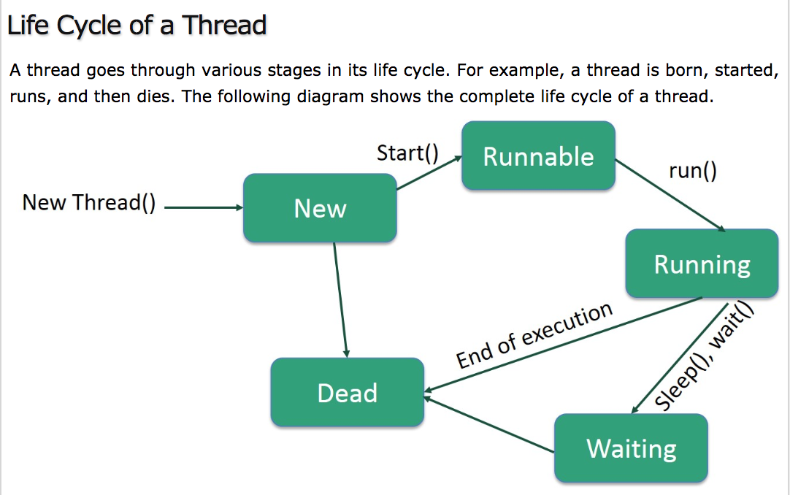
Notes:
New: A new thread has been created but not started. AKA a born thread.
Runnable: After thread is started, it is runnable.
Waiting: If the thread is waiting for another thread to perform a task. Transitions back to runnable when another thread signals it to continue.
Time Waiting: A thread may be set to wait for an interval of time. Transitions back to running when time expires.
Terminated or Dead: Once it completes a task or is terminated.

Slide 4
Create a Thread
3 different ways:
Implement Runnable Interface
Extend Thread Class
Executors
Threads and Runnables work directly with threads
Executors are a higher level replacement for working with threads directly

Slide 5
Implement Runnable Interface
Create class that implements Runnable
Preferred over Extending Class because
More flexible. Allows extending another class.
Can use Lambda expressions.
Use Runnable in main method
Use lambda expression to create runnable

Slide 6
To create a thread by implementing Runnable:
Create class that implements Runnable with run method
public class ExampleRunnable implements Runnable{
public void run(){
System.out.println(“Hello from thread.”);
}
}
In main method create instance of runnable, pass in to new thread | and thread name |
public class Example {
public static void main(String[] args) {
Runnable r1 = new ExampleRunnable();
new Thread (r1, “threadName”).start();
new Thread(r1, “AnotherName”).start();
}
Can create multiple thread that use same runnable.
Notes:
First create a class that extends Thread.
It must have the run() method to extend Thread. In run should be any logic that the thread will perform.
The main class is where you create and run the thread. First, create new instance of the class where the run method is.
Then create a new thread with the class instance as an argument.
Then start the thread with the start method. Start calls the run method in the class instance. Which causes the thread to become runnable. When it has finished, the thread dies.
This code can be simplified to one line. create thread, and start all at once. Drawback to this is it can’t be referenced again.

Slide 7
Runnable with Lambda Expression:
In main method, create Runnable
Public static void main(String[] args {
Runnable task = () -> {
String threadname = Thread.currentThread().getName();
System.out.println(“Hello from thread “ + threadName);
}
Still in main method, run on main thread or create tread to run task and start it.
task.run();
Thread thread = new Thread(task);
thread.start();
new Thread(task).start();
}
Can create multiple thread that use same runnable.
Notes:
First create a class that extends Thread.
It must have the run() method to extend Thread. In run should be any logic that the thread will perform.
The main class is where you create and run the thread. First, create new instance of the class where the run method is.
Then create a new thread with the class instance as an argument.
Then start the thread with the start method. Start calls the run method in the class instance. Which causes the thread to become runnable. When it has finished, the thread dies.
This code can be simplified to one line. create thread, and start all at once. Drawback to this is it can’t be referenced again.

Slide 8
Extend Thread Class
Thread class implements Runnable interface
Drawbacks to extending Class
Can’t extend other classes
Not overriding any methods, so not necessary.
Implement Runnable is preferred.
Notes:
Benefits: It has the same functionality of Runnables but it has additional methods.
Sleep() causes thread to sleep for specified length of time
setName() names the thread, so instead of thread-1, it could be named MessageThread
setPriority() make higher or lower than others. Doesn’t guarantee it will execute before other threads with lower priority.
dumpStack() prints the stack trace for that thread, useful for debugging
setDaemon() makes it so program can close without thread ending.
Drawbacks
You can only extend one class, so it limits your options for extending other classes.

Slide 9
To create a thread by extending Thread:
Create class that extends Thread with run method
public class ExampleThread extends Thread {
public void run(){
System.out.println(“Hello from thread.”);
}
}
Create class with main method that creates/starts thread
public class Example {
public static void main(String[] args) {
Thread t1 = new ExampleThread();
t1.start();
(new Thread (new MessageThread()).start();
}
Notes:
First create a class that extends Thread.
It must have the run() method to extend Thread. In run should be any logic that the thread will perform.
The main class is where you create and run the thread. First, create new instance of the class where the run method is.
Then create a new thread with the class instance as an argument.
Then start the thread with the start method. Start calls the run method in the class instance. Which causes the thread to become runnable. When it has finished, the thread dies.
This code can be simplified to one line. create thread, and start all at once. Drawback to this is it can’t be referenced again.

Slide 10
Methods that work with Threads
sleep(1000); Causes thread to wait for a time.
sleep needs try catch for InterruptedException
currentThread(); returns reference to current thread
setPriority(); Sets priority 1 (low) – 10 (high)
setName(); Sets name of thread
setDaemon(); Sets thread to daemon
dumpStack(); Prints stack trace of current thread

Slide 11
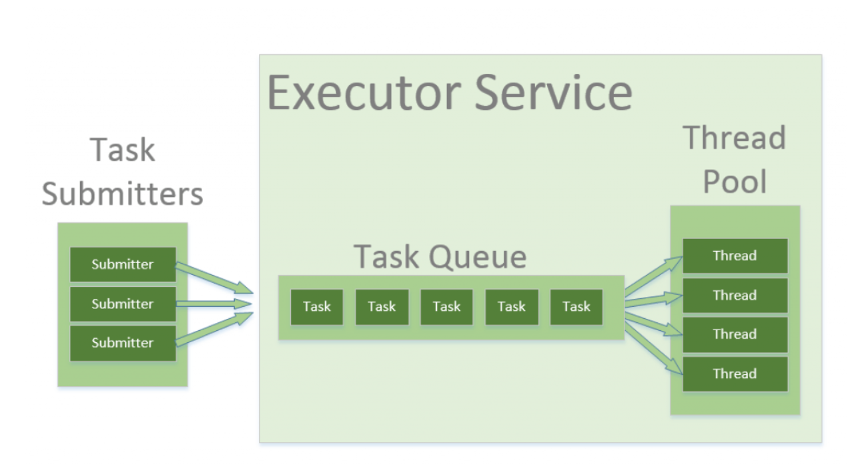
Executors
Higher level replacement for working with threads directly.
Simplifies asynchronous tasks.
Create and manage pool of threads
Notes:
Rather than creating a thread each time you need one, you can create an executor or executor service to handle creation and assigning of tasks.
You submit the task to the executor service, which assigns tasks to the threads. As a thread becomes available, it is given a new task.

Slide 12
There are many kinds of executors:
ExecutorService
newSingleThreadExecutor();
Creates 1 thread.
newFixedThreadPool(1);
Creates number of threads specified.
newWorkStealingPool();
Creates thread pool using all available processors. Idle threads can steal jobs from busy threads.
newCachedThreadPool();
Creates new threads as needed, but reuses threads if available.
ScheduledExecutorService
newScheduledThreadPool(1);
Creates executor capable of scheduling tasks to run periodically.
Notes:
Also there is a Fork/Join Executor

Slide 13
Create an Executor:
ExecutorService executor = Executors.newFixedThreadPool(1);
Stop an Executor:
The executor won’t stop by itself. It must be stopped before the program can end.
executor.shutdown();
// this will not stop immediately, but wait for threads to finish tasks.
executor.shutdownNow();
// this will stop all tasks immediately and shut down.
Suggested shutdown method
executor.shutdown();
try {
if (!executor.awaitTermination(800, TimeUnit.MILLISECONDS)) {
executor.shutdownNow();
}
catch (InterruptedException e) {
executor.shutdownNow();
}
Notes:
First create a class that extends Thread.
It must have the run() method to extend Thread. In run should be any logic that the thread will perform.
The main class is where you create and run the thread. First, create new instance of the class where the run method is.
Then create a new thread with the class instance as an argument.
Then start the thread with the start method. Start calls the run method in the class instance. Which causes the thread to become runnable. When it has finished, the thread dies.
This code can be simplified to one line. create thread, and start all at once. Drawback to this is it can’t be referenced again.

Slide 14
Use threads in an executor directly:
executor.submit(() -> {
System.out.println(“Hello “ + Thread.currentThread().getName());
Use Runnables:
executor.submit(runnableName);
Use Callables and Futures:
Callables are just like runnables but they return a value.
Futures get the value returned by the callable.
Notes:
First create a class that extends Thread.
It must have the run() method to extend Thread. In run should be any logic that the thread will perform.
The main class is where you create and run the thread. First, create new instance of the class where the run method is.
Then create a new thread with the class instance as an argument.
Then start the thread with the start method. Start calls the run method in the class instance. Which causes the thread to become runnable. When it has finished, the thread dies.
This code can be simplified to one line. create thread, and start all at once. Drawback to this is it can’t be referenced again.

Slide 15
Callable
Callable<Integer> task = () -> {
try {
TimeUnit.SECONDS.sleep(2);
return 123;
}
catch (InterruptedException e) {
throw new IllegalStateException(“task interrupted”, e);
}
};
Callable
Callable returns a value.
Notes:
Callable returns a value, so you can

Slide 16
Future
ExecutorService executor = Executors.newFixedThreadPool(1);
Future<Integer> future = executor.submit(task);
Integer result = future.get();
Integer result = future.get(1, TimeUnits.SECONDS);
boolean Done = Future.isDone();
Future
Submit callable with future to retrieve return.
Return is retrieved with future.get();
Add timeout to get() to prevent running forever.
Future is blocking, so .isDone() can check if task is done

Slide 17
InvokeAll and InvokeAny
ExecutorService executor = Executors.newFixedThreadPool(5);
List<Callable<String>> callable = Arrays.asList(
() -> “task1”,
() -> “task2”,
() -> “task3”);
executor.invokeAll(callables)
.stream()
.map(future -> {
return future.get();
}).forEach(System.out::println);
Submitting multiple Callables at once
Add timeout to get() to prevent running forever.

Slide 18
Future
ExecutorService executor = Executors.newFixedThreadPool(1);
Future<Integer> future = executor.submit(task);
Integer result = future.get(1, TimeUnit.SECONDS);
Future
Submit callable with future to retrieve return.
Return is retrieved with future.get();
Add timeout to get() to prevent running forever.

Slide 19
Sharing Mutable Values
Multiple threads reading/writing same value causes race conditions.
Synchronization and Locks prevent two threads accessing at once.
Atomic Variables and ConcurrentMap are another non-blocking option.

