Slide 1




Threads and Executors
Extend Thread
Implement Runnable
Notes:
A thread is a thread of execution in a program. You have a main thread, but if you want to do multiple tasks at once you need to create more threads.
Analogy: You have a business. You are the main thread. You can do 1 task at a time. If you want to do things concurrently, you have to hire employees or threads.
There are 2 ways to go about that.
You can create threads one by one. They are like temporary employees. They have a task to do. When their task is done, they leave.
Or you can create an executor. That is like a manager with a pool of employees. You give the manager tasks who assigns them to available employees. When the employee is done with the task, the manager gives them another task.
Once you have employees, you have to give them tasks. You can create tasks in a couple of ways. First, if you are creating threads, you can create a specific type of thread class and instantiate it. That type of thread always does the same job. Like hiring a taxi.
Or you can create runnables, which are specific tasks, and then assign them to a generic thread. Clean the bathroom, mail a package, fix a computer. So you create a runnable and then assign it to a thread. Or you can submit it to your executor, which will assign it to a thread in the thread pool.

Slide 2
Threads
A thread is a thread of execution in a program.
The JVM allows multiple threads to run concurrently.
Programs start with a single thread which calls the main method
Every thread has a priority 1 (low) to 10 (high).
Higher priority threads get preference over lower.
Thread may be marked as Daemon, meaning the thread will not prevent JVM from exiting program.

Slide 3
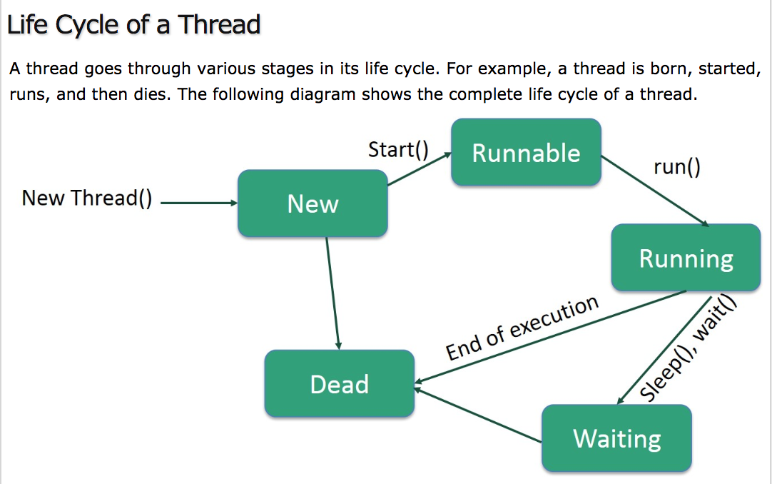
Notes:
New: A new thread has been created but not started. AKA a born thread.
Runnable: After thread is started, it is runnable.
Waiting: If the thread is waiting for another thread to perform a task. Transitions back to runnable when another thread signals it to continue.
Time Waiting: A thread may be set to wait for an interval of time. Transitions back to running when time expires.
Terminated or Dead: Once it completes a task or is terminated.

Slide 4
Runnables
Create a specific task for a generic employee to accomplish.
Implement Runnable Interface
Preferred over Extending Class because
More flexible. Allows extending another class.
Can use Lambda expressions.
Notes:
Remember, we can create a specific kind of thread or we can create a runnable and assign it to a generic thread.
This is the preferred method because it is more flexible. You can extend another class.
You can also use lambda expressions, like a shorthand way of writing the code.

Slide 5
To create a thread by implementing Runnable:
Create class that implements Runnable with run method
public class ExampleRunnable implements Runnable{
public void run(){
System.out.println(“Hello from thread.”);
}
}
In main method create instance of runnable, pass in to new thread | and thread name |
public class Example {
public static void main(String[] args) {
Runnable r1 = new ExampleRunnable();
new Thread (r1, “threadName”).start();
new Thread(r1, “AnotherName”).start();
}
Can create multiple thread that use same runnable.
Notes:
First create a class that extends Thread.
It must have the run() method to extend Thread. In run should be any logic that the thread will perform.
The main class is where you create and run the thread. First, create new instance of the class where the run method is.
Then create a new thread with the class instance as an argument.
Then start the thread with the start method. Start calls the run method in the class instance. Which causes the thread to become runnable. When it has finished, the thread dies.
This code can be simplified to one line. create thread, and start all at once. Drawback to this is it can’t be referenced again.

Slide 6
Runnable with Lambda Expression:
In main method, create Runnable
Public static void main(String[] args {
Runnable task = () -> {
String threadname = Thread.currentThread().getName();
System.out.println(“Hello from thread “ + threadName);
}
Still in main method, run on main thread or create tread to run task and start it.
task.run();
Thread thread = new Thread(task);
thread.start();
new Thread(task).start();
}
Can create multiple thread that use same runnable.
Notes:
First create a class that extends Thread.
It must have the run() method to extend Thread. In run should be any logic that the thread will perform.
The main class is where you create and run the thread. First, create new instance of the class where the run method is.
Then create a new thread with the class instance as an argument.
Then start the thread with the start method. Start calls the run method in the class instance. Which causes the thread to become runnable. When it has finished, the thread dies.
This code can be simplified to one line. create thread, and start all at once. Drawback to this is it can’t be referenced again.

Slide 7
Extend Thread Class
Hire a specific kind of employee that does a set task.
Thread class implements Runnable interface
Drawbacks to extending Class
Can’t extend other classes
Not overriding any methods, so not necessary.
Implement Runnable is preferred.
Notes:
The other thing you can do is create a specific thread class that does one task. This is not the preferred method because it is less flexible.
Drawbacks
You can only extend one class, so it limits your options for extending other classes.
Only do this if you are going to override more than just the run method.

Slide 8
To create a thread by extending Thread:
Create class that extends Thread with run method
public class ExampleThread extends Thread {
public void run(){
System.out.println(“Hello from thread.”);
}
}
Create class with main method that creates/starts thread
public class Example {
public static void main(String[] args) {
Thread t1 = new ExampleThread();
t1.start();
(new Thread (new MessageThread()).start();
}
Notes:
First create a class that extends Thread.
It must have the run() method to extend Thread. In run should be any logic that the thread will perform.
The main class is where you create and run the thread. First, create new instance of the class where the run method is.
Then create a new thread with the class instance as an argument.
Then start the thread with the start method. Start calls the run method in the class instance. Which causes the thread to become runnable. When it has finished, the thread dies.
This code can be simplified to one line. create thread, and start all at once. Drawback to this is it can’t be referenced again.

Slide 9
Methods that work with Threads
sleep(1000); Causes thread to wait for a time.
sleep needs try catch for InterruptedException
currentThread(); returns reference to current thread
setPriority(); Sets priority 1 (low) – 10 (high)
setName(); Sets name of thread
setDaemon(); Sets thread to daemon
dumpStack(); Prints stack trace of current thread

Slide 10
Create an Executor
Hire a manager and pool of employees
Preferred over working with threads directly
Creating threads individually has overhead.
Carefully choose the size of your thread pool
Don’t want unused threads sitting around
Don’t want tasks to take a long time
Notes:
Rather than creating a thread each time you need one, you can create an executor or executor service to handle creation and assigning of tasks.
Like hiring a manager and a pool of employees. Threads don’t leave when they are done, they come back to the pool to be reassigned.
You submit the task to the executor service, which assigns tasks to the threads. As a thread becomes available, it is given a new task.
Carefully choose the thread pool size. Too many threads take up space, but not enough will slow your program.

Slide 11
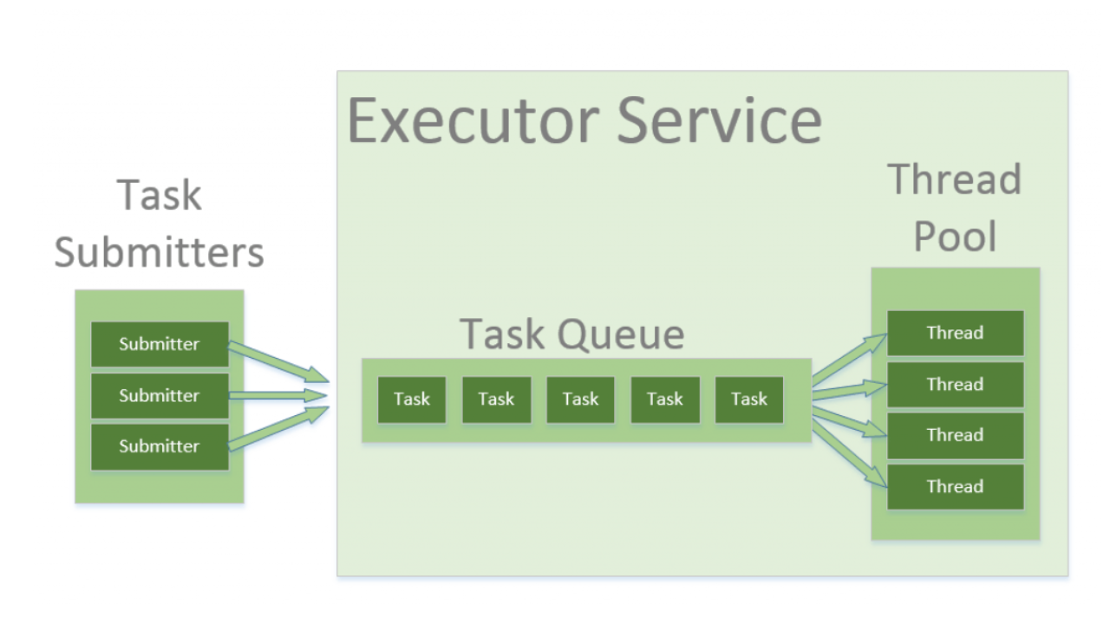
Executors

Slide 12
There are many kinds of executors:
ExecutorService
newSingleThreadExecutor();
Creates 1 thread.
newFixedThreadPool(1);
Creates number of threads specified.
newWorkStealingPool();
Creates thread pool using all available processors. Idle threads can steal jobs from busy threads.
newCachedThreadPool();
Creates new threads as needed, but reuses threads if available.
ScheduledExecutorService
newScheduledThreadPool(1);
Creates executor capable of scheduling tasks to run periodically.
Notes:
There are many kinds of executors,
You can create a fixed thread pool with a set number of threads,
Or you can create a flexible sized pool like cached thread pool, which will create and destroy threads if needed.
ScheduledExecutorService can schedule tasks to run after a period of time.
Other kinds of executors too.

Slide 13
Create an Executor:
ExecutorService executor = Executors.newFixedThreadPool(1);
Stop an Executor:
The executor won’t stop by itself. It must be stopped before the program can end.
executor.shutdown();
// this will not stop immediately, but wait for threads to finish tasks.
executor.shutdownNow();
// this will stop all tasks immediately and shut down.
Suggested shutdown method
executor.shutdown();
try {
if (!executor.awaitTermination(800, TimeUnit.MILLISECONDS)) {
executor.shutdownNow();
}
catch (InterruptedException e) {
executor.shutdownNow();
}
Notes:
Here is how you create an executor with a thread pool.
If you create an executor, you have to shut it down before your program can end. If you don’t the program will sit open indefinitely instead of closing.
Sort of like if you have a business, you can’t shut down the business until the employees are let go.

Slide 14
Use threads in an executor directly:
executor.submit(() -> {
System.out.println(“Hello “ + Thread.currentThread().getName());
Use Runnables:
executor.submit(runnableName);
Use Callables and Futures:
Like telling your employee purchase something, and bring it back.
Callables are just like runnables but they return a value.
Futures get the value returned by the callable.
Notes:
Once you have an executor you can give it tasks. You do this by submitting tasks to the executor. The executor will assign the task to a thread in the pool.
You can submit tasks directly without creating a runnable.
Or you can create a runnable and submit it.
Or another option with executables is using callables and futures. Callables tasks where you need a return value. Like asking an employee to purchase something, or to report back.
They are like runnables, but they can return a value. And a future gets that value.

Slide 15
Callable
public class CallableExample implements Callable<Integer>
{
public Integer cNumber;
public CallableExample(Integer number)
{
this.cNumber = number;
}
@Override
public Integer call() throws Exception {
return 123;
}
}
Notes:
You can create a callable class by implementing Callable, and then create a new instance of it, or you can create a callable. Here is an example of a callable class.
You would need to create a new instance of it before using it.

Slide 16
Callable
Callable<Integer> task = () -> {
try {
TimeUnit.SECONDS.sleep(2);
return 123;
}
catch (InterruptedException e) {
throw new IllegalStateException(“task interrupted”, e);
}
};
Notes:
Here is an example of a Callable that would be inside another class.
A callable returns a value. So to get that value, you need a future.

Slide 17
Future
Future<Integer> future = executor.submit(task);
Integer result = future.get();
Integer result = future.get(1, TimeUnits.SECONDS);
boolean Done = Future.isDone();
Future
Submit callable with future to retrieve return.
Return is retrieved with future.get();
Add timeout to get() to prevent running forever.
Future is blocking, so .isDone() can check if task is done
Notes:
To get the return value for a callable, you need to use a future.
The future saves the return value in a variable, but it doesn’t save it now, it waits until you ask for it.
To get it in the future, use get() Get is blocking, so you don’t want to use it too soon.
Also, to prevent it running forever if the answer is never returned, put a timeout value.

Slide 18
InvokeAll and InvokeAny
ExecutorService executor = Executors.newFixedThreadPool(5);
List<Callable<String>> callable = Arrays.asList(
() -> “task1”,
() -> “task2”,
() -> “task3”);
executor.invokeAll(callables)
.stream()
.map(future -> {
return future.get();
}).forEach(System.out::println);
Submitting multiple Callables at once
Add timeout to get() to prevent running forever.
Notes:
You can submit multiple callables at once using InvokeAll or InvokeAny.
InvokeAll will return all of the return values.
InvokeAny will only return the first return value.
Here the future is not being saved to a variable, it is just being gotten.

Slide 19
Sharing Mutable Values
Multiple threads reading/writing same value causes race conditions.
Synchronization and Locks prevent two threads accessing at once.
Atomic Variables and ConcurrentMap are another non-blocking option.

