Slide 1

Vehicle Service Booking with AI Diagnosis
Graduate: Raul Alexandru Moldovan
Supervisor: Prof.Dr.Eng. Dorian Gorgan

Slide 2
Introduction
Vehicle service Booking with AI Diagnosis
Problem: choosing the right service requires technical knowledge
Goal: a platform where describing the problem in plain language is enough

Slide 3
Requirements
Functional:
  User registration and login
  Browsing services
  Appointment management
  AI chatbot booking
  Admin management
Non-functional: Security, Usability, Performance, Maintainability

Slide 4
Proposed Solution
Full-stack platform
Two roles: customer, administrator
AI chatbot

Slide 5
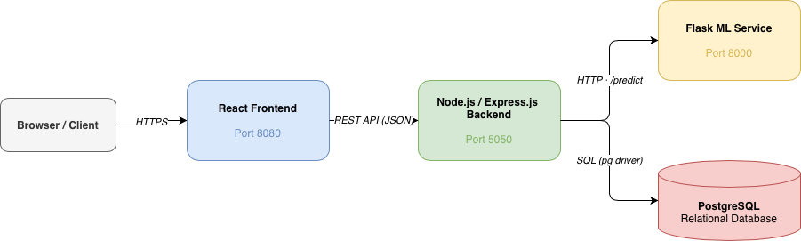
System Architecture
Frontend: React + TypeScript
Backend: Node.js + Express
Database: PostgreSQL
AI Service: Python + Flask

Slide 6
AI Module
Text -> TF-IDF vector -> classifier -> recommendations + confidence
500 training examples across 10 service categories
Four models: Logistic Regression, Linear SVC, Naive Bayes, Random Forest
Model and recommendation count adjustable

Slide 7
Workflows
Authentication
Browsing services
Appointment management
AI chatbot booking
Admin management

Slide 8
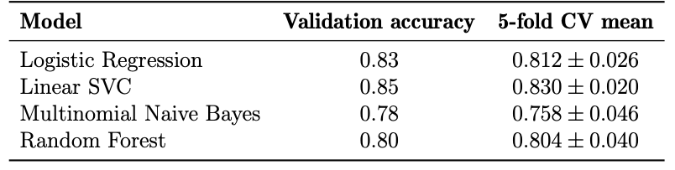
Testing and Verification
Backend: endpoints tested with Postman
Frontend: form validation, route protection, error handling
ML: held-out validation split + 5-fold cross-validation

Slide 9
Results Obtained
Working end-to-end system
Chatbot: problem description -> confirmed booking
Best accuracy: Linear SVC
Conflict detection

Slide 10
Personal Contributions
Full-stack development
AI training and integration
Chatbot conversation flow
Documentation

Slide 11
Future Improvements
Real customer inputs and periodic model retraining
Automated test suite
Docker-based deployment
Email notifications and admin reporting

Slide 12
Conclusion
Customers no longer need technical knowledge
All functional and non-functional requirements met

Slide 13
Thank you for your time

