Slide 1
ShipWars

Slide 2
What’s it about?
Earth’s space team has found a way to leave our Galaxy(Milky Way) and explores others
We enter the Pinwheel Galaxy to find out that its not run by humans, but “Aliens”
They take our entering as a threat and destroy the team, but that’s not it, they leave there Galaxy and come to ours for revenge.

Slide 3
Your Move
You have a choice of 4 ships
Skills: HP(hit points/life), Attack, defence

Slide 4
Features
There are a number of levels, completing one level unlocks the next.
Level’s send you to facing multiply number of waves before facing a boss.

Slide 5
Features Cont. (Experience)
As you kill enemies and beat levels you are given experience points.
Experience points are used to level up, levelling up boosts up your ships stats.
Determined? They are determined depending on which level you are one, which enemy you defeated and the level of your level

Slide 6
Features Cont. (Points)
As you kill enemies and beat levels you gain points
Points can be traded in for upgraded parts for your ship

Slide 7
Spending Your Hard Work
The points can be spent at the upgrade shop
This upgrades three stats stated at the beginning
Buying one unlocks more

Slide 8
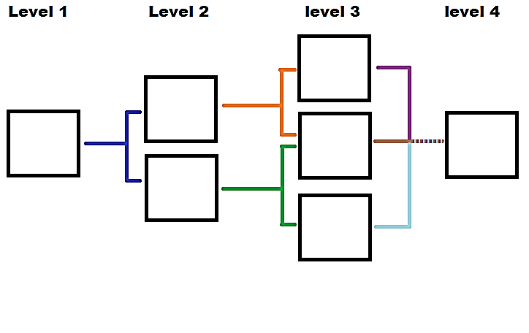

Slide 9
Special Attack
Each of the four ships has their own special move (depending on there stats)
Your special is only used once you fill up the bar, the bar is filled by defeated enemies only.
Special lasts only 30 secs

Slide 10
Controls
Key | Action
Right Arrow Key | Moves the ship to the right
Left Arrow Key | Moves the ship to the left
Up Arrow Key | Moves the ship up
Down Arrow Key | Moves the ship down
Shift + Right Arrow | Barrel Row to the Right
Shift + Left Arrow | Barrel Row to the Left
Space Bar | Fires
Z | Uses Special
Enter Key | Brings Up Menu

Slide 11
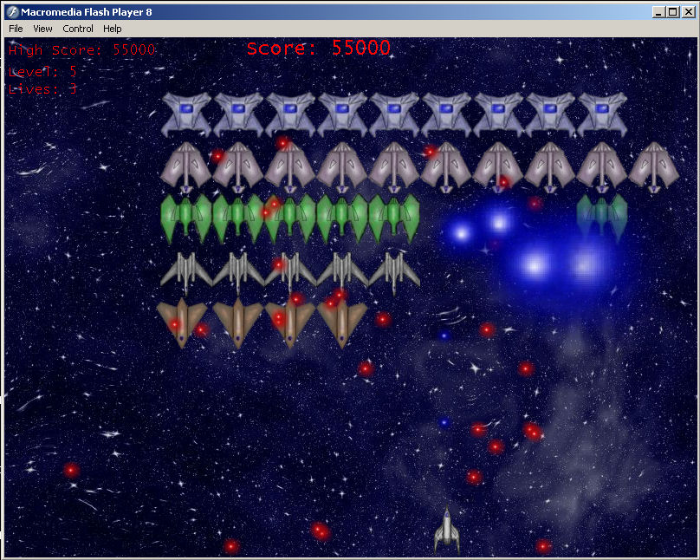
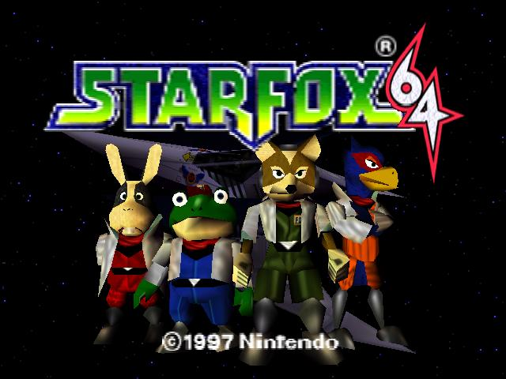
Competition
Space Invaders
Star Fox – Nintendo product, no problem

Slide 12
What to be done for Capstone
Unity or Visual Studios(C#)
All four ships
Up to three(3) playable levels
Ships level cap to (15)
At least 75% of the shop to be done

