Slide 1
AuraRA
Illuminate Her Health
HealthXher Hackathon
Team Auro
2026/2/22
Notes:
Screening me
Scoring knee

Slide 2


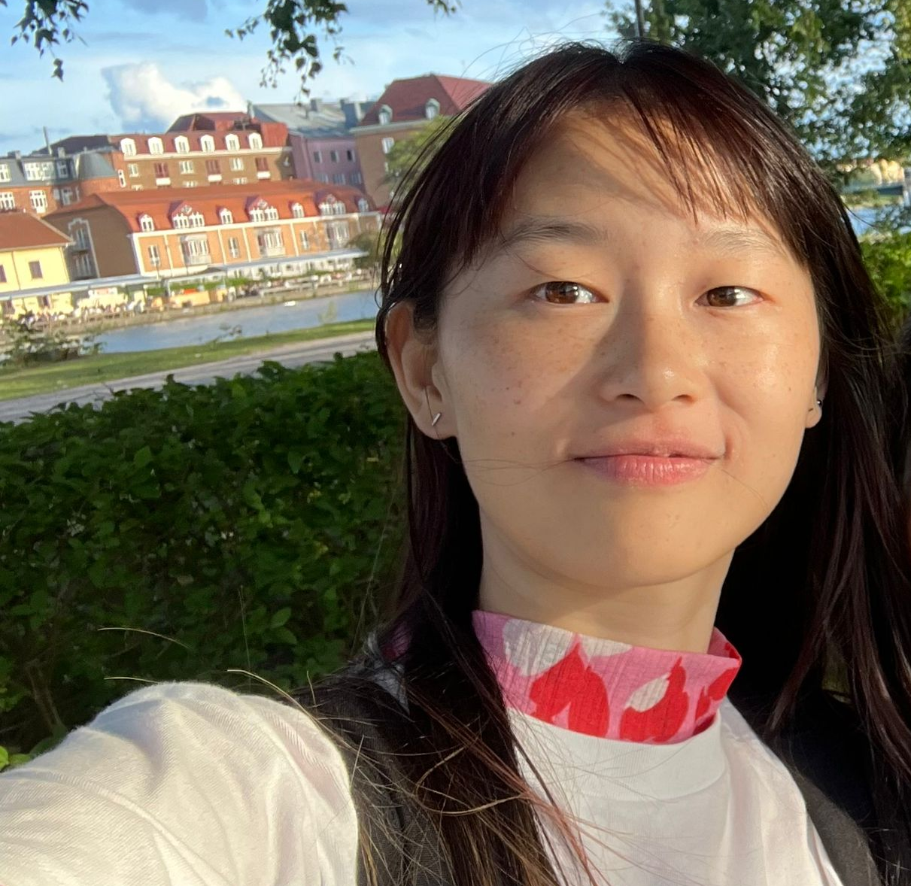
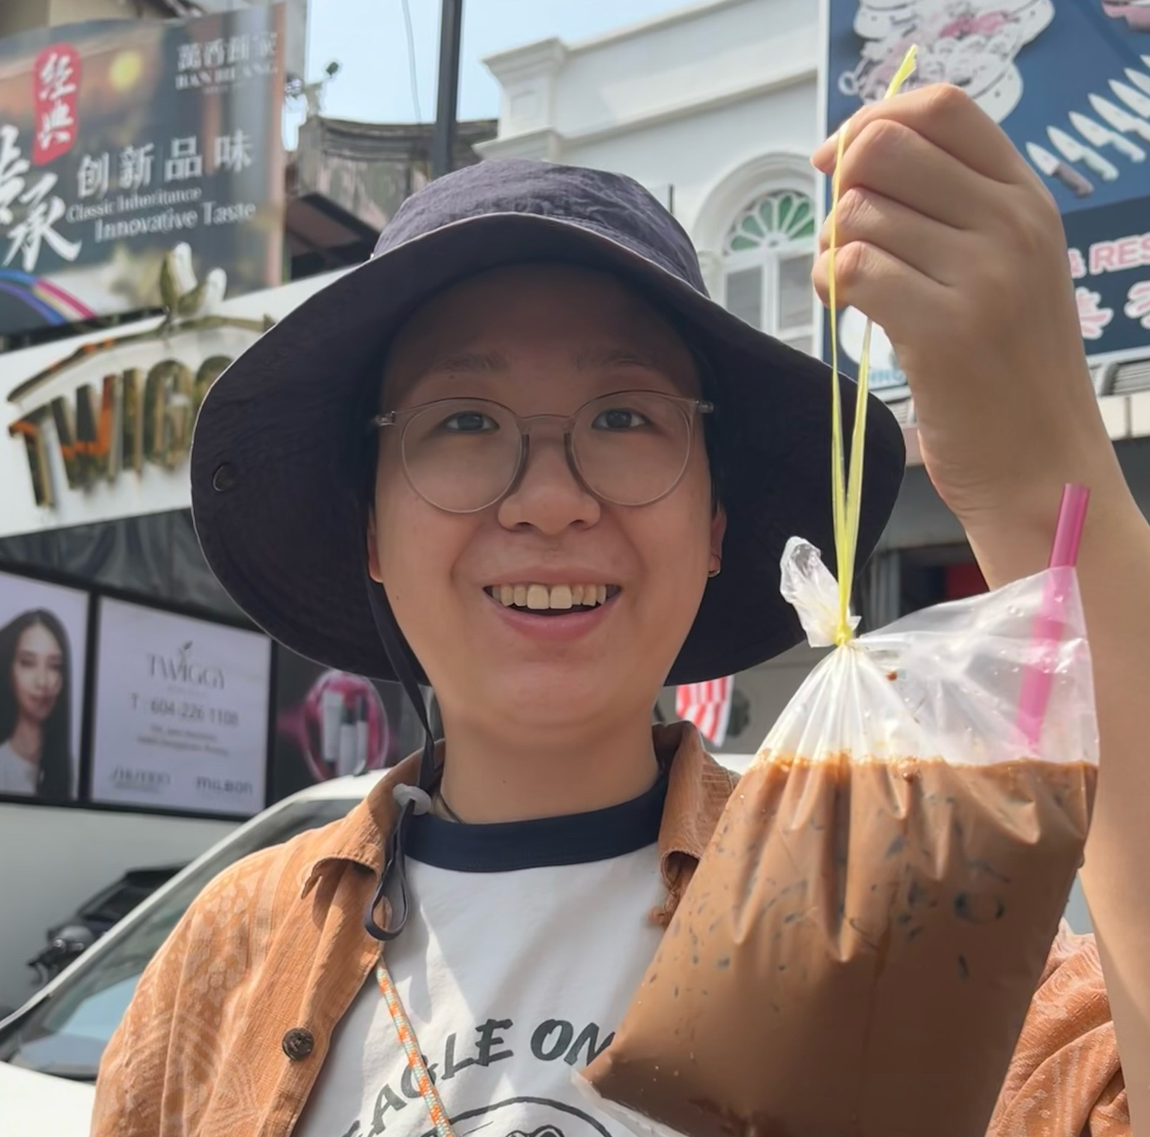


A Diverse, All-Female Team
A cross-disciplinary team with backgrounds in Biomedical, Computer Science, and AI.
Our prototype is a tool built by woman, for women’s health: we combine technical excellence with medical precision to solve the health challenges we truly understand.
Phichamon Sakdarat
Ranxuan Zhang
Moli Zhou
Jushuanghui Li
Xiaowen Yang
Biomedical Engineering，
MSc
Biomedical Engineering，
MSc
Data Science and AI,
MSc
High Performance Computer, MSc
Computer System and Cybersecurity, MSc

Slide 3
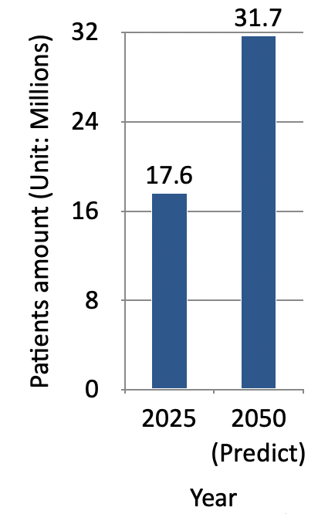
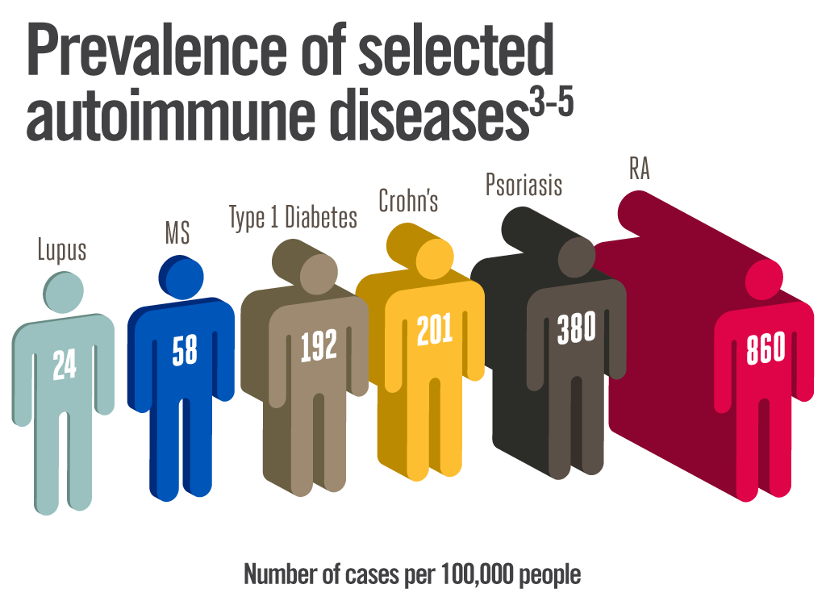
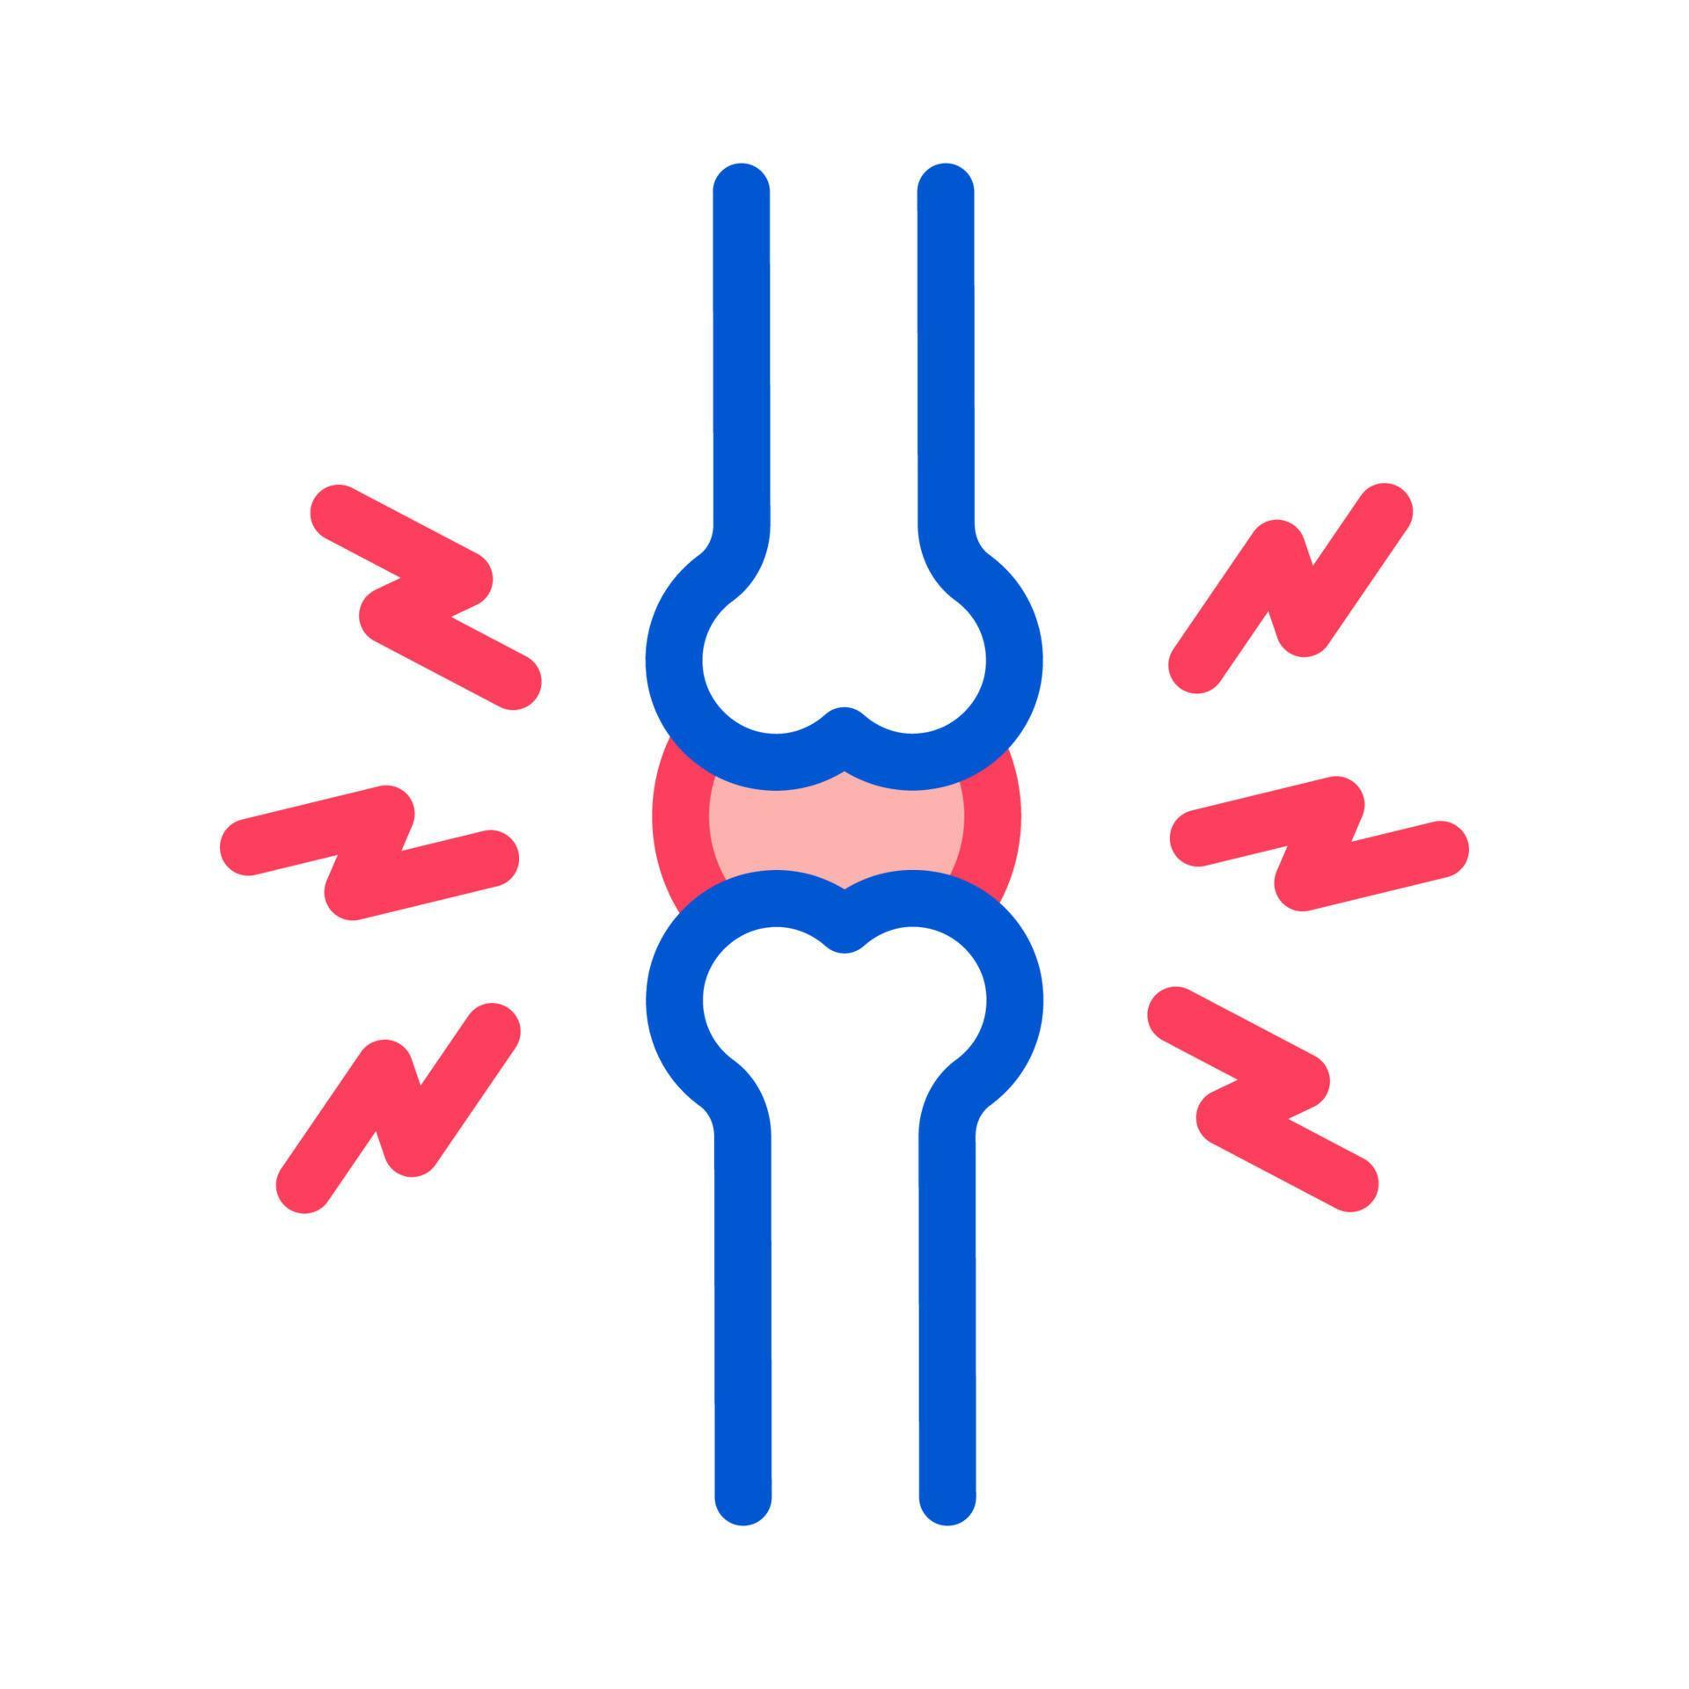

Challenge: Autoimmune Disease Diagnosis
Rheumatoid arthritis (RA)
Affecting 0.5% to 1% of the adult population worldwide².
Symptoms:
Symmetrical Pain & Morning Stiffness, chronic inflammation
Outcome:
Bone Erosion & Quality of Life
+$3,383[1]
Additional Annual Healthcare Expenditure per Patient (vs. Non-RA).
Driven primarily by Prescription Medication
Notes:
Women account for 80% of global autoimmune cases. It is a gender-based health crisis.
Chronic fatigue and joint pain often "mimic" other ailments, making early detection a "clinical maze."
Patients visit multiple doctors over several years before receiving an accurate diagnosis. The current system is fragmented.

Slide 4







RA occurs more on woman
Gene Density
The X-Chromosome "Double Dose"
Genetic Factors
Immune Regulation
The X chromosome carries a high concentration of immune-related and regulatory genes.
3:1
Higher Mutation Risk
Gender Distribution：
Hormonal Shifts
RA onset is frequently linked to periods of major hormonal change, such as pregnancy, and menopause.
Hormonal & Physiological
Higher Antibody Production

Slide 5




The Diagnostic Long Journey
Delayed Diagnosis
It takes an average of 4 years to get a final diagnosis, causing immense patient anxiety and mental strain.
Data Fragmentation
Scattered medical records prevent doctors from using past test outcomes to make faster, informed decisions.
"Invisible" & Overlapping Symptoms
Fluctuating pain and overlapping symptoms make RA difficult to distinguish from other conditions.
Confusion Over "Next Steps”
Inconsistent hospital standards leave patients lost and unsure of the necessary next steps.
Notes:
The Diagnostic Odyssey

Slide 6







AI-Optimized Early Detection for Rheumatoid Arthritis
Point-of-Care Screening Platform​
Clinical decision support for diagnosis
AI-based risk scoring from demographics and symptoms
User friendly
At-Home Assessment
Interactive symptom log
AI-Optimized reflex test
Suggesting next test based on lab result and AI risk scoring
Seamless integration
Plugs into existing Laboratory Information Systems (LIS)
Data integration
Patient summary
Sync with HIS system (with user consent)
Quantitative test analysis
Analyzes quantitative test value rather than binary results
Iterative Learning Loop
Learns from clinician feedback and real-world data
Refines test suggestions
Data privacy
Store data locally
Export reusable report
* This is the future plan
Notes:
To address the significant diagnostic delays in autoimmune care, we’ve developed a two-pillar solution that standardizes the journey from the first symptom to a definitive diagnosis.
Section 1: Point-of-Care Screening Platform (The Patient Gateway)
"The journey begins with a user-friendly web application for at-home assessment.
AI Risk Scoring: We move beyond basic forms by using Machine Learning to analyze demographics and interactive symptom logs
Data Integration & Privacy: This isn't just a static report. High-risk patients can choose to sync their summary directly with the Hospital Information System (HIS) or export a reusable report while keeping their data stored locally for maximum privacy."
Section 2: Clinical Decision Support for Diagnosis (The Lab Engine)
"Once the patient enters the clinical environment, the platform transitions into a powerful decision-support tool for the lab and clinician.
It help suggesting next optimal test based on initial result.
Seamless Integration: The tool is designed to plug directly into existing Laboratory Information Systems (LIS), ensuring it enhances—rather than disrupts—the current workflow.
Quantitative test analysis: This is where we revolutionize the process. Instead of following rigid, binary 'positive/negative' rules, the AI analyzes specific quantitative concentration levels. This allows the system to identify 'borderline' cases and automatically trigger the next, most effective test based on the patient's unique risk profile.
Iterative Learning Loop: Finally, the system is built to evolve. It learns from real-world data and direct clinician feedback to constantly refine its test suggestions, ensuring the highest accuracy for early RA detection."

Slide 7




Workflow: From Home to Hospital
Home-screening
Patients input their symptoms via the website/app to generate a risk score
3) The Clinical Decision Support (CDS) tool
System suggests an optimal, staged reflex testing workflow.
2) Bridge to Hospital
If high risk, the system suggested initial test.
Patient chooses to print the report or send data securely to hospital EHR.
4) Clinical confirmation - The feedback Loop
Clinicians review the AI summary, finalize the diagnosis, and provide feedback to iteratively retrain the AI.​
Notes:
The journey begins at home, where patients use our web application to input clinical symptoms and demographics.
The system uses Machine Learning models to analyze this data such as symmetrical joint pain or morning stiffness to generate an risk score.
2. When a 'High Risk' score is generated, the system suggests the initial laboratory testing phase. We empower the patient with a choice: they can transmit their risk profile securely to the hospital's Electronic Health Record or print a clinical report to bring to their consultation. This ensures a data-driven handoff that reduces the friction and delays typical of early autoimmune screening.
3. Once in the hospital, our Clinical Decision Support tool takes over, integrating directly into the laboratory system. Instead of following rigid, manual protocols, the AI suggests an optimal, staged reflex workflow. Because the AI analyzes specific quantitative concentration levels rather than simple binary results, it automatically triggers subsequent, more specific assays based on the patient's unique risk profile
4. Finally, the clinician reviews the AI-generated summary and lab results to finalize the diagnosis. This is not a 'black box' system; it is a collaborative loop. Clinician interpretations are fed back into the platform to iteratively retrain the AI, constantly refining the diagnostic path for the next patient to ensure that even 'borderline' or seronegative cases are never missed.
Public dataset cite
Smart referral + risk info should be one step
Add a mark or icon to show the first step(where to start)

Slide 8








We Value Data Privacy and Security
Collected Data is stored LOCALLY
Consent can be withdrawn anytime
After consent
Store the patient data to train our model
Encryption
Encryption
Encryption
Do the computation in the memory
No consent
Do the computation in the memory
Login with the Multi-Factor Authentication
Do the computation in the memory
Fill form
User get the results
The result and the patient's data is store locally
After computation,
delete data from the server
Patient clinical data is stored on the user device
The sever computation only transient inference without persistent storage
Only after consent, patient clinical data can be stored in the training server
Destroy the patient data on the server
Notes:
Dalayed diagnosis : We reduce friction by moving screening into the home and utilizing Real-Time Reflexing. Our web app acts as a Digital Front Door which triggering the necessary laboratory pathways the moment a patient is flagged as high-risk, we ensure immediate clinical progression and eliminate the cost of unnecessary, redundant testing.
Data fragmentation : Disconnected data leads to missed diagnoses. We provide a Unified AI Workflow that synthesizes home screening, clinical history, and lab results into a single, actionable diagnostic path.
Invisible & overlapping Symptoms : Autoimmune diseases are often masked by 'invisible' symptoms and overlapping clinical signs that mirror other conditions. We solve this by converting subjective patient symptoms into objective, data points using Interactive symptom log. Also, by shifting from binary 'Positive/Negative' rules to subclinical detection—analyzing specific quantitative values and trends in serology to ensure "borderline" or seronegative cases are not missed by rigid manual rules.
Confusion --> Automated Pathways: Replaces manual "guesswork" with an evidence-based, staged workflow based on risk probability

Slide 9
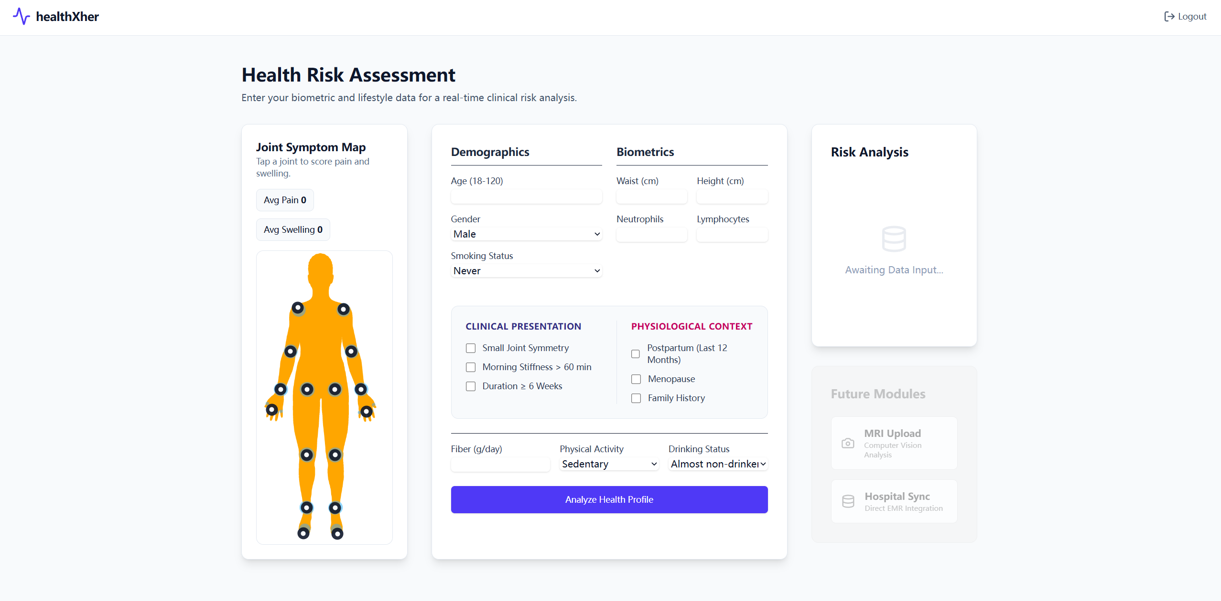
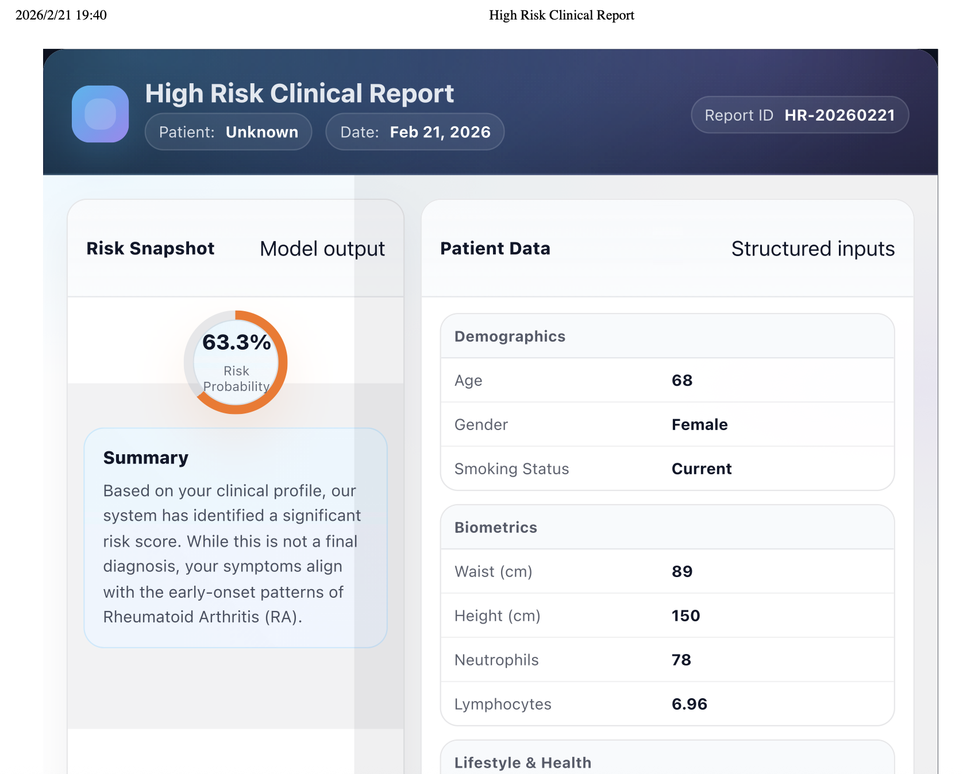
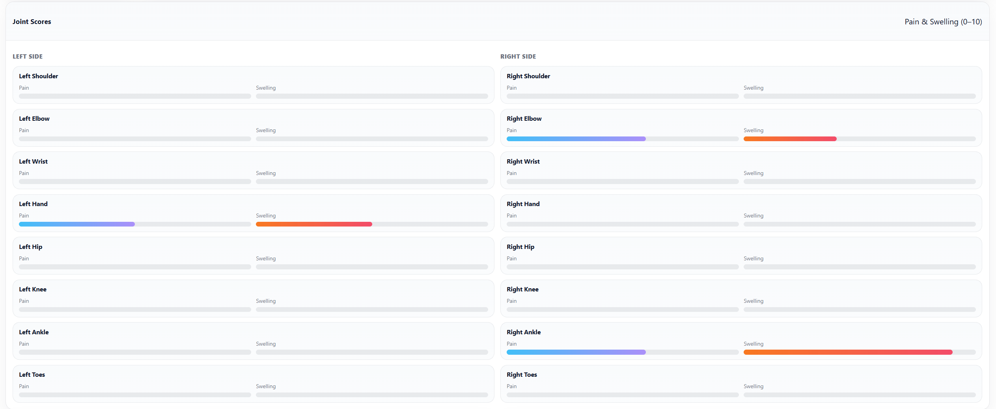
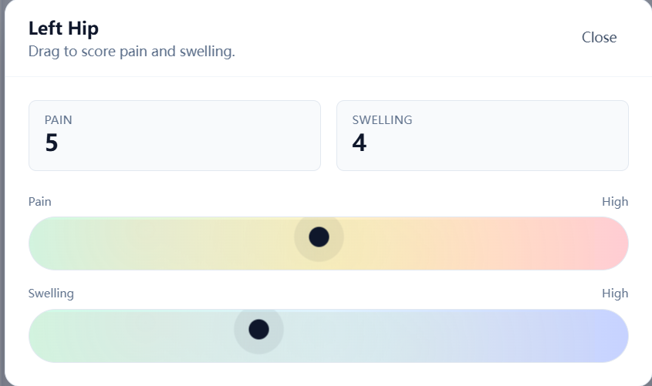
How the AuraRA solve the problems?
01
Delayed Diagnosis
At-home screening
Reflexing for immediate progression and to reduce unnecessary testing
02
Data fragmentation
Sending home screening results to HIS
Unified, automated AI-led workflow
03
Invisible & Overlapping Symptoms
Converts subjective patient experiences into objective, AI-analyzed data points
Shift to quantitative value in serology test
04
Confusion Over "Next Steps”
Automate pathways
Targeted testing based on risk-probability
Notes:
Dalayed diagnosis : We reduce friction by moving screening into the home and utilizing Real-Time Reflexing. Our web app acts as a Digital Front Door which triggering the necessary laboratory pathways the moment a patient is flagged as high-risk, we ensure immediate clinical progression and eliminate the cost of unnecessary, redundant testing.
Data fragmentation : Disconnected data leads to missed diagnoses. We provide a Unified AI Workflow that synthesizes home screening, clinical history, and lab results into a single, actionable diagnostic path.
Invisible & overlapping Symptoms : Autoimmune diseases are often masked by 'invisible' symptoms and overlapping clinical signs that mirror other conditions. We solve this by converting subjective patient symptoms into objective, data points using Interactive symptom log. Also, by shifting from binary 'Positive/Negative' rules to subclinical detection—analyzing specific quantitative values and trends in serology to ensure "borderline" or seronegative cases are not missed by rigid manual rules.
Confusion --> Automated Pathways: Replaces manual "guesswork" with an evidence-based, staged workflow based on risk probability

Slide 10




Roadmap: How to make it in practice
Development
Validation
Focus: System integration
Integrate with 1177 (patient-facing) and hospital EHR systems. Ensure interoperability (HL7/FHIR), regulatory compliance (SaMD) and GDPR.
Test clinical accuracy, safety, and usability with specialists before deployment.
Scaling & Integration
Build the AI model and platform on top of a validated clinical foundation.
Focus: Model performance + Clinical usability
Collaborate with specialists to define clinical criteria (guideline, early RA biomarkers, lab test).
Foundation
Focus: AI model + platform built
Focus: clinical requirement + system architecture
Define CDS logic framework and system architecture
Notes:
Looking ahead, our project is evolving into a complete diagnostic ecosystem. First, we will integrate Medical Imaging, using Computer Vision to detect synovitis and bone erosion that are invisible to the naked eye. Second, we are building a dedicated Doctor Page to provide clinicians with an efficient, data-driven overview of patient symptom patterns for faster diagnosis. Finally, we will continuously refine our predictive model by using real-world clinical outcomes to back-test and optimize our weighting system. By bridging the gap between home monitoring and clinical expertise

Slide 11



Roadmap: More things we want to do
Medical
Imaging
01
MRI and CT imaging are critical for visualizing synovitis and early bone erosion that patients cannot feel.
Doctor Page
Providing clinicians with a comprehensive overview of patient symptom patterns efficiently.
02
Update predictive model by real data
03
Using actual clinical outcomes to back-test and refine our weighting system.
...Not only RA, expand to other autoimmune diseases...
Notes:
Looking ahead, our project is evolving into a complete diagnostic ecosystem. First, we will integrate Medical Imaging, using Computer Vision to detect synovitis and bone erosion that are invisible to the naked eye. Second, we are building a dedicated Doctor Page to provide clinicians with an efficient, data-driven overview of patient symptom patterns for faster diagnosis. Finally, we will continuously refine our predictive model by using real-world clinical outcomes to back-test and optimize our weighting system. By bridging the gap between home monitoring and clinical expertise

Slide 12
AuraRA
Q&A
Thank you for your attention !
Phichamon Sakdarat: Biomedical Engineering, MSc
Ranxuan Zhang: Biomedical Engineering, MSc
Xiaowen Yang: Computer System and Cybersecurity, MSc
Jushuanghui Li: High Performance Computer, MSc
Moli Zhou: Data Science and AI, MSc

Slide 13
References
[1] Huang Y, Li J, Agarwal SK. Economic and Humanistic Burden of Rheumatoid Arthritis: Results From the US National Survey Data 2018-2020. ACR Open Rheumatol. 2024 Nov;6(11):746-754. doi: 10.1002/acr2.11728. Epub 2024 Aug 6. PMID: 39105293; PMCID: PMC11557984.
[2] Guo Q, Wang Y, Xu D, Nossent J, Pavlos NJ, Xu J. Rheumatoid arthritis: pathological mechanisms and modern pharmacologic therapies. Bone Res. 2018 Apr 27;6:15. doi: 10.1038/s41413-018-0016-9. PMID: 29736302; PMCID: PMC5920070.
[3] Angum F, Khan T, Kaler J, Siddiqui L, Hussain A. The Prevalence of Autoimmune Disorders in Women: A Narrative Review. Cureus. 2020 May 13;12(5):e8094. doi: 10.7759/cureus.8094. PMID: 32542149; PMCID: PMC7292717.
[4] World Health Organization. (2023). Rheumatoid arthritis. https://www.who.int/news-room/fact-sheets/detail/rheumatoid-arthritis

