Slide 1

Statistics, Experimental Design and R
Marco Antonio Florenzano Mollinetti¹
¹University of Tsukuba, Systems Optimization Laboratory
mollinetti@syou.cs.tsukuba.ac.jp

Slide 2
Why this tutorial?
Statistics are very important in the majority of the fields
How can you properly report your results?
Bad experiment design can invalidate experiments
Powerful and free statistical tool: R

Slide 3
What do I need to know?
Basic knowledge of statistics
Familiarity with your OS
Lots of patience
Basic mathematical concepts
Have I said patience?

Slide 4
What will you learn at the end of this tutorial?
Basic R programming
Handling datasets
Probability distributions
Experiment design with one variable
Experiment design with multiple variables
Linear Regression
Logistic Regression

Slide 5
How will it be done?
3 hours: 3 modules
50 minutes explanation
10 minutes break
I will try to use datasets more related to biology
Statistical lingo is highlighted in purple

Slide 6
Reference Material
Montgomery, Douglas C., and George C. Runger. Applied statistics and probability for engineers. John Wiley & Sons, 2010.*

Slide 7
Reference Material
Hastie, Trevor, et al. "The elements of statistical learning: data mining, inference and prediction." The Mathematical Intelligence r 27.2 (2005): 83-85.

Slide 8
Reference Material
James, Gareth, et al. An introduction to statistical learning. Vol. 112. New York: springer, 2013.

Slide 9

Reference Material
Lecture notes for the "Experiment Design for Computer Sciences" class at Tsukuba University, access: https://github.com/caranha/ExperimentDesignLectureNotes

Slide 10
Access to the Material
This material is free of use and distribution under the creative commons license.
Every presentation and dataset sample is at my github link: https://github.com/Mollinetti/Statistics-R
Don’t know what github is? Now is a good time to learn

Slide 11
Before we begin
We need to install R
In your browser go to the following page: https://cloud.r-project.org
Choose your OS, download and follow the installation procedure

Slide 12
Before we begin
Now, we need an IDE for R
Most popular IDE: Rstudio
In your browser go to the following page: https://www.rstudio.com/products/rstudio/download/
Choose the Rstudio Desktop version

Slide 13
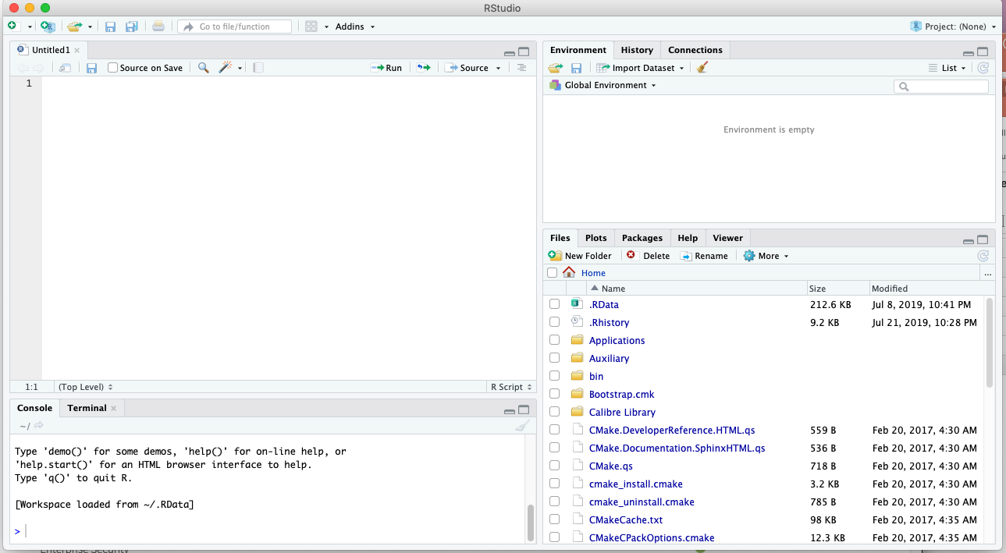
Before we begin
Open Rstudio, it should look like this:

Slide 14
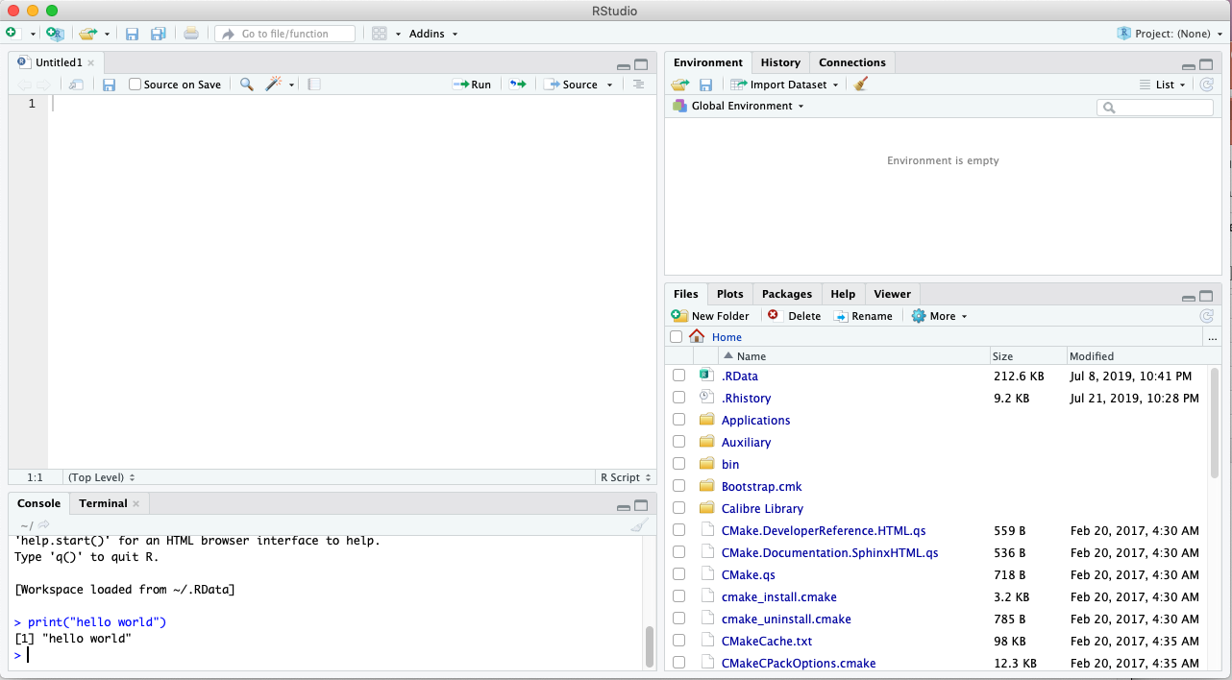
Before we begin
In the console type: print(“Hello World”)

Slide 15
Done! For now…
We’re ready to begin our journey!

Slide 16
Statistics, Experimental Design and R
Marco Antonio Florenzano Mollinetti¹
¹University of Tsukuba, Systems Optimization Laboratory
mollinetti@syou.cs.tsukuba.ac.jp

