Slide 1

Basic R Programming
Marco Antonio Florenzano Mollinetti¹
¹University of Tsukuba, Systems Optimization Laboratory
mollinetti@syou.cs.tsukuba.ac.jp

Slide 2
This module
We will start with basic R programming
Not too hard compared to others
No need to be too detailed
Any doubts? Consult cran and stackoverflow forums (even I do)

Slide 3
Before we Begin
Go to the github repo:
https://github.com/Mollinetti/Statistics-R
Download the script for this class! (in the ‘scripts’ folder class_1!)

Slide 4
Agenda
IDE environment
Setting your work directory
Your first program
Variables and types
Data structures
Conditionals
Loops
Functions
Importing modules
Basic plotting

Slide 5
IDE environment
Setting your work directory
Your first program
Variables and types
Data structures
Conditionals
Loops
Functions
Importing modules
Basic plotting

Slide 6
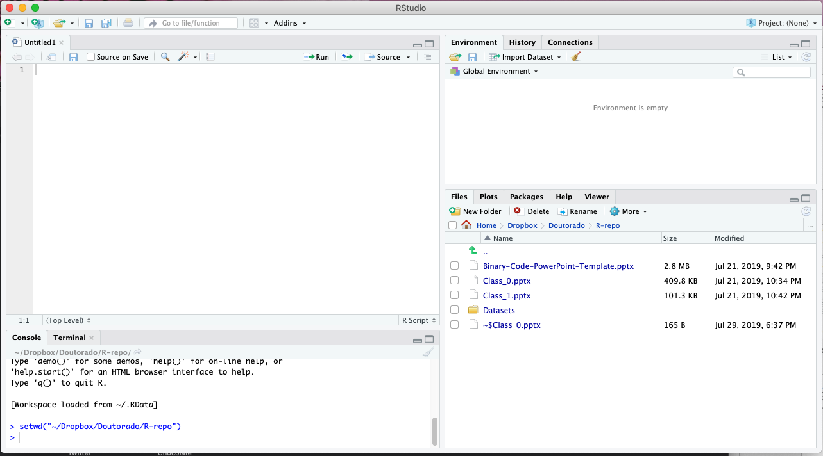
IDE Environment
When you open Rstudio, it looks like this

Slide 7
IDE Environment
When you open Rstudio, it looks like this
Your variables are stored in this tab!

Slide 8
IDE Environment
When you open Rstudio, it looks like this
File browser, you can set your working directory here!

Slide 9
IDE Environment
When you open Rstudio, it looks like this
Your scripts will be here!

Slide 10
IDE Environment
When you open Rstudio, it looks like this
Console and terminal for debugging

Slide 11
IDE Environment
When you open Rstudio, it looks like this
Console and terminal for debugging

Slide 12
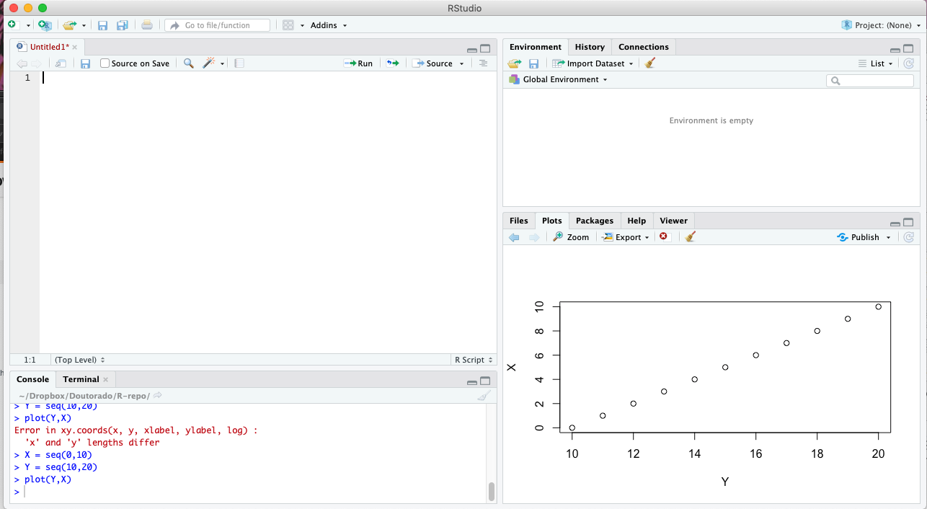
IDE Environment
When you open Rstudio, it looks like this
Your plots

Slide 13
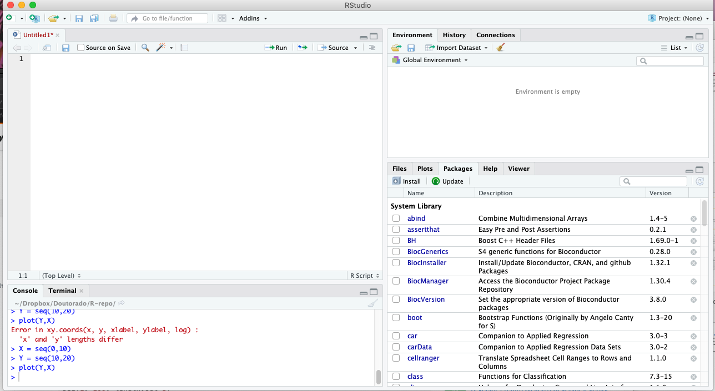
IDE Environment
When you open Rstudio, it looks like this
Your installed packages, checkboxes show whether they are active or not

Slide 14
IDE environment
Setting your work directory
Your first program
Variables and types
Data structures
Conditionals
Loops
Functions
Importing modules
Basic plotting

Slide 15
Setting your work Directory
We need to set the path to our datasets
Let’s say I want to access my folder called R-repo

Slide 16
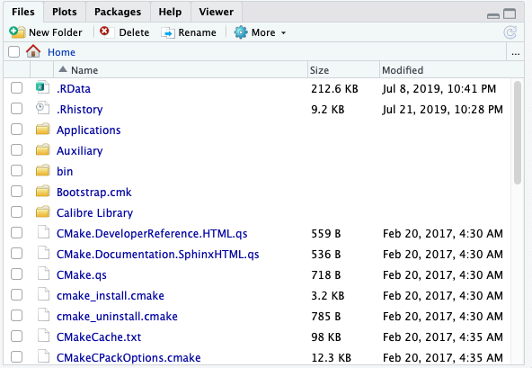
Setting your work Directory
We need to set the path to our datasets
Let’s say I want to access my folder called R-repo

Slide 17
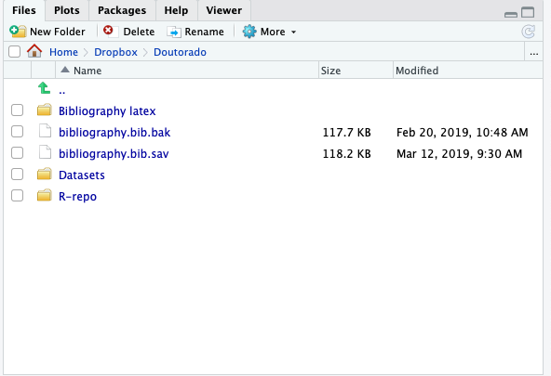
Setting your work Directory
We need to set the path to our datasets
Let’s say I want to access my folder called R-repo

Slide 18
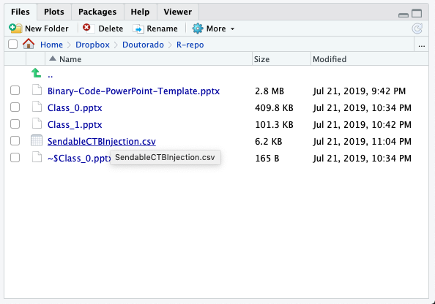
Setting your work Directory
We need to set the path to our datasets
Let’s say I want to access my folder called R-repo

Slide 19
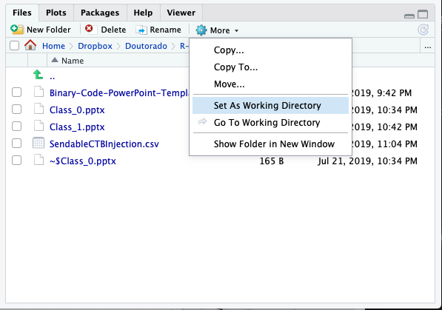
Setting your work Directory
We need to set the path to our datasets
Let’s say I want to access my folder called R-repo

Slide 20
IDE environment
Setting your work directory
Your first program
Variables and types
Data structures
Conditionals
Loops
Functions
Importing modules
Basic plotting

Slide 21
Your first program
Create a new script: File> new File> R script

Slide 22
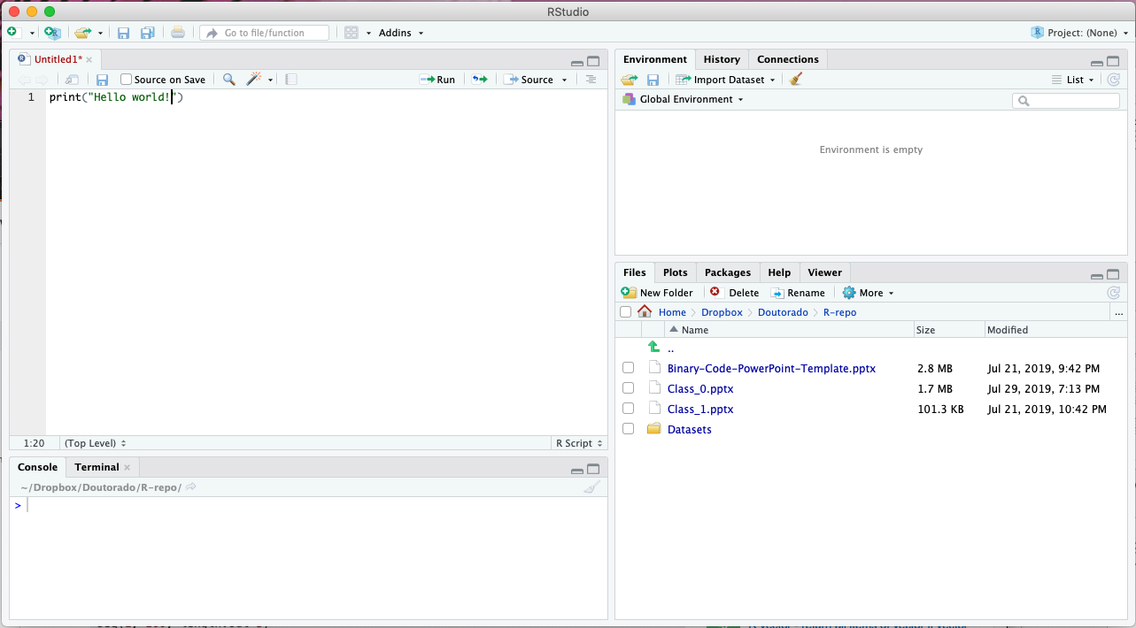
Your first program
Type: print(“Hello World!”)

Slide 23
Your first program
Click on Run or type ctrl/command+R

Slide 24
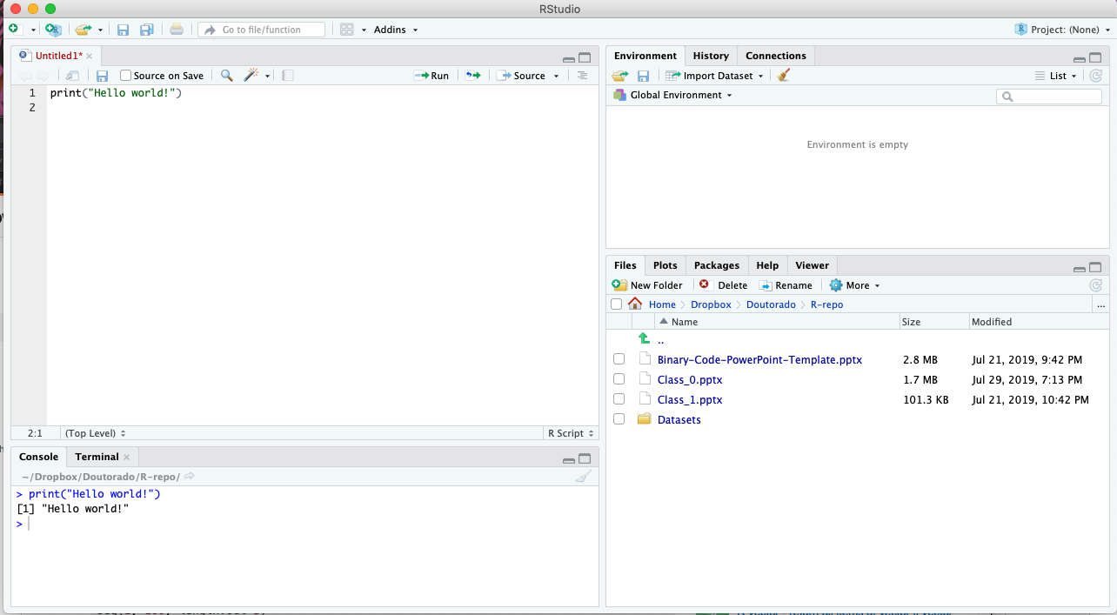
Your first program
Congratulations! You wrote your first R program!

Slide 25
IDE environment
Setting your work directory
Your first program
Variables and types
Data structures
Conditionals
Loops
Functions
Importing modules
Basic plotting

Slide 26
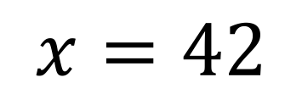
Variables and Types
Remember your math classes when you had to solve for x and y?
Variables hold some kind of value
$$x=42$$

Slide 27
Variables and Types
Remember your math classes when you had to solve for x and y?
Variables hold some kind of value
$$x=42$$
A variable named x

Slide 28
Variables and Types
Remember your math classes when you had to solve for x and y?
Variables hold some kind of value
$$x=42$$
Assigns to itself

Slide 29
Variables and Types
Remember your math classes when you had to solve for x and y?
Variables hold some kind of value
$$x=42$$
A value of 42

Slide 30
Variables and Types
Remember your math classes when you had to solve for x and y?
Variables hold some kind of value
$$x=42$$
In programming an = sign will ALWAYS signify assignment

Slide 31

Variables and Types
In R, you can assign a variable in both ways
The operator <- can be used anywhere, while the operator = is only allowed at the top level

Slide 32
Variables and Types
The most basic data types:
Character
Numeric
Integer
Logical
Complex

Slide 33

Variables and Types
The most basic data types:
Character
Numeric
Integer
Logical
Complex
Stores words

Slide 34

Variables and Types
The most basic data types:
Character
Numeric
Integer
Logical
Complex
Stores decimals

Slide 35

Variables and Types
The most basic data types:
Character
Numeric
Integer
Logical
Complex
Stores integers

Slide 36

Variables and Types
The most basic data types:
Character
Numeric
Integer
Logical
Complex
Stores either TRUE or FALSE

Slide 37

Variables and Types
The most basic data types:
Character
Numeric
Integer
Logical
Complex
Stores complex numbers

Slide 38
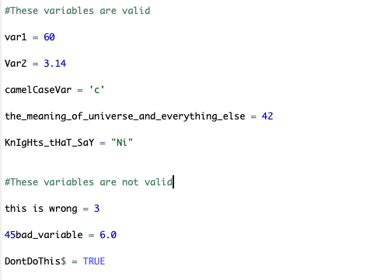
Variables and Types
Variables can have letters, numbers, . and _
Variables cannot have any special characters nor start by a number, and no space.

Slide 39
IDE environment
Setting your work directory
Your first program
Variables and types
Data structures
Conditionals
Loops
Functions
Importing modules
Basic plotting

Slide 40
Data Structures
We need a way to store multiple data together
Saving a single entry for each variable would be too hard to manipulate
Data structures: aggregation of data types

Slide 41
Data Structures
Data structures in R:
Vector
Matrix
List
Data Frame

Slide 42
Data Structures
Data structures in R:
Vector
Matrix
List
Data Frame

Slide 43
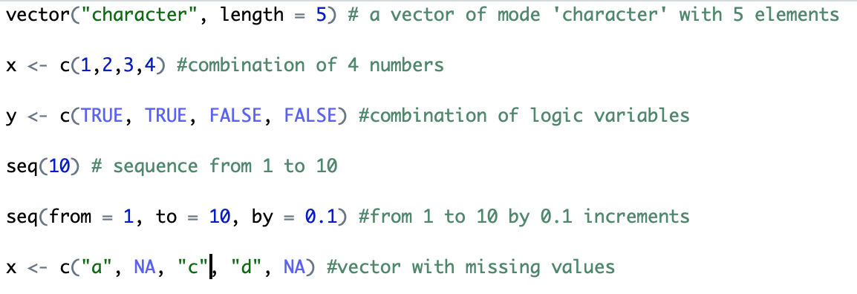
Data Structures-Vectors
The most basic aggregation of data in R
Can only be of a single data type
1-dimensional

Slide 44
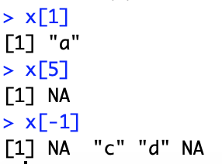
Data Structures-Vectors
How to obtain single entries of a vector?
Use the [] operator
First
Last
Everything but the first

Slide 45
Data Structures
Data structures in R:
Vector
Matrix
List
Data Frame

Slide 46
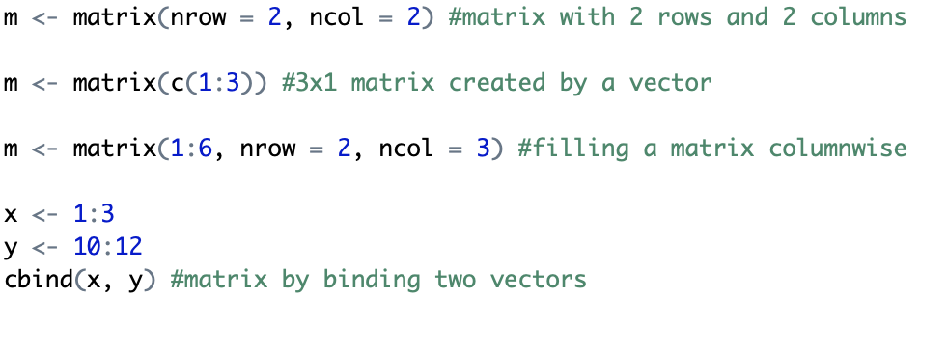
Data Structures-Matrix
Vectors with dimensions
Like vectors, can only be of a single data type

Slide 47
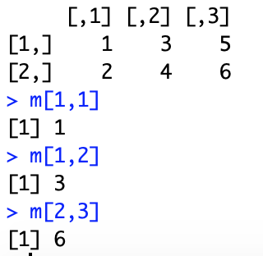
Data Structures-Matrix
How to obtain entries of a matrix?
Like vectors, use the [] operator

Slide 48
Data Structures
Data structures in R:
Vector
Matrix
List
Data Frame

Slide 49
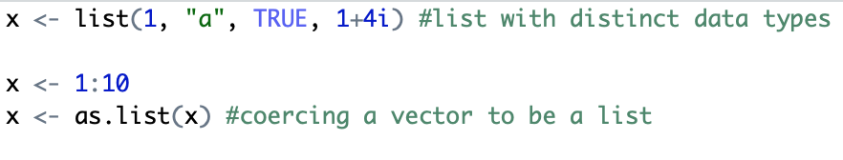
Data Structures-List
Vectors that can store any data type

Slide 50
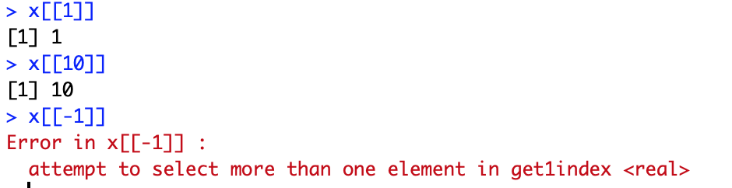
Data Structures-List
How to obtain entries of a list?
We now use the [[]] operator (cannot use – notation)

Slide 51
Data Structures
Data structures in R:
Vector
Matrix
List
Data Frame

Slide 52
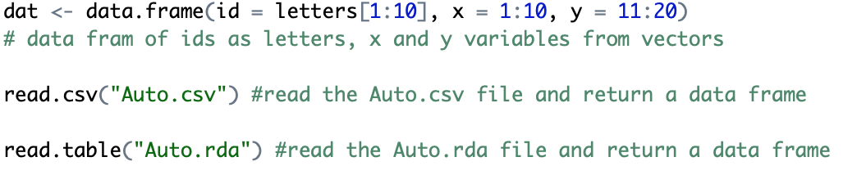
Data Structures-Data Frame
The most important Data structure of R
Data structure for most tabular data and what we use for statistics

Slide 53
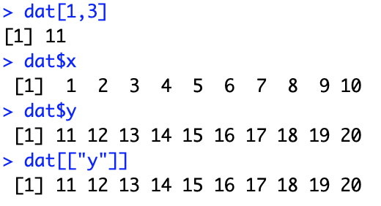
Data Structures-Data Frame
Access to single entries are similar to matrices
Access to columns can either be done by the [[]] operator or the $ operator

Slide 54
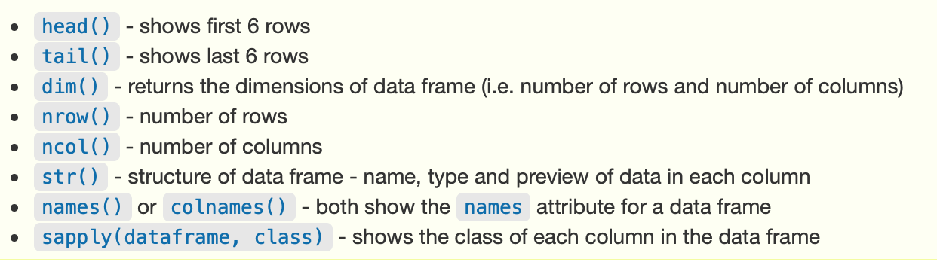
Data Structures-Data Frame
The Data frame structure has many methods that are useful
We will use some along the tutorials
For a complete list, check the API at Cran

Slide 55
Data Structures-Data Frame
The most important functions from Data Frames you must remember are:
Names() -names of the columns
Summary() -summary of all columns
Nrows() -number of rows
Ncols() -number of columns
Attach()* -column names as variables

Slide 56
IDE environment
Setting your work directory
Your first program
Variables and types
Data structures
Conditionals
Loops
Functions
Importing modules
Basic plotting

Slide 57
Conditionals
In the decision making process, we can have multiple choices
If something happens this happens, otherwise for any other case that happens
Seldom used in R (but we need to know)

Slide 58
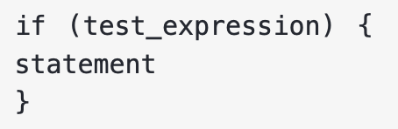
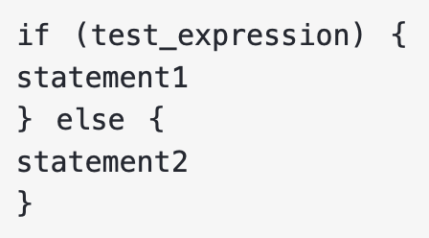
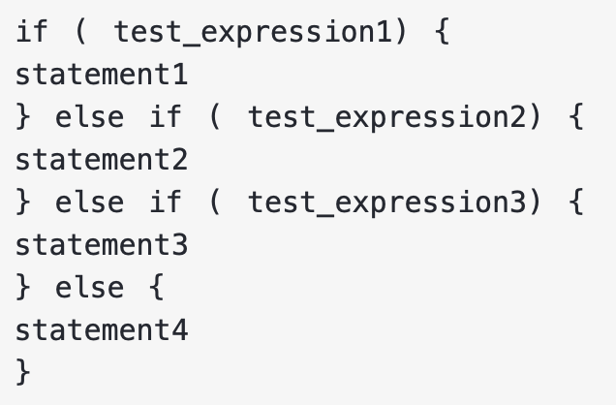
Conditionals
Conditional operands
== != < > <= >= && ||
Key words: if, else, else if
if
If + else
if + else if + else

Slide 59


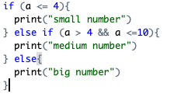
Conditionals
Conditional operands
== != < > <= >= && ||
Example:

Slide 60
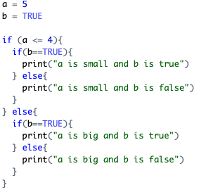
Conditionals
We can have if/else inside if/else (nested ifs)

Slide 61
IDE environment
Setting your work directory
Your first program
Variables and types
Data structures
Conditionals
Loops
Functions
Importing modules
Basic plotting

Slide 62
Loops
When we need to run the same command multiple times, we use loops
Frequently used in R
Runs whatever inside the block until the test statement is false

Slide 63
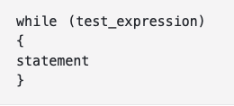
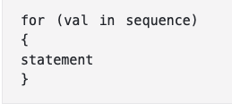
Loops
*Conditional operands
== != < > <= >= && ||
Key word: for, while
No need to tell when it ends*
Need to tell when it ends

Slide 64
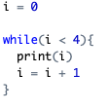

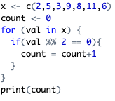
Loops
Examples:
while
while¹
for
¹example of an infinite loop

Slide 65
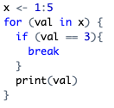
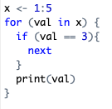
Loops
Break and next
Break: terminates the loop
Next: skip to the next iteration

Slide 66
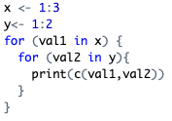

Loops
Like if/else we can have nested loops

Slide 67
IDE environment
Setting your work directory
Your first program
Variables and types
Data structures
Conditionals
Loops
Functions
Importing modules
Basic plotting

Slide 68
Functions
Blocks of code inside of a “wrapper”
We do it so we don’t have to rewrite everything all over again
3 components:
Input
Processing
Output

Slide 69
Functions
Works just like in math
Parameters x, y, z … (numbers, data frames, etc..)
Processing
Output (can be nothing)

Slide 70

Functions
For the function to output something, the return statement must be included
func_name follows the same naming rules for variables
Can put as many arguments as you need
This function outputs nothing

Slide 71
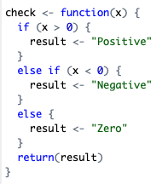

Functions
Example:

Slide 72
IDE environment
Setting your work directory
Your first program
Variables and types
Data structures
Conditionals
Loops
Functions
Importing modules
Basic plotting

Slide 73
Importing modules
Modules (or libraries) are packages with function that does not come included in R
If you already have a library, you must call it with the library() function
To download any extra package you must use the install.packages at the console

Slide 74
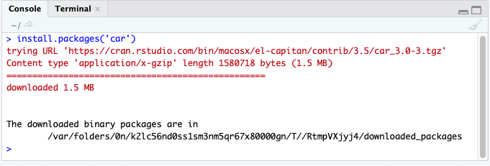

Importing modules

Slide 75
IDE environment
Setting your work directory
Your first program
Variables and types
Data structures
Conditionals
Loops
Functions
Importing modules
Basic plotting

Slide 76
Basic Plotting
Plotting can be done by many software nowadays
We’ll only see the basic plot() function
Many other libraries in R provide more specific plots

Slide 77
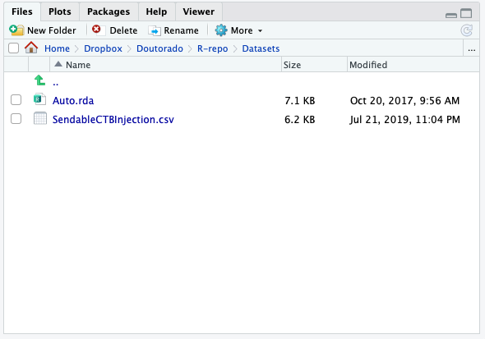
Basic Plotting
First we’ll load the Auto database
Just right click on the RDA file

Slide 78
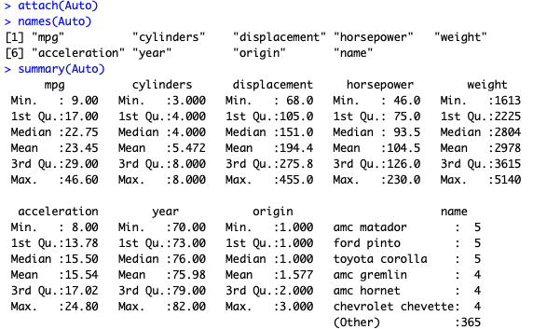
Basic Plotting

Slide 79
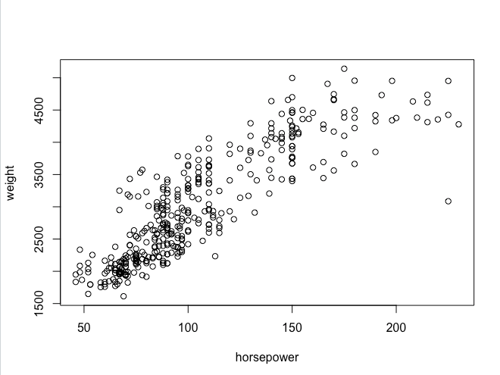
Basic Plotting
Plot two numerical variables

Slide 80
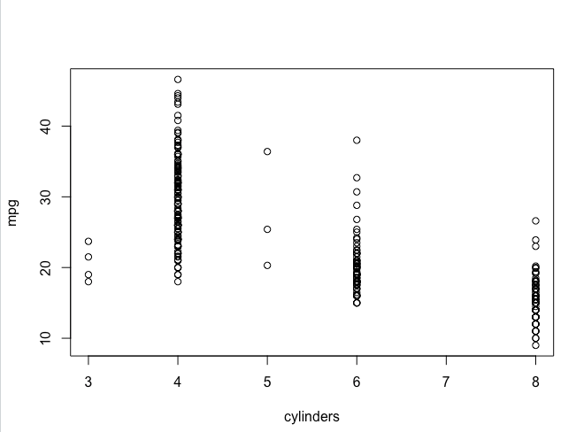
Basic Plotting
Another two numerical variables
Cylinders should be a categorical variable

Slide 81
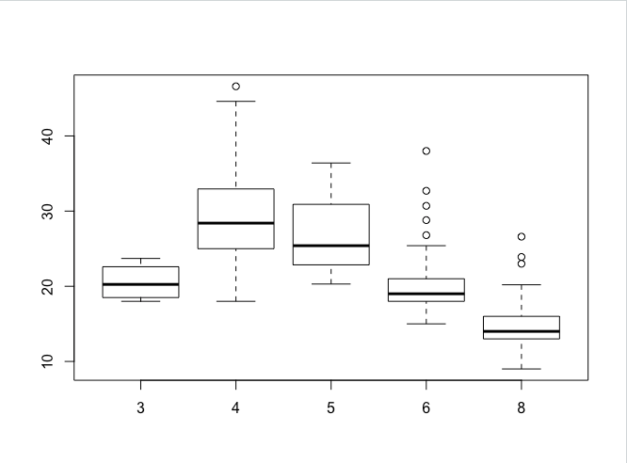
Basic Plotting
A categorical and numerical variable

Slide 82
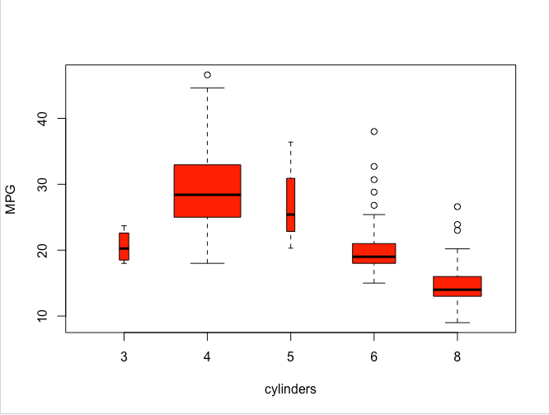
Basic Plotting
Fashion statement

Slide 83
Basic R Programming
Marco Antonio Florenzano Mollinetti¹
¹University of Tsukuba, Systems Optimization Laboratory
mollinetti@syou.cs.tsukuba.ac.jp

