Slide 1

Hypothesis Testing
Marco Antonio Florenzano Mollinetti¹
¹University of Tsukuba, Systems Optimization Laboratory
mollinetti@syou.cs.tsukuba.ac.jp

Slide 2
Agenda
Statistical Inference for One sample
Statistical Inference for Two samples

Slide 3
Statistical Intervals
Statistical intervals are important in quantifying the uncertainty associated to a given estimate
Define regions that are likely to contain the true value of an estimated quantity
Three of them*:
Confidence intervals (bound distrib. parameters)
Tolerance intervals; (bound selected proportion of distrib.)
Prediction intervals; (bound future observations)

Slide 4
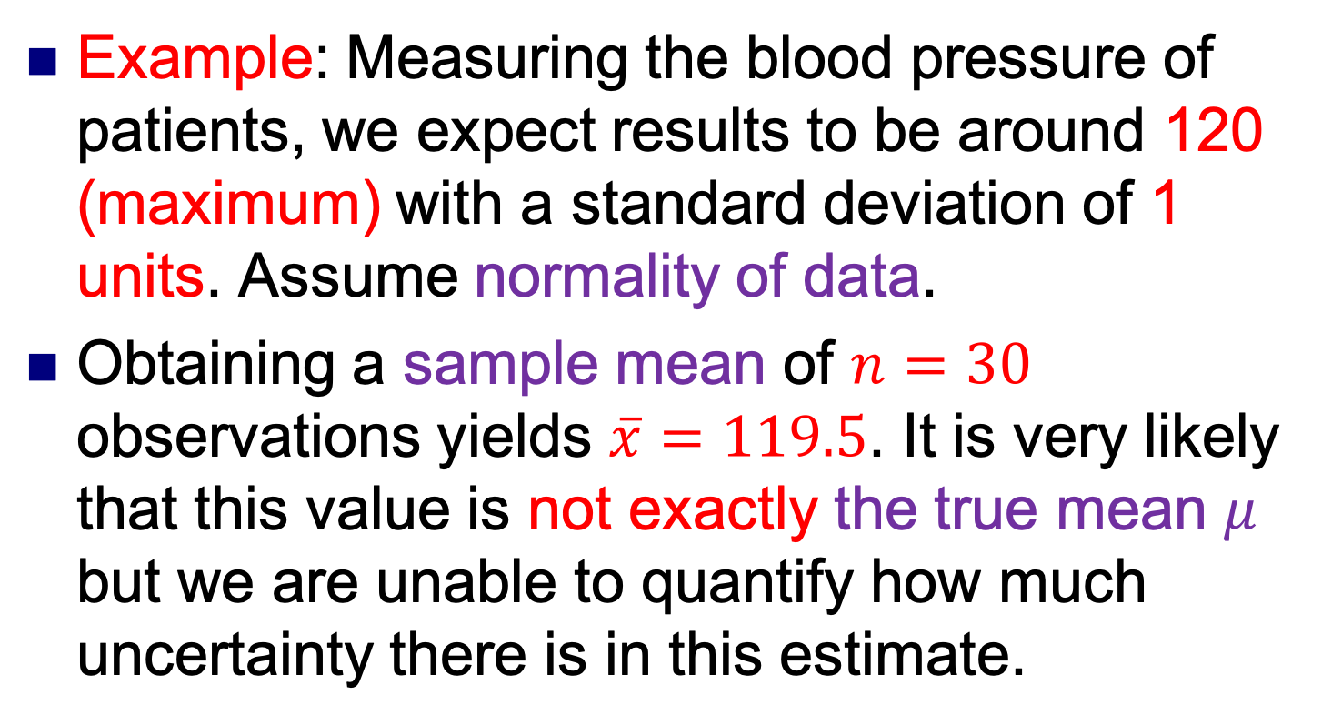
Statistical Intervals
Example: Measuring the blood pressure of patients, we expect results to be around 120 (maximum) with a standard deviation of 1 units. Assume normality of data.
Obtaining a sample mean of $n=30$ observations yields $\overline{x}=119.5$. It is very likely that this value is not exactly the true mean $μ$ but we are unable to quantify how much uncertainty there is in this estimate.

Slide 5
Statistical Intervals
Tolerance interval:
A tolerance interval is an enclosure interval for a specified proportion of the sampled population

Slide 6
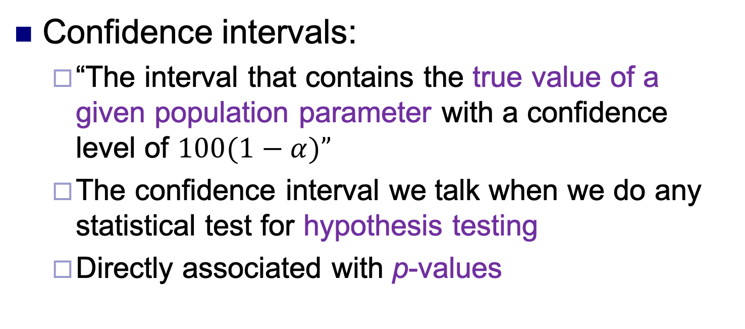
Statistical Intervals
Confidence intervals:
“The interval that contains the true value of a given population parameter with a confidence level of $100(1−α)”$
The confidence interval we talk when we do any statistical test for hypothesis testing
Directly associated with p-values

Slide 7
Statistical Intervals
“The method used to derive the interval has a hit rate of 95%” - i.e., the interval generated has a 95% chance of ‘capturing’ the true population parameter.”
99% vs. 95%

Slide 8
Hypothesis Testing
Marco Antonio Florenzano Mollinetti¹
¹University of Tsukuba, Systems Optimization Laboratory
mollinetti@syou.cs.tsukuba.ac.jp

