Slide 1

Datasets, Estimators, Intervals
Marco Antonio Florenzano Mollinetti¹
¹University of Tsukuba, Systems Optimization Laboratory
mollinetti@syou.cs.tsukuba.ac.jp

Slide 2
Agenda
Data sets – recap
Categorical x Numerical
Sampling Distributions
Point estimators

Slide 3
Before we Begin
Go to the github repo:
https://github.com/Mollinetti/Statistics-R
Download the script for this class! (in the ‘scripts’ folder class_2!)

Slide 4
Data sets – recap
Categorical x Numerical
Sampling Distributions
Point estimators

Slide 5
Data sets - Recap
Brief recap on Data set manipulation
We’ll use our common functions and a few extras
Heart disease Dataset

Slide 6
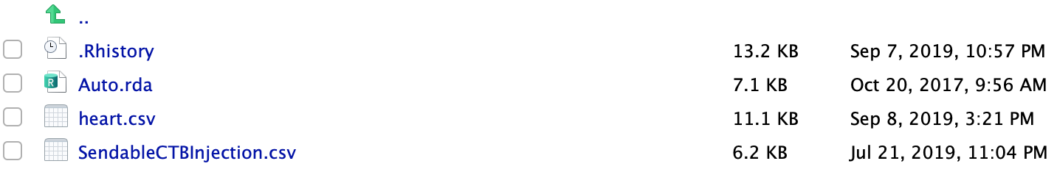
Data sets - Recap
Go to the folder where the Heart Dataset is saved
Don’t forget to set as working directory!!!
Run the following code:

Slide 7
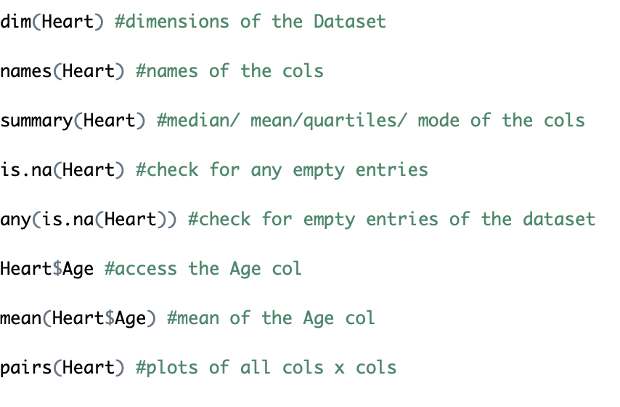
Data sets - Recap
Let’s run some common functions to check our Dataset

Slide 8

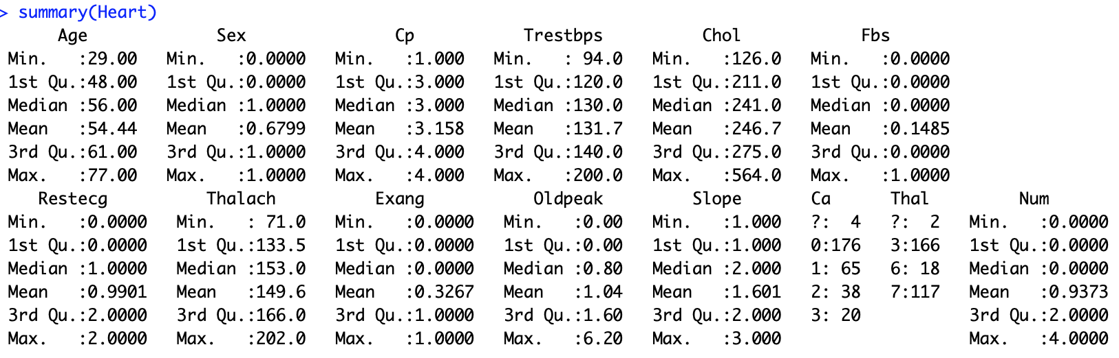
Data sets - Recap
Results of our scripts:

Slide 9
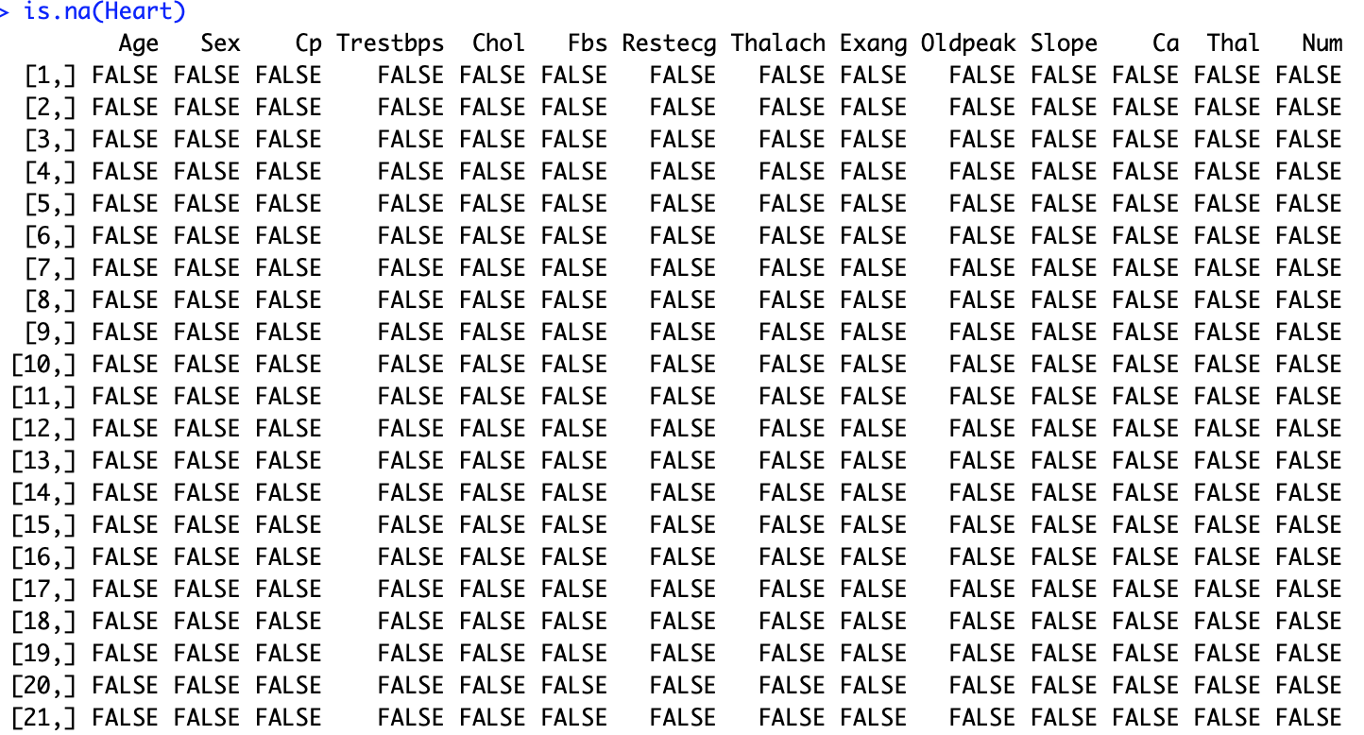

Data sets - Recap

Slide 10
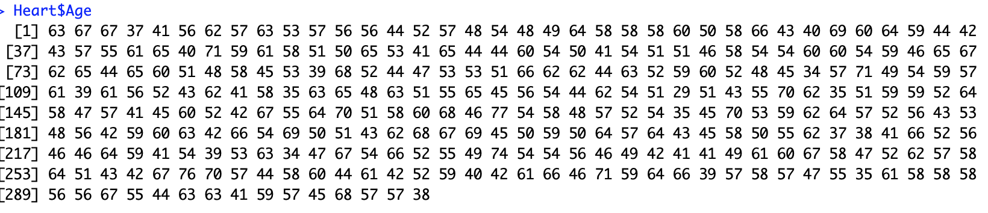

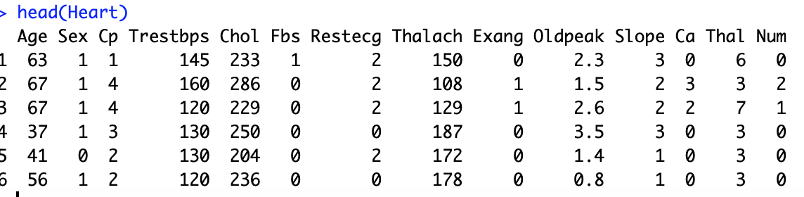
Data sets - Recap

Slide 11
Data sets – recap
Categorical x Numerical
Sampling Distributions
Point estimators

Slide 12
Categorical x Numerical
Let’s take a look into the following variables of Heart dataset:
Sex
Cp
Oldpeak

Slide 13
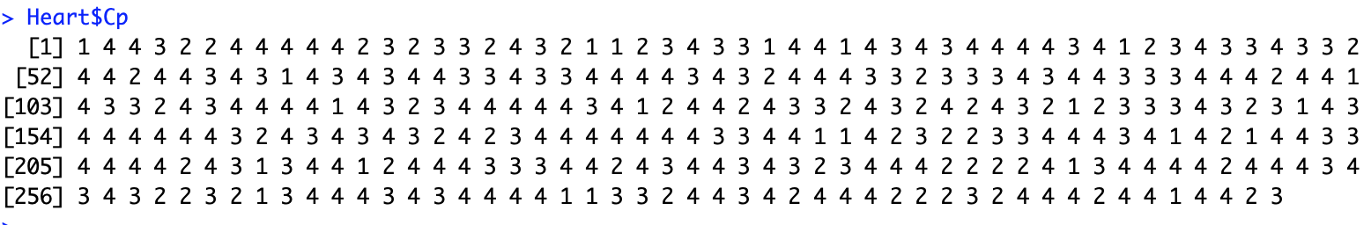
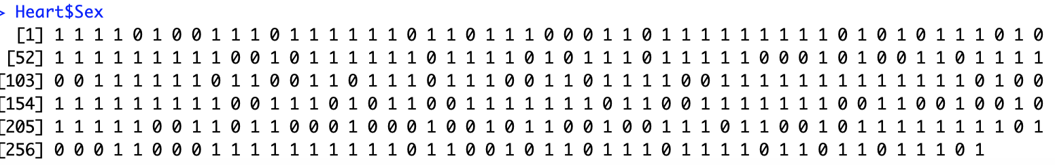
Categorical x Numerical
Let’s take a look into the following variables of Heart dataset:

Slide 14
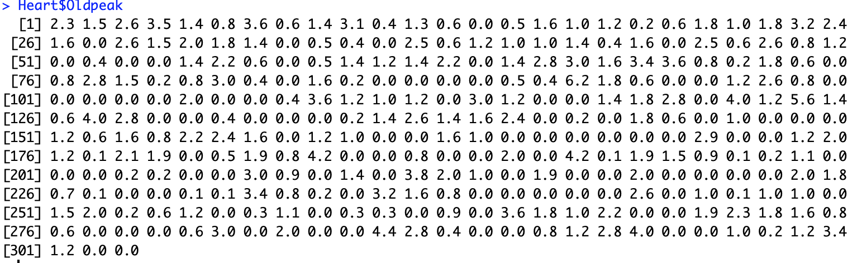
Categorical x Numerical
Let’s take a look into the following variables of Heart dataset:

Slide 15
Categorical x Numerical
Oldpeak has decimal numbers
Range: [0,4]
Obviously it is a numerical variable

Slide 16
Categorical x Numerical
Sex and Cp vary little
Sex: {1,0} (Male or Female)
Cp: {1,2,3,4} (None, Mild, Medium, Strong}
Even if they are represented as numbers they could be classes
We call them as categorical variables

Slide 17
Categorical x Numerical
Categorical variables must be converted into numerical variables
Conversion:
One-hot (one number for each class)
Binary (Binary numbers, e.g., 1010, 0001)
Clusters (groupings of similar classes)
Interval (Real number interval)
Depends on the number of categories

Slide 18
Categorical x Numerical
How do we do this in R?
R provides a built-in one-hot encoding function
Run the following:
We’re converting the cp column and saving it to another variable called ‘cp’

Slide 19

Categorical x Numerical
Now let’s compare the plots

Slide 20
Categorical x Numerical pt.2
Load the Nelder-mead.txt dataset
Run our common dataset functions
Names
Head
Summary

Slide 21
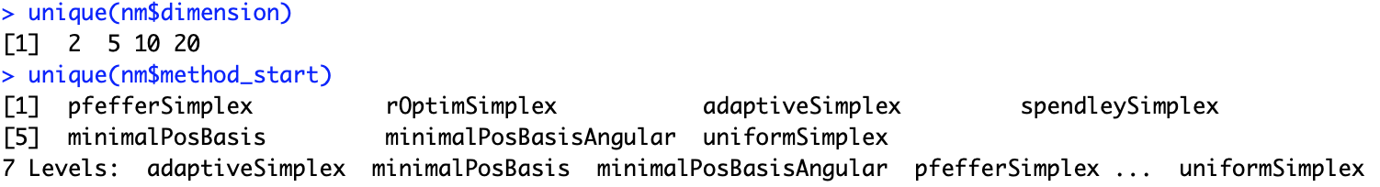
Categorical x Numerical pt.2
Let’s check the dimension and method_start columns of the dataset
Use the unique() function

Slide 22
Categorical x Numerical pt.2
Which variables are categorical?
Which are numerical?
Which variables should I plot?

Slide 23
Data sets – recap
Categorical x Numerical
Sampling distributions
Point estimators

Slide 24
Sampling Distributions
Randomly sampling from a population results in random variables. Statistics of these variable are also random
Being random variables means that statistics also have their own probability distributions, called sampling distributions.

Slide 25
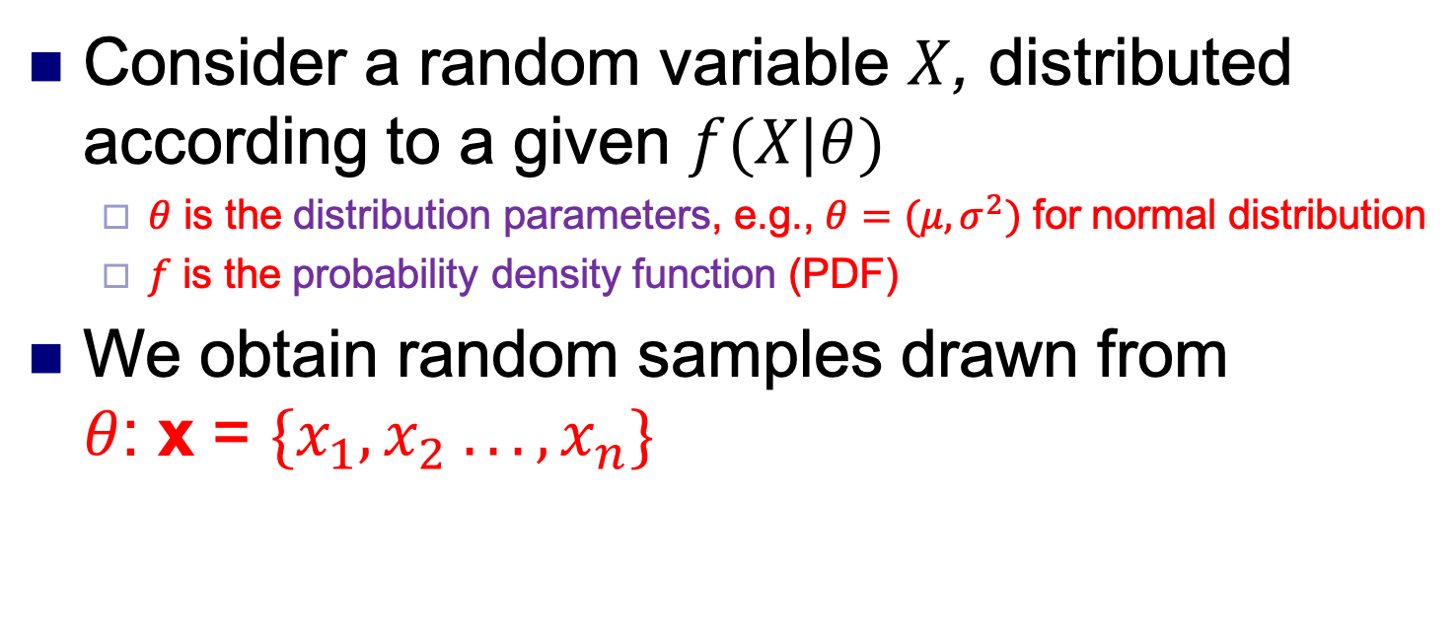
Sampling Distributions
Consider a random variable $X$, distributed according to a given $f(X|θ)$
$θ$ is the distribution parameters, e.g., $θ=(μ,σ^{2})$ for normal distribution
$f$ is the probability density function (PDF)
We obtain random samples drawn from $θ$: x = $\{x_{1}, x_{2} . . . , x_{n}\}$

Slide 26
Sampling Distributions
Many kinds of random distributions. Most common in the medical field are:
Normal distribution (common anywhere)
Chi-squared distribution (time series, intervals)
t Distribution (similar to normal, longer tails)

Slide 27
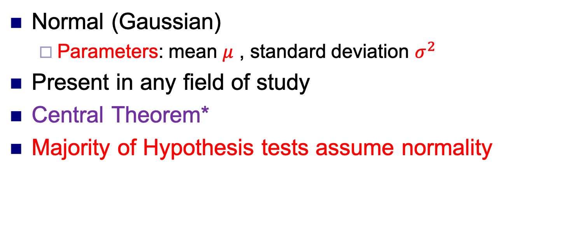
Sampling Distributions
Normal (Gaussian)
Parameters: mean $μ$ , standard deviation $σ^{2}$
Present in any field of study
Central Theorem*
Majority of Hypothesis tests assume normality

Slide 28

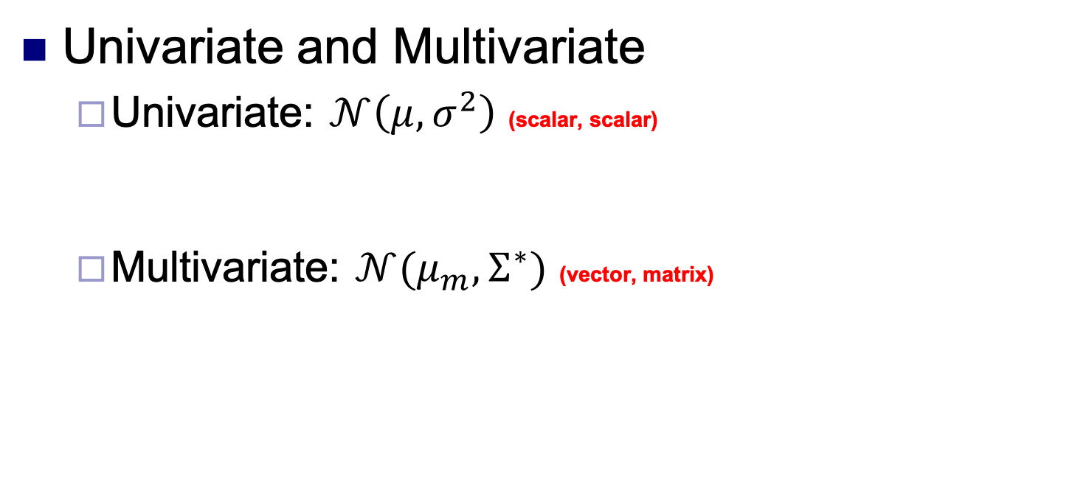
Sampling Distributions
Univariate and Multivariate
Univariate: $𝒩\left(μ,σ^{2}\right)$ (scalar, scalar)
Multivariate: $𝒩(μ_{m},Σ^{∗})$ (vector, matrix)
*$Σ$ is called Covariance Matrix

Slide 29
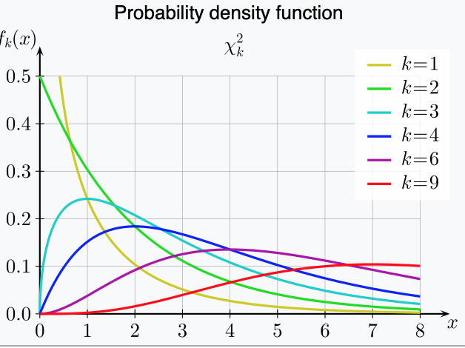
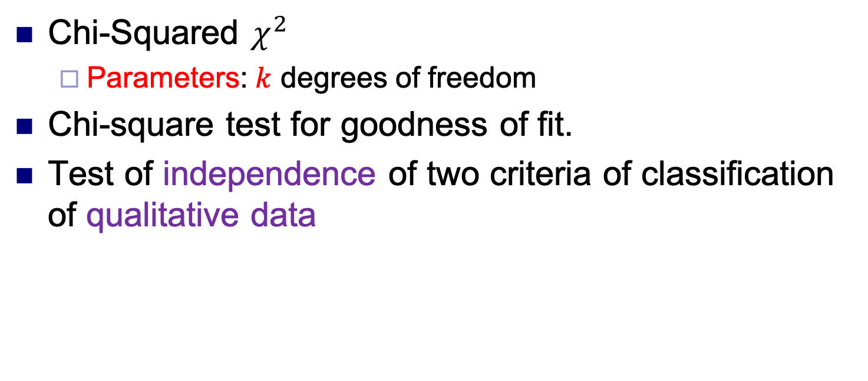
Sampling Distributions
Chi-Squared $χ^{2}$
Parameters: $k$ degrees of freedom
Chi-square test for goodness of fit.
Test of independence of two criteria of classification of qualitative data

Slide 30
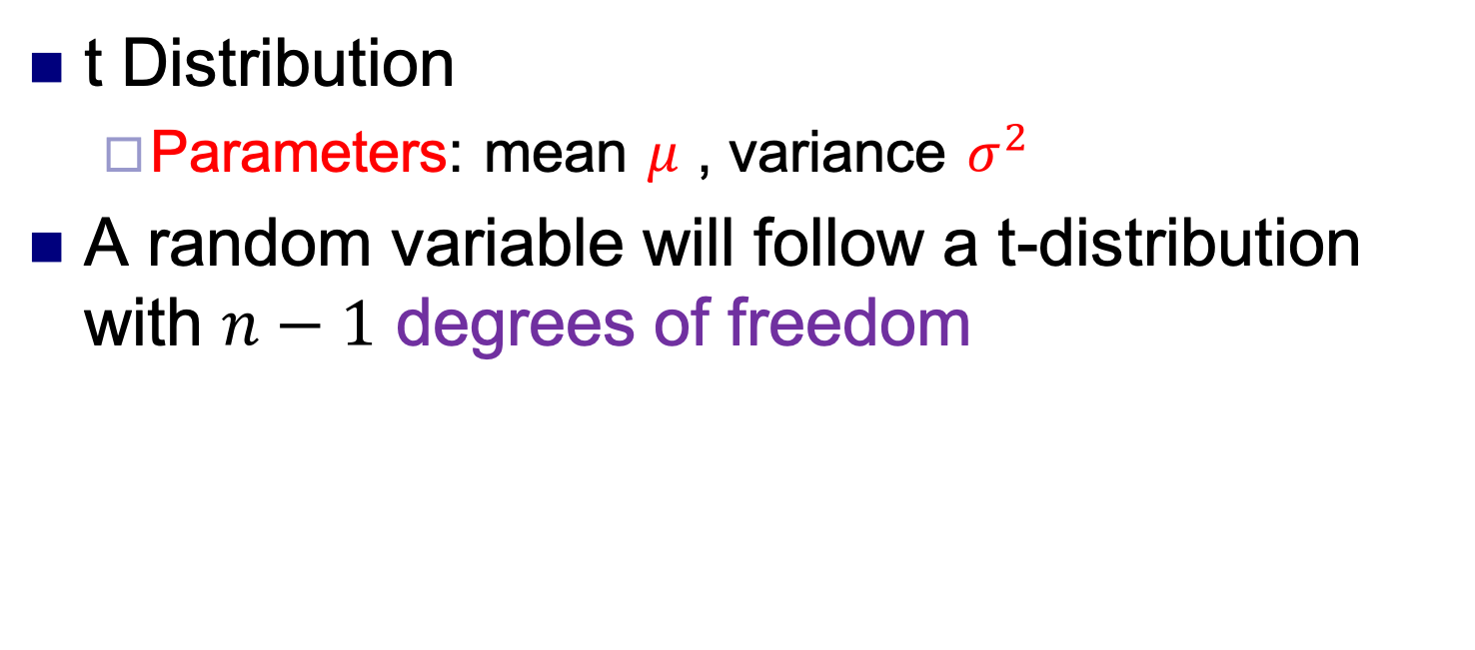

Sampling Distributions
t Distribution
Parameters: mean $μ$ , variance $σ^{2}$
A random variable will follow a t-distribution with $n−1$ degrees of freedom
$$T=\frac{\overline{X}−μ}{S/\sqrt{n}}$$

Slide 31
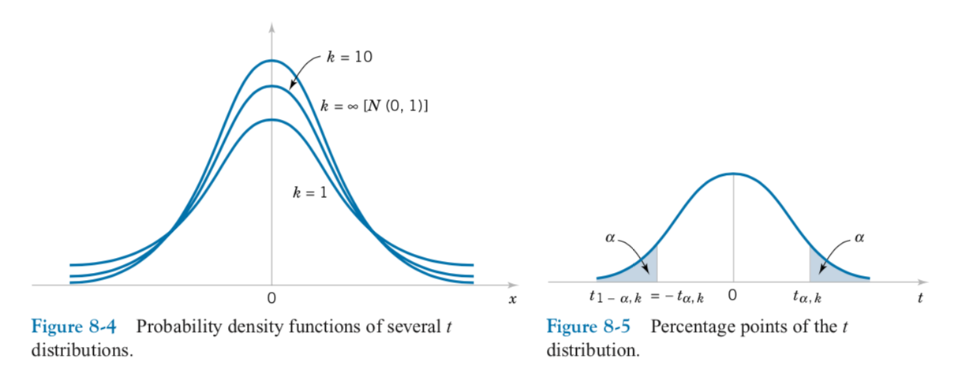
Sampling Distributions
Symmetric, unimodal, similar to the normal distribution but with heavier tails

Slide 32
Data sets – recap
Categorical x Numerical
Sampling distributions
Point estimators

Slide 33
Point Estimators
Looking at the Heart Dataset, do you think it properly characterizes a given population?
Is it a suitable sample?
Any empty entry in a given observation?

Slide 34
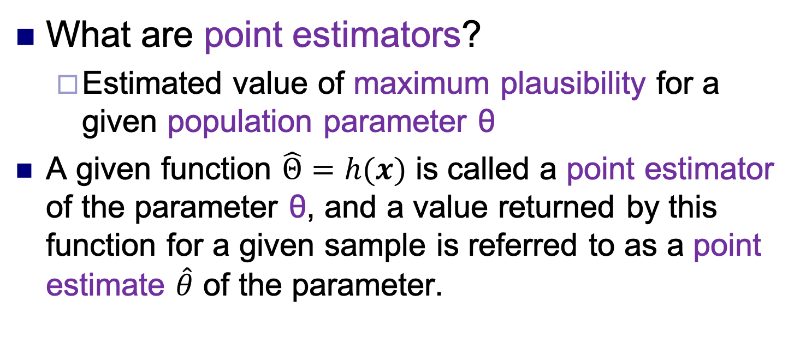
Point Estimators
What are point estimators?
Estimated value of maximum plausibility for a given population parameter θ
A given function $\hat{Θ}=h(x)$ is called a point estimator of the parameter θ, and a value returned by this function for a given sample is referred to as a point estimate $\hat{θ}$ of the parameter.

Slide 35
Point Estimators
We have two kinds:
Unbiased Estimator
Lie close to the real value of the real population
Minimum variance*
Biased Estimator
Introduce some bias related to the real value of the real population

Slide 36
Point Estimators
Example of unbiased estimators¹
Mean
Standard Error
Variance
Example of biased estimators
Standard Deviation
¹Estimators of gaussian Distributions

Slide 37
Datasets, Estimators, Intervals
Marco Antonio Florenzano Mollinetti¹
¹University of Tsukuba, Systems Optimization Laboratory
mollinetti@syou.cs.tsukuba.ac.jp

