Slide 1



Building an auth microservice
with ASP.NET Core Identity and IdentityServer4
Miroslav Popovic
Technical Lead @Seavus
@miroslavpopovic
miroslavpopovic.com
Notes:
unDraw illustrations used on several slides - https://undraw.co/license

Slide 2
Agenda
1
Introduction
2
Terminology
3
Demo
4
Tips & Tricks
5
Closing words

Slide 3

Introduction

Slide 4
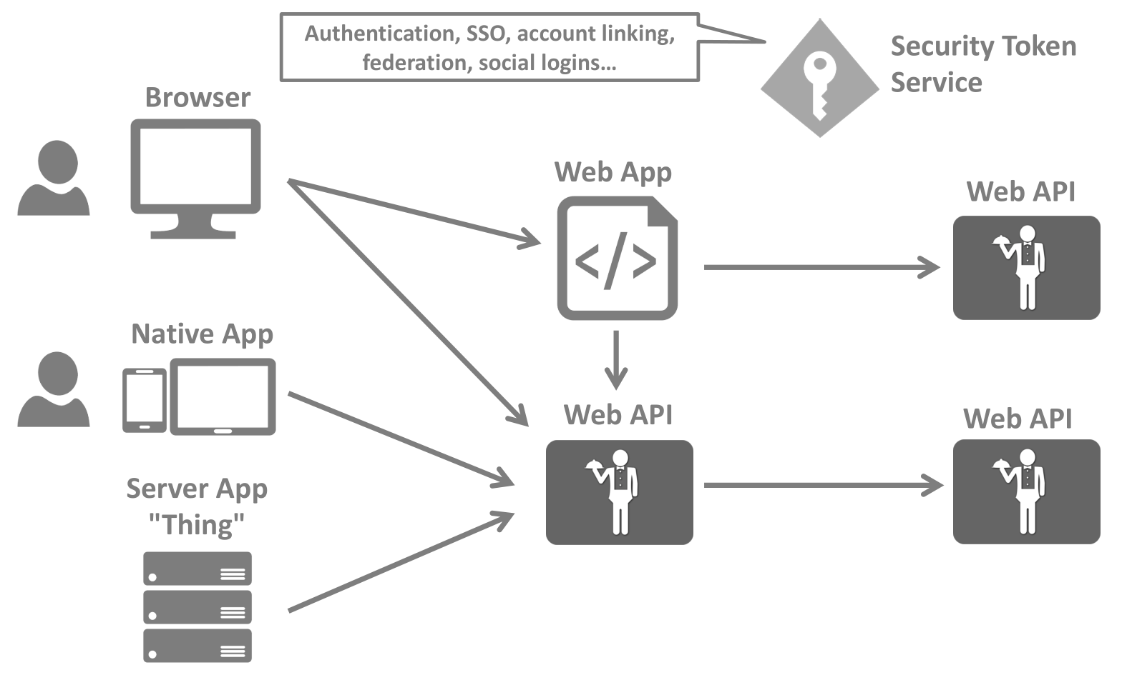
How modern apps look like?
Image taken from IdentityServer4 workshop by Dominick Baier
Notes:
https://identityserver4.readthedocs.io/en/latest/intro/big_picture.html
https://identityserver.io/training/

Slide 5
Why an auth service?
Problems to solve:
Authentication
Authorization
Resource protection
Centralized solution
Auth service = Security Token Service

Slide 6
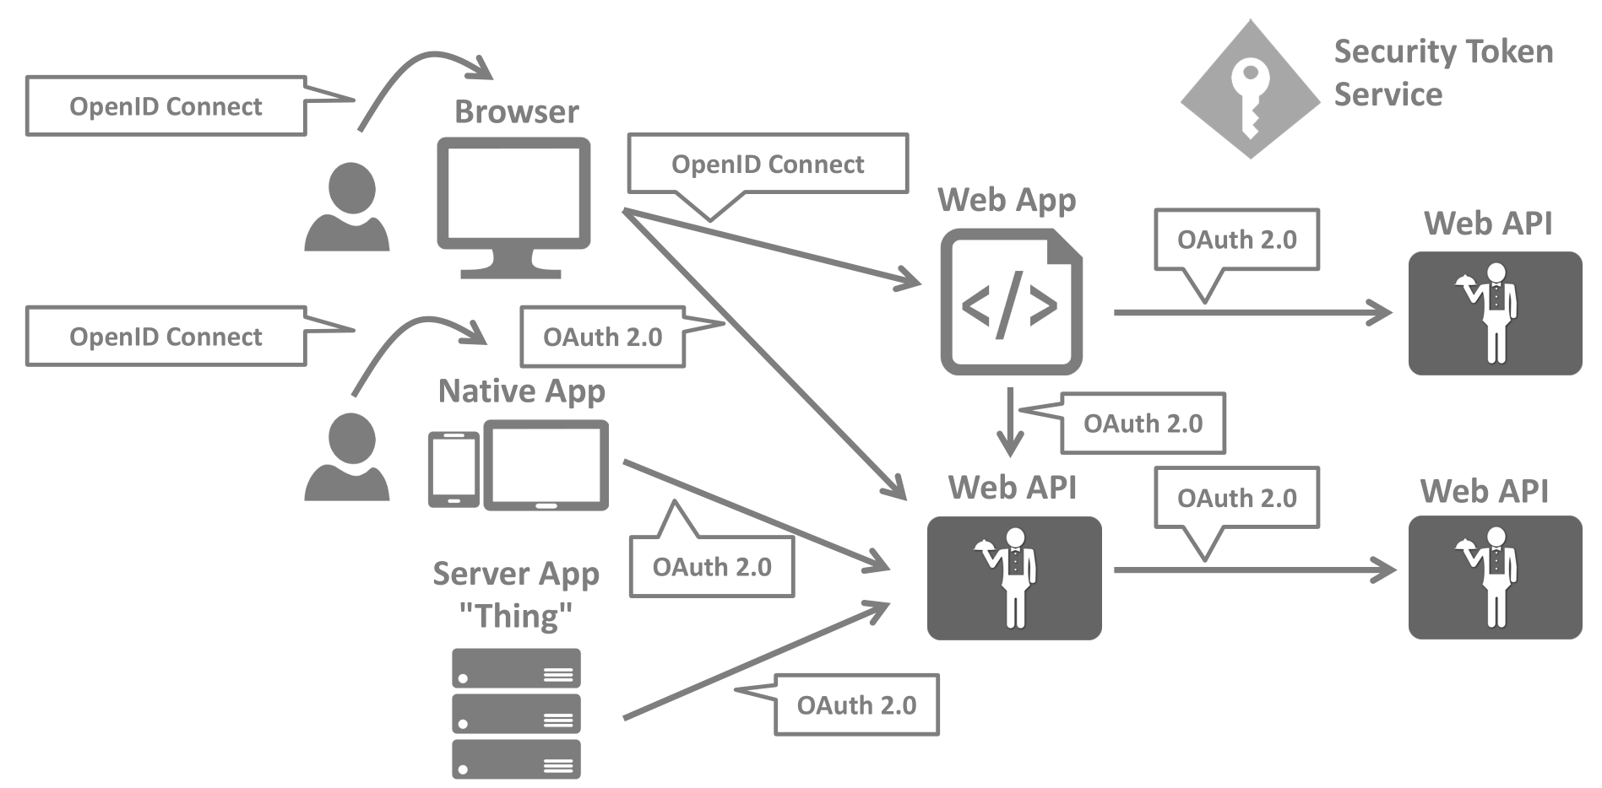
With auth service
Image taken from IdentityServer4 workshop by Dominick Baier
Notes:
https://identityserver.io/training/

Slide 7
Solution?
OAuth 2.0
OpenID Connect
ASP.NET Core Identity
IdentityServer4

Slide 8


OAuth 2.0 & OpenID Connect
OAuth 2.0
Authorization
Granting access to data and features from one application to another
OpenID Connect
Authentication
Login and profile information
Notes:
Things to go through:
OAuth history
OpenID history
DotNetOpenAuth
OpenID Connect, built upon OAuth 2.0

Slide 9

ASP.NET Core Identity
Managing users, passwords, profile data, roles, …
DB persistence with EF Core
Predefined UI for login, register, forgot password, 2FA, …
UI Scaffolding
Support for external logins

Slide 10

IdentityServer4
Protect your resources
Authenticate users using a local account store or via an external identity provider
Provide session management and single sign-on
Manage and authenticate clients
Issue identity and access tokens to clients
Validate tokens
Notes:
Token validation through introspection endpoint

Slide 11
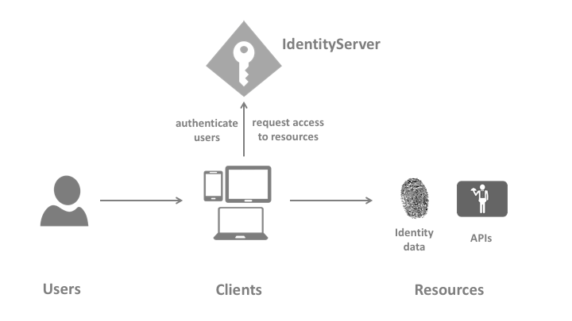

Terminology
ASP.NET Core Identity
+
Notes:
https://identityserver4.readthedocs.io/en/latest/intro/terminology.html

Slide 12
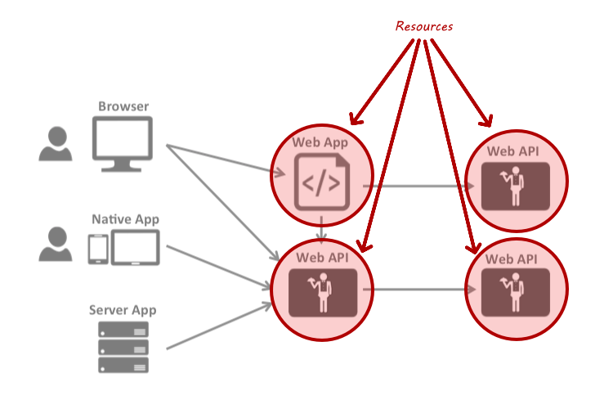
Resources
Identity resources
API resources
Notes:
Identity resources
Claims about the user – user ID, name, email…
Named group of claims that can be requested with scope parameter
API resources
A functionality client wants to access
Group of scopes – logical API

Slide 13
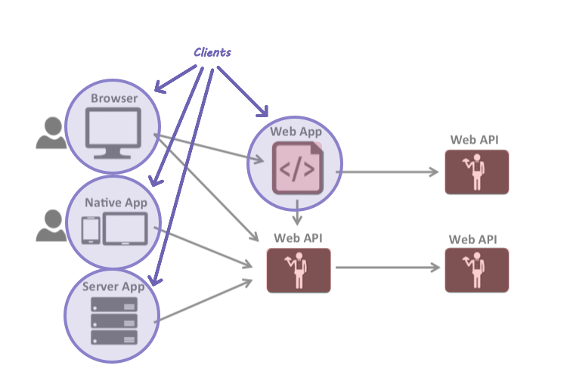
Clients
Accesses to resources
Need to be authorized

Slide 14
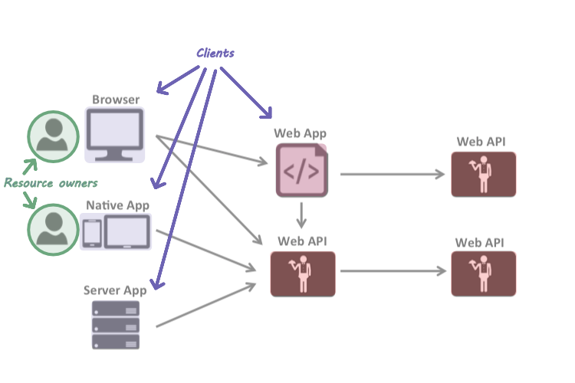
Resource owners
Practically, users

Slide 15
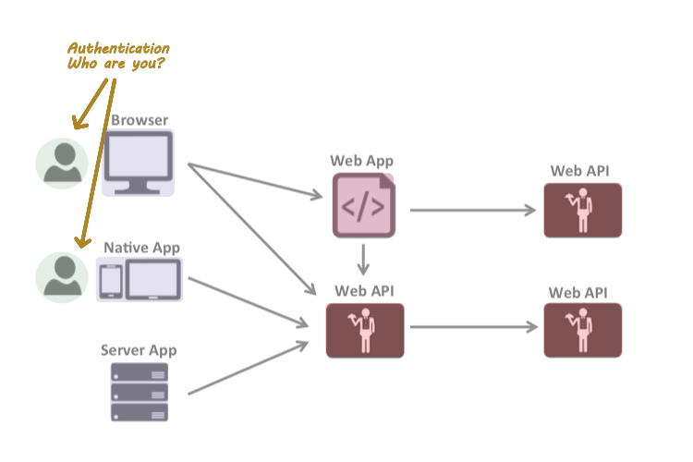
Authentication
Confirming user identity

Slide 16
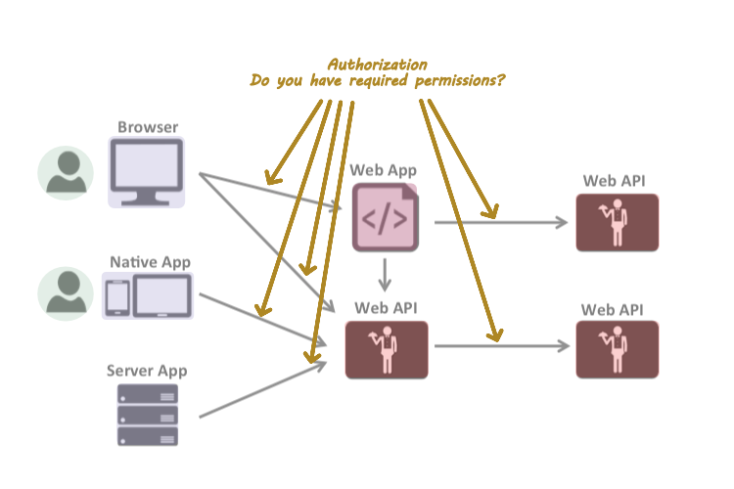
Authorization
Allowing the access to a specific functionality or resource

Slide 17
Other terms
Claim
One piece of information
Scopes
Something you want to protect and client wants to access
Tokens
Access token, Identity Token, Refresh token
JWT
Grant types / flows
Non-interactive – client credentials flow
Interactive – authorization code flow with PKCE, device flow
Notes:
https://identityserver4.readthedocs.io/en/latest/topics/grant_types.html
https://identityserver4.readthedocs.io/en/latest/topics/reference_tokens.html
Reference tokens (instead of JWT)

Slide 18
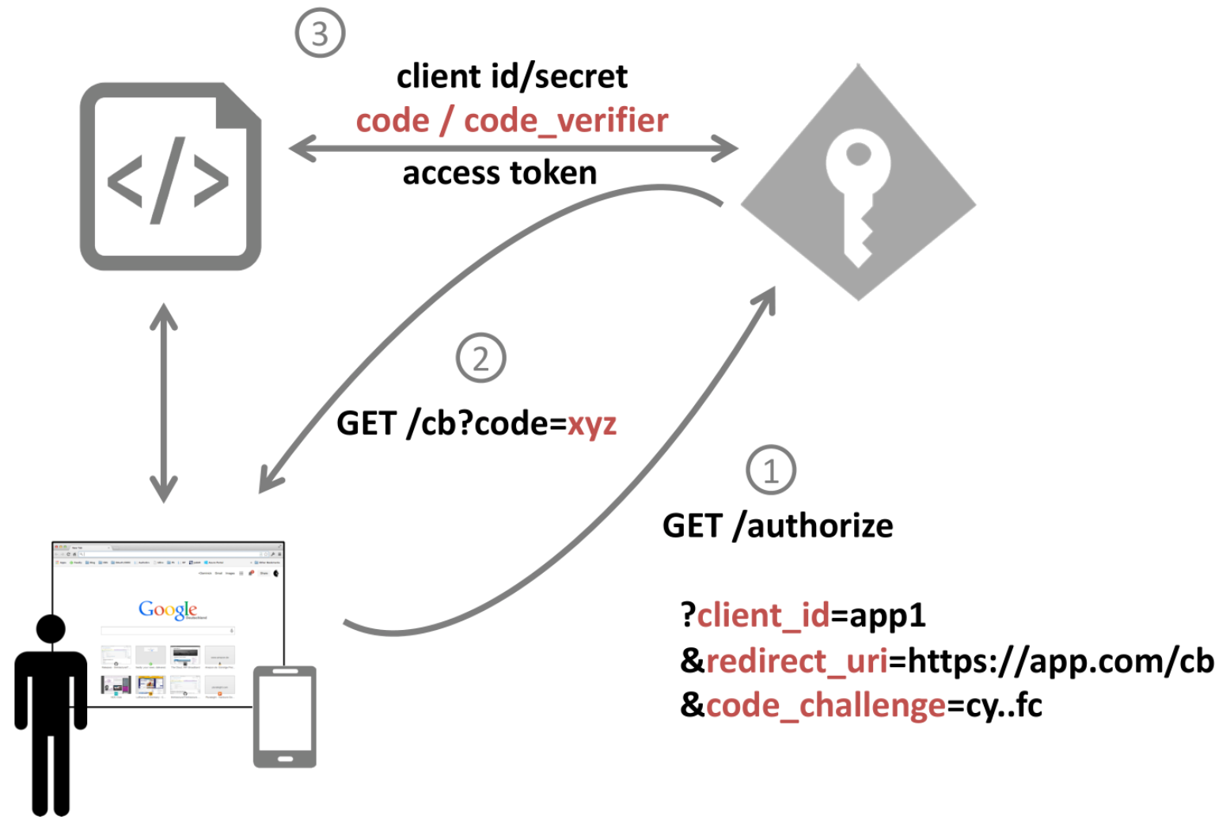
Authorization code flow with PKCE
code_verifier = random
code_challenge = hash
Image taken from IdentityServer4 workshop by Dominick Baier
Notes:
https://identityserver.io/training/
PKCE = Proof Key for Code Exchange

Slide 19
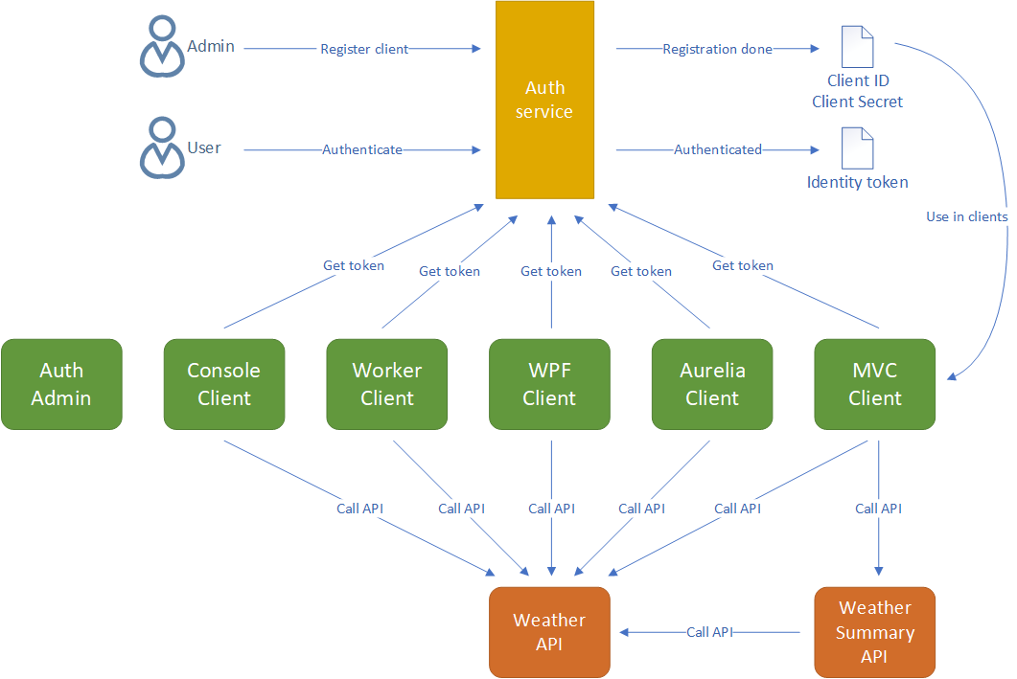
Demo

Slide 20
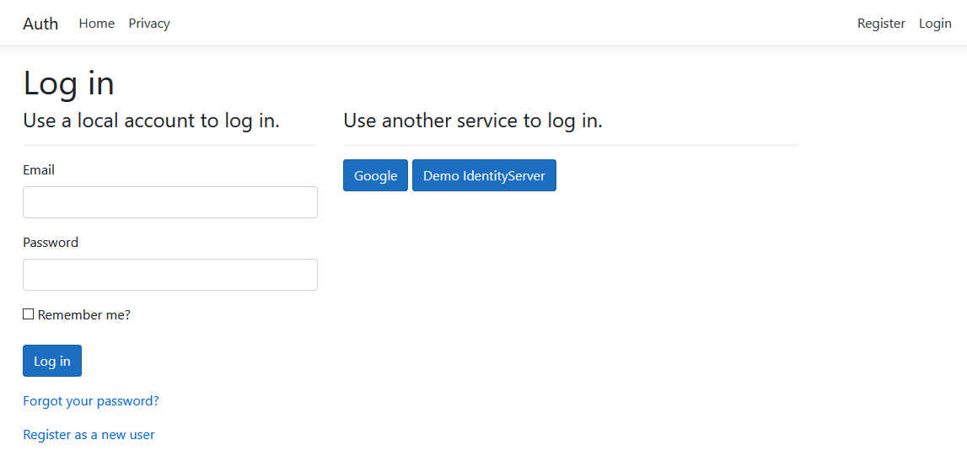
New ASP.NET Core project with Identity
Implement 2FA auth
Implement email service with MailKit
Extend IdentityUser
Notes:
- Don’t trust external authentication providers to always return claims that you need – ask the user to fill in the data on first login – i.e. email, display name, etc.

Slide 21
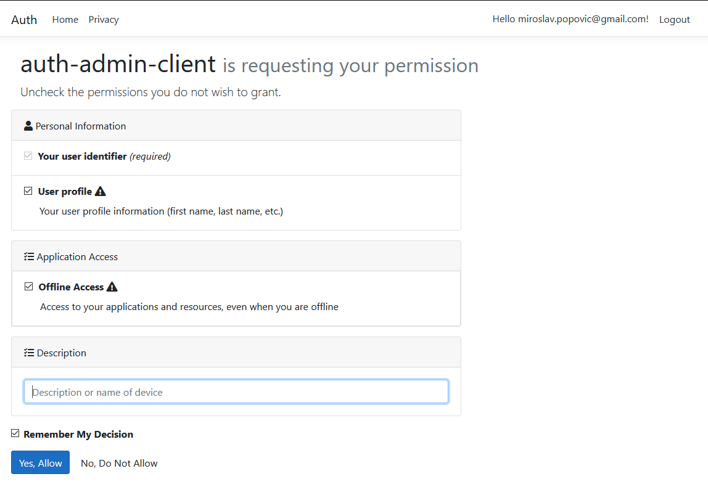
Including IdentityServer4.AspNetIdentity
Configuring Startup
Defining resources
Defining clients
Configuring Consent page
Configuring Device Authorization page
/.well-known/openid-configuration

Slide 22
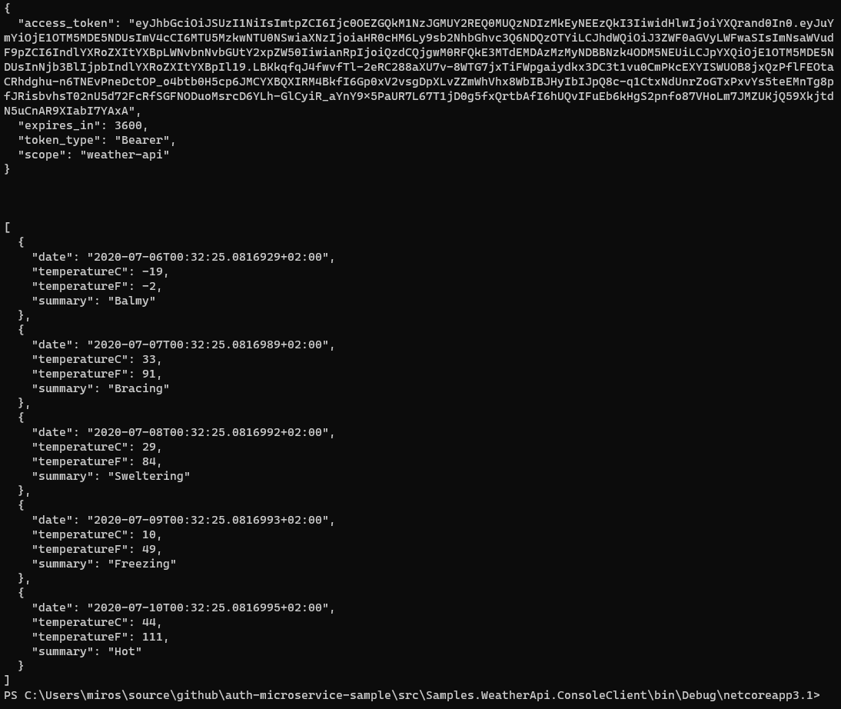
Console / Worker Client
Use of IdentityModel library

Slide 23
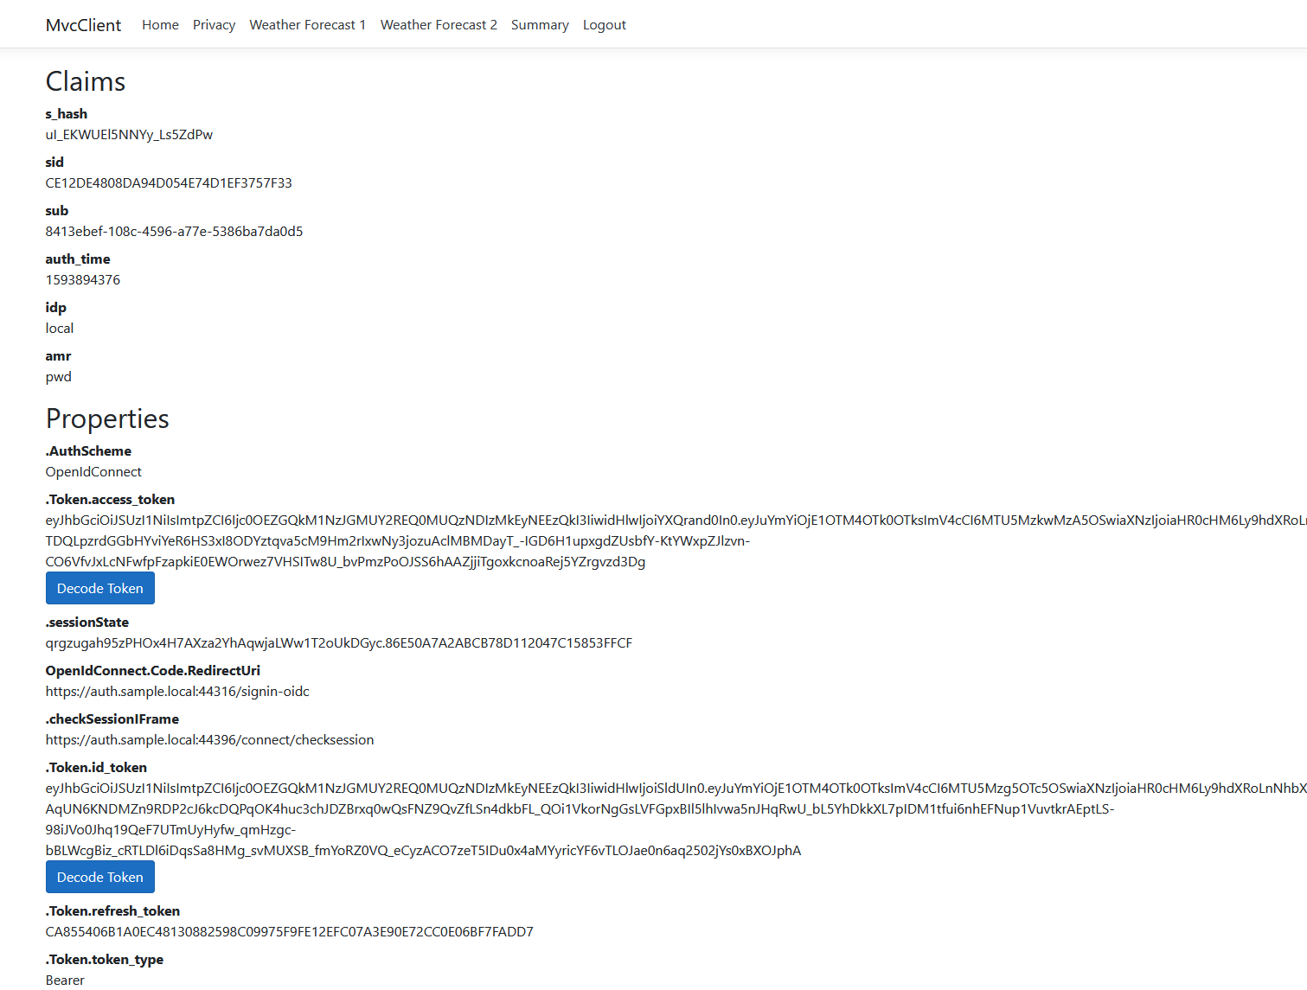
MVC client
Same token for MVC app and API
Getting new token for API
Calling API through another API

Slide 24
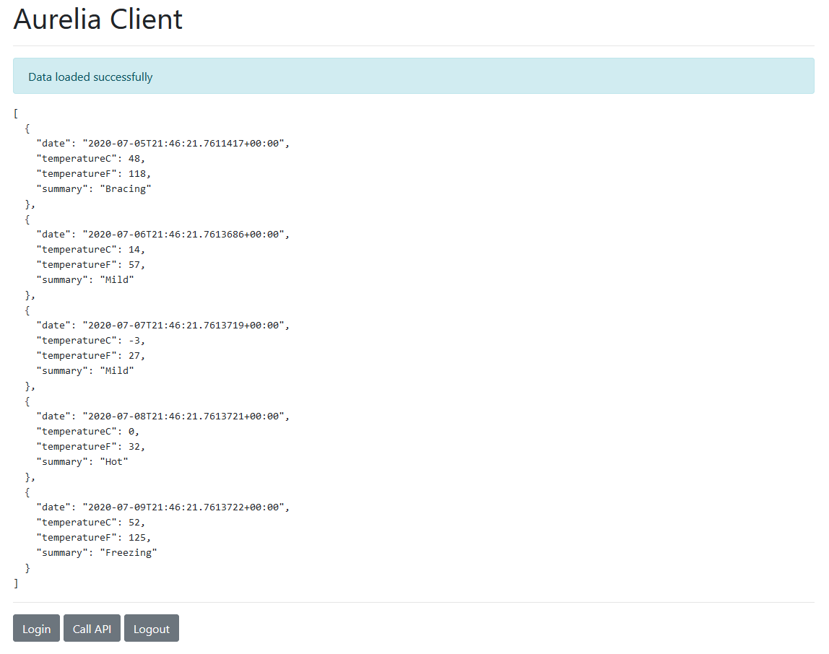
SPA client
Uses oidc-client library
Not recommended
IETF Draft: OAuth 2.0 for browser-based apps

Slide 25
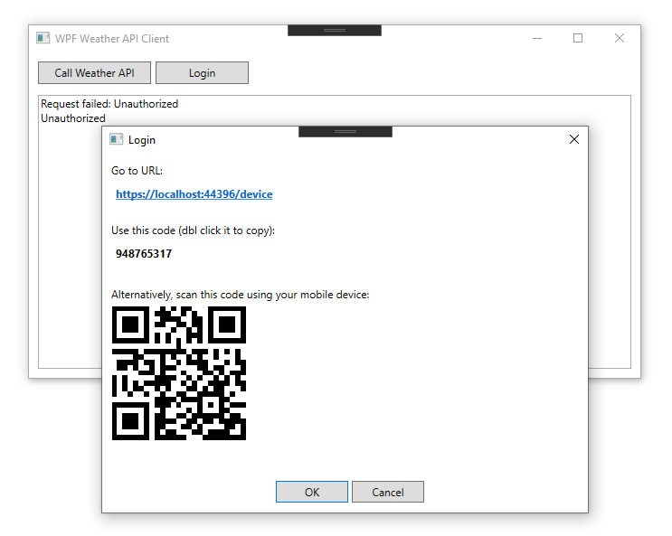
Device Client
Intended for devices without browser
i.e. smart TVs, gaming consoles…
Simulated with WPF
RFC 8628

Slide 26
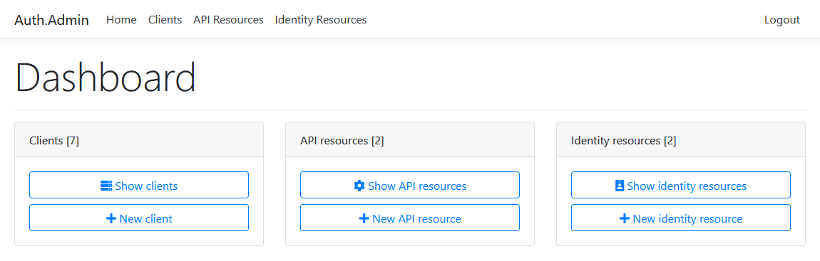
Switching to db resources / clients
Adding Admin interface

Slide 27

Containerization
Docker
Docker Compose
TODO: Project Tye and Kubernetes

Slide 28

Tips & tricks

Slide 29
Tips & tricks 1
Don’t add many claims to access tokens
Don’t include secure data to JWT tokens
Don’t store tokens to localStorage in browser-based apps
Use BFF architecture for browser-based apps
Use authorization code flow with PKCE for native apps too
Use rotation for refresh tokens (default behavior) and prevent reply attacks

Slide 30
Tips & tricks 2
Handle new users in external auth callback
i.e. ask them to fill in the data, don’t trust that provider will return it
Use IdentityServer as Federation Gateway
Use IdentityModel library for .NET clients
Create the strategy for encryption key rotation

Slide 31
Advanced concepts

Slide 32
Advanced
Single-sign on
Single-sign out
Complicated – front-channel, back-channel
Not all external providers support it
Key material
AddSigningCredentials, AddDeveloperSigningCredential, AddValidationKey
Proof of possession tokens
Bound to client that requested the token
Notes:
https://identityserver4.readthedocs.io/en/latest/topics/pop.html

Slide 33
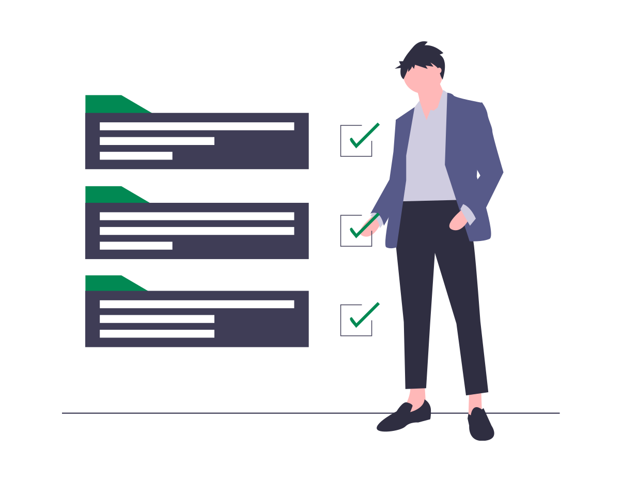
Closing words

Slide 34
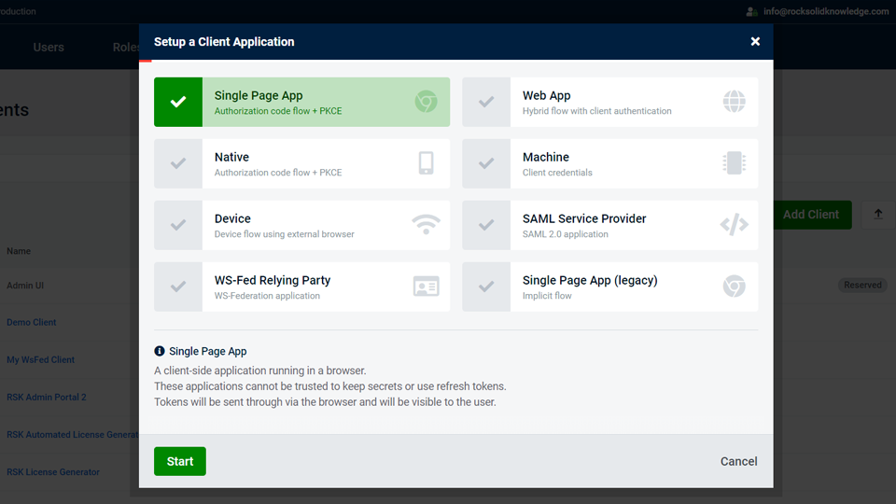
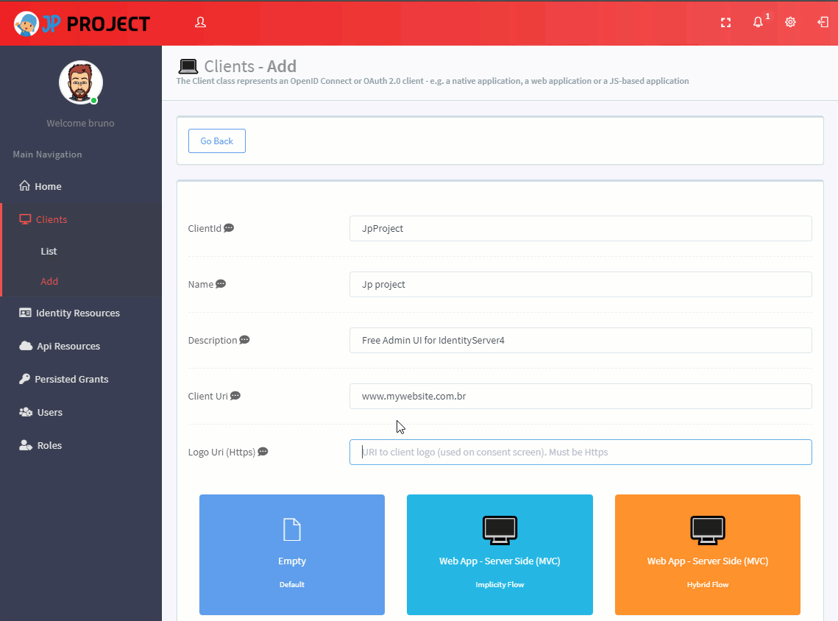
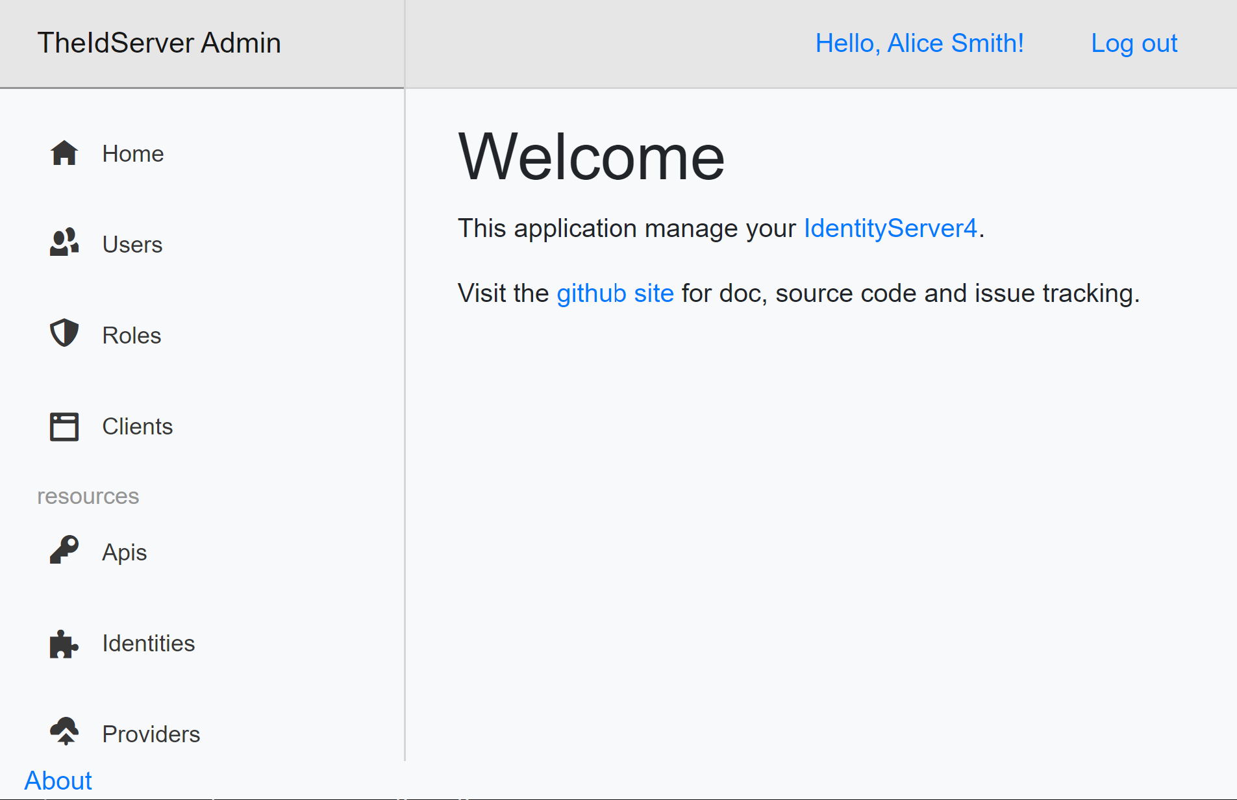
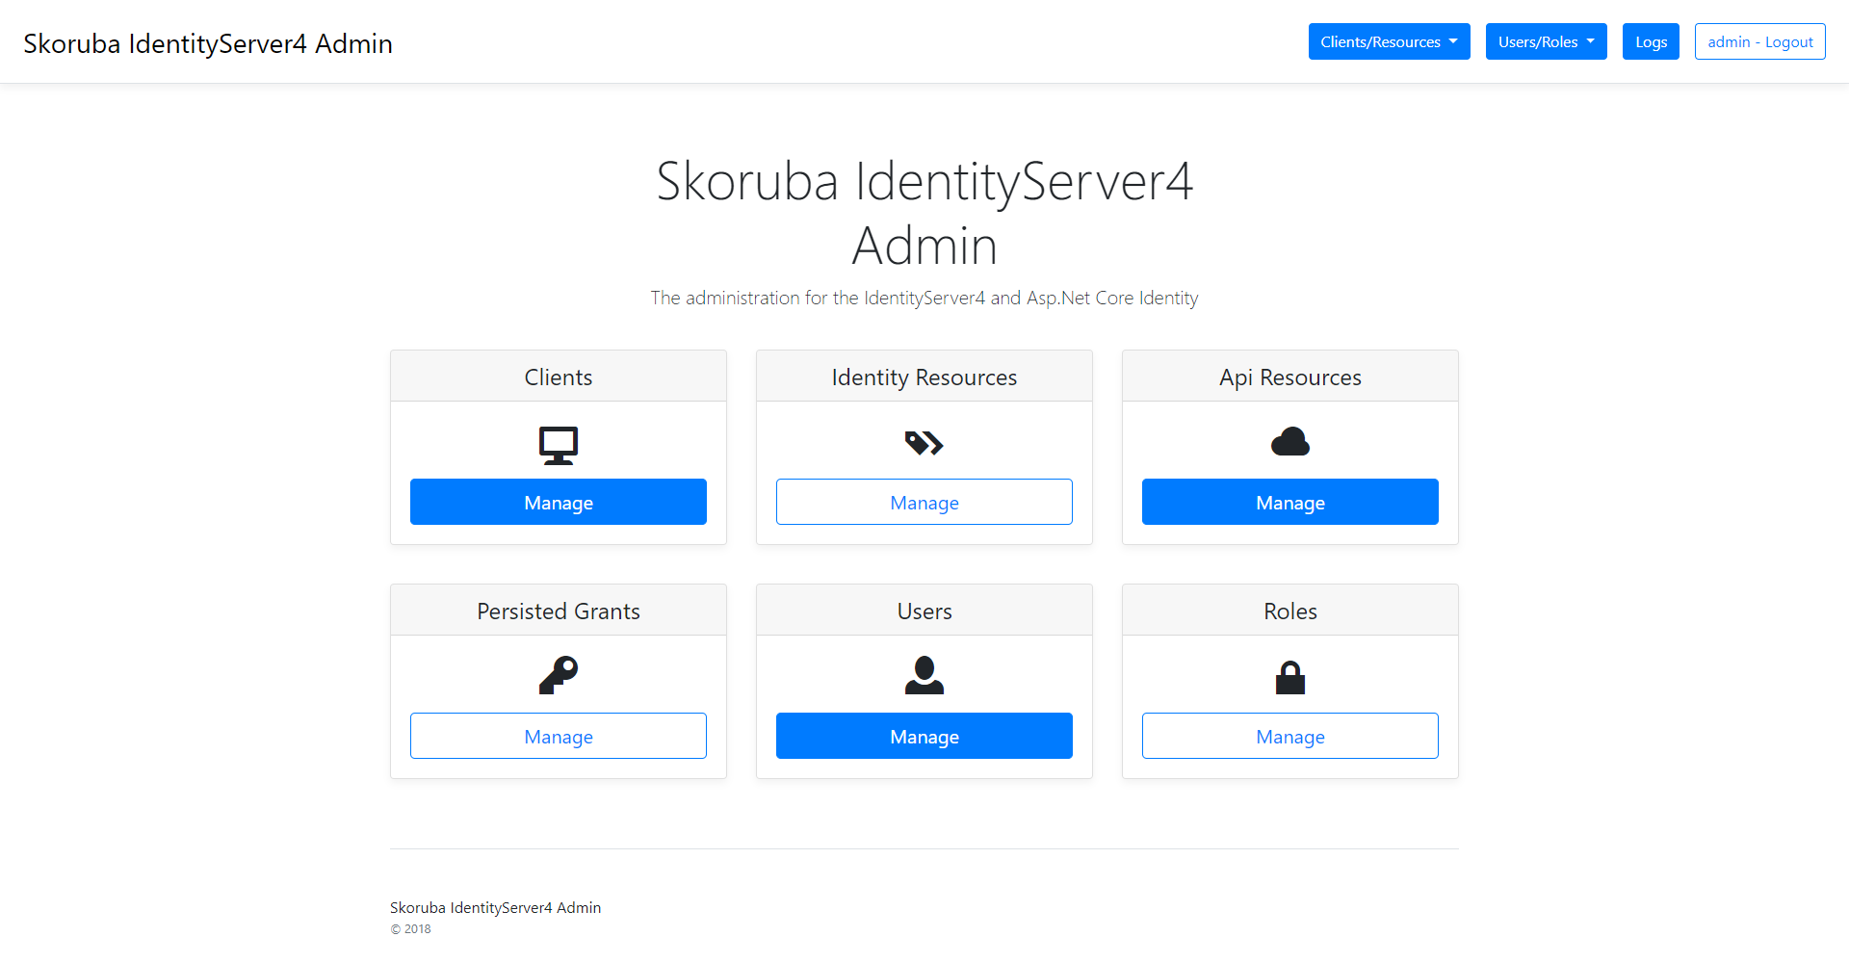
More things to look at
Admin interfaces
https://www.identityserver.com/products/adminui
https://github.com/skoruba/IdentityServer4.Admin
https://github.com/brunohbrito/JPProject.IdentityServer4.SSO
https://github.com/Aguafrommars/TheIdServer
Policy / permission servers
https://policyserver.io/
https://github.com/Xabaril/Balea

Slide 35
What comes in future
OAuth 2.1 / 3.0
.NET 5
IdentityServer4 5.0
Probably released with .NET 5

Slide 36
Summary
Auth as a service
ASP.NET Core & IdentityServer4 integration
Auth flows with IS4
Simplification
Demo auth server with various client types
Tips & tricks
Future

Slide 37
References
ASP.NET Core Identity documentation
IdentityServer4 documentation
Dominick Baier’s blog - https://leastprivilege.com/
Brock Allen’s blog - https://brockallen.com/
IdentityServer workshops - https://identityserver.io/training/
NDC Conferences YouTube channel
Search for “IdentityServer”, or “Dominick Baier”, or “Brock Allen”
An illustrated guide to OAuth and OpenID Connect
https://developer.okta.com/blog/2019/10/21/illustrated-guide-to-oauth-and-oidc
What’s new in OAuth and OpenID Connect?
https://developer.okta.com/blog/2020/04/09/whats-new-with-oauth-and-oidc
https://github.com/miroslavpopovic/auth-microservice-sample/

Slide 38
Thank you!

