Slide 1
Review- 3
By
Vaishnavi- 21BD5A0516
Varsha- 21BD5A0513
Sreeya-21BD5A0518
Molly-20BD1A0555

Slide 2
Support Vector Machine (SVM)
Support Vector Machine (SVM) is a popular supervised machine learning algorithm used for classification and regression tasks. It aims to find an optimal hyperplane that separates different classes in the input data by maximizing the margin between them.
SVM can handle both linearly separable and non-linearly separable data by using kernel functions to transform the input spac

Slide 3
Training SVM Classifier
In the process of training a classifier with svm using the extracted feature vectors from fashion item images, the SVM learns to separate different classes by finding an optimal hyperplane in the feature space. During training, the SVM adjusts its parameters, such as the C regularization parameter and kernel type, to maximize the margin between classes and minimize classification errors. This process enables the SVM to accurately classify fashion items based on their extracted features, facilitating effective fashion items classification.

Slide 4
Model Evaluation and Optimization
In model evaluation, the trained model is tested on a separate dataset, and metrics such as accuracy, precision, recall, and F1-score are computed. Based on the evaluation results, the model can be further optimized by adjusting hyperparameters, refining the feature representation, or exploring ensemble methods. Continuous evaluation and optimization help improve the model’s accuracy and generalization ability for reliable fashion items classification.

Slide 5
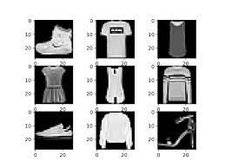
OUTPUT
MODEL | ACCURACY
CNN | 83.28
CNN+SVM | 90.95

Slide 6
THANK YOU

