Slide 1
final
File created on: 5/1/24 GMT-4 上午10:43:01

Slide 2
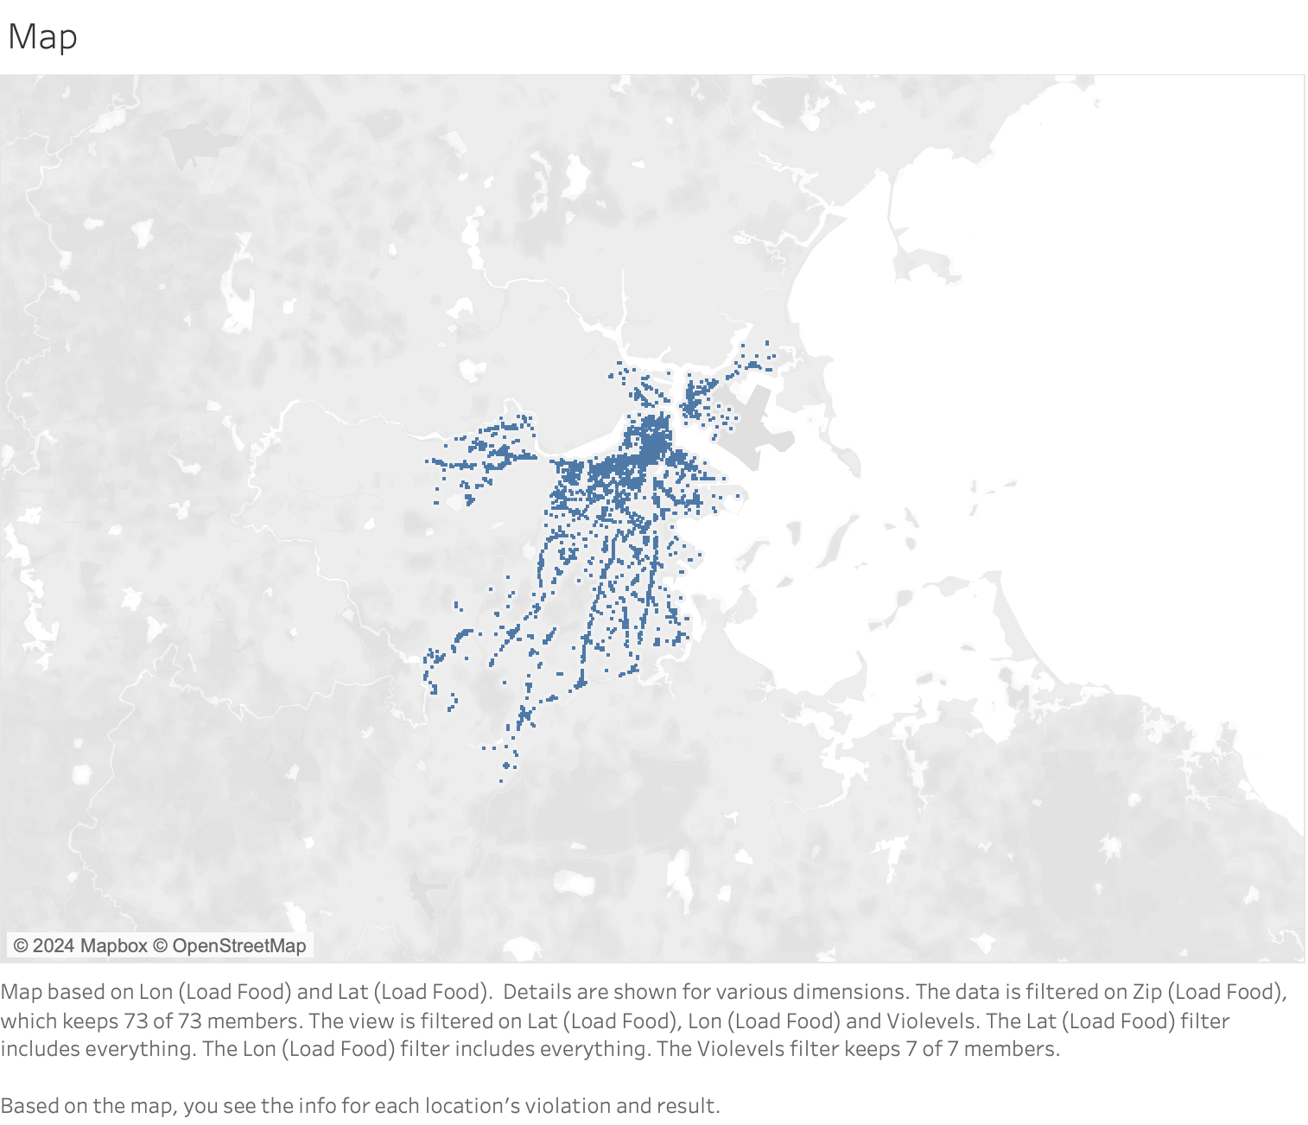

Slide 3
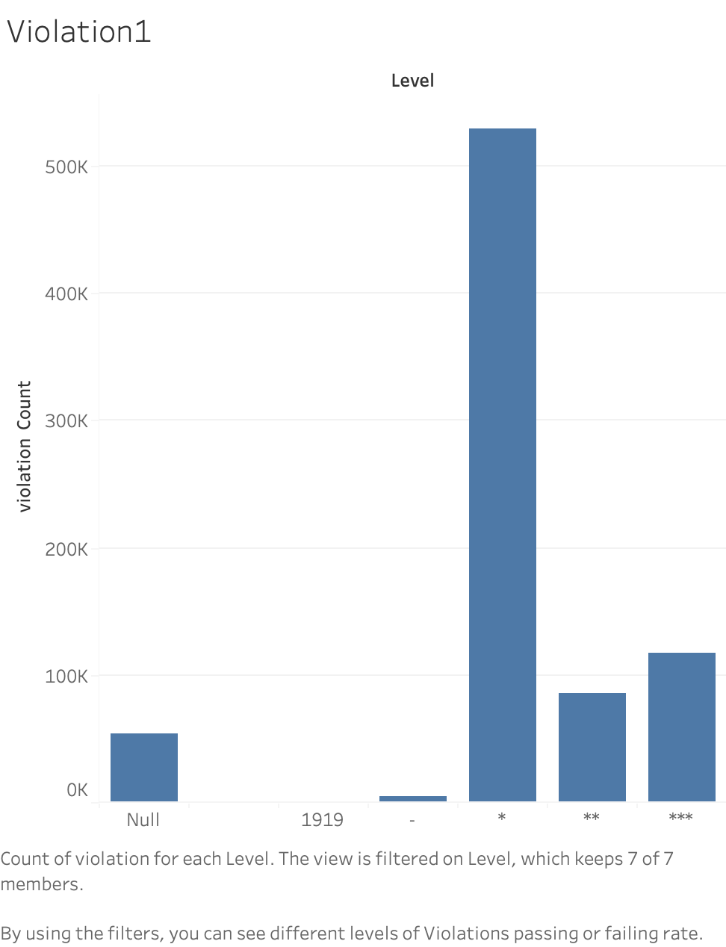

Slide 4
