Slide 1
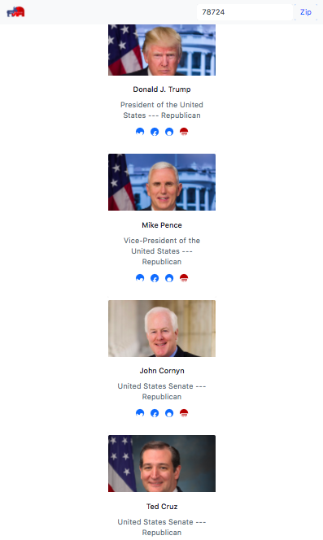
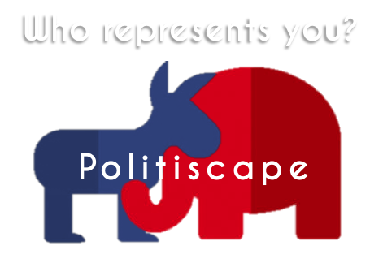
Politiscape
Molly Johnson
Ryan Mullowney
Ryan Bonner
B Barrnett

Slide 2
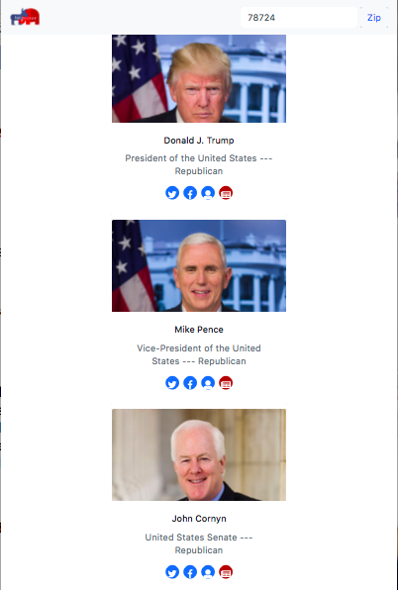
Purpose -
Politiscape is built for the millenial.
With just knowledge of your own zip code, users can find out who is representing them. Clean, “Scroll-able” profiles will dynamically populate the screen and let users see quick links to their politicians’ social media channels, their website, and recent articles from the New York Times.

Slide 3
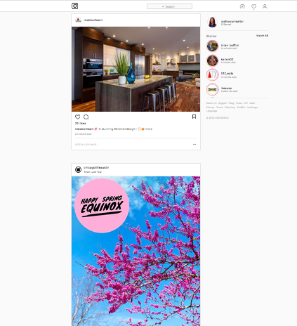
Look familiar?

Slide 4
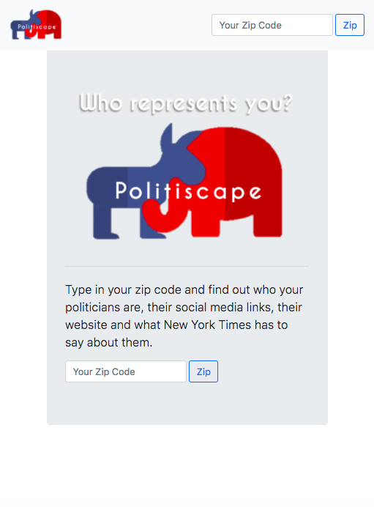
Keep it clean!
Politics is a dirty game… so we needed to keep it clean.
Pops of blue and red, and 50 shades of gray… because grayscale doesn’t mean boring.

Slide 5


The code! - HTML
When working with the api, we realized our site built itself through js. However, a few basic elements stayed static in the HTML.
The nav-bar is a bootstrap dream. It fits your screen, and collapses the form on smaller screens. It’s static and simple for ease of use.

Slide 6
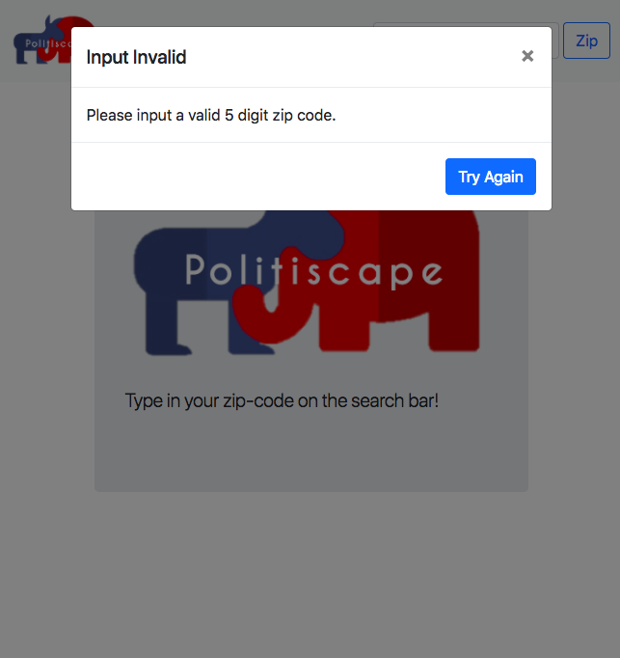
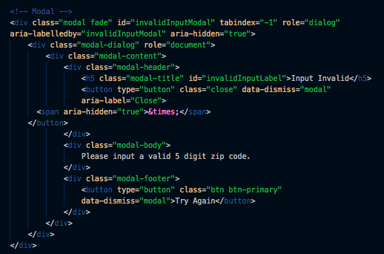

Zip Codes are 5 numbers!
Since alerts aren’t allowed, a modal was a great solution! Bootstrap offers several styles, and shows you how to hide the element until they are needed.

Slide 7
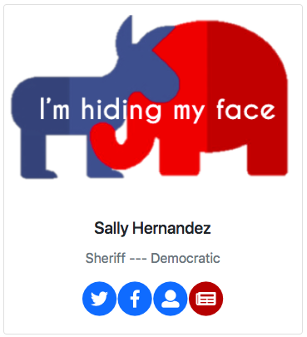
Creating the profile
9 Elements exist within each profile:
The card
A photo
Their name
Their office
Their party
Twitter handle
Facebook page
Website
Related New York Times headlines

Slide 8
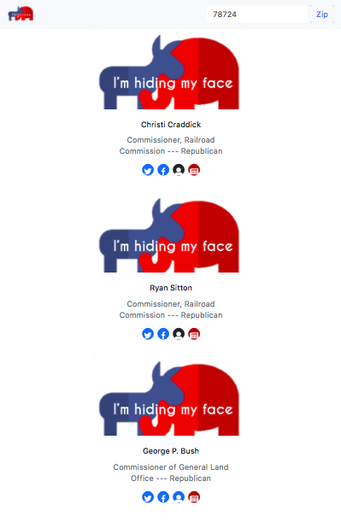
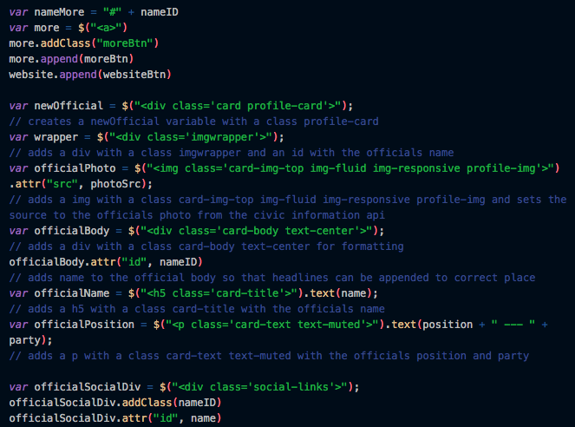
Dynamic “cards” -through javascript
Each time the API returns a name, a profile card is created.

Slide 9

But there was a catch!

Slide 10
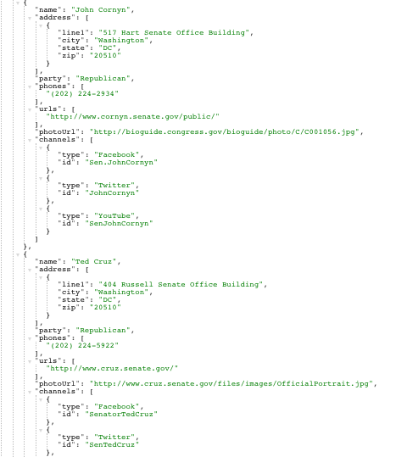
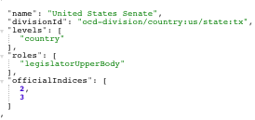
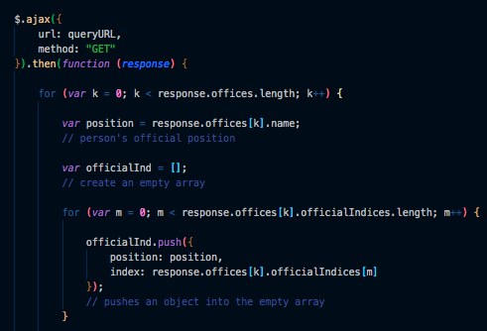
To get their office, we had to use a different response….
Push to a new array!

Slide 11
Creating the profile
9 Elements exist within each profile:
The card
A photo
Their name
Their office
Their party
Twitter handle
Facebook page
Website
Related New York Times headlines

Slide 12
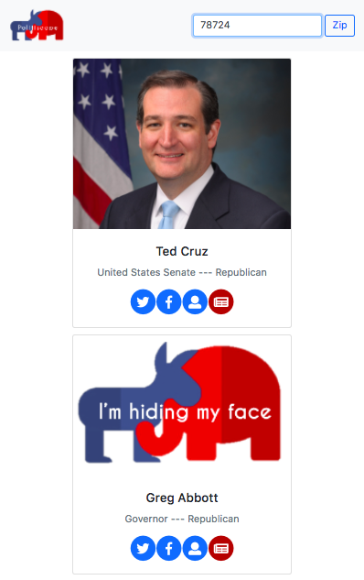

What IF they don’t have a photo?

Slide 13
4 little buttons left…
9 Elements exist within each profile:
The card
A photo
Their name
Their office
Their party
Twitter handle
Facebook page
Website
Related New York Times headlines

Slide 14


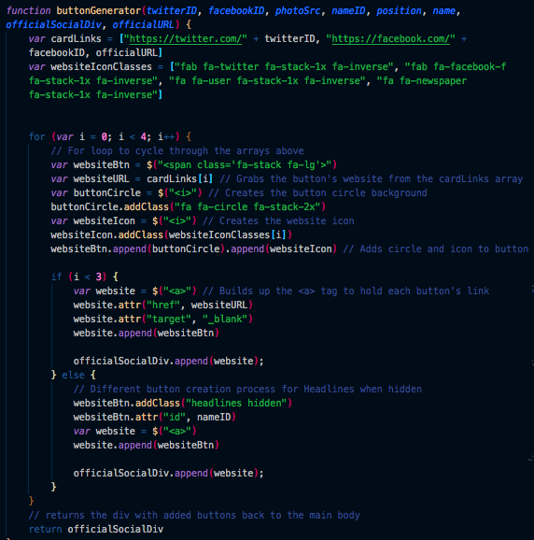
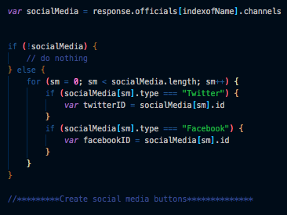
Just + 4 + little buttons = famous last words!
First we had to establish if they had social media… and then we had to make the button. Thanks FontAwesome.com

Slide 15
One API to go…
Now the real fun starts!
9 Elements exist within each profile:
The card
A photo
Their name
Their office
Their party
Twitter handle
Facebook page
Website
Related New York Times headlines

Slide 16
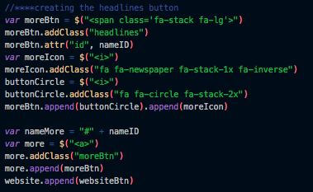
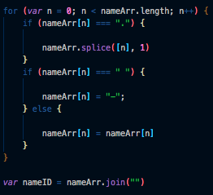

The “Headlines” Button
The names had to be split; remove punctuation; replace spaces with hyphens; and, finally, join the name.
This gave us “nameID”. We used it as values and IDs to use in the next step of the API.

Slide 17
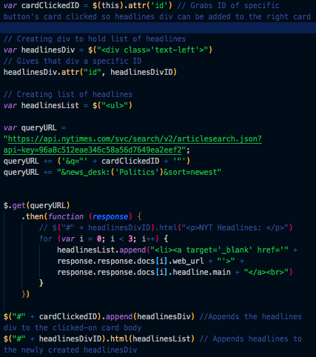
API #2 – New York Times
Now that we built “nameID” the headlines button can register the value to search in the NYT-API.
By placing the “Get” within the button clicked function, we activate the 2nd API, and our page loads faster initially.

Slide 18
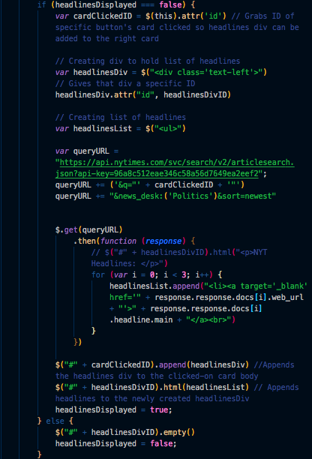
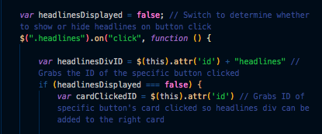
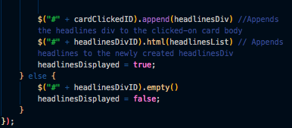
Remember: “Keep it clean”
To stay true to the “keep it clean” branding style, the headlines button can clear the headlines by just being clicked again… but it took some code!
True & False!

Slide 19
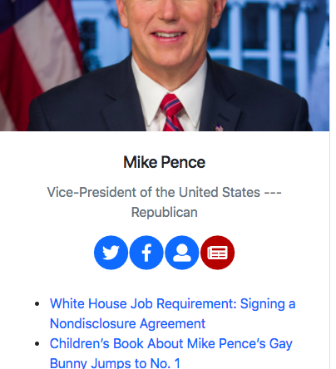
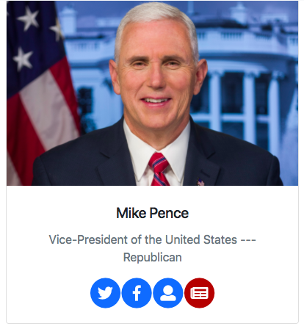
Headlines button complete!

Slide 20

Clean & simple
We did it!!!!
9 Elements exist within each profile:
The card
A photo
Their name
Their office
Their party
Twitter handle
Facebook page
Website
Related New York Times headlines

Slide 21
Did we meet the criteria?
2 APIs
Use Ajax
New Library
Polished Front-end
Quality code-standards
No alerts
Repeating element
Use Bootstrap
Deploy on GitHub
User input validation
- Google Civics & NYT
- FontAwesome.com
- We used a modal
- The Profiles
- Zip Code Input

Slide 22
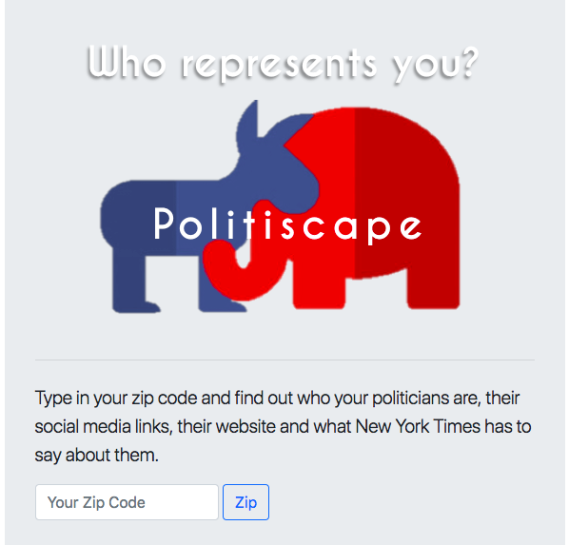
Wanna see?

Slide 23
We know there is room to EXPAND!
Search-ability
Create searches for special interest groups:
Form Letters
What to post, who to tag.
Search by office, federal vs local, and other more specific queries.
Create searches for upcoming elections:
Who is running?
Who is on the chopping block?
Create user login –
Allow users to register their party and pull info based on that.

Slide 24
What is “sell-able”?
Sell data to polling efforts.
Sell advertising space on scrolling profiles.
Let Special interest groups pay to host their form letters and campaigns.
Let campaigns pay to post their invitations to rallies, speeches and other politically-motivated events.

