Slide 1

HealthGang
Mental Health App

Slide 2

Our team
Gergő Rostás
Danique Botter
Vesethmollyka Var
CEO
IT Lead
R&D Lead

Slide 3
Introduction
”Mental health is a state of well-being in which an individual realizes his or her own abilities, can cope with the normal stresses of life, can work productively and is able to make a contribution to his or her community”
- World Health Organization
Notes:
Long version:
This is the definition of mental health as stated by the World Health Organization. While physical health is more obvious, a broken leg or bruise is rather easily spotted and has a clear cure, this is quite in contrast with mental health; a worsened mental health like depression or anxiety is more difficult to diagnose and to cure. However, mental health is of great importance to us all. It affects how people value their lives, do they experience joy and happiness? Or do they feel lost, down and anxious in life? The state of mental health is important for society and economy since it affects how people handle and react to certain situations. During the COVID-19 Pandemic, mental health has decreased according to different researches. Since in particular students are hit hardest by these mental health problems, our main focus will be on finding a solution for this group.
-----------------------------------------------------
Short version:
Today we will talk about mental health, an important factor in everyone’s lives. It determines your life quality, how people react and handle certain situations and it also affects your physical health. During the COVID-19 Pandemic, mental health has decreased according to different researches. Since in particular students are hit hardest by these mental health problems, our main focus will be on finding a solution for this group.
------------------------------------------------

Slide 4
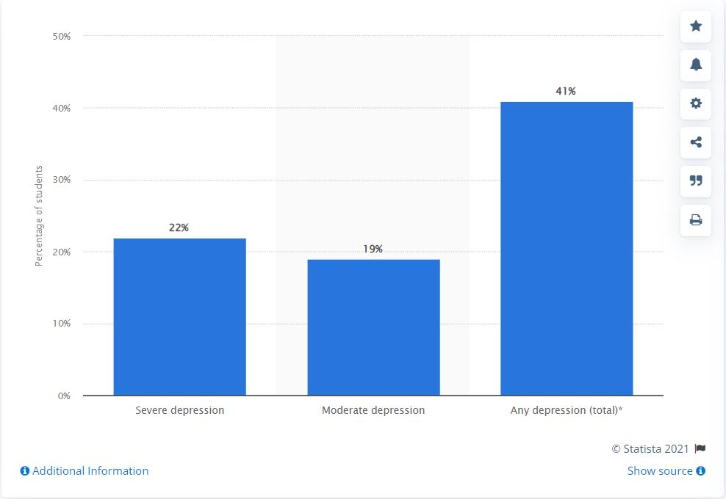
Percentage of college students with symptoms of depression in the United States in 2020 to 2021
The Healthy Minds Study
Percentage of college students with depression U.S. 2020-2021. (b. d.). Statista, 8. november 2021, https://www.statista.com/statistics/1126279/percentage-of-college-students-with-depression-us/
Notes:
During the 2020 to 2021 school year, around 22 percent of college students in the United States reported being severely depressed. This statistic shows the percentage of postsecondary students with symptoms of depression in the United States in 2020 to 2021.
Depression is measured using the Patient Health Questionnaire-9 (PHQ-9),

Slide 5
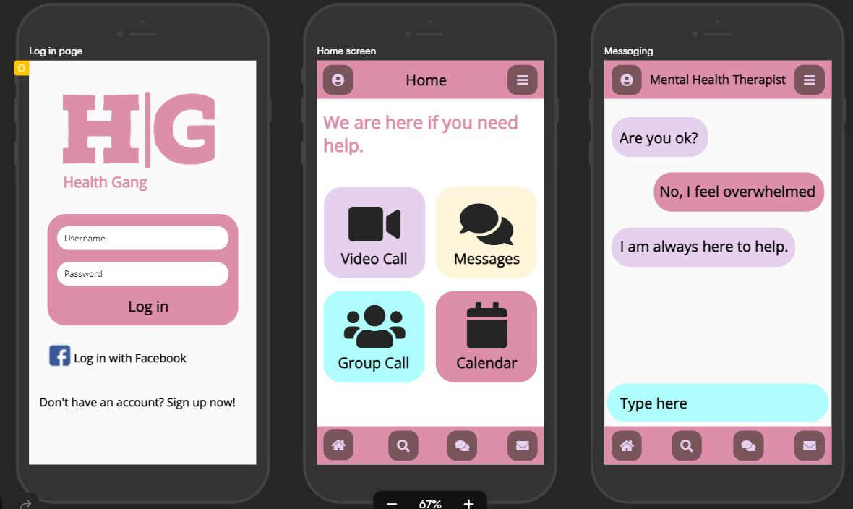
Presenting HealthGang
HealthGang is a free application for the university students who are facing mental health problems such as depression, anxiety, stress related to their academic, professional, and personal life. The online counseling and therapy services are provided through application-based interaction.
https://app.uizard.io/prototypes/JJee4lRQR7T1me0PKWxy/player

Slide 6
Competitors
1.
2.
3.
BetterHelp
notOk
Talkspace
4.
Moodfit
BetterHelp offers convenient online counseling who fits client’s preferences and needs.
notOk is a free digital panic button to get people immediate support via text, phone call, or GPS location.
Talkspace offer comprehensive online mental health treatment options to meet all client needs via video, messaging, phone.
Moodfit is a free mental health app whose tools and insight are meant to “share up” client mood.

Slide 7
What makes HealthGang Different
All-in-one platform
More Flexibility
University Student
Quick Help

Slide 8
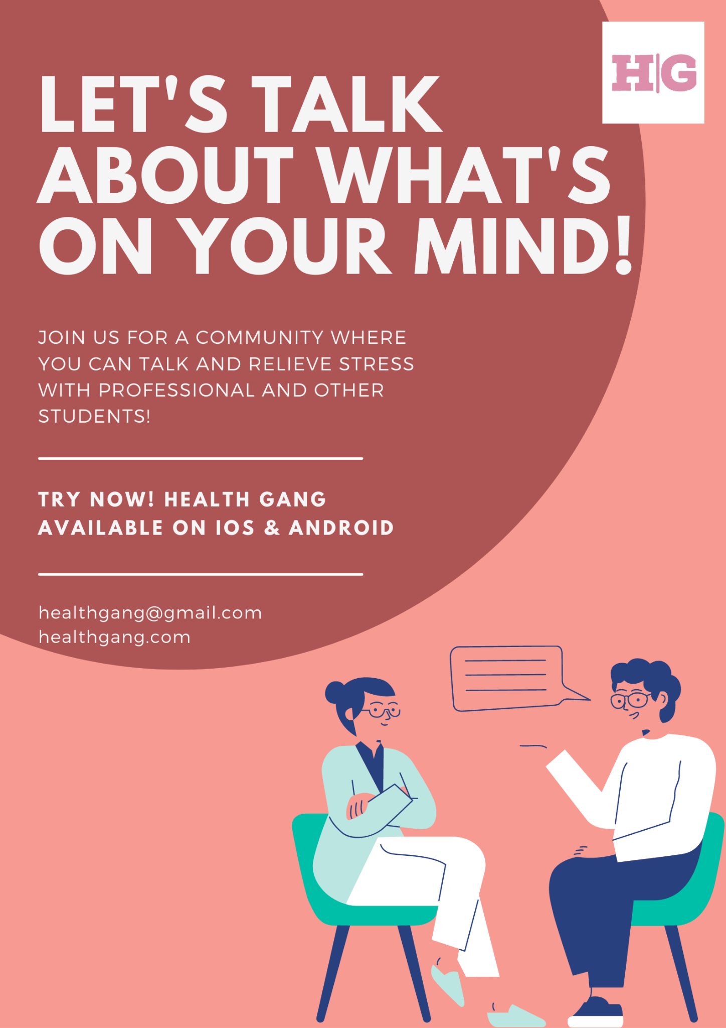
Promotion
Social Media
Face-to-Face
Poster
Visiting faculties
Visiting student activities
Health care institutions
University channels
Student organizations
Social media groups

Slide 9
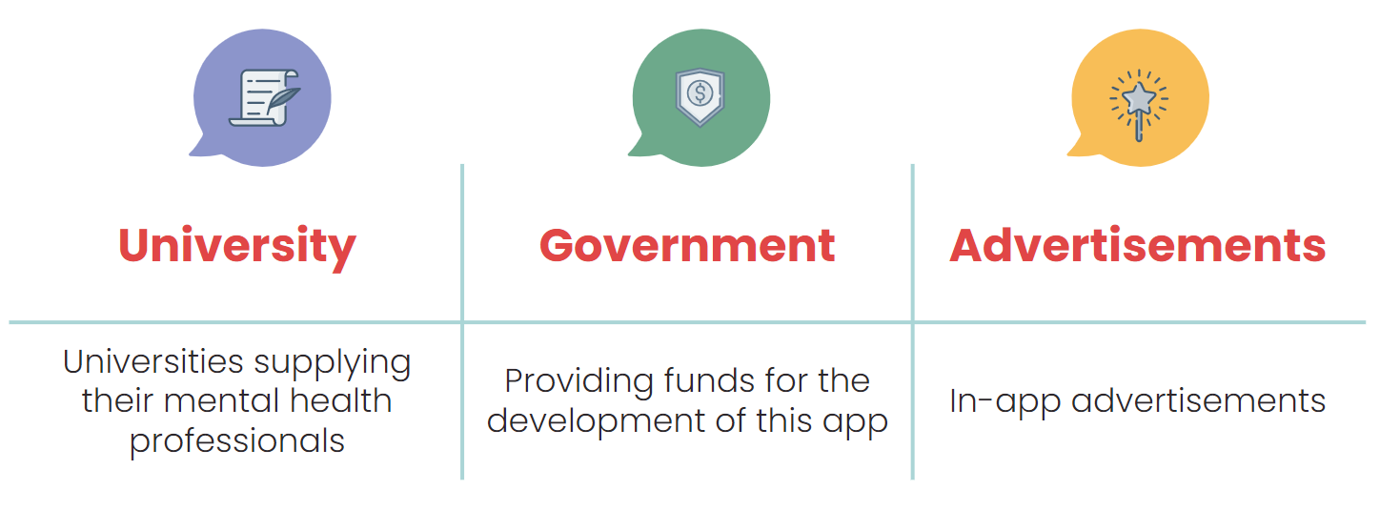
Call for action
Funding
Mental health professionals
Professional support for our team
Marketing
Sponsor us to make this project possible!
Enroll with us to help students improve their mental health
Guide us during the process of building this app
Provide us with your website, social medias, emails to promote and marketing this platform for students

Slide 10

Thanks!
“You don’t have to struggle in silence” - HealthGang
healthgangofficial@gmail.com
healthgang.com
Please keep this slide for attribution

Slide 11
Q&A

Slide 12
References
Fergusson, D. M., McLeod, G., Horwood, L., Swain, N. R., Chapple, S., & Poulton, R. (2015). Life satisfaction and mental health problems (18 to 35 years). Psychological Medicine
Prince, M., Patel, V., Saxena, S., Maj, M., Maselko, J., Phillips, M. R., & Rahman, A. (2007, 09). No health without mental health. The Lancet
Pierce, M., Hope, H., Ford, T., Hatch, S., Hotopf, M., John, A., . . . Abel, K. M. (2020). Mental health before and during the covid-19 pandemic: a longitudinal probability sample survey of the uk population. The Lancet Psychiatry
Szabó, C., Pukánszky, J., & Kemény, L. (2020). Psychological Effects of the COVID-19 Pandemic on Hungarian Adults. International journal of environmental research and public health.
National Dutch student mental health monitor (2021). Mental health of students in the Netherlands during the COVID-19 Pandemic.
Grubic, N., Badovinac, S., & Johri, A. M. (2020). Student mental health in the midst of the COVID-19 pandemic: A call for further research and immediate solutions. International Journal of Social Psychiatry
Kurimay T. (2010). Mental healthcare in Hungary: contradictions and possibilities. International psychiatry : bulletin of the Board of International Affairs of the Royal College of Psychiatrists.
Notes:
Fergusson: life satisfaction affected by mental health
Prince: mental health is also important for physical health
Pierce: most increased mental distress was found for 18-34 year olds
Szabó: mental health hungarians during COVID pandemic decreased
National dutch student monitor: more than half of the students experience mental distress

Slide 13
Customer Journey
She talked about her problems and listened to others’ problems. She got advice from people in the group. And now, she felt relieved.
She then discovered an application called HealthGang posted through NEPTUN email at the University.
Day 1
Day 3
Jennie Kim has been feeling overwhelmed with high workloads and anxiety from exams.
She signed up and got connected to a group call. There were 5 people such as 4 students and 1 psychology professional.
Day 2
Day 4

Slide 14
Target
Age
Gender
Status
Occupation
Objective
Internet Use
20
Female
Single
Student
Improve Mental Health
Yes

Slide 15
Launching Cost
Advertising Cost
Developing Cost
The average cost to develop a similar app to Slack ranges between $15,000 to $20,000+.
Google Play Store: 25$ to create a developer account
App Store: 100$ in annual basis.
Digital Attraction: No cost
Physical Attraction: 20$ per poster

