Slide 1
Group 1 Presentation 3

Slide 2
Why we changed the focus
Not all people over 40 is technology friendly
After interview, we found that the problem is not shared by a big group of people.
We do not have the professional background to develop the App idea.
Better implementability through a service than an App.

Slide 3
New Selected Problem
Having trouble with the completition of admission tasks and paperwork for university.

Slide 4
Persona
Age:
Marriage Status:
Occupation:
Objectives:
Single
20
University Student
Get a degree
Gender:
Female
Internet use:
Yes

Slide 5
Survey Questions- 38 people
1
2
3
4
5/6
Gender
Age
University and Major
Year
Difficulties in the admission process, which
7
8
9
Would have been easier with help?
Would you volunteer to help?
Which reward would you like

Slide 6
Gender

Slide 7
Age

Slide 8
University and Major
Business Administration and Management.
Arquitecture.
Economic Science.
International Relations.
Biology.
Social Work.
Psychology.
Industrial Engineering.
Electrical Engineering.
Dental Hygiene.
Medicine.
Computer Science.
Actuary.
Communication and Media Science.
English Teaching Training.
Business Development.
Environmental Engineering.
Marketing.
Business Development.
Agriculture and Rural Development.
University of Pécs.
Budapest University of Technology and Economics.
Lane Community Collage.
University of Debrecen.
Universidad de Buenos Aires.
Senac (Brazil).
Budapest Metropolitan University.
Universidad Nacional de Formosa.
Universidad Nacional de Rosario.
University of Szeged.
University of Sopron.
UCC Business School.
TUL.
Universidad Tecnológica Nacional.

Slide 9
Year

Slide 10
Did you face any difficulties in term of searching the university, your desire major, and university admission?

Slide 11
If you encountered difficulties, what are those issues?
University hunt.
Finding the university that offered the study program for me.
Tuition fee information, scholarships.
Bureaucracy.
No-one to guide.
Courses in the relevant major, university’s facilities and popularity.
Entrance exam preparation and requirements.
Many requirements of applying procedures were unclear.
Finding my desired major in English and navigating the faculty website.
Trying to decide.
Bad preparation for admission.
Trouble to contact the couse director.
Admission issues.
Admission difficulties.
Lot of misinformation and steps were not really clear in the admission process.
Procedures.
Lack some information.

Slide 12
Would it have been easier if there was someone who could help you with the university admission process?

Slide 13
Are you willing to volunteer to help potential students who face the same problems as yours?

Slide 14
If yes, what is the reward you want for your help?
None.
I don’t need any rewards.
Honey lemon tea.
Nothing.
Happiness.
I don’t know.
Continuous friendship.
Scholarship.
Maybe some free days.
Some payment and/or internship certificate.
Allowance.
Extra hours recognition.
Discount for education.
Not necessary.
More opportunities to attend in learning event.
Scholarchip bonus.
Them being satisfied and happy then we can go for coffee.
Sushi.
$$$
Nothing, just thanks.
Everything is good.
Appreciation.
The phrase “thank you”.
Certificate.
Maybe a small payment but I’m down to do it for free as well.

Slide 15
Implementability:
Create an App which would provide the place for a connection between university students and future students, in which they can interact with each other, get rid of doubts and make the admission process easier.
Technology:
Social Media, cybersecurity, artificial intelligence, internet of behaviours.
Trends:
Networking, personalisation, learning, technology usage, social responsibility.

Slide 16
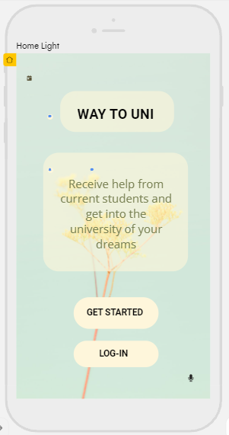
Mockup version of the App

Slide 17
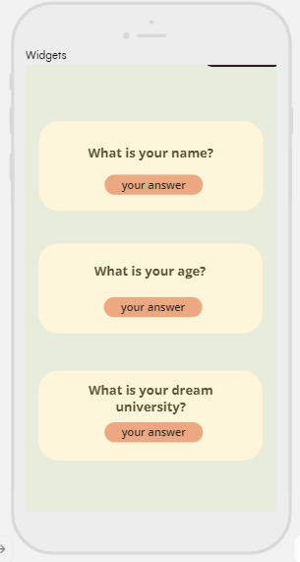

Slide 18
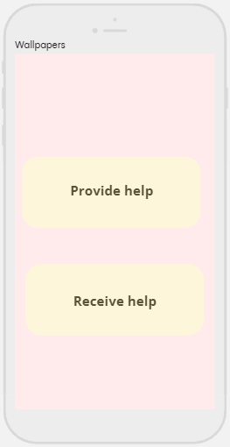

Slide 19
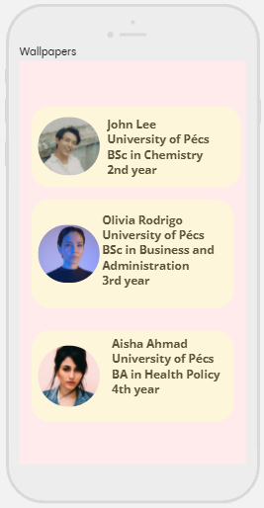

Slide 20
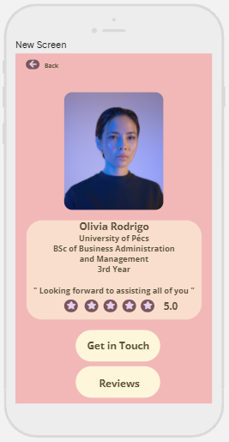

Slide 21
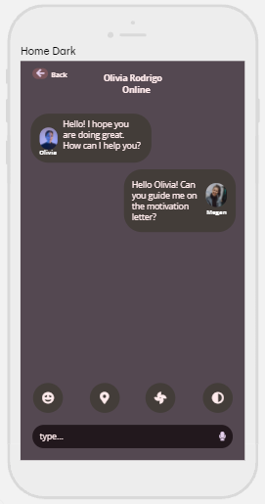

Slide 22
Competitors
01
02
03
MentorHub NU
Infigon- The Career Mentor
Find your Mentor-OMYS
04
05
HÖOK program
Unibuddy

Slide 23
MentorHub NU
Purpose: Student support regarding information about which classes to take, extracurriculars, adaptation, etc, withing NU, mostly for freshmen.
Registration process: Log-in with NU username and password, answer questions about student perception, such as: I feel part of the NU community, I am confident I will be a successful student at NU, All things considered, I am satisfied with my life as a whole.
Check in: What challenges bother the student the most: academic performance, finance, mental health, etc. What for: track one’s progress over time, give information to guide, give information to the app so it can suggest other resources (apps/services) to tackle related issues. 1x or more - rewards for regular check ins.

Slide 24
Dashboard: Progress in Mentor Hub, detailed view of check-ins.
How to get help: Through referrals.
After completing check-in, chat with a Student Success Guide. Based on problematic areas, Guide will create a referral (e.g. sign up for class), where there would be steps how to solve the problem. If not solved, continue working with a guide or chat with an academic advisor. Video chat option is available too.
Emergency and non-emergency resources tab available.
Revenue model: Based on MentorHub platform (who partner with Big Brothers Big Sisters of America, Friends of the children, My brother’s keeper, etc.), university funding, partnerships with other apps such as Khan Academy, Headspace, etc.

Slide 25
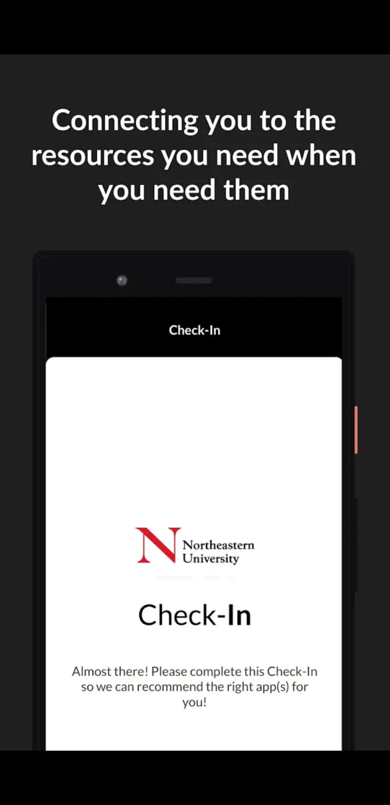
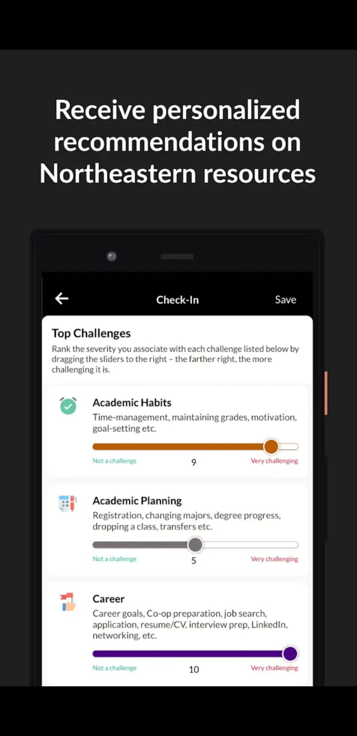
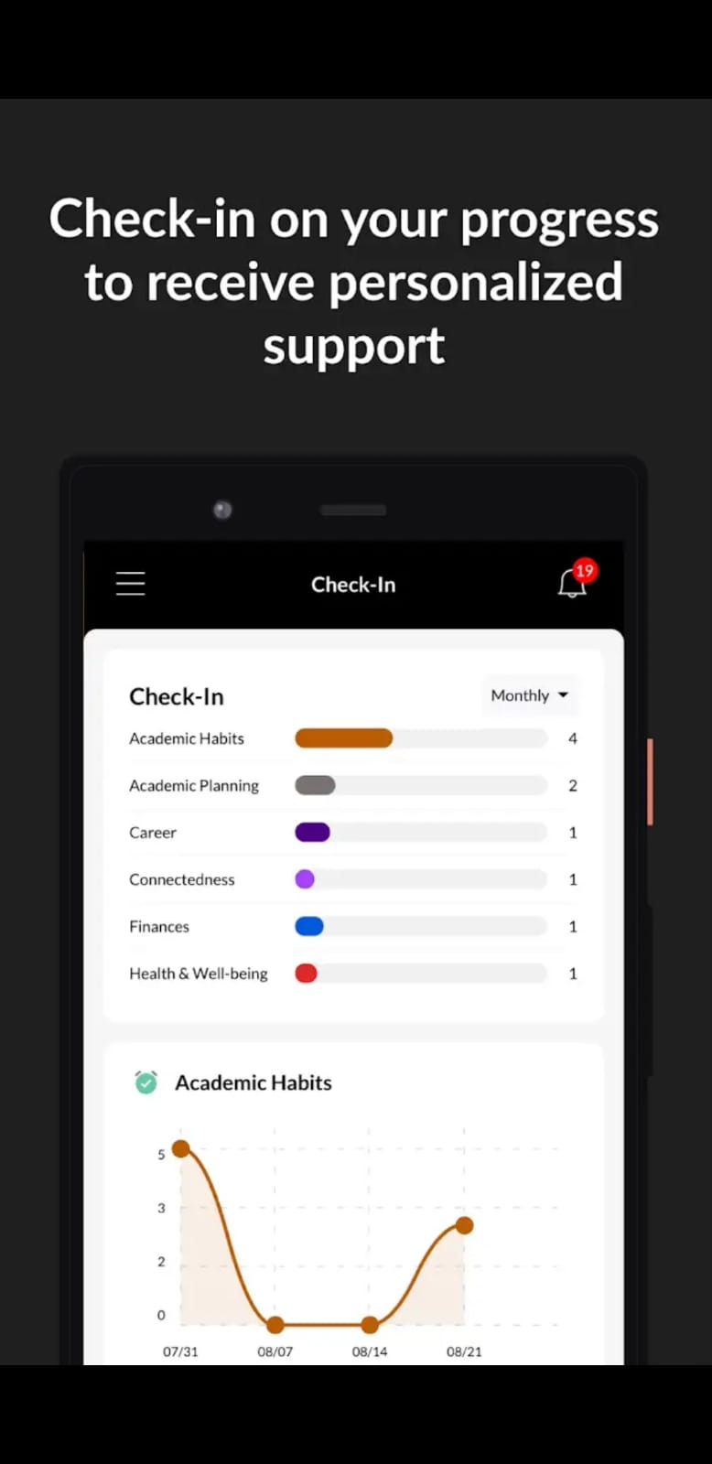

Slide 26
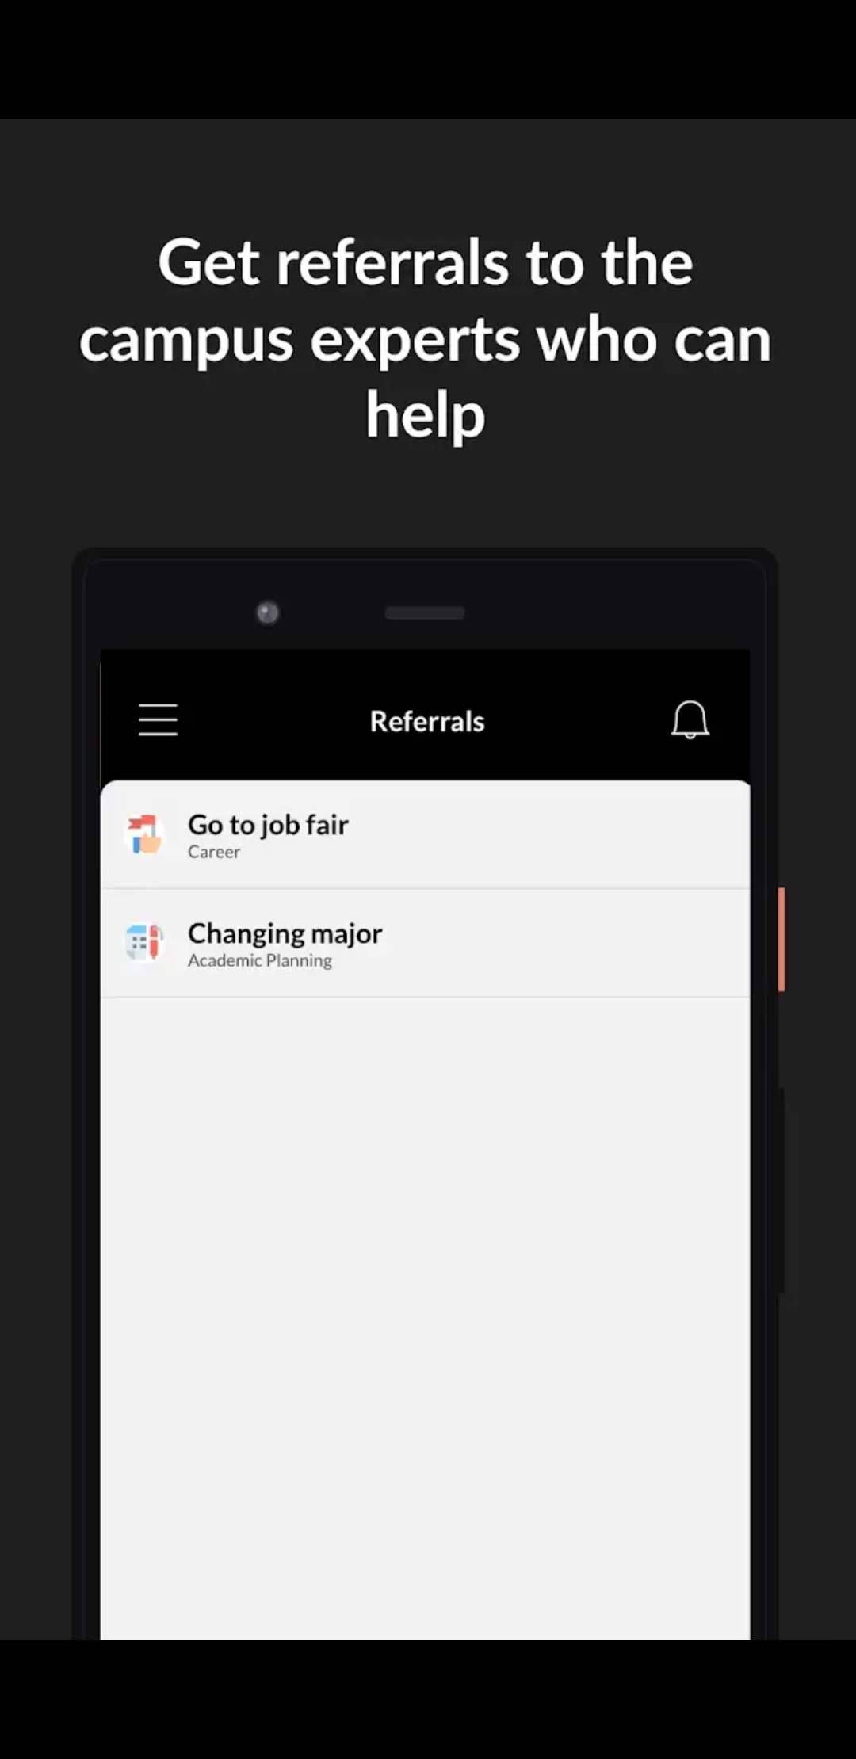
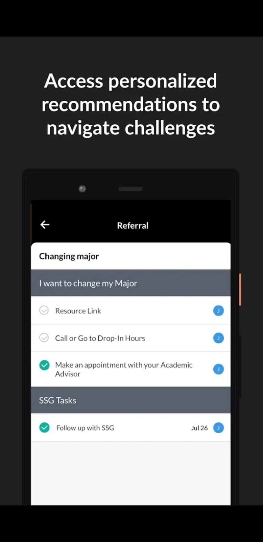
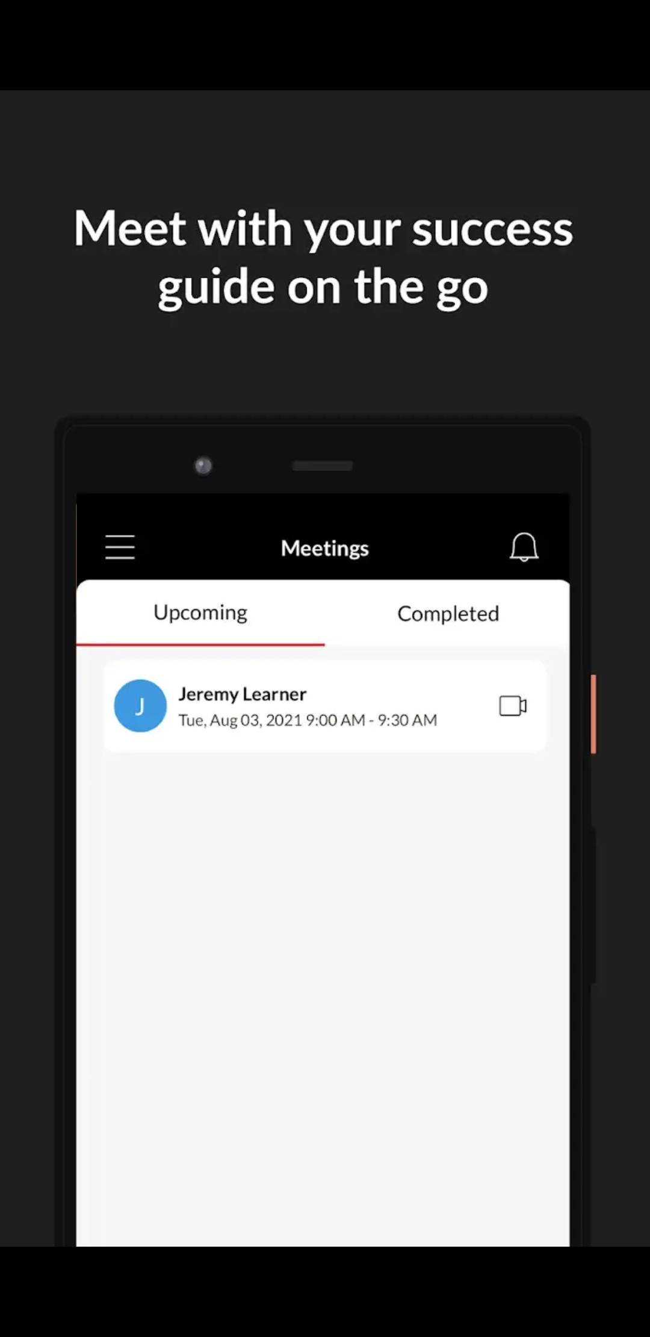

Slide 27
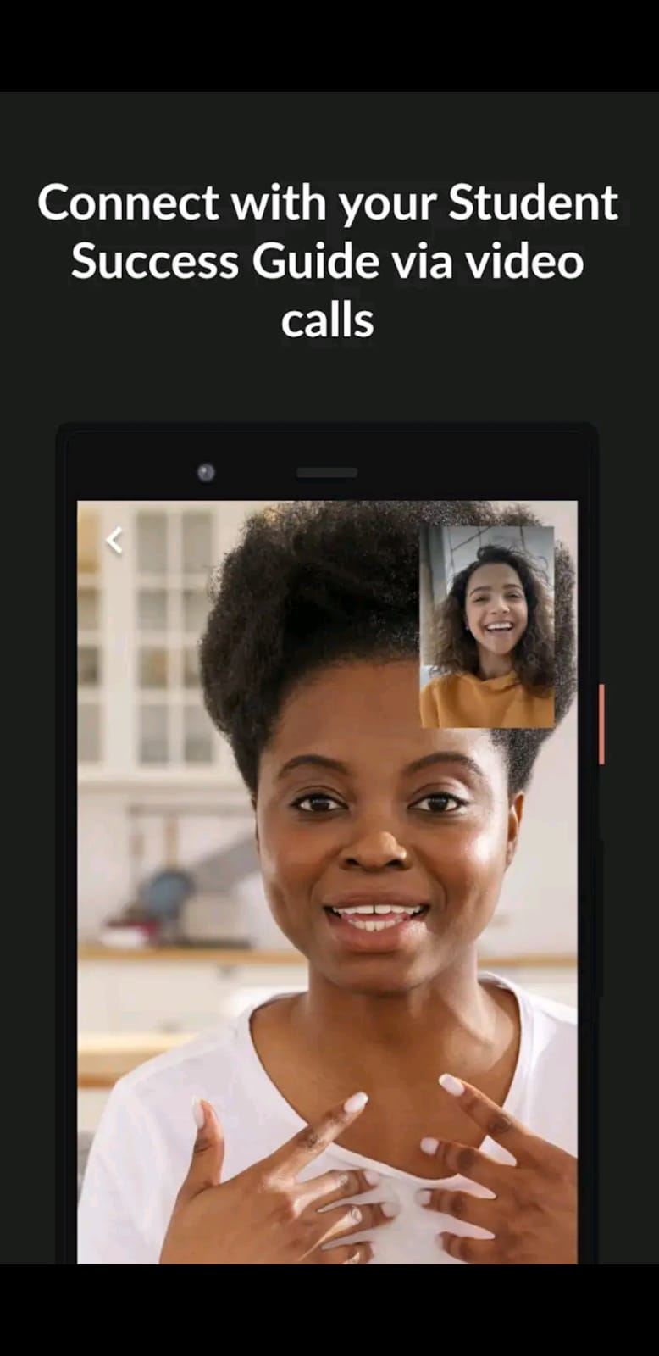
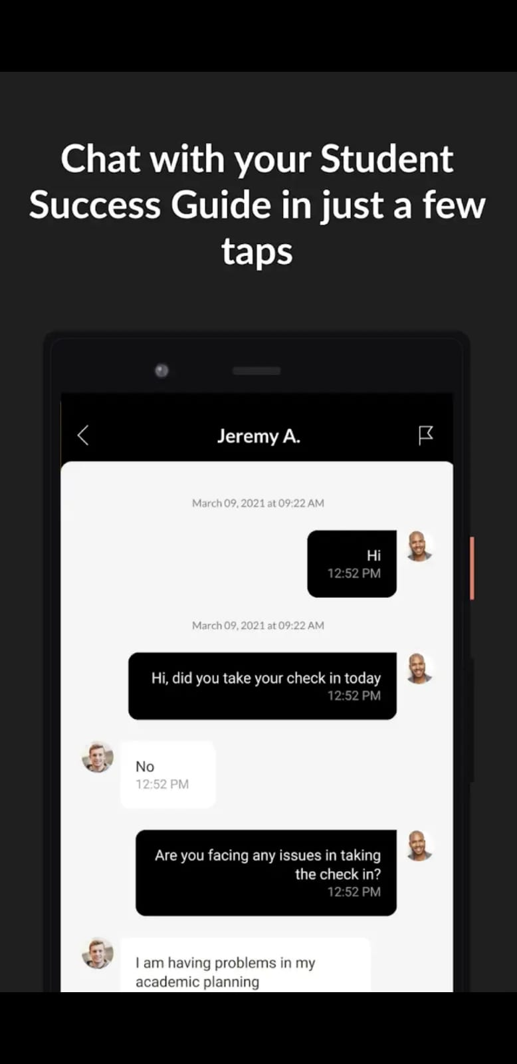

Slide 28
Infigon- The Carreer Mentor
Purpose: Provides career mentorship to students across India.
Registration purpose: Students need to log in with their phone number. However we can not give more information due to the fact that we were not able to do the login since the app did not recognise our phones number. We believe that the app is designed just for Indian students.
Once you are done with the log in, students first attempt a 15-minute self-analysis test Based on the results, getting suggestions about career options most suitable for them. They can select one of these suggestions as their target career, get details of all the education paths available to achieve their target career. After that they counsellors guide them at every step of their journey. And they are able to contact the mentor any time.
Revenue Model: Designated Partners of Infigon Infotech Llp are Hasif Saheb and Ashutosh Kumar Singh.

Slide 29
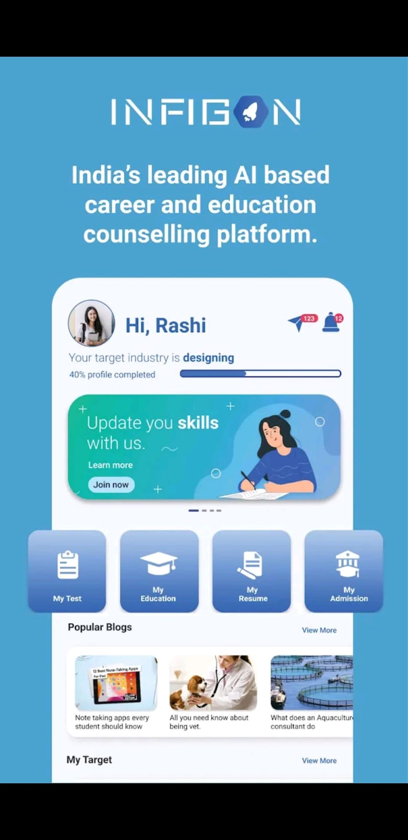
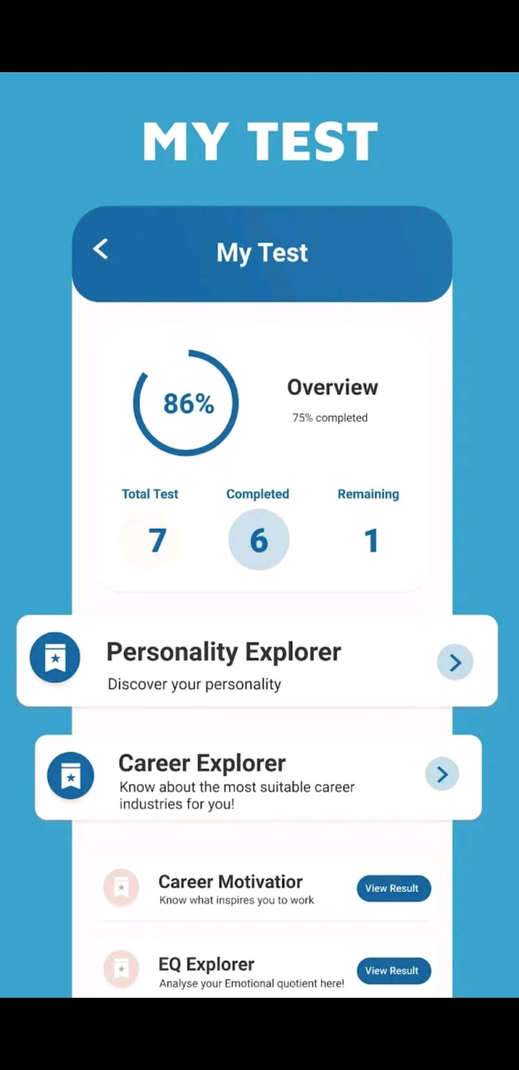
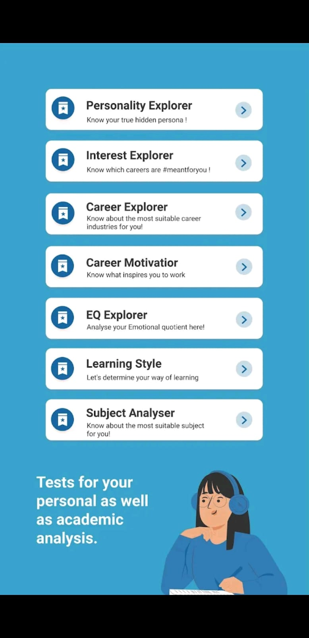

Slide 30
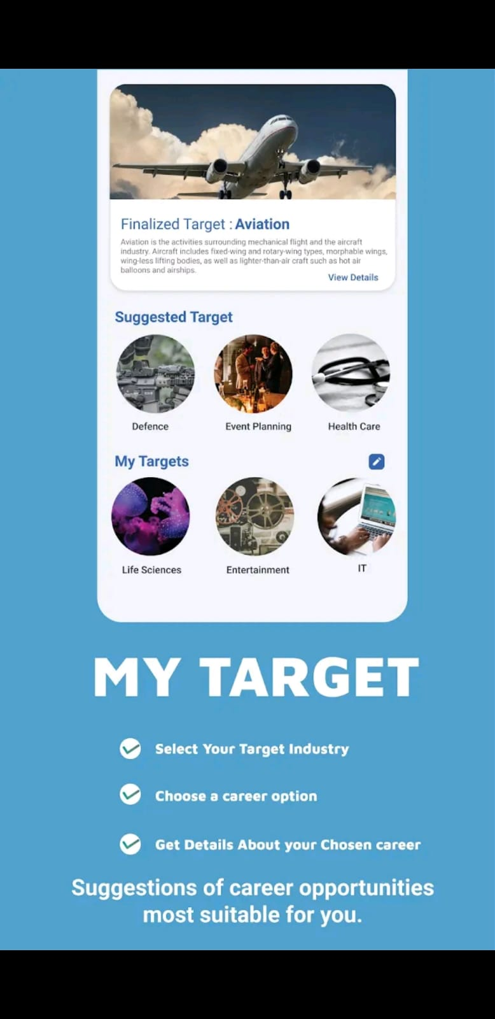
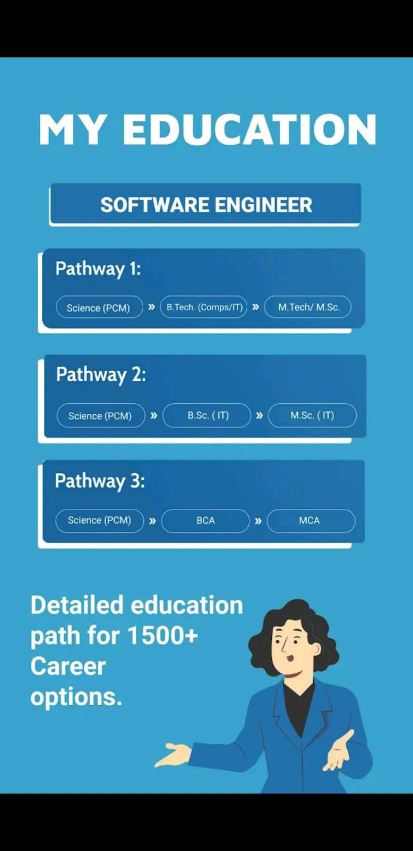
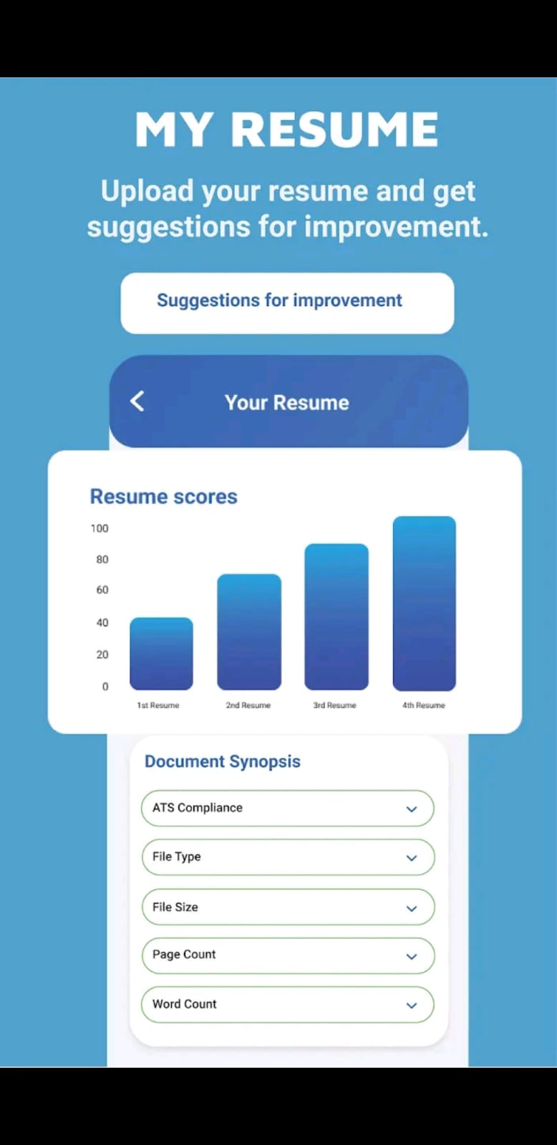

Slide 31
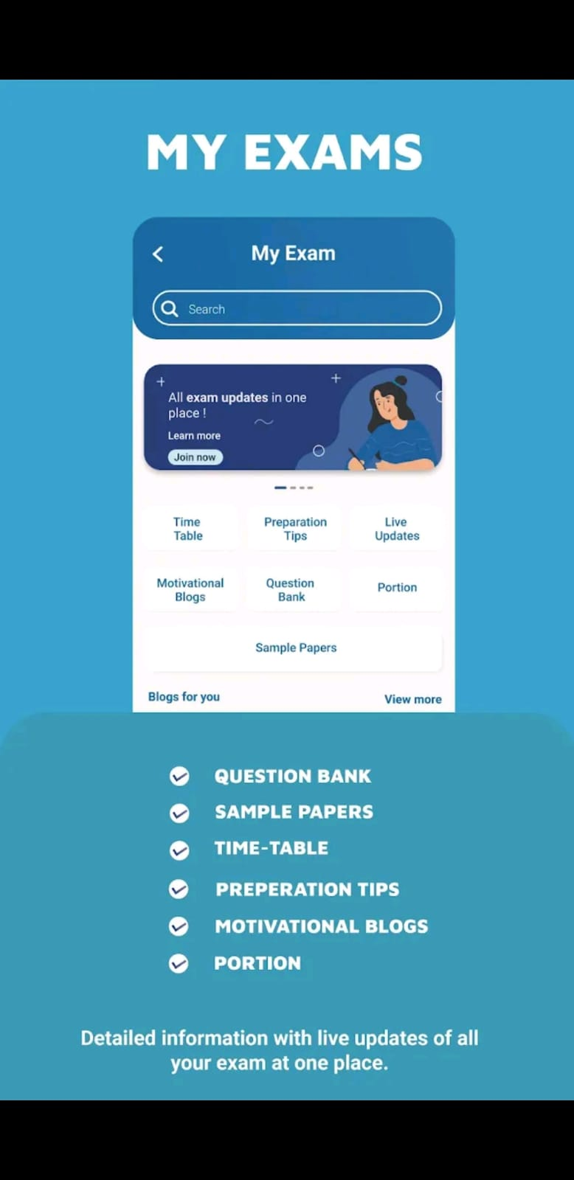
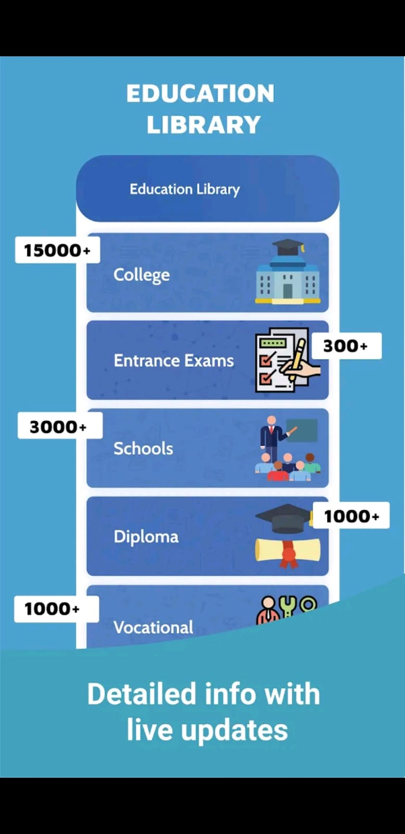

Slide 32
Find your Mentor-OMYS
Purpose: Provide student guidance, according to their chosen field of education
Registration process: First select if you are a student and a mentor, after that you will need to login as normal. Later then you need to select what course you are taking.
Through this application mentors and mentees will be able to contact each other at an specific time via phone call, Whatsapp or skype.
Revenue Model: Not information available.

Slide 33
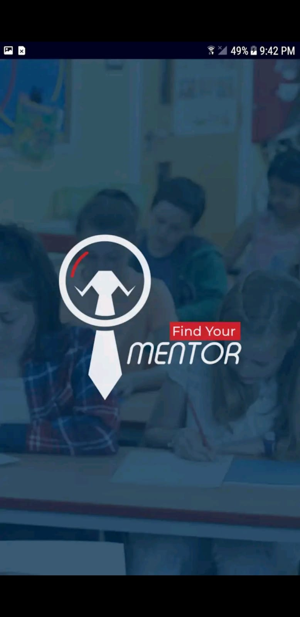
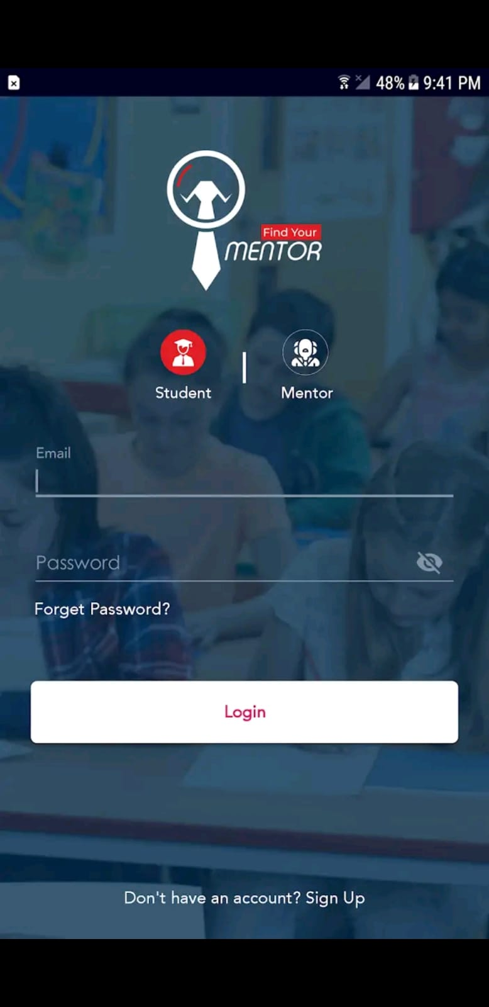

Slide 34
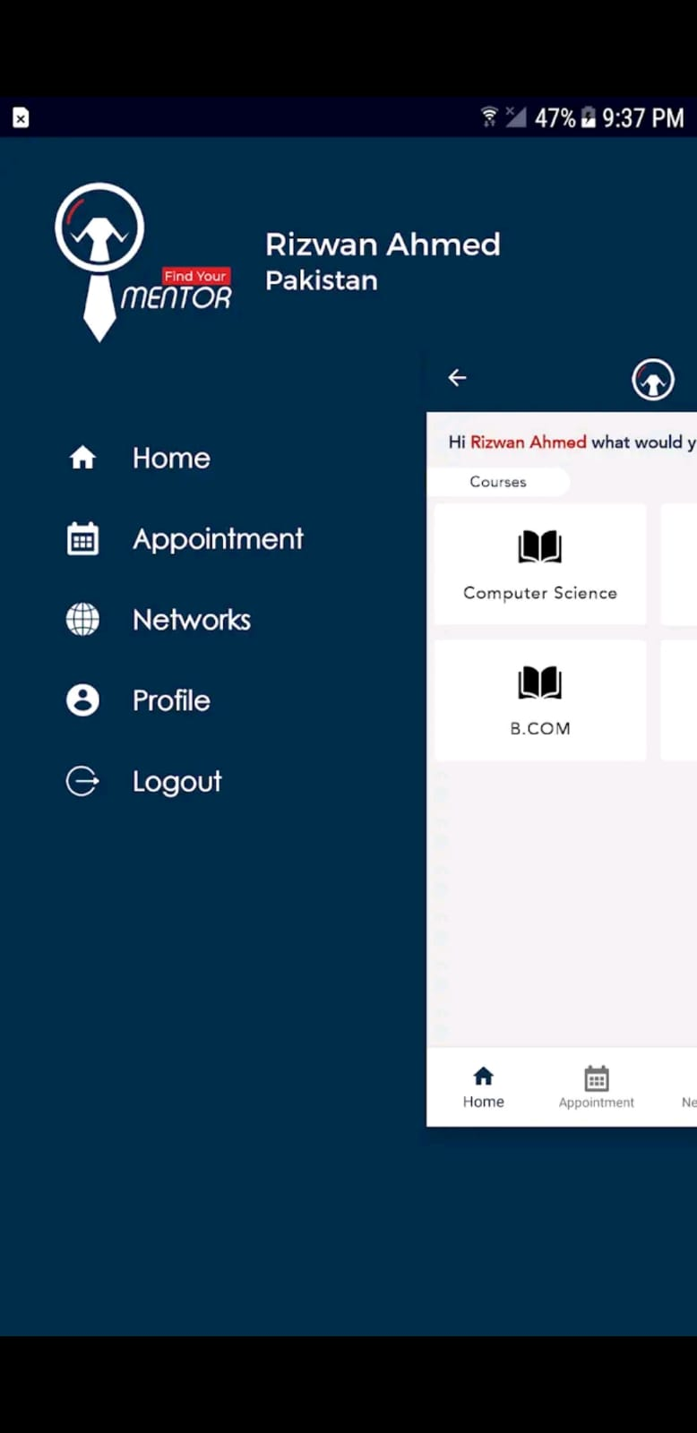
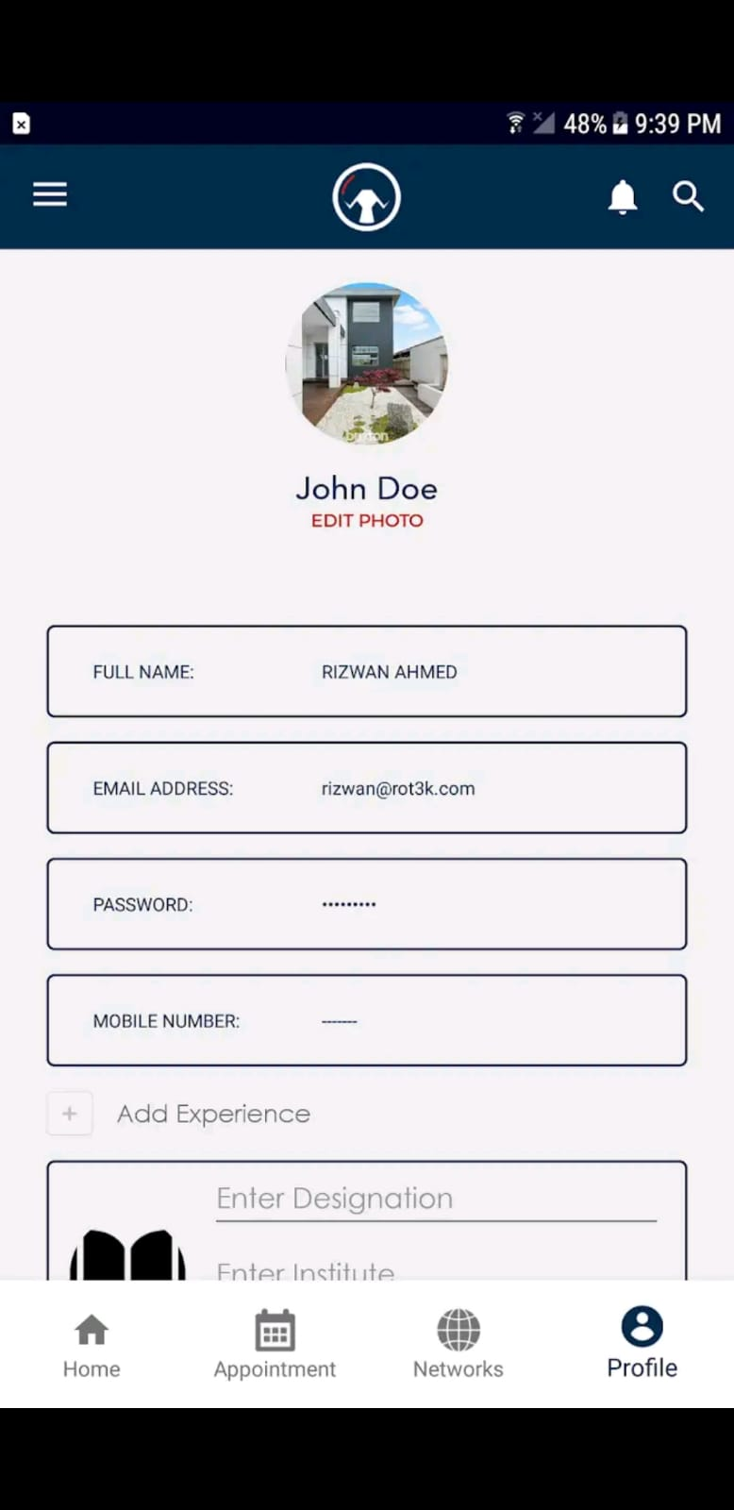

Slide 35
HÖOK program
Purpose: Mentorship network for freshmen students at Hungarian universities for adaptation. Mentors are current students.
Registration process: To be a mentee you have to register through a website, you are asked personal data such as name, age, gender, nationality, etc., as well as your university, faculty and department.
After the registration process you are able to choose a mentor from your university (not always the same faculty), afterwards they will get in touch with you through social media.
Personal experience: Since mentors are not always from the same faculty as yours they are sometimes unable to help. The program focuses on your needs once you are in Hungary, therefore is not helpful during your first steps.
Revenue Model: Financing from university.

Slide 36
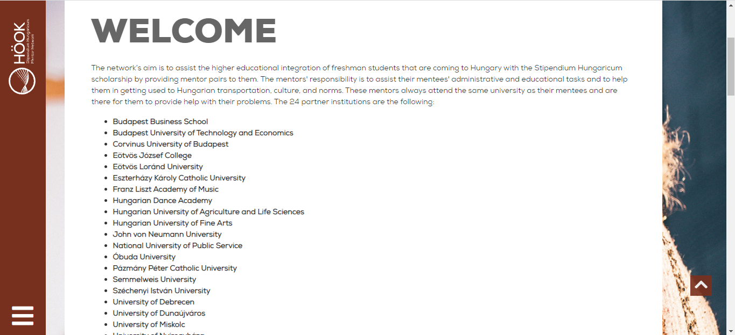

Slide 37
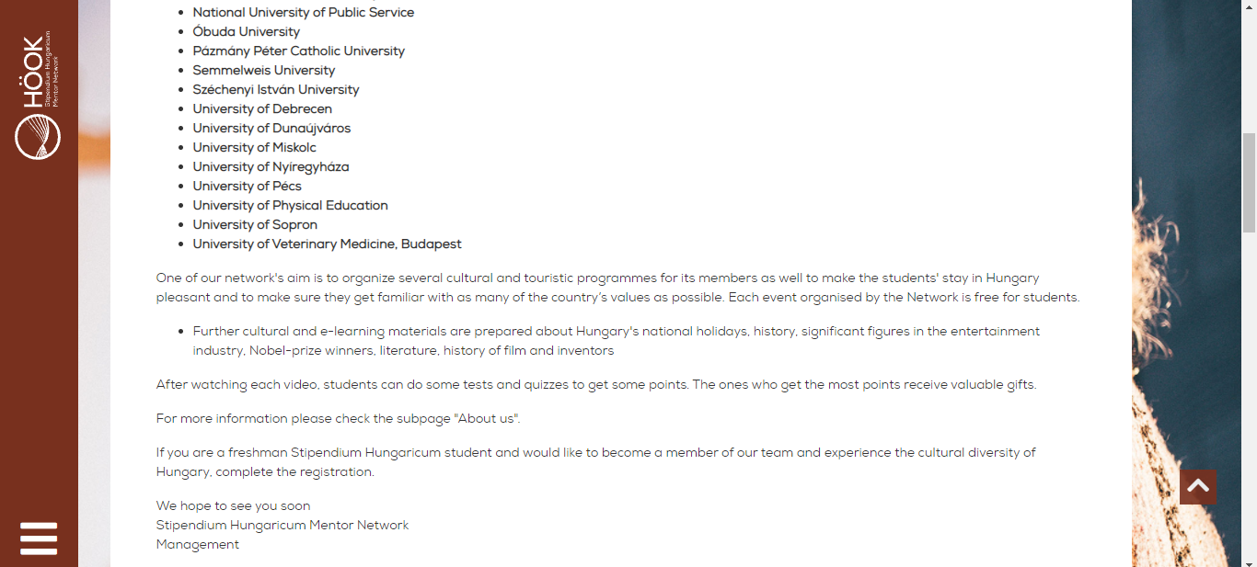

Slide 38
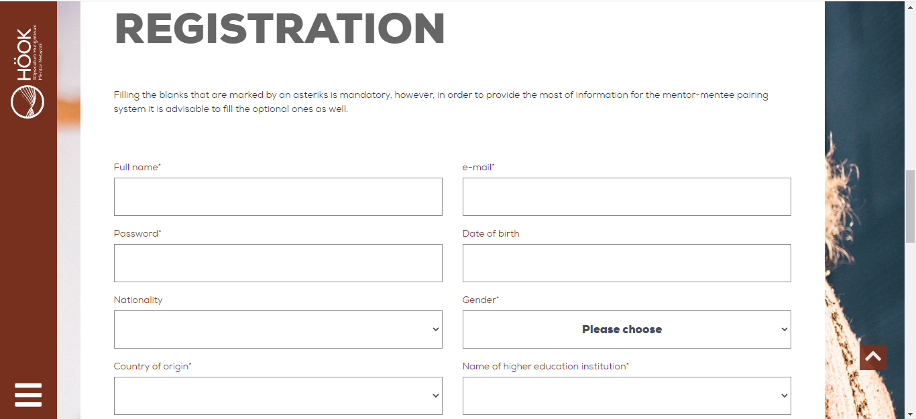

Slide 39
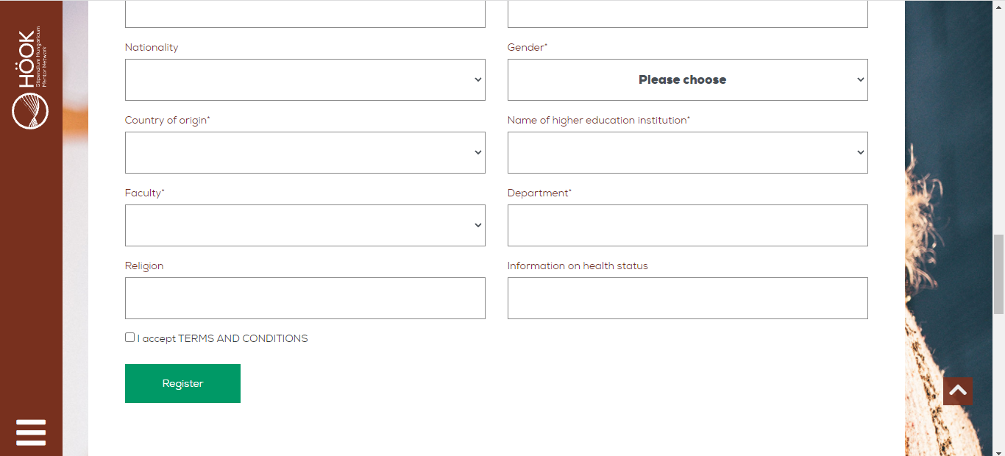

Slide 40
Unibuddy
Purpose: Universities and students around the world use Unibuddy to make more informed decisions about higher education and the recruitment process. They have three products: Unibuddy chat, Unibuddy event, Unibuddy Discovery
Chat: chat with students at your dream university (all over the world). Give prospective students an insider’s view of what it is really like to study, live, or socialize at their dream higher education institution.
Event: Q & A events on accommodation, admission, etc.
Discovery: Pair with student ambassadors of unibuddy to help students discover higher education institutions.
Registration Process: Normal Sign up. Select the dream university, then find an ambassador you would like to pair up with. Then chat!
Value Proposition: Unibuddy helps students thrive through sharing their experience, effortless technology and the smart application of data. This drives leads for universities, increases conversion to improve recruitment, and creates a sense of belonging.
Revenue Model: Funding series B. In Unibuddy, they partner up with the universities rather than the students.

Slide 41
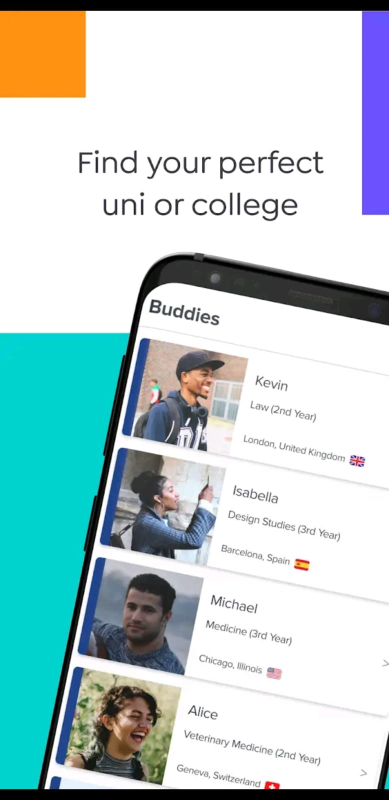
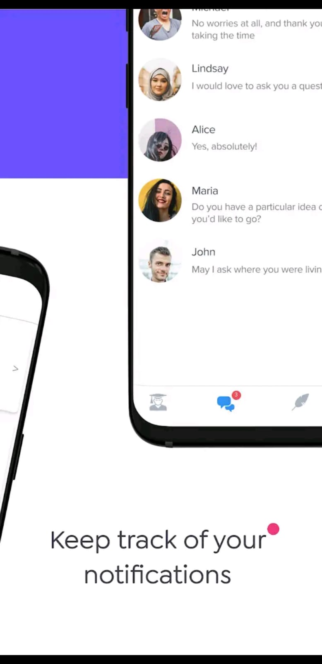

Slide 42
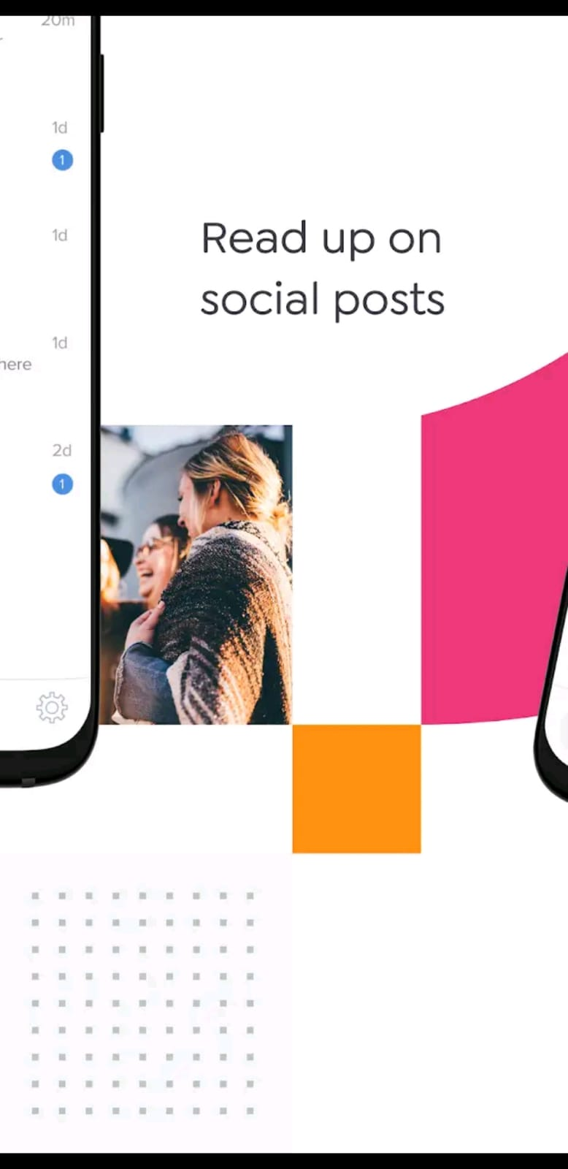
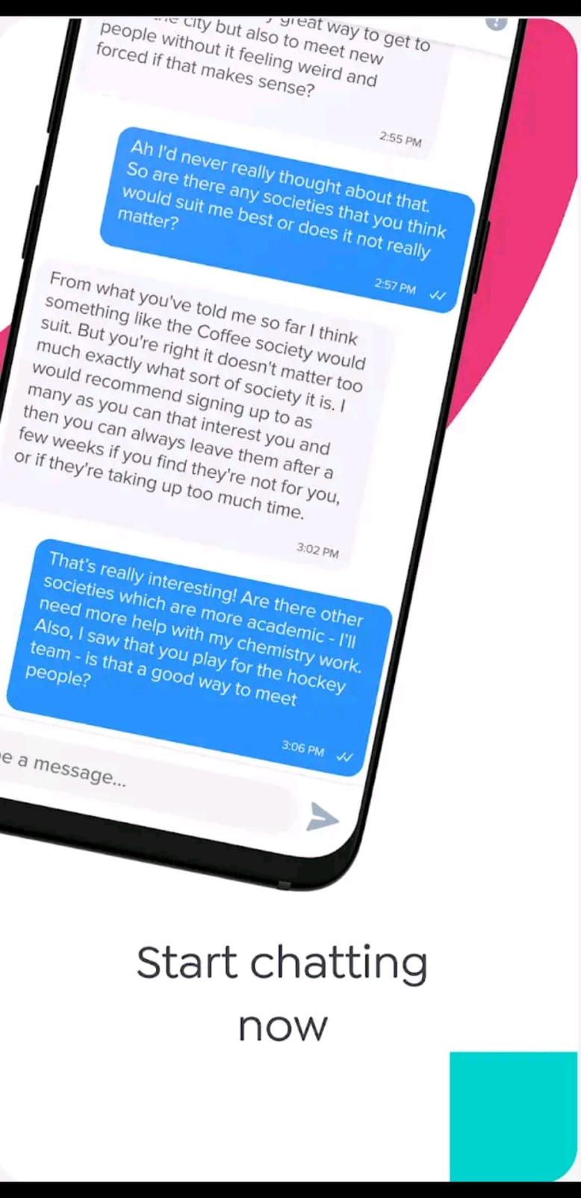

Slide 43
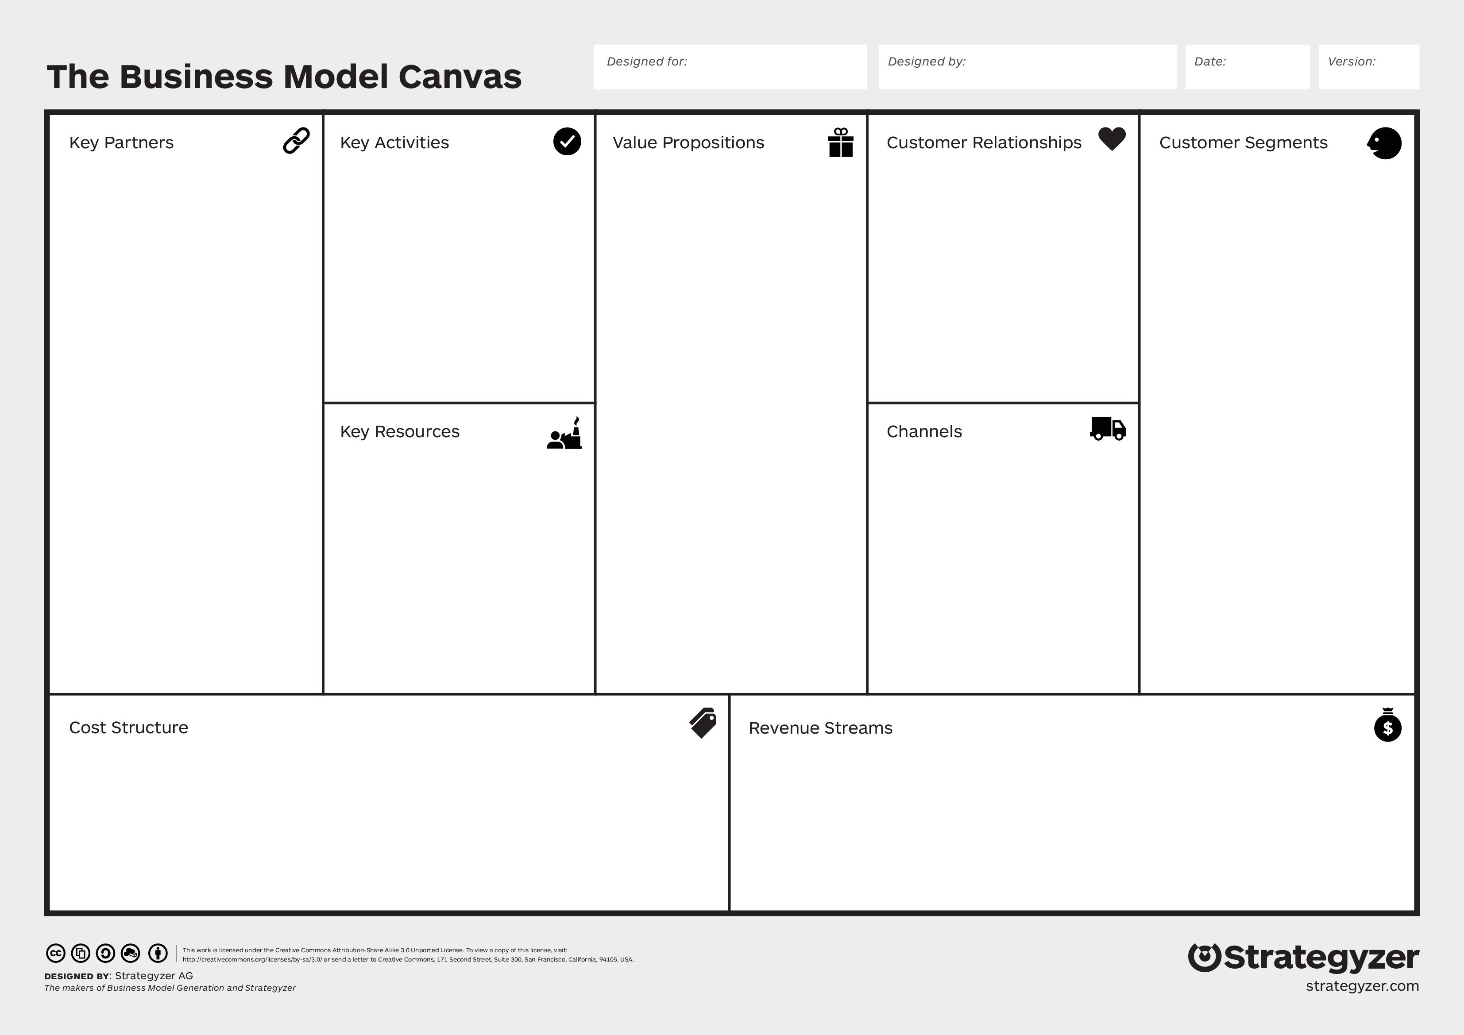
Promotion/advertisement.
Getting more volunteers.
Make processes easier.
Reduce anxiety.
Stop wasting time.
Social interaction and immersion to the new study place.
Short-term relations- Focus on acquiring new people.
Connection of people through technology.
Possibility to choose the person to talk to.
Future/Current University Students.
Young people.
Friendly.
Looking for experiences.
Volunteers-current university students.
Social Media.
Internet.
IT people.
Social Media: Instagram, Landing page
Word of mouth.
App
App creation.
Cost of launching the app.
Costs related to advertisements.
Rewards for help ¿?
In-App advertising.
Affiliate Marketing and Lead Generation.
University sponsorship.

Slide 44
Market Experiments
Personal interviews with current university students.
Objectives:
Have a proper insight in what a student have problems during the admission processes.
Know what are their expectations just knowing they are able to download a Mentors-App.
Determine whether they would make use of an app with the features we described.

Slide 45
Summary of the answers
The people interviewed did not have serious problems in the admission process (it was not impossible) but they would have appreciated help, which would have result in a reduction of their anxiety.
All of them would download an app which promises to help. They seemed very curious and excited about the idea.
All of them would volunteer to help freshman students, even without any rewards.
Responding time was a concern, suggesting us to do much as possible in order to ensure a quick answer.

Slide 46
Lessons learnt
We were quite worried about which rewards could be given for volunteers, but after having the personal conversations we discovered that most of the people, even though a reward would be appreciated, would be more that happy to help, knowing how hard it can be.
It was decided to eliminate the rewards from out costs in the business model, since most of the people seems not to need them. There could be a possibility to implement them in the future.
Also we decided to give a two working days frame to get an answer.

Slide 47
Promotion/advertisement.
Getting more volunteers.
Make processes easier.
Reduce anxiety.
Stop wasting time.
Social interaction and immersion to the new study place.
Speed.
Short-term relations- Focus on acquiring new people.
Connection of people through technology.
Possibility to choose the person to talk to.
Future/Current University Students.
Young people.
Friendly.
Looking for experiences.
Volunteers-current university students.
Social Media.
Internet.
IT people.
Social Media: Instagram, Landing page
Word of mouth.
App
App creation.
Cost of launching the app.
Costs related to advertisements.
Rewards for help ¿?
In-App advertising.
Affiliate Marketing and Lead Generation.
University sponsorship.

Slide 48
Social Media
@waytouniok
waytouniok@gmail.com
http://waytouni.tilda.ws/

Slide 49
THANKS!

