Slide 1
Aumovio Scolarship Report 2026
-Ádám Molnár-

Slide 2
Agenda
Testing in ROS vs testing in ROS 2
1
The Testing Pyramid
2
Unit testing
3
Integration testing
4
System testing
5

Slide 3

Testing in ROS vs testing in ROS 2
Source: www.swri.org
ROS:
Custom framework
Rostest
Xml files
Roscore
Central master node
Cross-talk between tests
Global states
Global functions
Difficult to isolate pieces of code
ROS 2:
Industry standards
Pytest for python
Gtest for C++
Masterless architecture
Nodes discover each other dynamically
Easy isolation
OOP design
Everything inherits from „node” class
Clean code

Slide 4
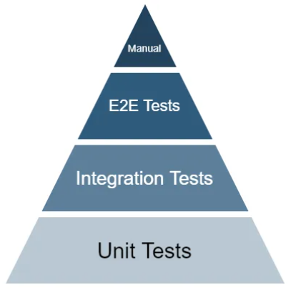
The Testing Pyramid
Unit Tests (The Foundation)
Integration Tests (Connecting the Blocks)
E2E (End-to-End) Tests
Manual Tests
Source: circleci.com

Slide 5
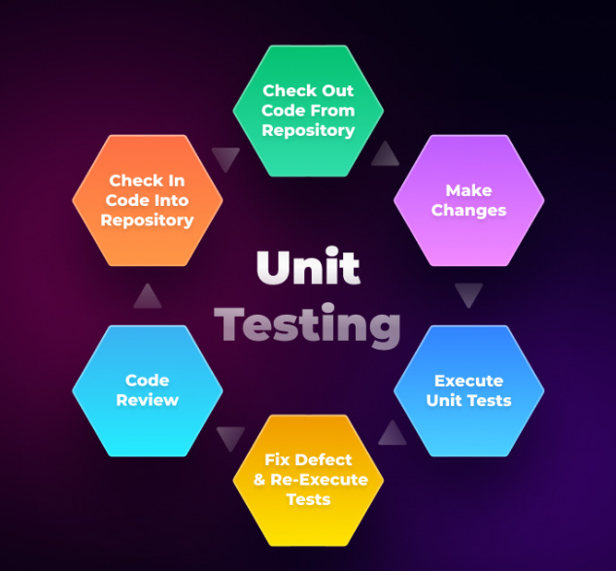
Unit testing
The Goal of Unit Tests:
isolate core logic completely from the ROS middleware
Tests run in milliseconds providing instant feedback on code correctness
Mocking:
Simulating the behavior of ROS objects without actually creating a ROS network.
ROS : Global functions -> easier to mock
Source: testgrid.io

Slide 6
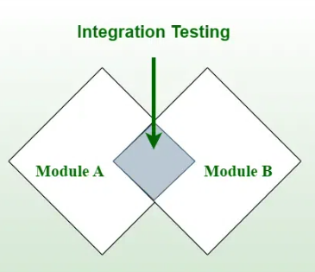
Integration testing
Tests communication between nodes
Real Middleware, Fake Hardware
Language independent
ROS:
XML-based launch files
Use of roscore – slower tests
ROS 2:
Pure python framework
deterministic control over node lifecycles
Source: geeksforgeeks.com

Slide 7
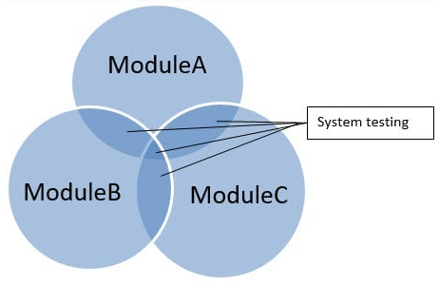
System testing
Works like a big integraion test
Scope:
Testing the entire software architecture—perception, planning, and control— working together as a single entity.
Mission-Level Assessment:
1 test 1 scenario
The Ultimate Safety Net
Source: blog.nashtechglobal.com

Slide 8
Thank you for your attention
I would be happy to answer any questions.

