Slide 1
E-Commerce Logistics Review
By: Molo Munyansanga

Slide 2
Introduction
This project analyzes e-commerce delivery performance using the Olist Brazilian E-Commerce dataset.
The goal is to determine whether delivery delays are concentrated in specific regions and whether late deliveries are contributing to lower customer satisfaction.
The analysis combines delivery performance, geographic patterns, and customer reviews to identify key logistics issues and areas for improvement.

Slide 3
Summary
Delivery reliability is generally high, but regional disparities exist.
Northern states show some of the highest late-delivery percentages.
Late deliveries are strongly associated with lower customer satisfaction, with severe delays producing the lowest ratings.

Slide 4
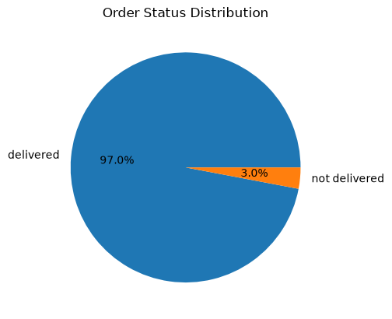
97% of Orders Reached Delivered Status
The vast majority of orders reached the delivered stage.
Approximately 3% remained in other fulfillment statuses, including canceled, unavailable, shipped, processing, invoiced, created and approved.

Slide 5
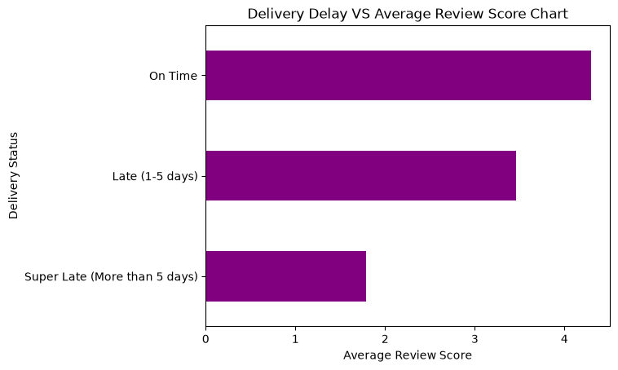
Does Late Delivery Hurt Customers?
Not all delays are equal.
Late deliveries resulted in reduced customer satisfaction on average.
The satisfaction was even lower for deliveries that were late by more than 5 days.

Slide 6
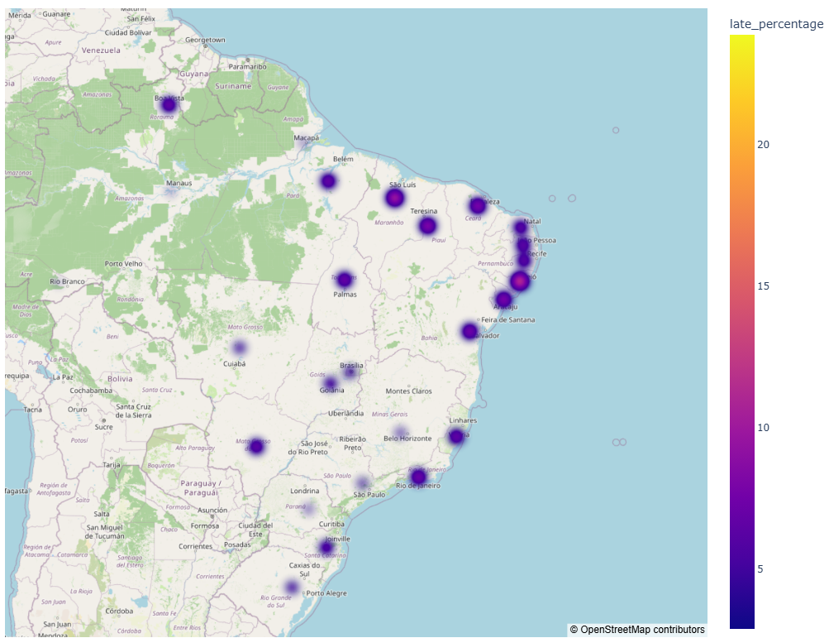
Is It a Regional Problem?
The far North/Northeast shows a stronger concentration of late deliveries than many southern and central states.
Notes:
São Paulo was used as a geographic reference point because distribution-center coordinates were not available in the dataset.

Slide 7
Recommendations
Focus operational investigation on states with the highest late-delivery rates, particularly in the North/Northeast.
Investigate whether estimated delivery dates are systematically too optimistic for high-risk regions.
Track Super Late (>5 days) deliveries separately because they have the strongest relationship with poor customer ratings.

