Slide 1
STACKEDHUB
Restaurant operations
and customer engagement
Application overview
Overview
Product/solution
Frontend architecture
user workflows
quality and delivery considerations
Endnotes
Repository reviewed: MolokommeLefa/stackedhubgo
29 September 2026
Notes:
Sources: GitHub repository README and source tree, accessed 29 September 2026.

Slide 2
The Problem:
BruvBurger now formarly know as StackedBurgers is a growing business with an established
Customer base through instagram, whatsapp and phone calls as well as their integration of uber eats. However
A major challenge they face is their lack of digital operations that seamlessly integrate their current processses.
This makes BruvBurger fall behind on the digital innovation that would help grow their operations drastically.
As technology continues to grow, bruvBurger may lose the opportunity to enhance their customer base if they do not
Implement some kind of digital system.
This presents an opportunity for us to design and develop a modern software solution that improves their business
Operations whilst meeting all INSY7315 work-integrated learning technical requirements.

Slide 3
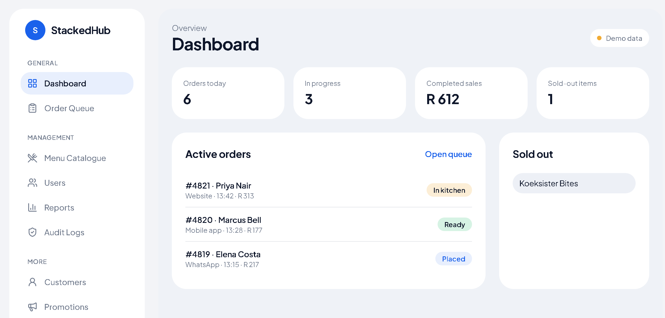
Full stack customer management system:
Admin Dashboard
Customer Portal
Staff Portal
The Product/solution:

Slide 4
One Platform, three types of users
StackedHub isnt just another application, it’s platform that connects customers, staff and admin in one
Seamless platform. No more switching between different disconnected tools.

Slide 5
What StackedHub does
A restaurant-management frontend with separate customer, staff and administrator experiences
CUSTOMER
STAFF
ADMINISTRATOR
Browse the menu, build an order, view order history, see loyalty points and request AI meal suggestions.
Monitor the live order queue, move orders through the kitchen lifecycle and change item availability.
Manage menu items, users, promotions, customer records, reports and audit logs.
The UI routes users to the customer portal or operational dashboard according to their signed-in role.
Connects customers, staff and admin in one simple integrated system
StackedHub application overview
02
Notes:
Sources: src/lib/auth.tsx; src/components/AppShell.tsx.

Slide 6
The Flow:
StackedHub is built around three personas:
Customer:
Staff:
Admin:
Customer
Staff
I use Stackedhub to perform the day-to-day operational task assigned to me
Admin
I oversee the system and manage information and users required to keep StackedHub running
I want to use Stackedhub to interact with the business and manage my customer experience:

Slide 7
Customer journey
The portal supports ordering, loyalty engagement and personalised menu discovery
Sign in
Choose items
Ask for a meal idea
Place and track
Customer role opens /portal
Menu displays available items and prices
Prompt goes to the recommendation service or demo fallback
Cart confirms placement and order history shows status
AI meal assistant
Customer-facing features
In live API mode, the portal posts the customer prompt to /api/ai/recommendations. Demo mode selects from the available menu using simple prompt matching.
• Loyalty point balance and offer count
• Add and remove cart items
• Order confirmation and status history
• Suggestions can be added to the order
StackedHub application overview
03
Notes:
Sources: src/routes/portal.tsx; src/lib/auth.tsx.

Slide 8
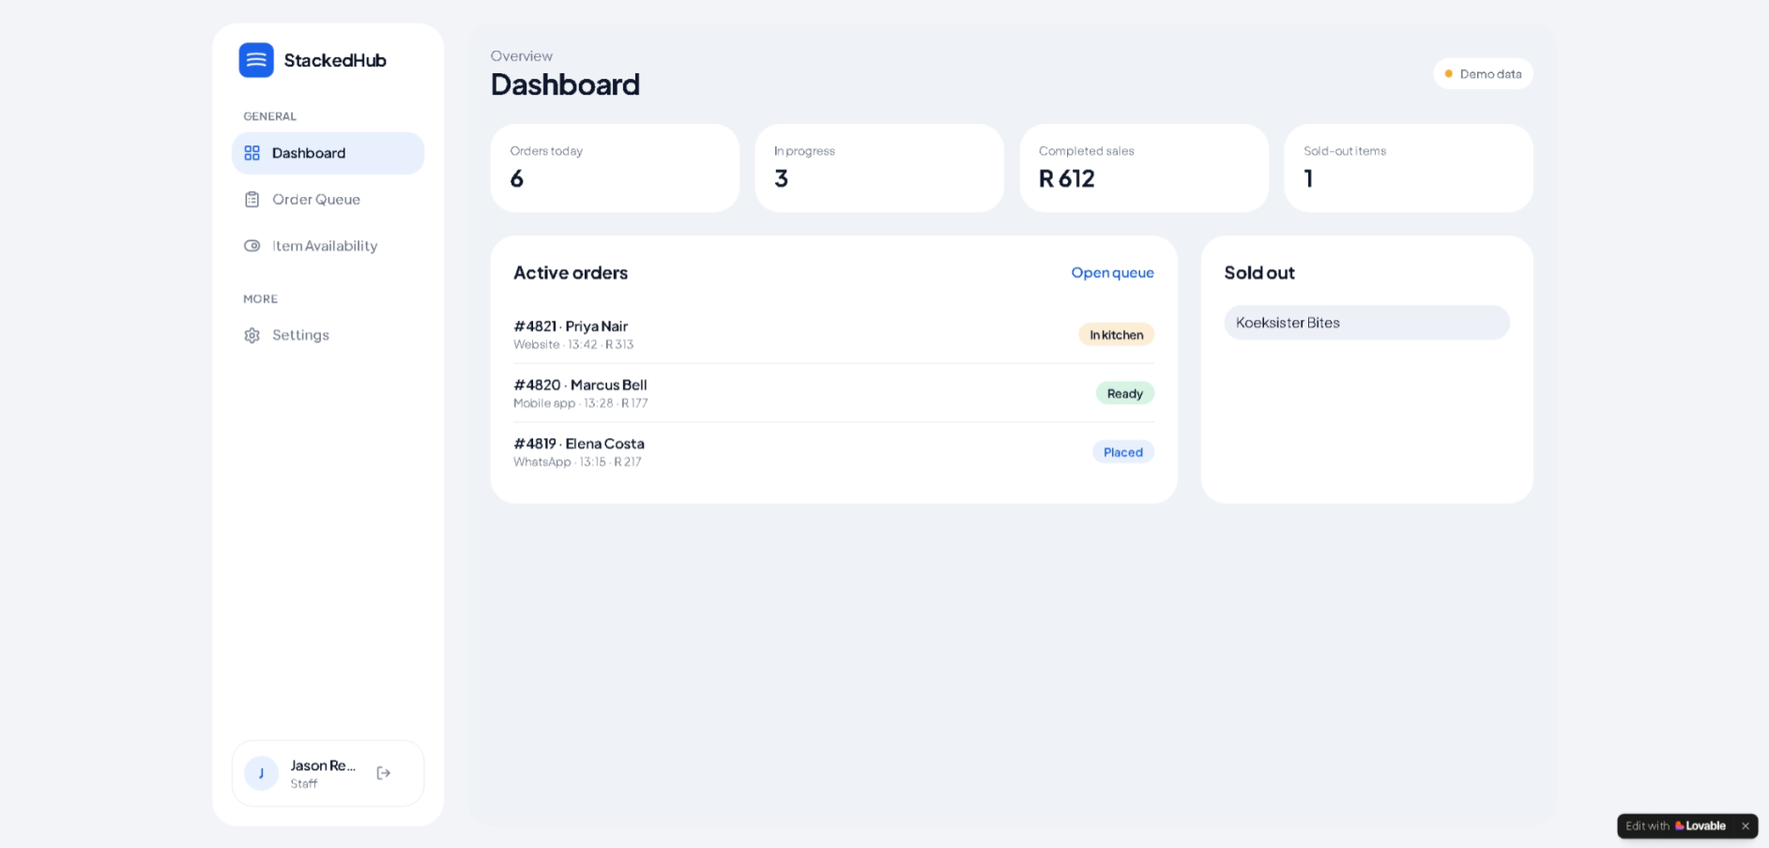
Product Overview:
Staff Dashboard

Slide 9
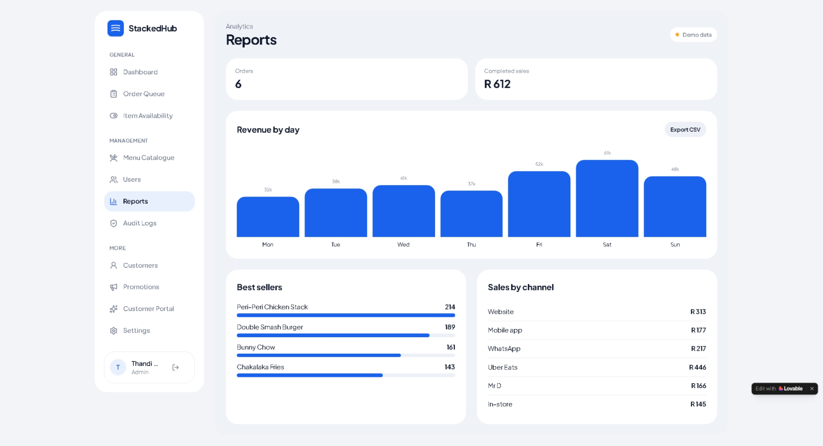
Product Overview:
Admin Dashboard

Slide 10
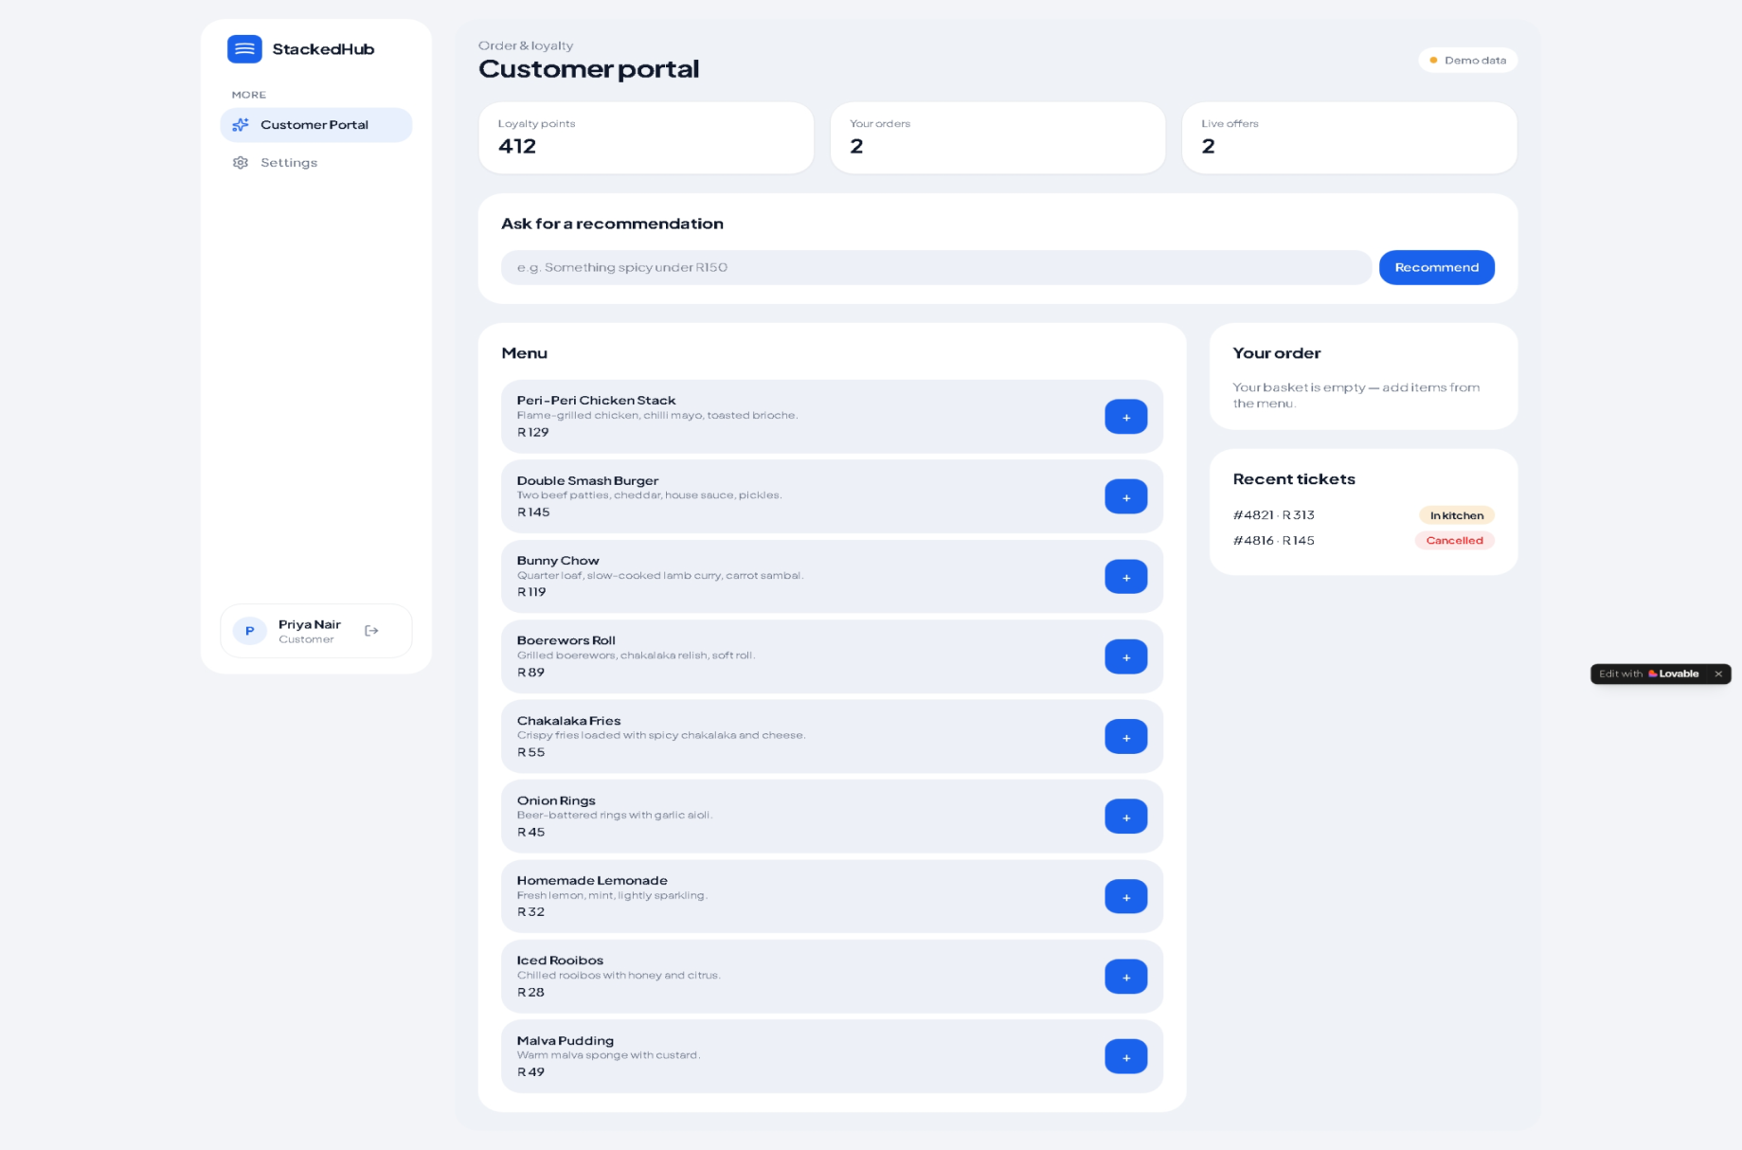
Product Overview:
Customer Dashboard

Slide 11
Operational workflow
Staff and administrators work from the dashboard and role-limited management screens
Placed
In kitchen
Ready
Completed
New order arrives
Staff accepts the order
Kitchen marks it ready
Order closes
Staff controls
Administrator controls
Dashboard
• Filter and refresh the queue
• Cancel an open order
• Switch menu availability when stock runs out
• Create and edit menu items
• Activate or deactivate user accounts
• Maintain promotions and customer notes
• Review reports and audit activity
Orders today
In progress
Completed sales
Sold-out items
StackedHub application overview
04
Notes:
Sources: src/routes/orders.tsx; src/routes/availability.tsx; src/routes/menu.tsx; src/routes/users.tsx; src/routes/dashboard.tsx.

Slide 12
Frontend and API architecture
The frontend can operate with bundled demonstration data or a configured live API
Browser frontend
Data access layer
Optional services
React 19
TanStack Start file-based routes
Tailwind CSS and Radix UI components
Vite development and production builds
One API client adds JSON headers and a JWT bearer token when available. It handles unreachable API, 401, 403 and other response errors.
ASP.NET Core Web API
Health endpoint
Role-specific REST endpoints
AI recommendations endpoint
Settings read VITE_API_BASE_URL or a saved browser value.
When no base URL exists, the app uses in-memory demo data.
Deployment boundary: the repository contains the frontend. The source references an external ASP.NET Core API rather than including its server implementation.
StackedHub application overview
05
Notes:
Sources: package.json; src/lib/api-client.ts; src/lib/data.ts; README.md.

Slide 13
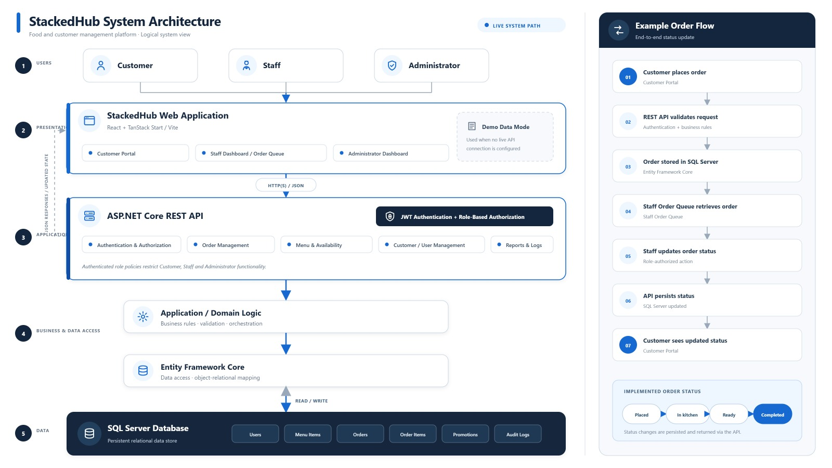
System architecture

Slide 14
Requirements and non-functional expectations
Evidence from the current frontend implementation
Expectation | Implementation evidence | Current boundary
Role-based access | Route shell checks allowed roles and redirects unauthorized users. | Client-side route control depends on server-side enforcement in live mode.
Operational continuity | Demo mode keeps the UI usable without an API. Load and error states communicate failures. | Demo changes live only in browser memory and reset after refresh.
Security | Live API calls attach JWT bearer tokens. API client handles 401 and 403 responses. Audit logs exist as an admin view. | Token storage uses localStorage in this frontend. Backend controls are outside this repository.
Usability | Role-specific navigation reduces irrelevant screens. Mobile navigation provides an alternative to the desktop sidebar. | Accessibility testing is not evidenced by a test suite in this repository.
Reporting | Revenue, best sellers and sales-by-channel screens include CSV export. | Data accuracy depends on the live API or bundled demo data.
The “current boundary” column keeps the presentation accurate about what the frontend can demonstrate versus what needs backend or QA evidence.
StackedHub application overview
06
Notes:
Sources: src/components/AppShell.tsx; src/lib/api-client.ts; src/lib/data.ts; src/routes/reports.tsx.

Slide 15
Quality, deployment and reliability
The repository provides build quality checks. A complete pipeline still needs to be added.
Current project scripts
Recommended deployment pipeline
npm run dev
Local development server
npm run build
Production build to dist/
npm run lint
ESLint validation
npm run format
Prettier formatting
Pull request
Merge to main
Health check
Run install,
lint and build
Publish static
dist/ assets
Verify API and
monitor errors
Repository finding
The visible repository contains no GitHub Actions workflow directory. The deployment pipeline shown above is a recommended next step, not an implemented feature.
StackedHub application overview
07
Notes:
Sources: package.json; README.md; repository root reviewed on 29 September 2026.

Slide 16
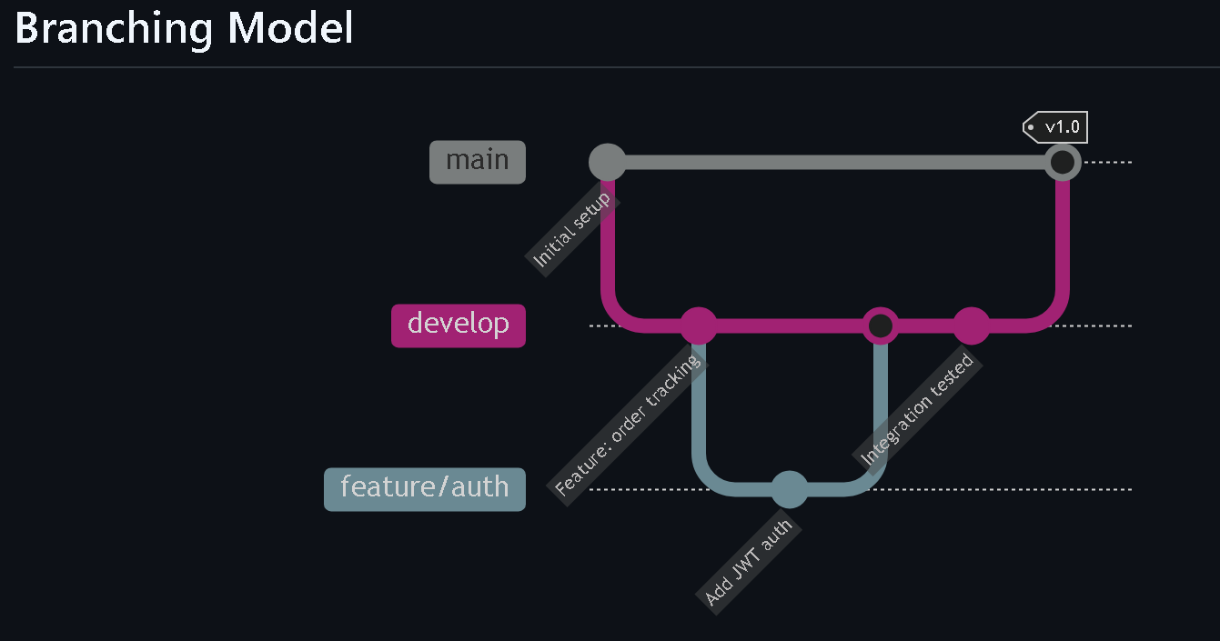
CI/CD Pipeline:
The StackedHub project uses GitHub Actions for Continuous Integration and Continuous Deployment (CI/CD). The pipeline automatically builds, tests, and deploys the backend API to Azure App Service whenever changes are pushed to the main branch.

Slide 17
Technical decisions and implementation considerations
Why the current design supports a staged restaurant-system rollout
DEMO-FIRST MODE
SINGLE API CLIENT
FILE-BASED ROUTING
Teams can demo the full interface before the API is deployed. The trade-off is that updates reset on refresh.
One integration point centralises base-URL selection, headers, JWT handling and standard error messages.
TanStack Start routes map directly to screens, which keeps the application structure easy to navigate and extend.
Priority enhancements
1. Add automated unit, component and end-to-end tests.
2. Add GitHub Actions for lint, build and deployment checks.
3. Verify server-side role authorisation, validation, token lifecycle and audit persistence.
4. Replace demo-only portal checkout with a persisted order endpoint when the backend is available.
StackedHub already demonstrates the key restaurant workflows. The next milestone is turning the demo-to-live integration boundary into an evidence-backed production release process.
StackedHub application overview
08
Notes:
Sources: src/lib/api-client.ts; src/lib/data.ts; package.json; README.md. Recommendations are clearly labelled as future work.

Slide 18
Thank you

