Slide 1
Title

Slide 2
Intro
Hi there

Slide 3
Objectives
To save the world

Slide 4
Methods
Idealized recognizer built by over-training on a single high-quality clip

Slide 5
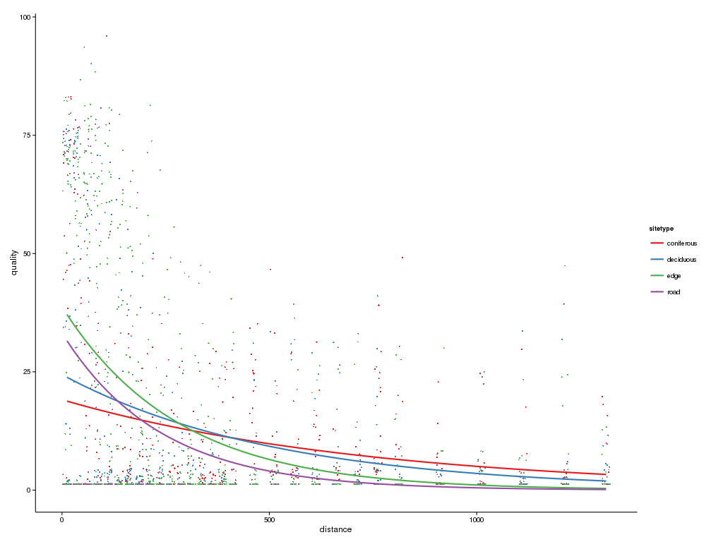

Slide 6
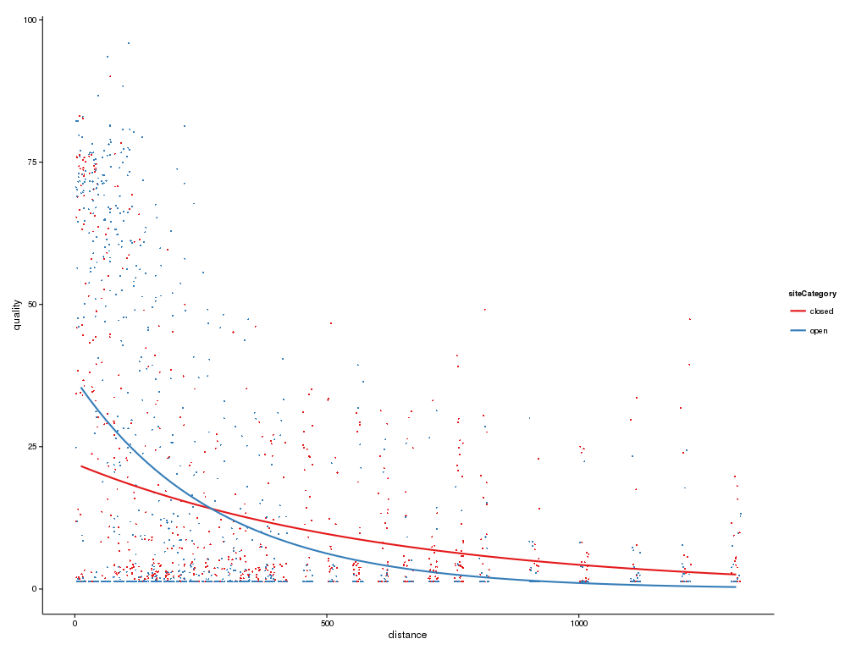

Slide 7
What's next
Do things

Slide 8
Questions?

