Slide 1
Introduce
2023.08.08
Molecular Simulation Group, CBE, KAIST

Slide 2
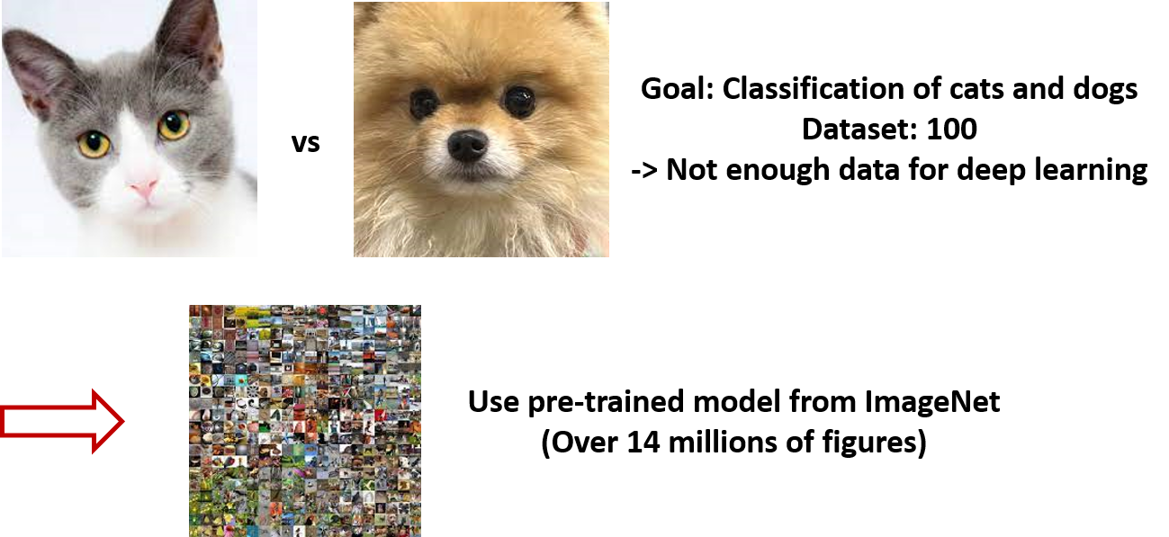
Transfer Learning
Transfer learning: When data is scarce to make a deep learning model, use pre-trained model and improve accuracy through knowledge transfer from a similar task

Slide 3
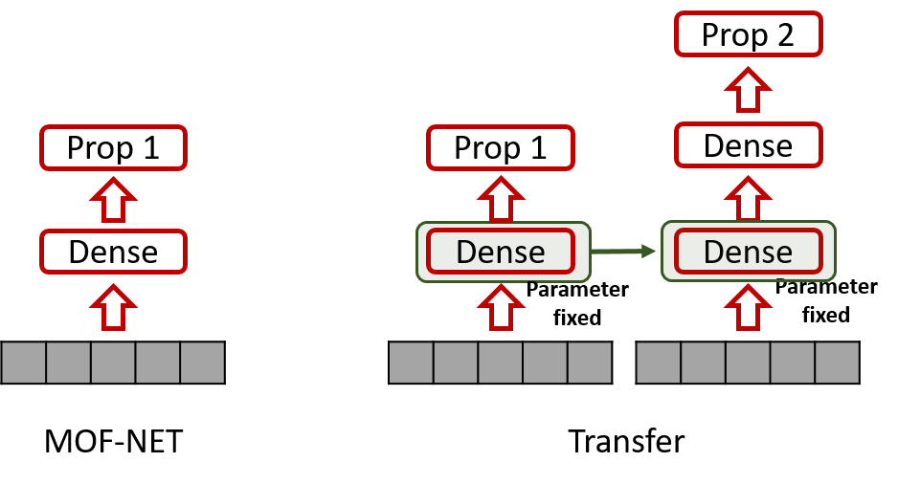
Transfer Learning
Transfer learning: When data is scarce to make a deep learning model, use pre-trained model and improve accuracy through knowledge transfer from a similar task

Slide 4
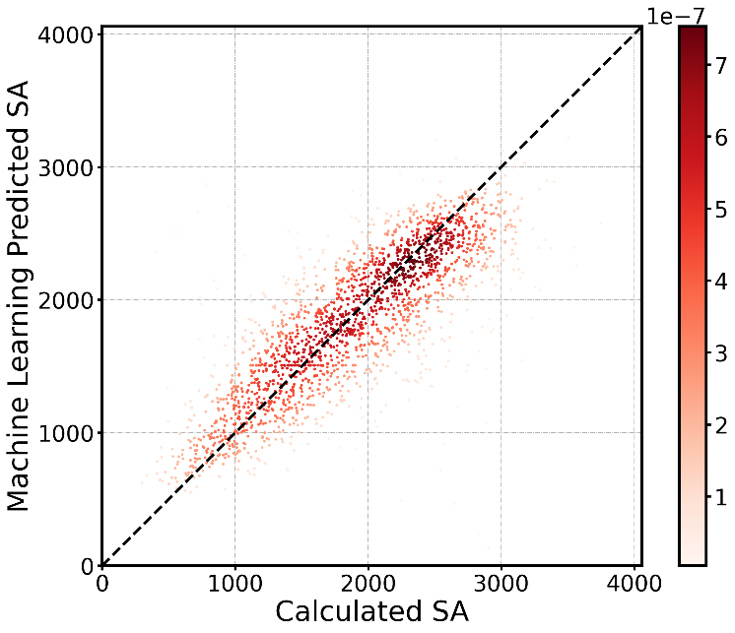
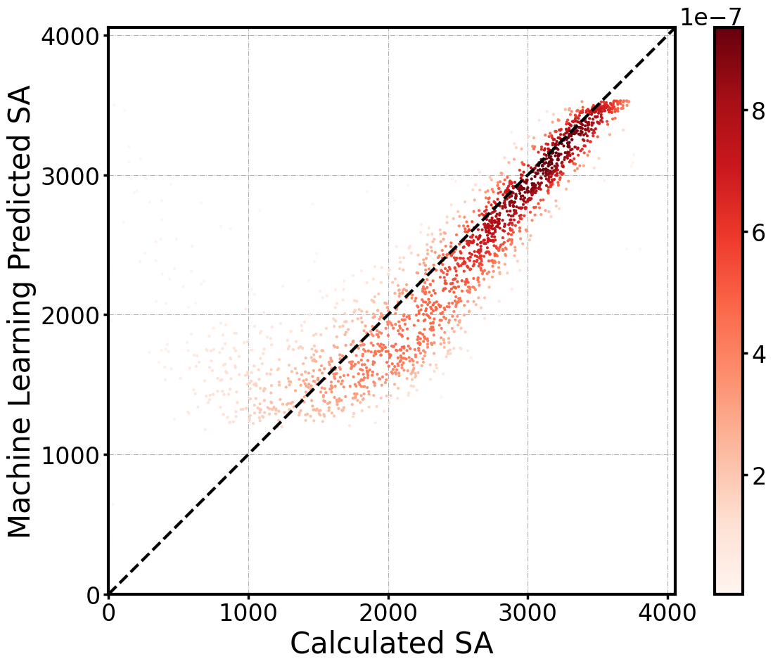
Transfer Learning - Example
Prediction of volumetric surface area using transfer learning
Single task learning
(Dataset # 10,000)
Transfer learning
(Dataset # 10,000)
Using pre-trained model
Dataset # 20,000 Dif
R2: 0.570
R2: 0.714

Slide 5
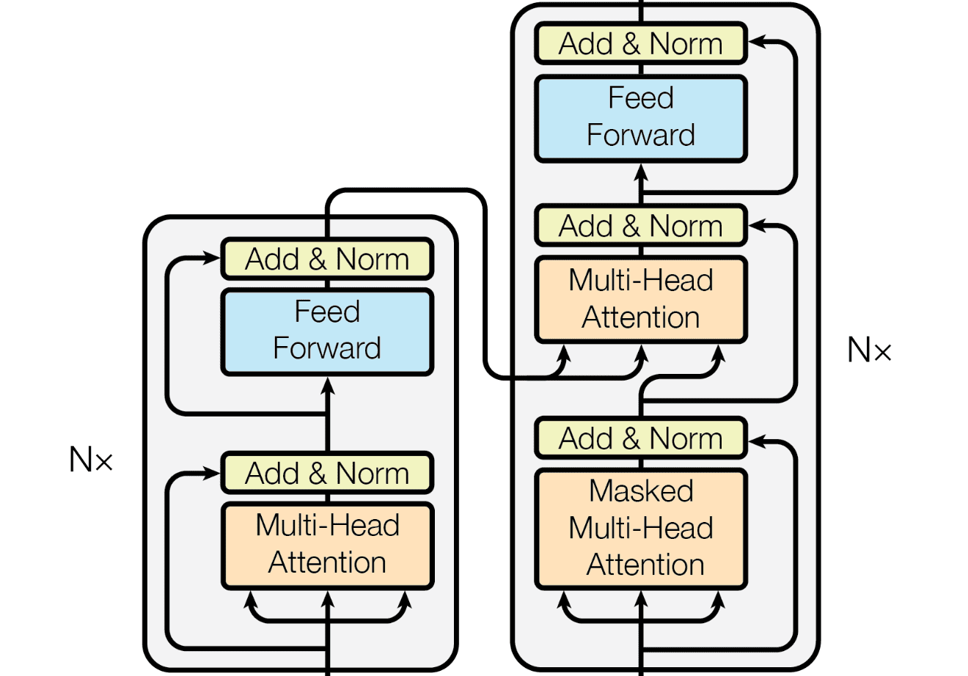
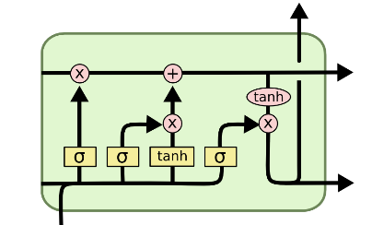
Machine Learning for Language Models
RNN
Word2Vec
Transformer
ChatGPT
h₀
h_{t}
h_{T}
man
woman
_{A}
_{A}
_{A}
king
queen
daughter
cat
father
x₀
x_{t}
x_{T}
cats
son
1997
2015
2018
1986
2013
2017
2022
the
animal
didn’t
cross
street
because
it
was
too
tired
encoder
decoder
the
animal
didn’t
cross
street
because
it
was
too
tired
…
…
encoder
decoder
encoder
decoder
LSTM
Attention
GPT
BERT

Slide 6

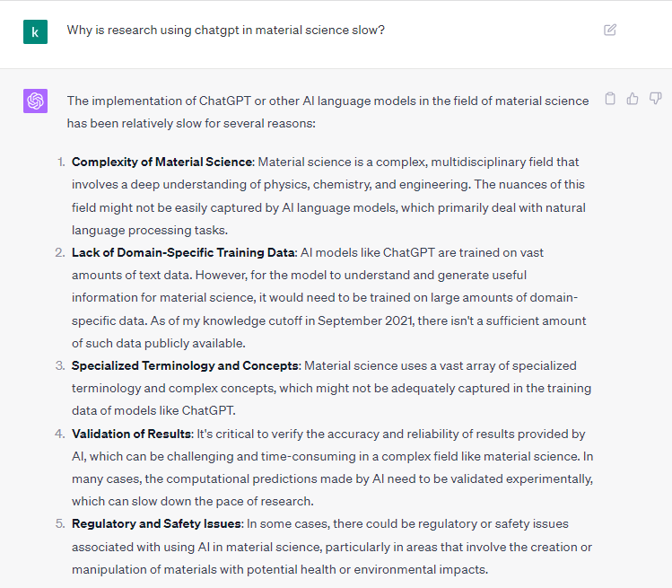
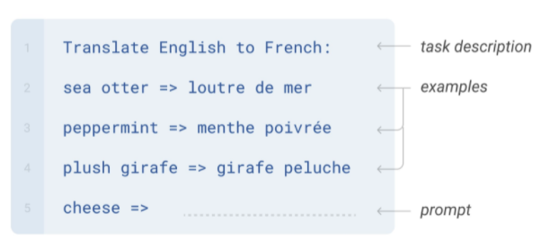
Large Language Model (LLM)
AI의 발전은 대규모 언어 모델(LLM)을 통해 기하급수적으로 이루어짐
LLM은 수많은 데이터와 Transformer 구조를 통해 구현된 언어 모델임. (예: ChatGPT)
LLM은 자연어 처리 뿐만 아니라 추론에 기반하여 소수 학습 (few-shot) 또는 제로 샷 (zero-shot) 학습에서도 높은 정확도를 보여줌
Few-shot & zero-shot learning
LLM (ChatGPT)

Slide 7
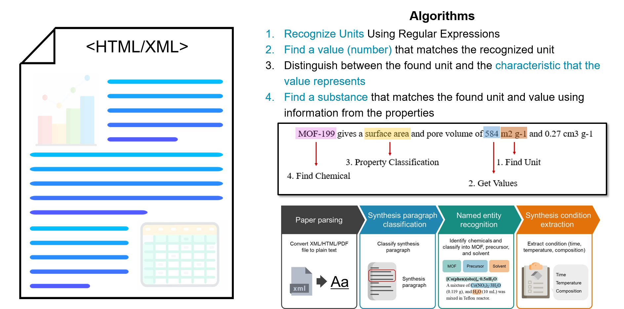
Large Language Model (LLM) - example
Original Text and Table Mining

Slide 8

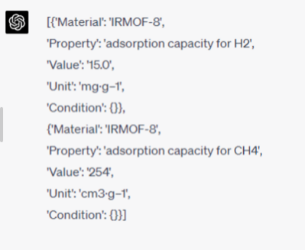

Large Language Model (LLM) - example
GPT based Text and Table Mining
Please check if the paragraph has a intensive property which include unit and value. If not, return an empty list. Else, please extract the intensive properties of materials mentioned in the following paragraph and present them as a list of dictionaries. Each dictionary should include the keys 'Material', 'Property', 'Value', 'Unit', and 'Condition'. Include all properties if multiple are present, and list all relevant conditions for each property in the form of a dictionary.
<gpt 4.0>
<Prompt>
IRMOF-8 has the potential to be a hydrogen and fuel gas storage material due to its adsorption ability of gases of small molecular weight such as hydrogen and methane. The comparison of some properties of IRMOF-8 with other IRMOFs is shown in Table 1. Though the intrinsic surface area and pore volume of IRMOF-8 is lower than those of the three IRMOFs we introduced above, the capacities of IRMOF-8 are quite satisfying. The strong interaction between adsorbates and IRMOF-8 is likely to contribute to such high capacities. For example, the interaction between CH4 and IRMOF-8 proves to be greater than for some other IRMOFs like IRMOF-1, IRMOF-6, IRMOF-16, and IRMOF-18. (72) The adsorption capacities of IRMOF-8 for H2 and CH4 reach 15.0 mg·g–1 and 254 cm3·g–1, respectively, under the given conditions (shown in Table 2.), which are both greater than those of IRMOF-1. (30,56)
<Text>

Slide 9
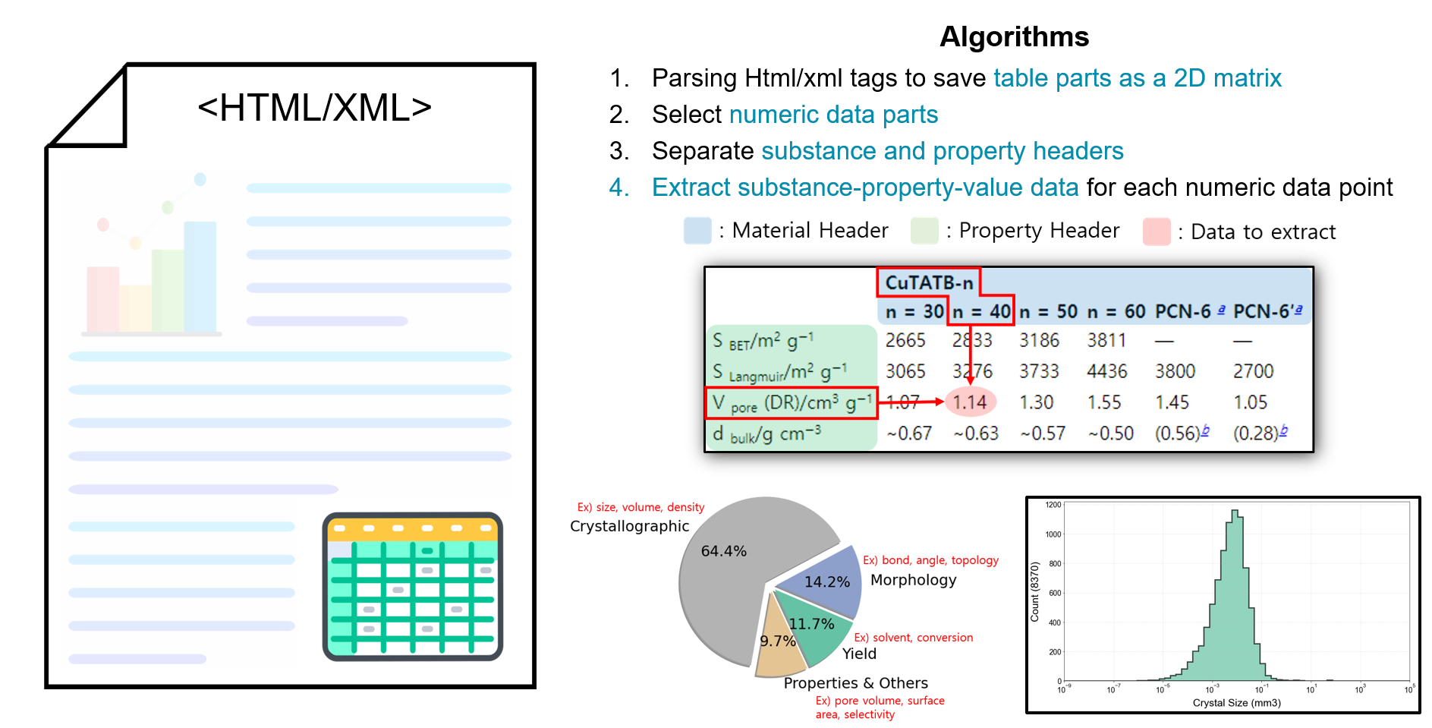
Large Language Model (LLM) - example
Original Text and Table Mining

Slide 10
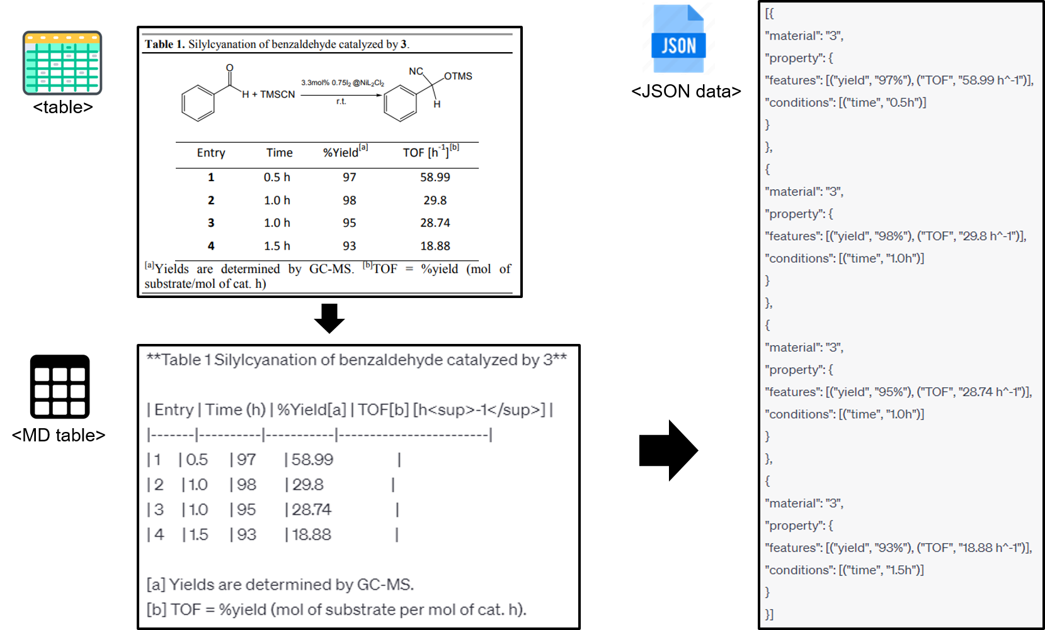
Large Language Model (LLM) - example
GPT based Text and Table Mining

Slide 11
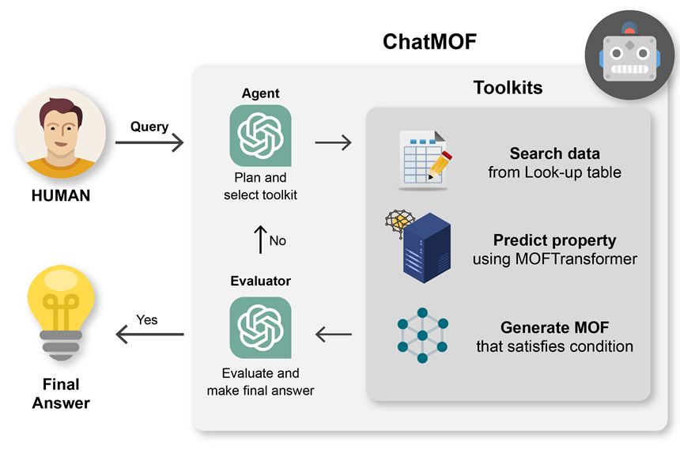
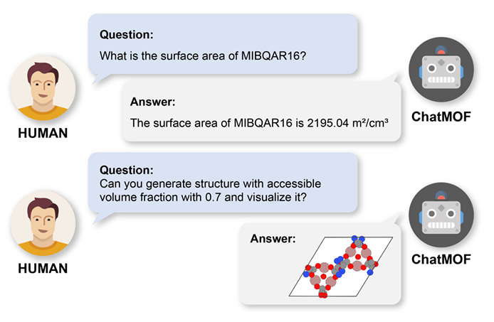
Prompt Engineering
LLM이 발전함에 따라 LLM의 Input을 적절하게 작성하여 원하는 결과를 이끌어내는 “Prompt engineering”이 등장하였음
다공성 소재에서는 Prompt Engineering을 이용하여 합성 문단의 데이터를 추출하는 연구가 진행되었음
뿐만 아니라 사용자의 질문에 맞추어 적절한 도구 (예: AI 모델, 계산기)를 선택하고 실행하여 답을 제공하는 Autonomous agent가 개발되었음.
(kang et al., 2023)

