Slide 1
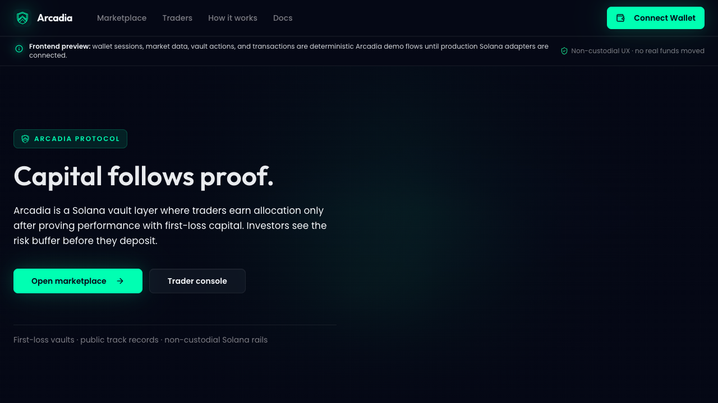
ARCADIA
COLOSSEUM / SOLANA
Capital
follows proof.
A Solana vault marketplace where traders earn
allocation only after proving performance with
their own first-loss capital.
Proof-gated vaults on Solana
Paper mode · first loss · public records
ARCADIA / COLOSSEUM PITCH
01

Slide 2
02 / PROBLEM
Managed DeFi vaults still run
on trust.
PROOF OBJECT
Arcadia turns those social
assumptions into protocol checks.
Investors are asked to fund managers before seeing enough
proof, while managers keep upside without enough downside.
01
No required skin in the game
NO SKIN
NO PROOF
NO EXIT
02
No enforced track record before deposits
03
Manual unwinds create trust assumptions
ARCADIA / COLOSSEUM PITCH
02

Slide 3
03 / WHY NOW
Solana rails make proof-gated
vaults practical.
PROOF OBJECT
No off-chain spreadsheet needs to
decide whether an investor can exit.
Fast settlement, public program state, Pyth prices, and
Jupiter routing let Arcadia enforce risk controls in the
product loop.
01
Public records replace unverifiable claims
02
Fresh NAV makes withdrawals measurable
03
Routing support can unwind exposure when liquidity is short
VAULT
BUFFER
LIMIT
EXIT
ARCADIA / COLOSSEUM PITCH
03

Slide 4
04 / PRODUCT
A marketplace for traders who
prove first.
PROOF OBJECT
The marketplace is designed as the
first product surface, not a
marketing page.
Investors browse graduated vaults by buffer, performance,
health, and strategy instead of trusting a pitch.
01
Compact vault discovery
02
Risk and buffer visible upfront
03
Portfolio and alerts built around withdrawal confidence
VAULT
BUFFER
LIMIT
EXIT
ARCADIA / COLOSSEUM PITCH
04

Slide 5
05 / MECHANIC
The trader’s money is the
first fuse.
PROOF OBJECT
The manager UI shows progress,
capital, status, and limits as
operating constraints.
Junior capital protects senior investor capital and shrinks
trading freedom as the buffer deteriorates.
01
Paper mode before investor access
PAPER
JUNIOR
SENIOR
02
First-loss junior buffer
03
Dynamic position limits as health falls
ARCADIA / COLOSSEUM PITCH
05

Slide 6
06 / DEMO
One flow, two roles, strict
boundaries.
PROOF OBJECT
Investor views do not expose
execution controls; trader views
focus on vault management.
Arcadia separates investor discovery from trader operations
so each role sees the right controls.
01
Landing to marketplace
02
Vault detail to deposit/withdrawal clarity
03
Manager console to trade limits and operations
VAULT
BUFFER
LIMIT
EXIT
ARCADIA / COLOSSEUM PITCH
06

Slide 7
07 / SAFETY
Withdrawal safety is part of
accounting, not support.
PROOF OBJECT
Shares were removed from the user
model; investor data now tracks
principal and claim.
The v1 model uses USDC base liquidity and WSOL exposure so
withdrawals can be valued and protected.
01
Pyth-backed SOL/USDC NAV
USDC
PYTH NAV
UNWIND
02
10% liquid USDC reserve guard
03
Jupiter-assisted WSOL unwind design
ARCADIA / COLOSSEUM PITCH
07

Slide 8
08 / SOLANA EDGE
Arcadia is stronger because
it is on-chain.
PROOF OBJECT
The program, generated clients,
frontend, and indexer are designed
as one Solana-native loop.
The product relies on public state, non-custodial custody,
composable vault records, and deterministic execution paths.
01
Managers cannot edit their past
02
Investors can verify state
03
Indexers can materialize public performance
VAULT
BUFFER
LIMIT
EXIT
ARCADIA / COLOSSEUM PITCH
08

Slide 9
09 / PROGRESS
The MVP is already a real
product surface.
PROOF OBJECT
The demo package captures the app
directly from localhost.
Arcadia has a polished frontend, role-gated flows, program
design, indexer scaffold, and tests around core accounting
behavior.
01
Arcadia UI and SVG brand system
02
USDC/WSOL accounting plan implemented in program direction
03
Frontend tests/build/lint passing before media work
VAULT
BUFFER
LIMIT
EXIT
ARCADIA / COLOSSEUM PITCH
09

Slide 10
10 / ASK
Help Arcadia recruit the
first serious managers.
PROOF OBJECT
The next milestone is not more hype.
It is guarded live capital with
visible proof.
Colosseum support helps move Arcadia from MVP to pilot
vaults with disciplined traders and real feedback.
01
Select Arcadia for the Solana DeFi track
02
Introduce pilot traders and protocol reviewers
03
Pressure-test withdrawal safety before mainnet
VAULT
BUFFER
LIMIT
EXIT
ARCADIA / COLOSSEUM PITCH
10

