Slide 1
Reliability Plotting Program
Suggested Workflow and Program Features
Evan Chong
14 May 2019

Slide 2
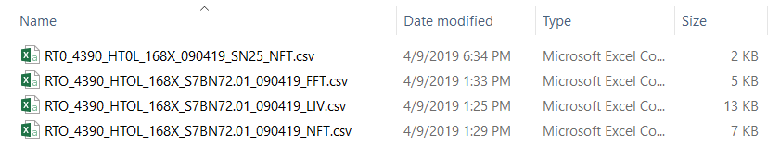
Background
Currently, Drift Calculation is done manually through Excel. Raw data is in the form of CSV files of different formats (different headers) and includes data both from entire RTO boards as well as singular SNs from retests.
The aim of the Reliability Plotting program is to provide Reliability Engineers at AMS Tampines a tool to do the following:
Compile Raw CSV data for each RTO into a single CSV file used as a `database` file
Batch Drift Computation
Interactive Plots (for both Raw data and Calculated Drift) for monitoring
Batch Boxplot Generation (for both Raw data and Calculated Drift)
NFT Measurement
for SN25 at 167Hrs
NFT Measurement
for Entire Board at 168Hrs

Slide 3
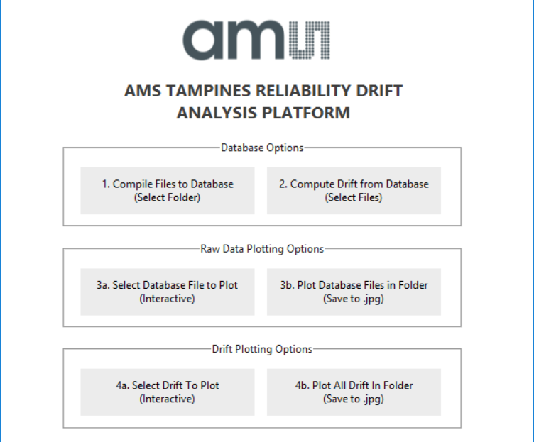
Proposed Program User Interface
NEW!
The proposed user interface is as shown below. In the user interface there are six buttons to execute tasks as labeled.
Each button invokes a helper function to execute the task described by the label. The manner of execution will be explained for each function in the subsequent slides.
NEW
1. Database File Compilation
Invokes build_database() - Single SN File handling not yet implemented
90% Completion
2. Batch Drift Computation
Invokes drift_calculation()
DONE!
3a. Database Interactive Plotting
Invokes file_plot_interactive()
3b. Batch Plot Saving
Invokes folder_save_img()
DONE!
DONE!
4a. Calculated Drift Interactive Plotting
Invokes drift_plot_interactive()
4b. Batch Drift Plot Saving
Invokes folder_drift_save_img()
NEW!
DONE!
NEW!
DONE!

Slide 4
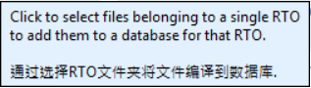
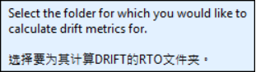
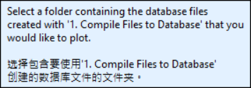
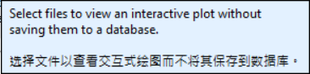
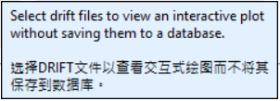
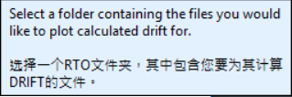
Proposed Program User Interface
NEW!
Another additional feature is that the tooltips now have Chinese text to aid operators less familiar with English in the usage of the software if necessary. Language accuracy varies (will be improved on)

Slide 5
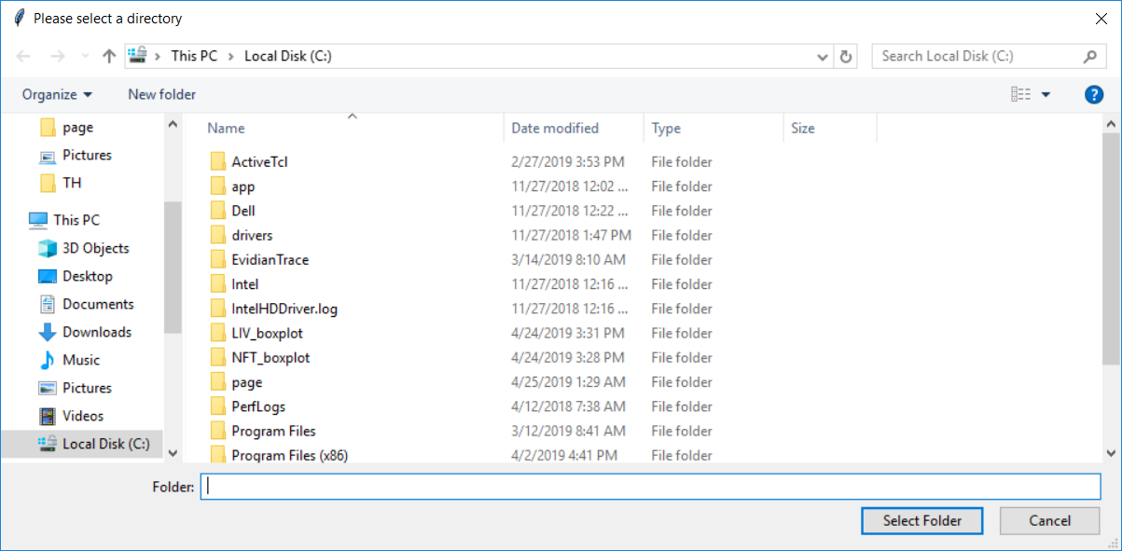
Button 1: Database File Compilation (1/2)
Invokes build_database()
When this button is pressed, a file dialogue appears. The user is intended to select the RTO folder in the shared Rel folder for which the user wants to create a compiled database CSV.
The program then looks through the folder and groups files by the stress_test keywords 'HTOL, THB, TH, TC, HSTL' followed by the measurement_type keywords 'NFT, LIV, FFT'.
File name is used to identify the cycle time for the file. ie. ‘RTO-4149_168C_NFT.csv’
If there are any files that are singular SN measurements, the values in these files will replace any older measurements made (based on measurement time/date)
If any files are excel files, sheets with sheet names from 0 - 1000 will be processed into the dataset with empty sheets being ignored.
Data is saved in .csv files stored in the same folder with the following directory structure: [Reliability Public Folder] > [RTO Number] > [Stress_Test] > [DataBaseFile].csv'.
An example of this directory structure would be ‘/Reliability/Public/Datalogs/RTO-4149/HTSL/RTO-4149_NFT_Data.csv'

Slide 6
Button 1: Database File Compilation (2/2)
Proposed Database Folder Format
In support of the proposed database building scheme, I would also like to propose the following standardization of the folder organization to both make it easier to keep track of RTO data, compile RTO data and to plot them. Highlighted in orange are the files/folders generated by the program
Folder Structure:
\\fstpdata\Team\Reliability\Public\
Datalogs
RTO-XXXX
HTOL
…
THB
RTO-4251_NFT_Data.csv
...
0H, 120H, 240H, …
RTO-4251_TH_240X_C01-11_03042019_FFT
NFT_Boxplots
…

Slide 7
Button 2: Batch Drift Computation
Invokes folder_save_img()
Reads a database .csv file generated using build_database() for a single RTO.
Calculates the following drift statistics
After calculation, a save prompt opens asking the user where to save the file.
Saves drift statistics as an excel file (?)

Slide 8
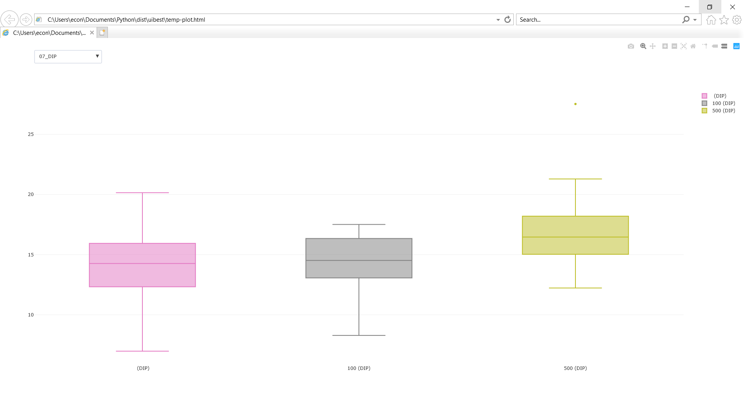
Button 3: Interactive Plotting
Invokes file_plot_interactive()
Reads a database .csv file generated using build_database() for a single RTO.
Generates an interactive plot that opens in the user’s default browser.

Slide 9
Button 4: Batch Plot Saving
Invokes folder_save_img()
Reads multiple database .csv files of the format generated by the build_database() function.
The program then looks through the folder and groups files first by RTO number followed by the stress_test keywords 'HTOL, THB, TH, TC, HSTL' followed by the measurement_type keywords 'NFT, LIV, FFT'.
Saves files in the second lowest folder ie. '[relative path] > [RTO Number] > [Stress_Test_Plot] > [Measurement_Type Plot Folder]‘
An example of this directory structure would be ‘/Reliability/Public/Datalogs/RTO-4149/HTSL/NFT_boxplot'

